Slide 1
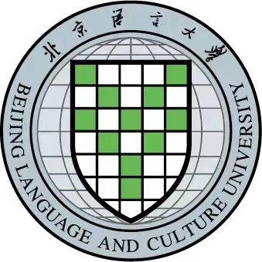
Make CTBT Education Sustainable
Huaping Liu & Yiqing Ren
Beijing Language and Culture University & King’s College London
P5.4-221
For making CTBT education sustainable, there are 4E- proposals:
•Enhancing contents on CTBT in related courses & lectures for graduates & undergraduates in university；
•Engaging more young people into CTBT related discussion and research work;
•Educating students to keep attention on any advancements & applications of verification technologies on CTBT;
•Encouraging students to participate in CTBTO’s various events and any other related activities.
Sustainable education on CTBT has 2 major objectives:
•Awake the young, the public and the media to focus on CTBT issue and wide applications in both civil and scientific areas of verification technologies;
•Keep the decision makers’ alert on the importance of CTBT for nuclear disarmament, international security and human well-being as well.
hp_liu@hotmail.com yqing.1.ren@kcl.ac.uk

