Slide 1
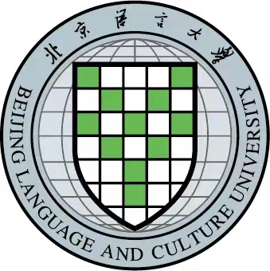
Make CTBT Education Sustainable
Huaping Liu & Yiqing Ren
Beijing Language and Culture University & King’s College London
Make more efforts to educate the young people to raise their awareness and support for CTBT’s early ratification
Increase contents and courses on CTBT for graduates and undergraduates in university
Engage more young people into discuss and research work on CTBT related issues
It’s very urgent to take multiple approaches to lead the younger generation to persistently concern about CTBT
Please do not use this space, a QR code will be automatically overlayed
P5.4-221

Slide 2
Introduction: Sustainable education on CTBT
•After more than 20 years of its opening for signature, CTBT is facing ever-decreasing attention from younger generation according to my observation while I have been teaching some related courses in my university, BLCU, China for more than ten years;
•Nuclear weapons and nuclear proliferation still threat international security and even the existence of mankind. However it’s not predictable that when this key treaty will go into force;
•Though CTBTO and international society has made countless efforts since 1996 in various aspects to push its ratification, with the passing of time, people especially younger generation are becoming less and less concerned about this issue;
•Therefore, it’s very necessary to make more efforts to educate the young people to raise their awareness and support for CTBT’s early ratification.
Please do not use this space, a QR code will be automatically overlayed
P05.4-221
P5.4-221

Slide 3
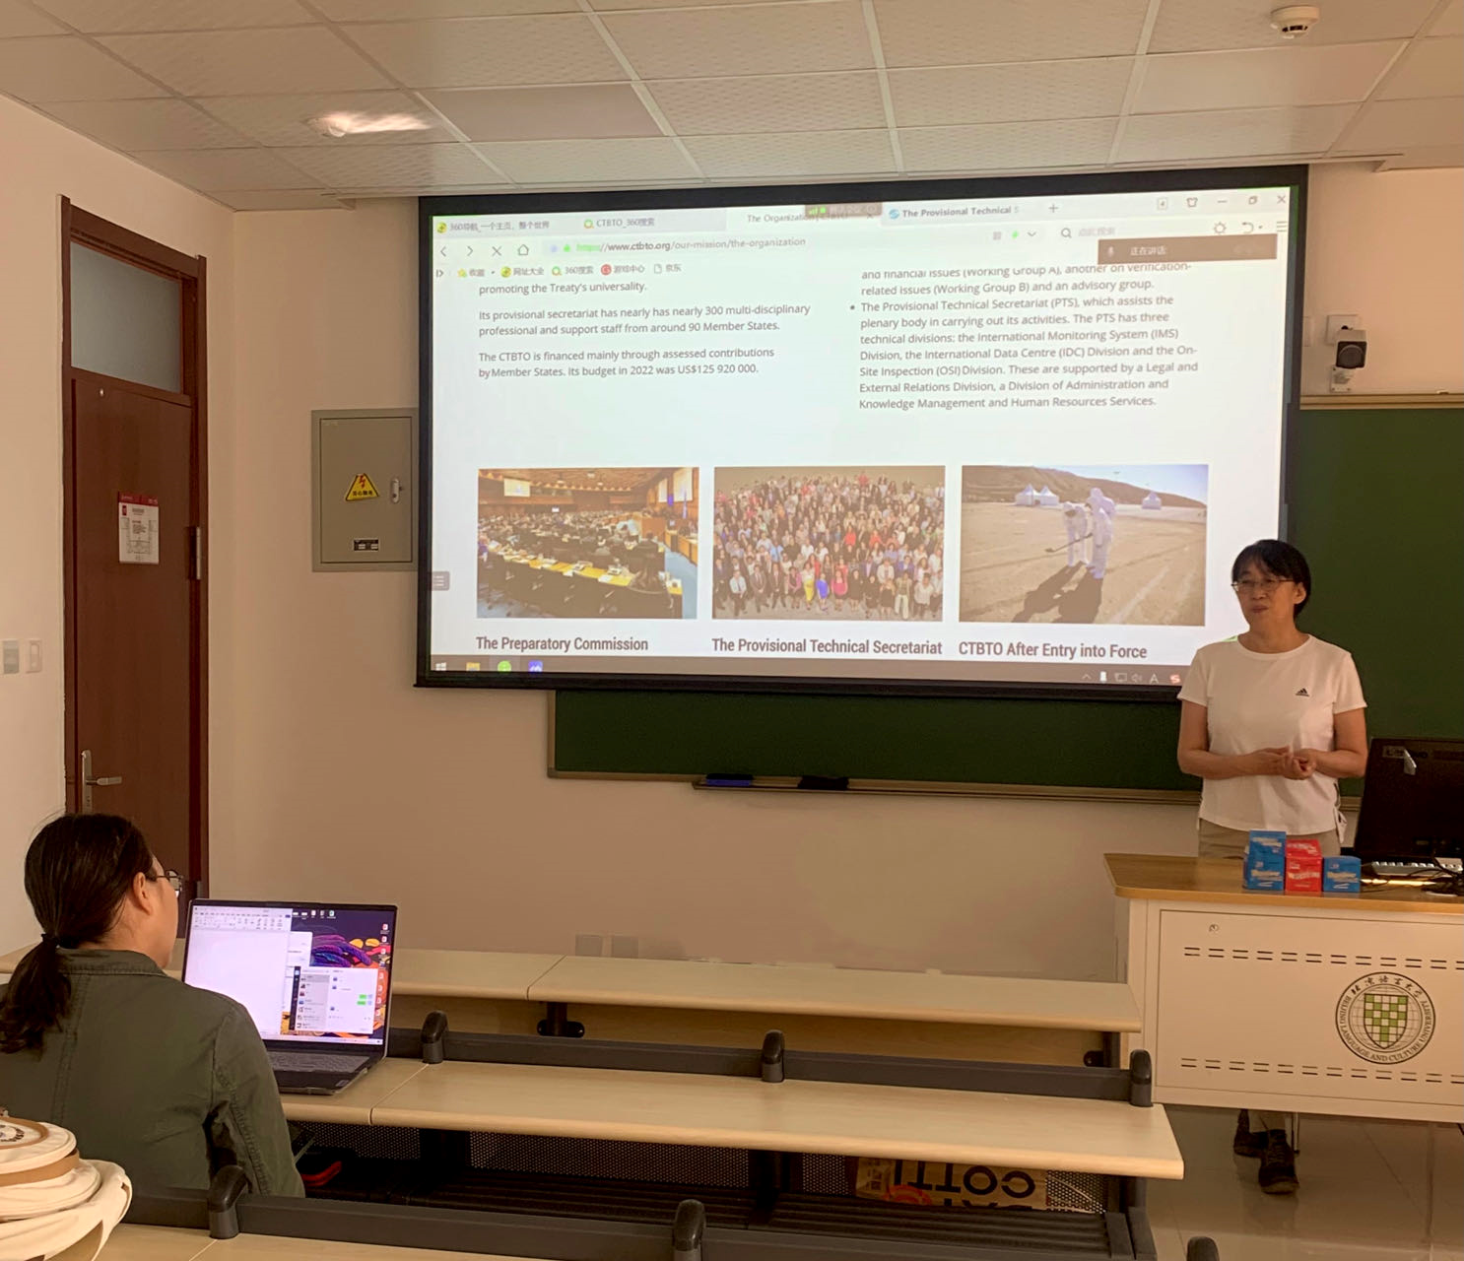
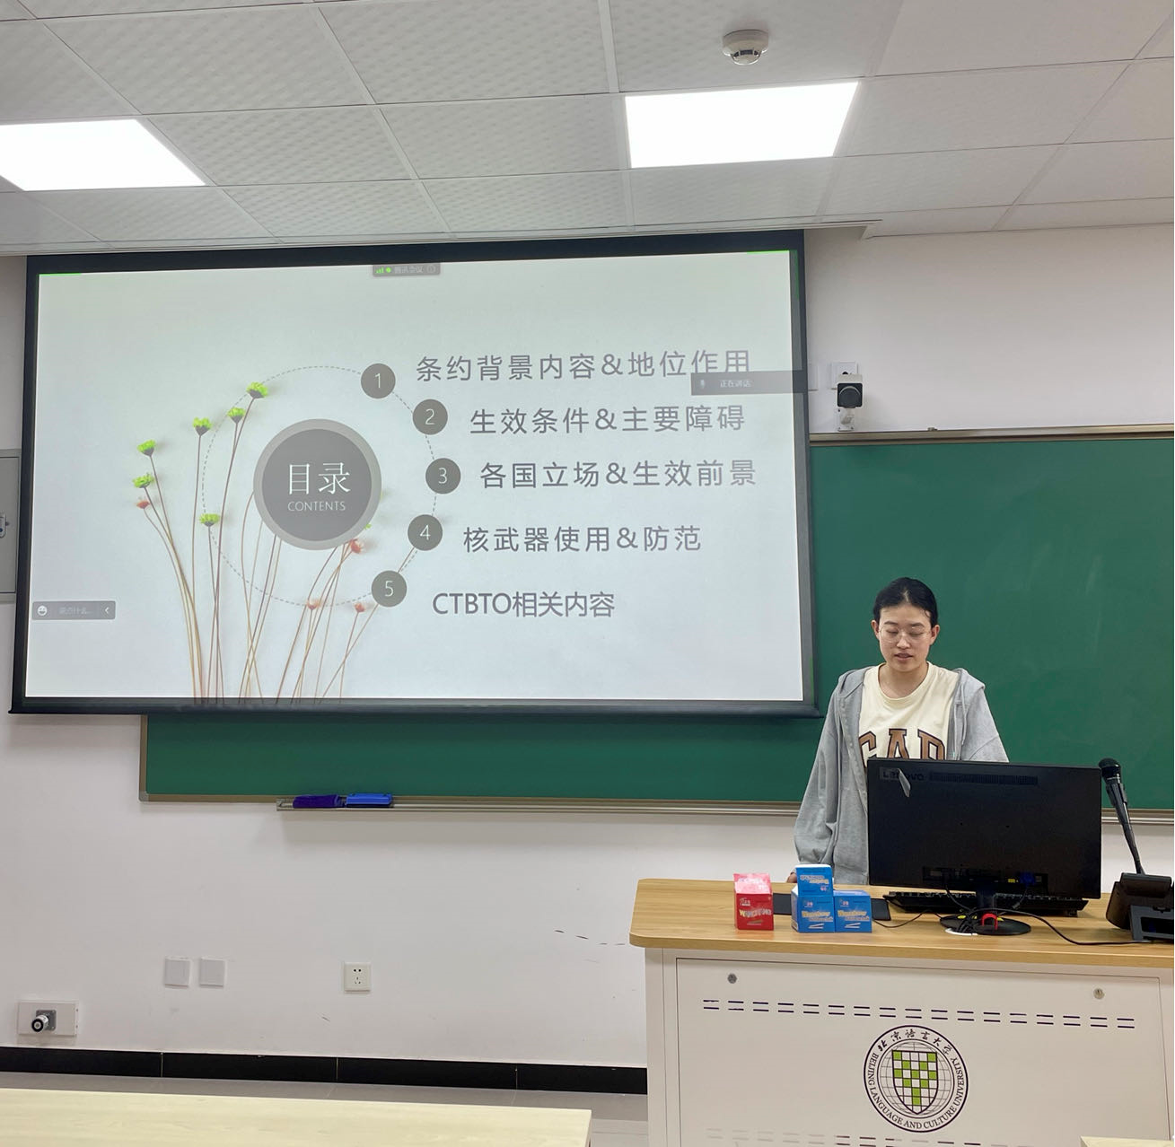
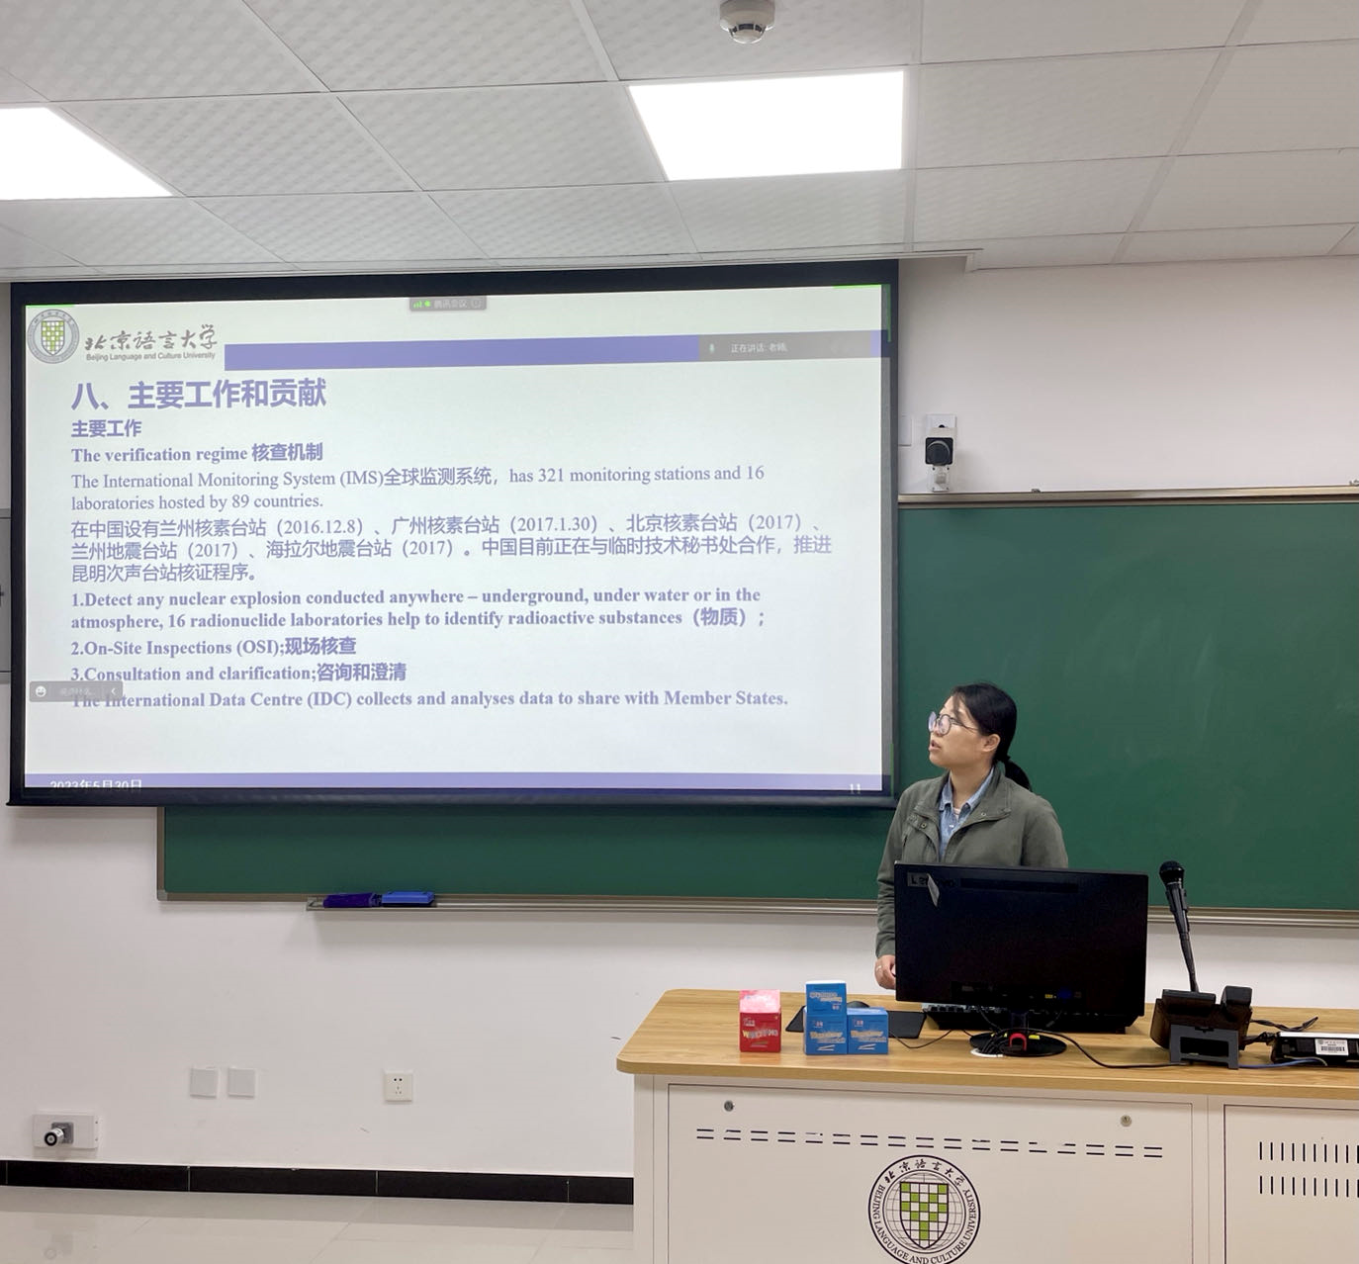
Objectives of Sustainable Education on CTBT
•Guide more younger students to get involved in CTBT related discussion and research work;
•Awake the young, the public and the media to focus on CTBT issue and wide applications in both civil and scientific areas of verification technologies;
•Keep the decision makers’ alert on the importance of CTBT for nuclear disarmament, international security and human well-being as well.
Please do not use this space, a QR code will be automatically overlayed
P5.4-221

Slide 4
Methods for Sustainable Education on CTBT
•Increase contents on CTBT in my courses for graduates and undergraduates. Vast valuable materials and information on CTBT’s history, progress and challenges which block its entry into force from the website of CTBTO are much helpful for teaching and discussion in class.
•Promote students to keep their attention and enthusiasm on any new developments of verification technologies in CTBT related field and its civil & scientific applications.
•Encourage young people to join teachers’ daily research work. Some students may choose topics related to CTBT for their theses and continue paying attention to this issue afterwards.
•Continue to guide and organize students to participate in CTBTO’s events such as online courses, and any other related activities.
Please do not use this space, a QR code will be automatically overlayed
P5.4-221

Slide 5
Results of Sustainable Education on CTBT
•CTBTO online resources have been purposefully integrated into the regular courses in BLCU. Three major approaches to teaching the CTBT have emerged:
-A three-week period introducing the background, history, achievements of, and obstacles facing the CTBT, while students are required to read broadly about the CTBT verification regime, mainly using materials from the CTBTO website;
-Wide and open discussion and debate on specific questions in class;
-Students are encourage to take part in CTBTO online courses.
•Through diversified teaching and training, nearly one hundred students, 80% of the total number in the classes, once registered for the CTBTO online courses and most of them obtained their final certificates.
•Some students become interested in CTBT or related issues and finish their theses in such areas each year. Some among them continue to further study or work in CTBT related field after graduation.
Please do not use this space, a QR code will be automatically overlayed
P5.4-221

Slide 6
Conclusion of Sustainable Education on CTBT
•Educating the younger generation about CTBT with the new techniques are equally important to the technical advancements themselves;
•Widely civil and scientic applications of variety of verification technologies should be known to the young and the public, in return attract more people to involve in such fields;
•Scientists and educators should speak louder to make the advancements of technologies known to the others far beyond the experts’ circle. Wider & deeper awareness of CTBT by the young and public can hopefully make the decision-makers alert on it.
hp_liu@hotmail.com yqing.1.ren@kcl.ac.uk
Please do not use this space, a QR code will be automatically overlayed
P5.4-221

