Slide 1
Beyond Academia: Leveraging Classroom Lessons Learned
for Open Education and CTBTO Outreach
Allen Sens¹ and Matthew Yedlin²
¹Dept. of Political Science and ²Dept. of Electrical and Computer Engineering
University of British Columbia
The history and structure of the flipped classroom, transdisciplinary course, “Nuclear Weapons and Arms Control” is summarized as introductory information, prior to discussing the proposed open, online version of the course.
We present the methods utilized to evaluate the efficacy of the online materials used in the classroom version. Data analytics are used to show that almost half of the views of online materials were from viewers outside the course registrants.
Results are presented in the form of lessons learned from the ZOOM presentation of the classroom course during the time of Covid 19. These lessons provide both opportunities and constraints in the design of the open, online course.
Conclusions comprise the most critical factors in designing the new open online course. These are:
The course-offering model;
The necessity of including new partners;
Resource acquisition for course development.
Please do not use this space, a QR code will be automatically overlayed
P5.4-511

Slide 2
APSC/POLI 377: Nuclear Weapons and Arms Control
A Flipped Person to Person Classroom Model
History
2014-2022
Jointly Taught by Allen Sens and Matt Yedlin
850 students are alumni – nominal class size = 100
Course Structure
Cohort = 50 Engineering and 50 Political Science Students
Fully-flipped model – full set of online course materials, including short lecture videos, demonstrations, and self-check questions. Online materials prepare students to engage in transdisciplinary activities involving the real-world challenges related to nuclear weapons and arms control. There is no lecturing. After a quiz at the beginning of each class, an activity is introduced by the instructors. These include simulations such as the prisoner’s dilemma, treaty analyses, targeted briefs, and applied science exercises such as location of the DPRK test site using IDC data and the 3-circle method implemented on Google Earth. Assessments include an editorial and a group project “Improving the CTBT”
Outreach – Student Presentations and Interactive Demos
SnT 2015 – Ban the Bomb Campaign;
SnT 2017 – Countdown Challenge
SnT 2023 – 5 Poster Presentations
Prisoner’s Dilemma Simulation - Applied Science Open House
Please do not use this space, a QR code will be automatically overlayed
P5.4-511

Slide 3
Objectives: Move from Person to Person to Open Format
Main Objective: Create an Open, Online course to engage participants in “Nuclear Weapons and Arms Control” outside a traditional Academic Setting
1. Who? – Interested parties both inside and outside academia
2. Size? -- How many participants can we engage?
3. Presentation Mode? If Size is very large ( greater than 200) we will have to do this online.
4. Course Materials? What material shall we include from the present classroom mode and
experience? The success of our classroom course relies on the interactivity, especially in
the simulations. Can these be scaled to an on-line course with many participants from
different time-zones?
5. Course Progression? Will this be synchronous or asynchronous? These queries are key to
keeping participants engaged.
6. What resources will be needed, depending on the answers to the foregoing?
7. Whom shall we partner with? We need to engage the CTBTO more directly. From
a public perspective, we also need to involve the IAEA and other universities with similar
interest in democratizing education at scale.
8. How could the designed course provide flexible learning options to reach as many
participants as possible? How can these online materials be used to support an
instructor-facilitated cohort as well as self-directed online learners?
Please do not use this space, a QR code will be automatically overlayed
P5.4-511

Slide 4
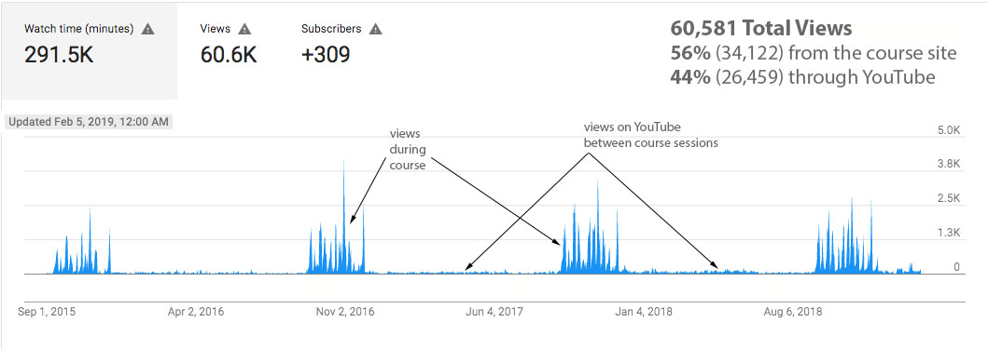
Methods: Processing Data Analytics from the Classroom
Data analytics provide some hints already for the answers of the question relating to who will be engaged
and how large should the Open course be. The watch graphs for 2015-2018, publicly available from YouTube,
show an interesting hint. The large peak distribution for each year ( height of peaks = number of views)
occurs while the course is being given. We note that after the course has ended, there is a very long tail,
until the next offering. Views in this tail, lasting about 7 months, are from individuals, not connected to the
Course, but interested in course materials. Thes results bode well for creation of open online public education modules and demonstrate how the same materials can support a wide range of learners across different contexts.
Please do not use this space, a QR code will be automatically overlayed
P5.4-511

Slide 5
Results: Lessons Learned During COVID Applicable to Remote Course Delivery
Remote delivery using ZOOM during COVID provided a living laboratory for creating an online course.
Lessons learned
1) Instructors designed a model for effective, transdisciplinary pedagogy for nuclear weapons and arms control.
2) Synchronous engagement is difficult to achieve with a large class population — greater than 20.
3) Creation of simulations such as treaty negotiations, in which countries negotiate in pairs is almost impossible on a ZOOM-type platform.
4) The prisoner’s dilemma on ZOOM was more successful and intense than in person. Students participating were not distracted and thus fully engaged in the negotiation segment of the game.
5) Quizzes that supported the flipped classroom format were difficult to administer.
6) Feedback was more focused and direct in an online environment.
7) Managing course delivery across time zones resulted in lower engagement. Time-zone synchrony diminished the impact of many of the live, interactive activities.
8) Analytics showed that there was a high rate of students’ usage of the online materials. Student feedback showed that students found the materials valuable as preparation for the classroom activities.
For the survey question “The videos and online resources were helpful in preparation for the classroom
Activities”, 100% of the students responded either “strongly agree” or “agree”.
The foregoing lessons provide important constraints and opportunities in the design of an open, online course.
The pedagogical approach and created online materials provide a strong foundation for the new course design.
Please do not use this space, a QR code will be automatically overlayed
P5.4-511

Slide 6
Conclusions: Future Perspectives
The over-arching goal in launching this new course is the significant engagement of the public to participate in the political discourse, at scale, focussed on nuclear weapons policy.
The most critical factors for consideration are:
The course-offering model - From the foregoing analysis, we see that it is impossible to include most of the live, interactive portions of the classroom version. Three options have arisen:
A self-directed MOOC with no assignments, instructor engagement, or other human resource involved. This model is instructor agnostic and more sustainable.
Single user online model implemented asynchronously. Interactive activities (prisoner’s dilemma) are included. Instructors would set regular online discussion sessions
A Stanford model in which an instructor-led course is offered in groups of 10.
2) Partners – The development of this new course will require new partners. Immediate connections will be made with CTBTO and the IAEA. The design will be of interest to the university community writ large and we will search for academic collaborations. We’ve developed an effective model for teaching nuclear weapons and arms control. With the collaboration of new partners, we can adapt and expand our current model to reach a diverse constituency. A key design issue is the location of the course – Where will it sit? At a university or organization such as the CTBTO?
3) Resources – The design and implementation of this course will require considerable funding from all
Interested parties: government, academia, private sector and organizations (CTBTO, IAEA).
Please do not use this space, a QR code will be automatically overlayed
P5.4-511

Slide 7
References and Acknowledgements
References
Stanford free coding course:
( https://www.forbes.com/sites/michaeltnietzel/2023/06/01/stanford-universitys-free-code-in-place-course-hits-the-mark/ )
Acknowledgements
The authors would like to thank Jason Myers, CTLT, University of British Columbia, for assistance in preparing this e-poster.
Please do not use this space, a QR code will be automatically overlayed
P5.4-511

