Slide 1
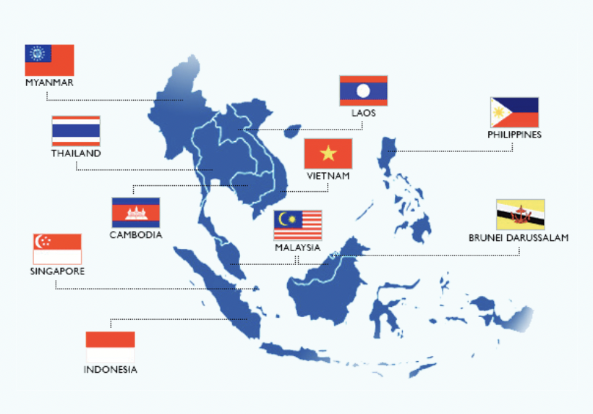
Evolving CTBT Outreach Efforts in Pakistan: Lessons from Southeast Asia
Hannan Hussain
P5.4-427
This presentation carries three key objectives to transform your understanding about effective, targeted outreach:
Generate new knowledge about CTBT outreach needs in Pakistan, and underlying barriers to signing the treaty.
Extract lessons from Southeast Asia to promote more localized and effective CTBT advocacy in Pakistan’s strategic community.
Explain how ASEAN states were able to promote an enduring consensus on CTBT objectives, despite some divergence on nuclear escalation and nonproliferation risks.
Want to know more? Come see my e-poster during session P5.4 (427) on 23rd June or access it online on the SnT2023 Conference platform!

