Slide 1
Evolving CTBT Outreach Efforts in Pakistan: Lessons from Southeast Asia
Hannan Hussain
Pakistan, a key Annex-2 state, insists on reciprocity from India on a proposed bilateral agreement against nuclear tests.
Lessons from Southeast Asia suggest the need to factor such concerns to the benefit of CTBT outreach.
Mixed-Method Analysis
Qualitative
Quantitative
ASEAN Case Study
Better explain Pakistan’s CTBT approach through key provisions of the Treaty.
Need to narrow the “reciprocity gap” between Pakistan/India on nuclear test ban.
Early evidence of mutual compliance against nuclear testing is critical.
Effective advocacy demands priority focus on key hold out states.
Please do not use this space, a QR code will be automatically overlayed
P5.4-427

Slide 2
Introduction
Pakistan
Actively contributed to negotiations, Treaty adoption (CD; UNGA 1996); CTBT Annual Res (96-)
Prospects of signing Treaty: informed by regional security considerations – India’s approach to CTBT.
Demonstrated support for Treaty, non-proliferation objectives:
i.e. Joint Indo-Pakistan declaration renouncing acquisition of nuclear weapons (1978), South Asian Nuclear Weapons Free Zone (1978), mutual inspections by India and Pakistan of nuclear facilities (1979), acceptance of full-scope IAEA safeguards (1979), bilateral or regional nuclear test-ban treaty (1987), South Asia Zero-Missile Zone (1994), CTBT verification technologies (-present).
Association of Southeast Asian Nations (ASEAN)
10-member bloc – all ratified the Treaty; Concept of “ASEAN centrality”
Nonproliferation, disarmament important considerations.
Demonstrated adherence to CTBT objectives: 1995 Bangkok Treaty.
P5.4-427
Please do not use this space, a QR code will be automatically overlayed

Slide 3
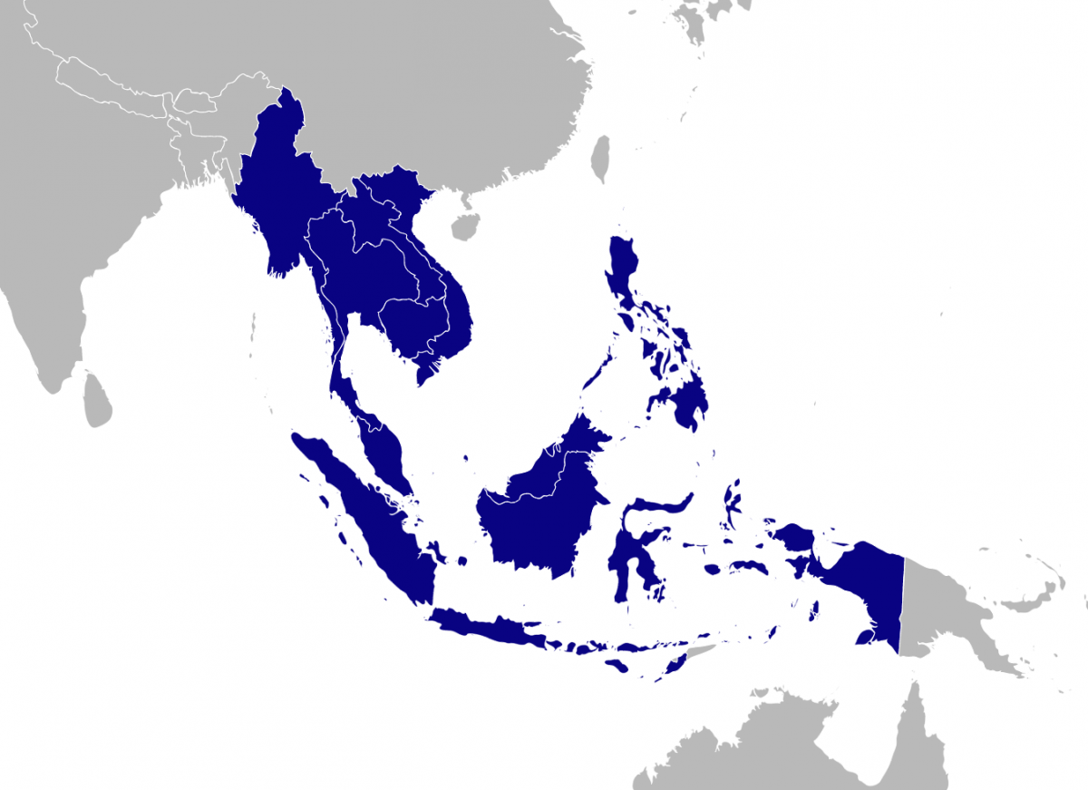
Objectives
Generate new knowledge about CTBT outreach needs in Pakistan, and underlying barriers to signing the treaty.
Extract lessons from Southeast Asia to promote more localized and effective CTBT advocacy in Pakistan’s strategic community.
Explain how ASEAN states were able to promote an enduring consensus on CTBT objectives, despite some divergence on nuclear escalation and nonproliferation risks.
P5.4-427
Please do not use this space, a QR code will be automatically overlayed
Southeast Asia Nuclear Weapons Free Zone

Slide 4
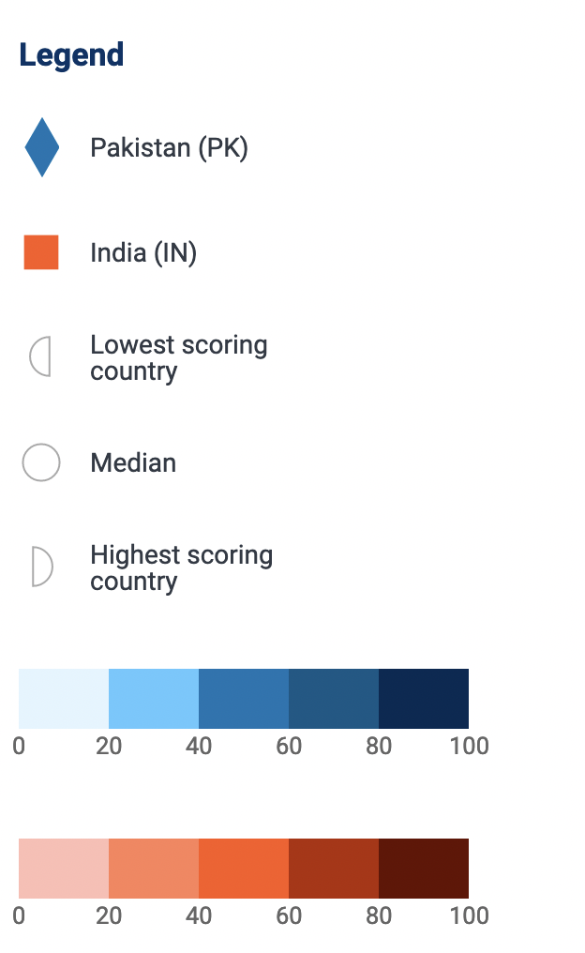
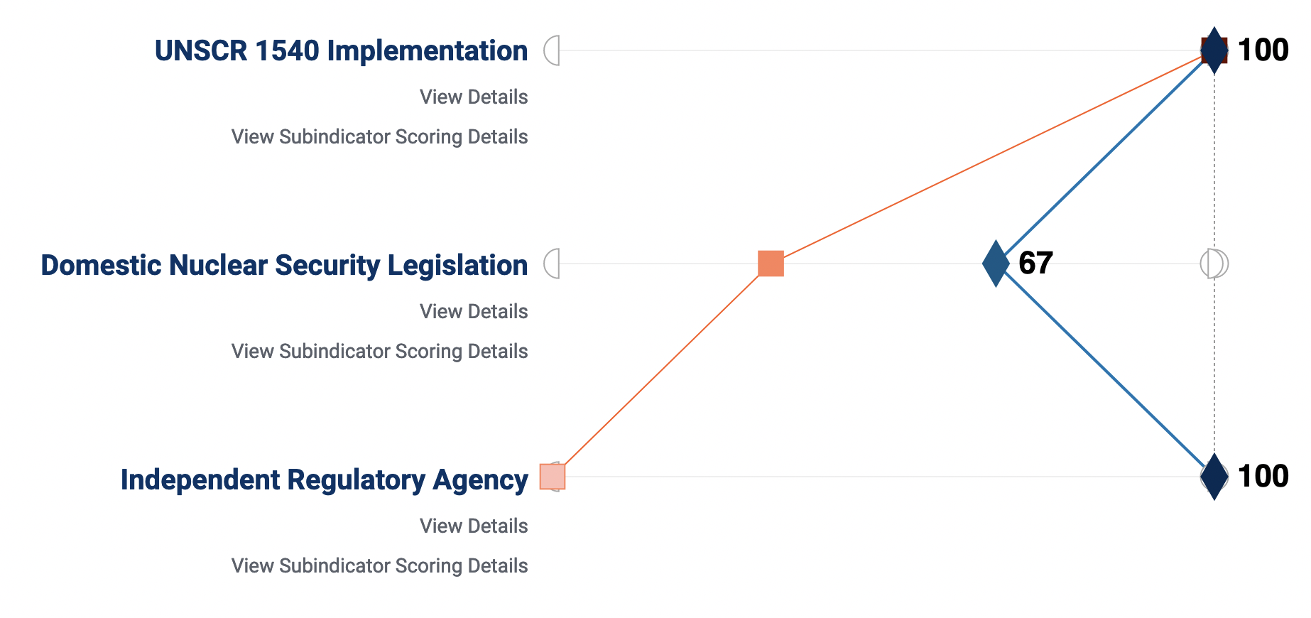
Methods/Data
Mixed Method Analysis:
Qualitative: select research studies on India and Pakistan’s distinct CTBT positions, UNGA voting patterns, government policy documents.
Case Study: Association of Southeast Asian Nations (ASEAN).
Quantitative: ASEAN/Pakistan fact sheets on CTBT progress.
P5.4-427
Please do not use this space, a QR code will be automatically overlayed
Source: NTI Nuclear Security Index

Slide 5
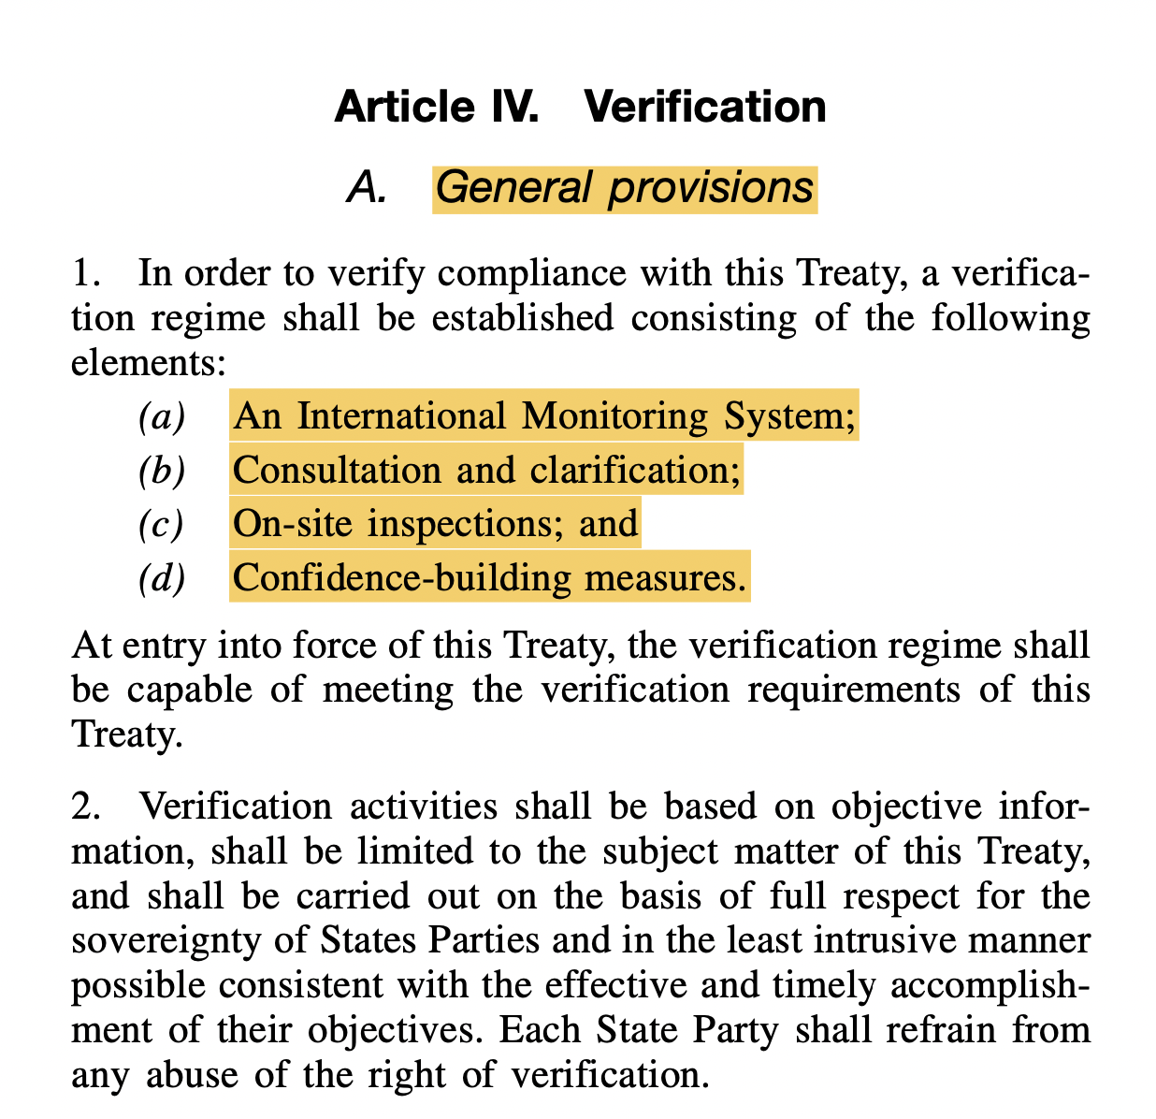
Results
Targeted advocacy: Pakistan and key provisions of the CTBT.
Article IV – verification, obligation, rights.
CTBTO team visit to Pakistan (May 2018)
Reciprocity gap: address barriers to signing the Treaty.
Pakistan: nuclear testing risks cannot be addressed in isolation.
Test case: Bilateral moratorium on nuclear testing with India.
2008 US-India nuclear deal, aftermath.
Treaty objectives – signing, early entry into force. (2012, 2013, 2015).
P5.4-427
Please do not use this space, a QR code will be automatically overlayed

Slide 6
Conclusion
Early evidence of mutual compliance is critical
Key to effective advocacy, long-term incentives to advance treaty objectives.
1995 Bangkok Treaty: building block for moratorium on nuclear tests.
Lays groundwork: SEANWFZ Plan of Action (2023-27)
Sustained confidence-building drives CTBT universalization in the region.
Priority focus on key hold out states.
Indonesia: 2011 – CTBT, nonproliferation objectives on ASEAN agenda.
Lasting activism against nuclear testing:
2013 ASEANTOM (ASEAN Network of Regulatory Bodies on Atomic Energy).
- Consolidates agencies; need for nuclear safety, safeguards.
2. Ripple effect of ratification: Brunei, Myanmar, Thailand. (2013, 16, ‘18).
P5.4-427
Please do not use this space, a QR code will be automatically overlayed

