Slide 1
Regional Training Schools as Tools to Promote Active Involvement of Governments on CTBTO Issues
Marino Protti
Costa Rica Volcanological and Seismological Observatory
National University
O5.3-177
Presentation Date: 21 June 2023 13:45

Slide 2
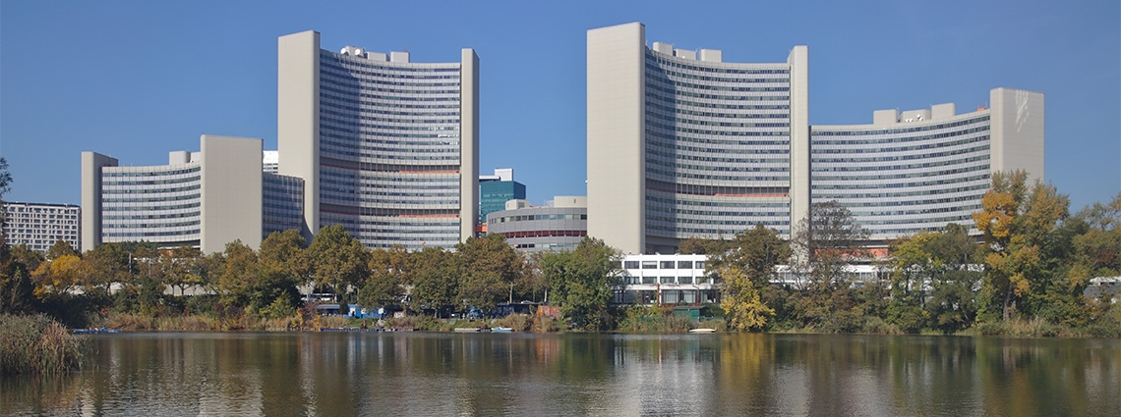
Background
Place your Logo here after removing this text box!
O5.3-177
CTBTO is an interim organization tasked with building up the verification regime of the Comprehensive Nuclear-Test-Ban Treaty (CTBT) in preparation for the Treaty's entry into force, as well as promoting the Treaty's universality.
Notes:
The Preparatory Commission for the Comprehensive Nuclear-Test-Ban Treaty Organization (CTBTO) … is an interim organization tasked with building up the verification regime of the Comprehensive Nuclear-Test-Ban Treaty (CTBT) in preparation for the Treaty's entry into force, as well as promoting the Treaty's universality.

Slide 3
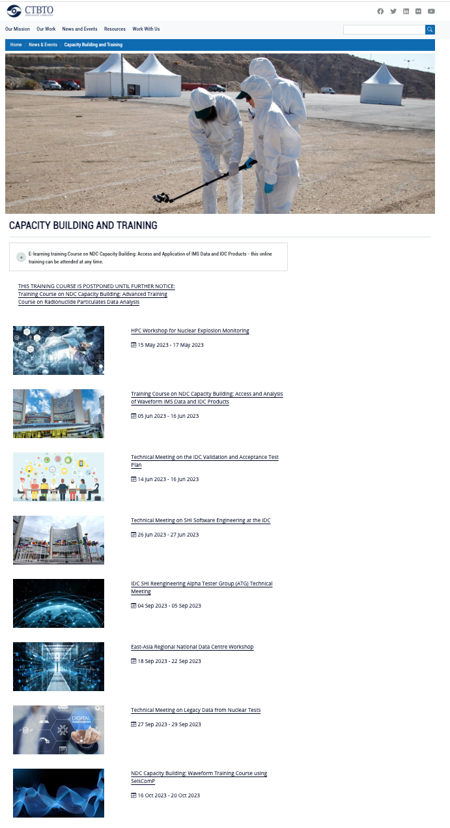
CAPACITY BUILDING AND TRAINING
Place your Logo here after removing this text box!
O5.3-177
Yearly, CTBTO carries out around a dozen training courses for National Data Center technical staff and authorized users.
Most in Vienna but a few of them in several regions around the globe.
https://www.ctbto.org/news-and-events/capacity-building-and-training
Notes:
CTBTO has a active program for capacity building, to increase the ability of scientist and operators from signatory countries to process and interpretate data. While most of the courses are carried out in Europe, a few regional training courses have proven to be excellent ways to integrate people from countries in that region.

Slide 4
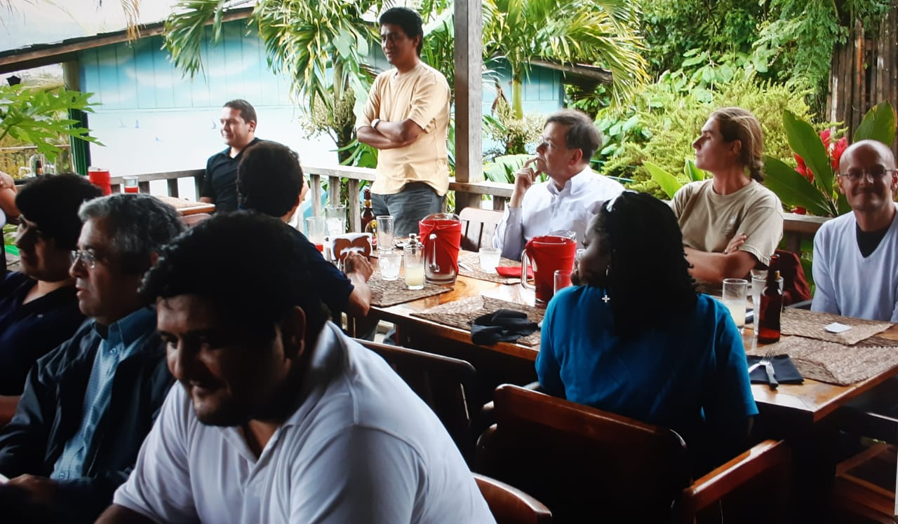
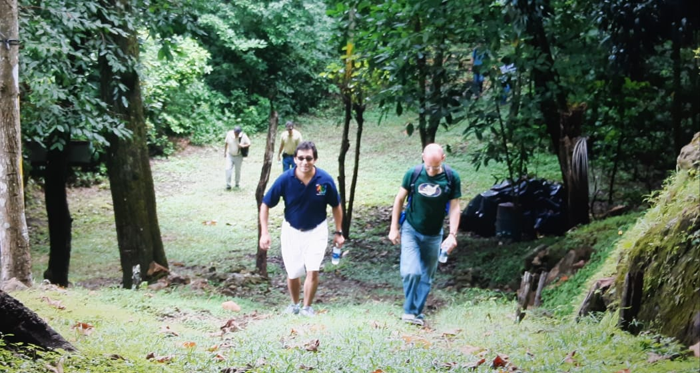
Suggestion
Place your Logo here after removing this text box!
O5.3-177
Increase the number of these regional courses …
Notes:
I suggest , not only to increase the number of these regional courses

Slide 5
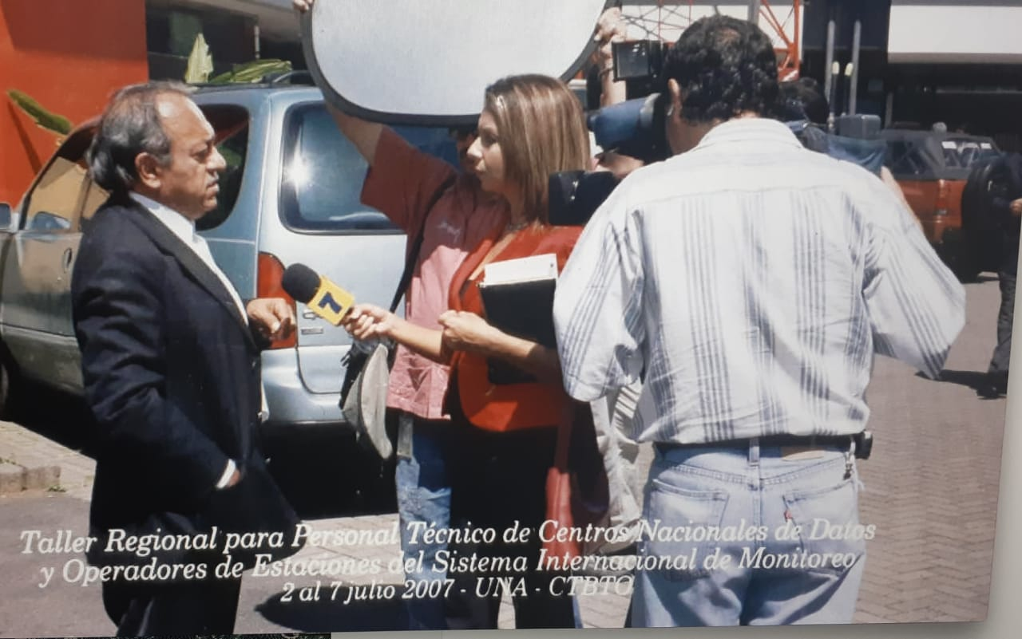
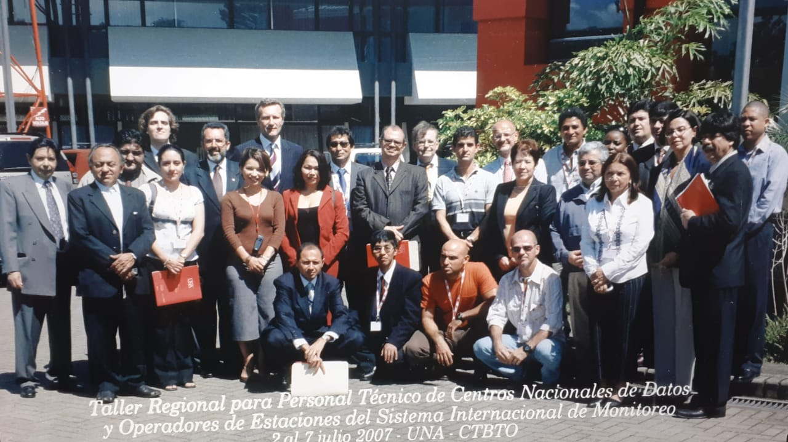
… and
Place your Logo here after removing this text box!
O5.3-177
and have these courses in parallel with political courses or meetings, with diplomats and politicians from the countries participating in the scientific meetings and training courses are from.
Notes:
but also to have these courses in parallel with political courses or meetings, with diplomats and politicians from the countries where the participating in the scientific meetings and training courses are from.

Slide 6
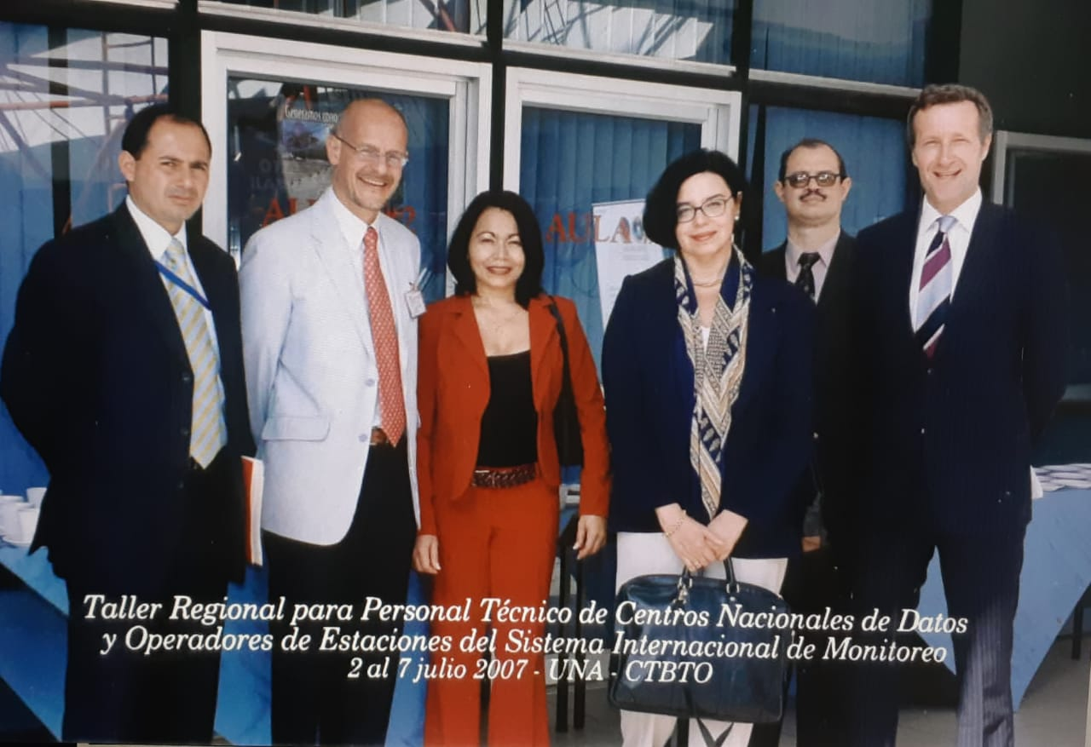
Potential effect
Place your Logo here after removing this text box!
O5.3-177
This way awareness could be increased among politicians on the importance of having an active involvement on CTBTO issues.

Slide 7
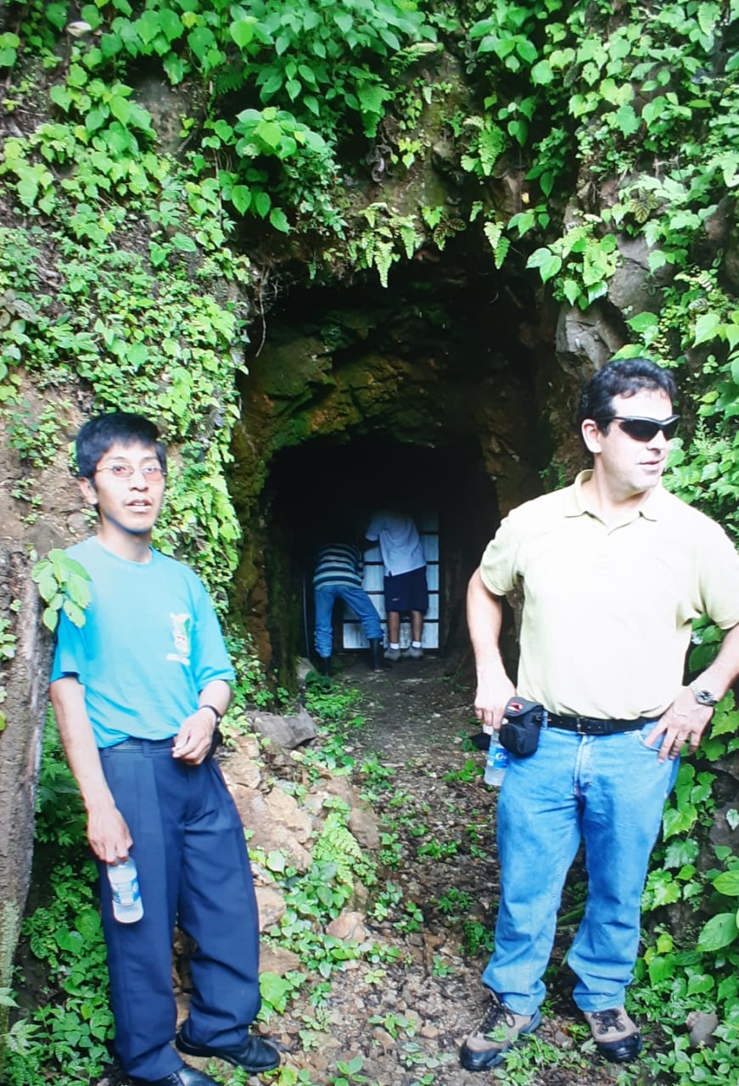
Everybody wins
Place your Logo here after removing this text box!
O5.3-177
Integrating countries at a regional level could allow politicians to see the advantages of full membership and could trigger some countries to reestablish payments and to others to start contributing to CTBTO.

Slide 8
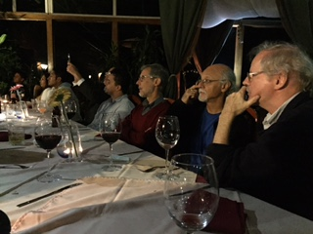
Regional political integration around the CTBT
Place your Logo here after removing this text box!
O5.3-177
A regional political integration of countries, for instance, from the Caribbean or Central America, among other regions, could also trigger proposals to create regional funds to pay CTBTO fees.

Slide 9
Young Professionals Network (YPN)
Place your Logo here after removing this text box!
O5.3-177
Early career scientists and politicians from the region should also be exposed (invited for a day or to the opening ceremony) of these regional meetings so the learn about the CTBTO and the opportunities it could bring in their careers, and potentially join the CTBTO YPN
In 2018, the CTBT Young Professionals Network (YPN) was introduced by Norway in cooperation with the Executive Secretary and the PTS. The CTBT Young Professionals Network is a community of young scientists and technical professionals working on monitoring and verification of the Comprehensive Nuclear-Test-Ban Treaty (CTBT).
https://www.ctbto.org/resources/for-civil-society/ctbt-young-professionals-network

Slide 10
CTBTO YOUTH GROUP [CYG]
Place your Logo here after removing this text box!
O5.3-177
To include, as part of the program of regional training courses, an hour-or-two workshops for college students from the host country, could provide an arena for scientific and technical participants, to interact with these age group and expose them to political and technical issues related to the treaty. This will be an efficient way to incorporate more young people in the CTBTO Youth Group.
Through the years, CYG members have actively engaged in national, regional and international events and activities to promote the entry into force and universalisation of the Comprehensive Nuclear-Test-Ban Treaty (CTBT), and the involvement of the younger generation is key to reaching these goals. CYG members have debriefed the UN Security Council and participated in many forums and high-level events in person and virtually, as speakers and contributors.
https://www.ctbto.org/resources/for-civil-society/ctbto-youth-group

Slide 11
Conclusion
Place your Logo here after removing this text box!
O5.3-177
Regional training courses are arenas where scientists can provide more technical information to politicians and diplomats from their own countries, in order to stimulate them to actively engage in CTBT issues. By doing so, we scientists will be activating the pillars of science diplomacy: science for diplomacy, science in diplomacy and diplomacy for science.

