Slide 1
NDC Argentina: First year of Operation and Radionuclide Data Analysis
Marcelo Alejandro Fernández
Autoridad Regulatoria Nuclear - ARGENTINA
05.3-404
Presentation Date: 21 June 2023

Slide 2
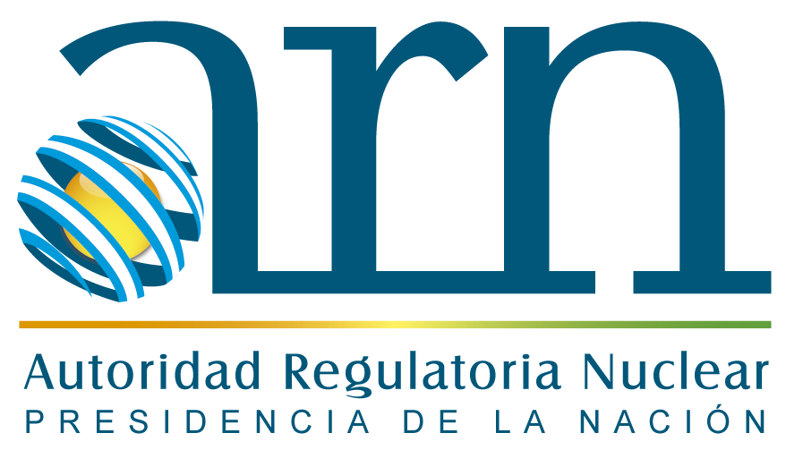
The Nuclear Regulatory Authority
05.3-404
The Nuclear Regulatory Authority is the agency of the Argentine State dedicated to the regulation and control of nuclear activity, in the areas of radiological and nuclear safety, protection and physical security, and safeguards and non-proliferation.
The ARN's mission is to maintain an appropriate level of protection for people, the environment and future generations from the harmful effects of ionizing radiation.
To fulfill this mission, the ARN operates as the competent national authority for regulation and inspection in four regulatory areas, defined by the National Nuclear Activity Law:
Radiation safety
Nuclear safety
Safeguards and non-proliferation
Protection and physical security

Slide 3
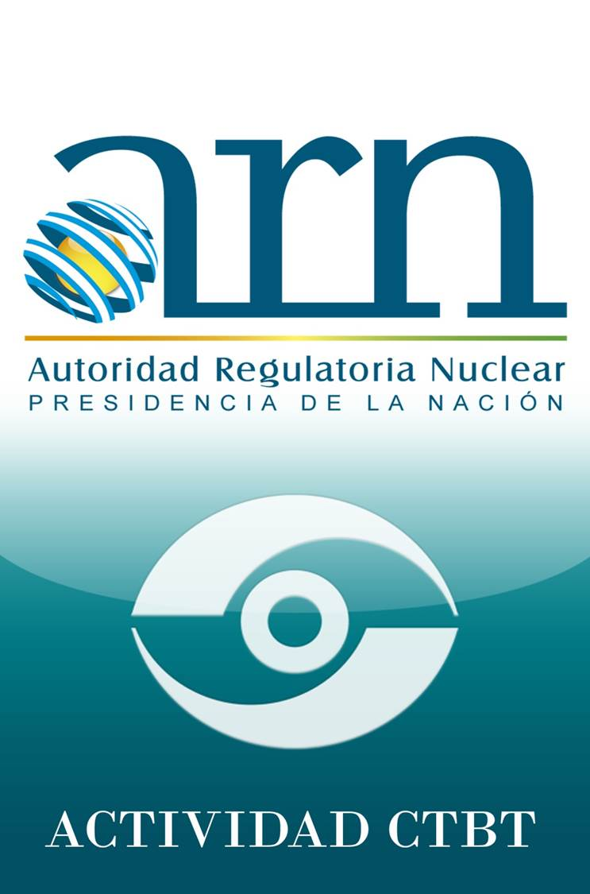
The Role of CTBT Unit in ARN
05.3-404
The ARN acts as a "point of contact" before the CTBTO and is responsible for the operation and maintenance of radionuclide and infrasound monitoring stations and the laboratory that the Argentine National Government undertook to install in its territory.
The CTBT Unit is part of the Nonproliferation Policies and Institutional Affairs Department.
Head, Non-Proliferation Policies and Institutional Affairs Department: Mr. Pablo ZUNINO
Head of CTBT Unit: Mr. Andrés Pantin
IMS Stations and NDC Coordinator: Mr. Marcelo Fernández
RN Laboratory Coordinator: BS. Ezequiel Avaro
The CTBT Unit is in charge of the Operation and Maintenance of five stations of the International Monitoring System (IMS), a Radionuclide Laboratory and the Primary NDC for Radionuclide and Infrasound data analysis.

Slide 4
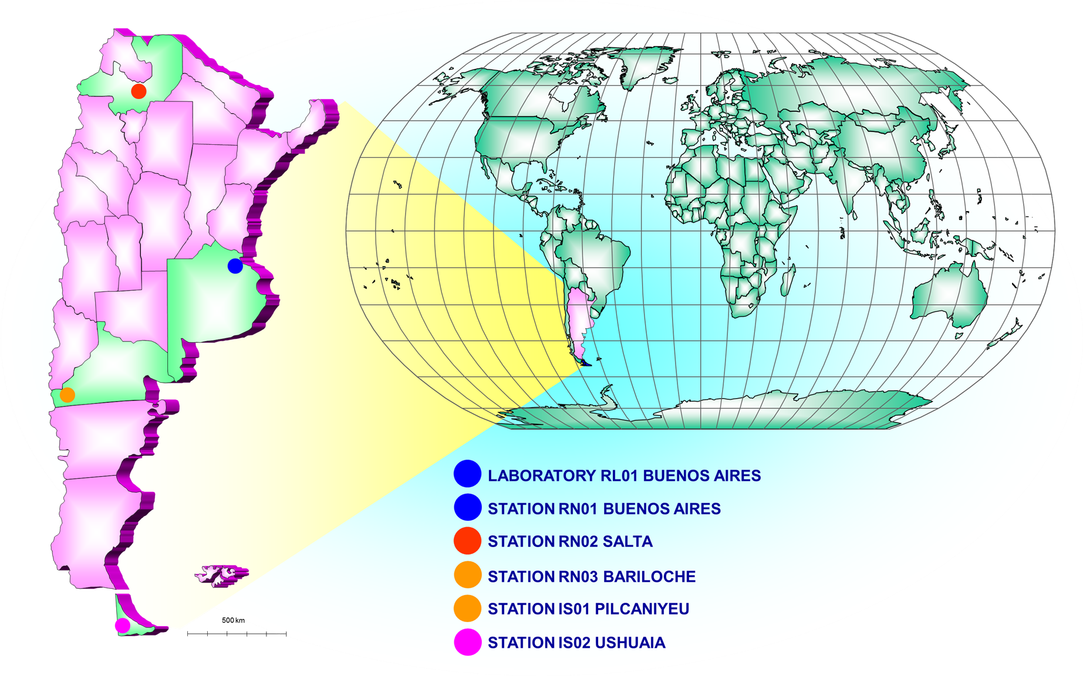
IMS Facilities under ARN responsibility
05.3-404
RN01 – C.A.B.A.
Radionuclide Station with NG Detection Capability
Certificated september 29,2002
RL01 – C.A.B.A.
Radionuclide Laboratory.
Certificated September 29,2005
NDC – C.A.B.A.
Radionuclide and Infrasound Analysis 2021/22
RN02 – Salta
Radionuclide station
Awaiting Certification
RN03 – Bariloche, Rio Negro
Radionuclide Station
Certificated December 21, 2004
IS01 – Pilcaniyeu, Rio Negro
Infrasound Station (8 elements) Certificated December 13, 2019
IS02 – Tolhuin, Tierra del Fuego
Infrasound Station (5 elements) Certificated August 23, 2006

Slide 5
What is a National Data Centre (NDC)?
05.3-404
A National Data Centre is an organization working with Treaty verification under the guidance of, or as an integral part of, the National Authority and with technical expertise in the monitoring technologies.
“A data centre operated and maintained by a State Party whose functions may include sending IMS data to the IDC and/or receiving data and products from the IDC.” (Glossary to the draft IDC Operational Manual).

Slide 6
Role of an NDC
05.3-404
Advise the National Authority by: - Verifying the nature of the events and the compliance with the Treaty - Reviewing proposed technical changes to the verification system - Providing technical advice to the representatives in the Executive Council
Use IMS data and IDC products as needed to assist the verification efforts
Provide scientific expertise to the technical subsidiary organs (Scientific Advisory Board, Working groups of scientific experts)
Act as an interface to national scientific organizations and civil applications of the verification technologies
Responsible for the proper use of IMS data and IDC products (confidentiality policy)

Slide 7
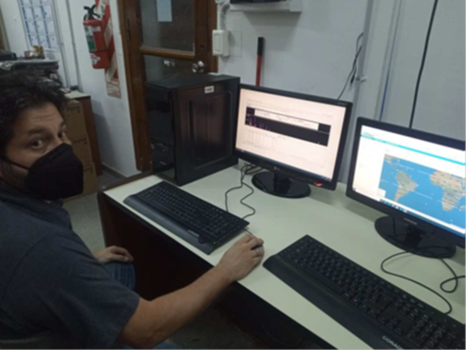
Establishment of Primary NDC For Radionuclide and Waveform Data Analysis
05.3-404
Having complied with the Argentine IMS network in accordance with the Treaty, the next milestone in the verification regime is to establish our own National Data Center (NDC) to access and analyze IMS Radionuclide and Waveform data.
Using the tools provided by the IDC we start by collecting, storing, analyzing and sharing the data coming from our stations and in case of any event the data related will be re-analyzed and investigated.
Software used at the NDC
NDC-in-a-box.
RNToolkit.
Performance Reporting Tool. (PRTool)

Slide 8
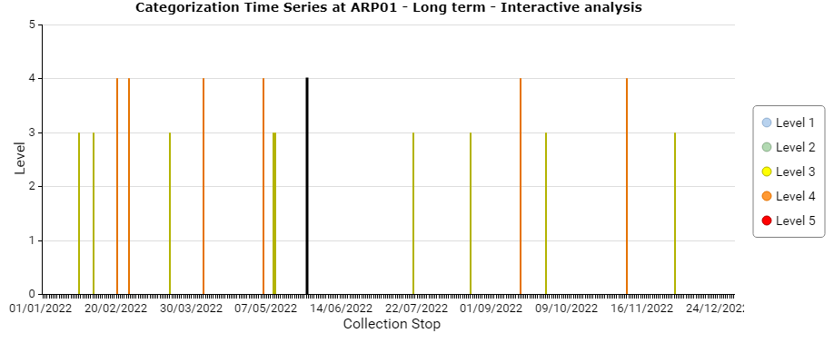
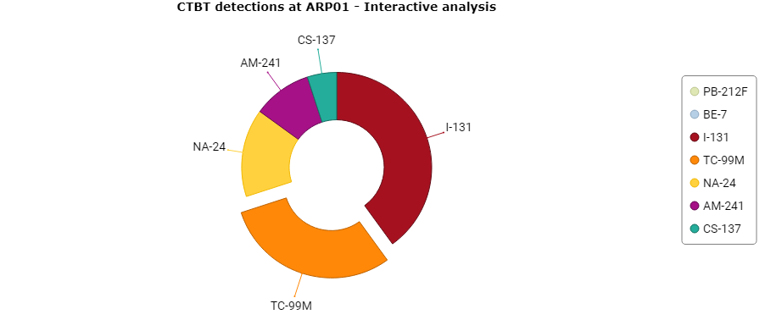
Detections of CTBTO relevant nuclides at ARP01 Station during 2022
05.3-404
Detections at ARP01 Station, located in Buenos Aires, Argentina during 2022.
Detections of CTBT relevant nuclides
Nuclide | Half-life | Type of Product | Detections 2022
PB-212F | 10.64 H | Natural | 350
BE-7 | 53.22 D | Natural | 350
I-131 | 8.040 D | Fission | 8
TC-99M | 6.010 H | Fission | 6
NA-24 | 14.959 H | Activation | 3
AM-241 | 432.2 Y | Fission | 2
CS-137 | 30.100 Y | Fission | 1

Slide 9
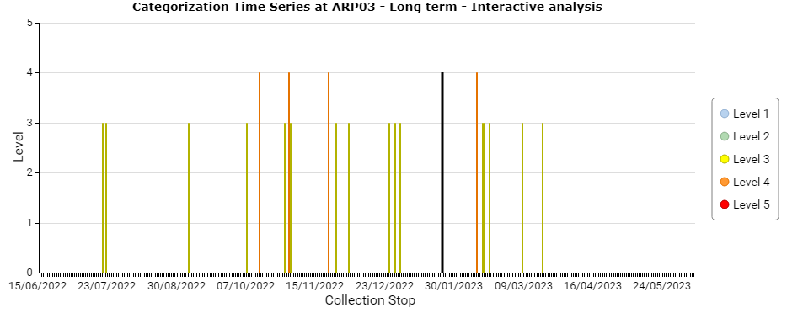
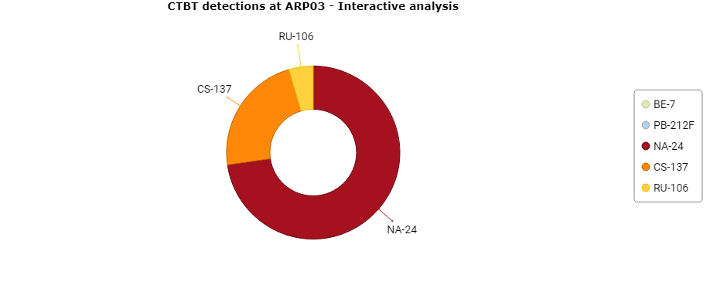
Detections of CTBTO relevant nuclides at ARP03 Station during 2022
05.3-404
Detections at ARP03 Station, located in Rio Negro, Argentina during 2022.
Detections of CTBT relevant nuclides
Nuclide | Half-life | Type of Product | Detections 2022
PB-212F | 10.64 H | Natural | 359
BE-7 | 53.22 D | Natural | 359
NA-24 | 14.959 H | Activation | 16
CS-137 | 30.100 Y | Fission | 5
RU-106 | 1.023 Y | Fission | 1

Slide 10
NDC Argentina - Current projects:
05.3-404
Collecting, storing and analyze RN raw data and data products coming from the IMS Stations.
Detection levels trends.
Data comparison between IDC and NDC for testing and capacity building purposes for analyst training.
Produce RN Reports.
Training of NDC Staff.
Improvement/upgrade of NDC Equipment.
Three RN stations from Argentina plus one from Chile are being monitoring on daily basis using the tools provided by IDC for CTBTO relevant radionuclide detection in the four corners of the country.

Slide 11
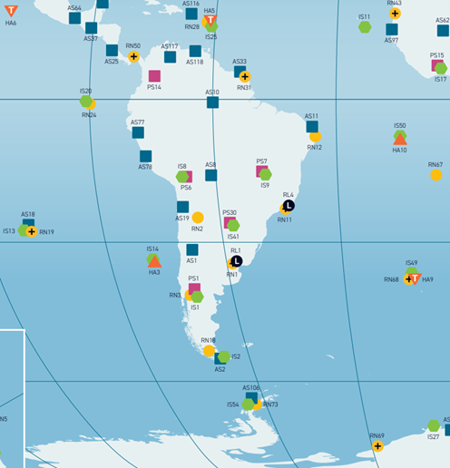
Our Goal
05.3-404
Radionuclide Stations Monitored by NDC Argentina
Station Code | Responsible State | Location | Coordinates |  | Radionuclide Stations. | Radionuclide Stations with Noble Gas monitoring capability
 |  |  | Lat. | Lon.
ARP01* | Argentina | Buenos Aires | 34.5 S | 58.5 W
ARP02 | Argentina | Salta | 24.8 S | 65.5 W
ARP03 | Argentina | S.C de Bariloche | 41.1 S | 71.2 W
BRP11* | Brasil | Rio de Janeiro | 23.0 S | 43.4 W
CLP18 | Chile | Punta Arenas | 53.1 S | 70.9 W
CLP19* | Chile | Hanga Roa, Isla de Pascua | 27.1 S | 109.3 W
FRP28 | France | Pointe-à-Pitre Guadeloupe | 16.3 N | 61.5 W
FRP31* | France | Kourou, Guyana Francesa | 5.2 N | 52.7 W
PAP50* | Panamá | Panamá | 9.0 N | 79.5 W
GBP67 | United Kingdom | Santa Helena | 15.9 S | 5.7 W
GBP68* | United Kingdom | Tristán da Cunha | 37.1 S | 12.3 W
GBP69* | United Kingdom | Halley Antártida | 76.0 S | 28.0 W
USP73 | USA | Palmer Station Antártida | 64.8 S | 64.1 W
* Radionuclide Stations with Noble Gas monitoring capability

Slide 12
What we expect for the future?
05.3-404
Improve our capabilities through training courses and equipment upgrade.
To cover the entire region of South America, Caribean and Antarctica by monitoring 13 RN Stations.
Cooperation and Interaction with other NDCs in the region.
Share the data coming from our stations with educational Institutions for scientific research purposes.
… And enjoy our work

Slide 13
Final Words
05.3-404
Thank you for your attention!!!
Questions?
Marcelo Alejandro Fernández
IMS Station and NDC Coordinator
Autoridad Regulatoria Nuclear - ARGENTINA

