Slide 1
A comprehensive report of M 7.5 14th December 2021 Flores Sea Earthquake: rapid observation, tsunami warning and aftershock distribution
I Made Kris Adi Astra¹, Abraham Arimuko¹, Iman Fathurochman ¹, Dwi Karyadi Priyanto ¹, Mohamad Taufik Gunawan ¹, Dwi Hartanto ¹, Yohanes Agus Setiawan ¹, Cahyo Nugroho ¹, Dwikorita Karnawati ¹, Suko Prayitno Adi ¹, Daryono ¹, Bambang Setiyo Prayitno ¹, Sigit Pramono ¹
1) Meteorology Climatology and Geophysics Agency of Republic of Indonesia
O5.2-854
21 June 2023

Slide 2
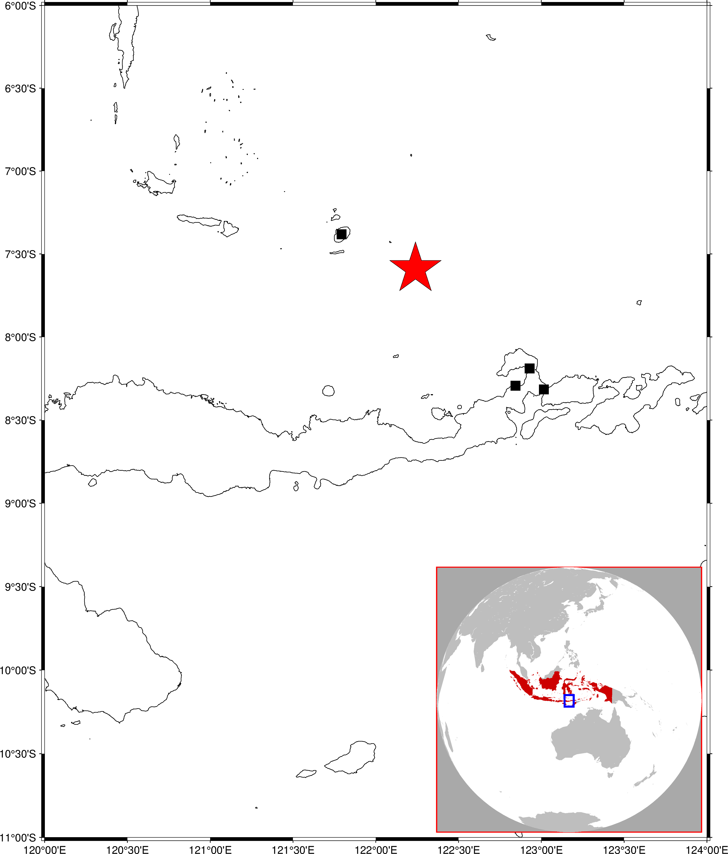
A comprehensive report of M 7.5 14th December 2021 Flores Sea Earthquake: rapid observation, tsunami warning and aftershock distribution
O5.2-854
M 7.5
Flores Sea Earthquake
Wall collapsed, Sinamalaka village
OT: 03:20:23
Lon: 122.26, Lat: -7.59,
Depth: 12 km
1161 houses damage ,
16593 people evacuated,
Selayar Island Regency
Hospital damaged, Larantuka city
School damaged, Lewobele village
Earthquake Epicenter

Slide 3
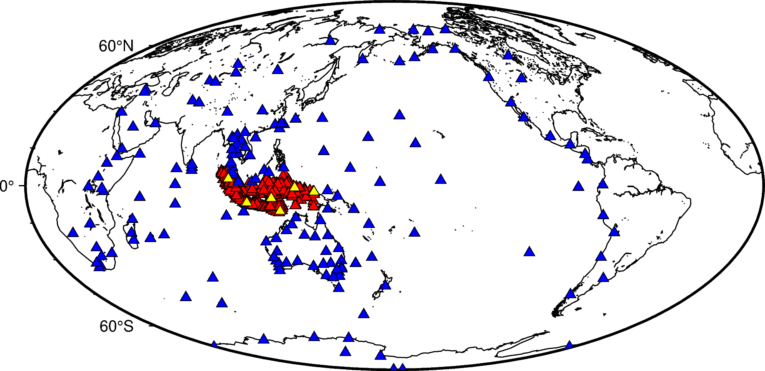
A comprehensive report of M 7.5 14th December 2021 Flores Sea Earthquake: rapid observation, tsunami warning and aftershock distribution
O5.2-854
Seismograph network retrieved by MCGA (BMKG).
Indonesian owned seismographs (434 sensors)
CTBTO seismograph stations (6 sensors)
neighboring countries seismograph network (167 sensors).

Slide 4
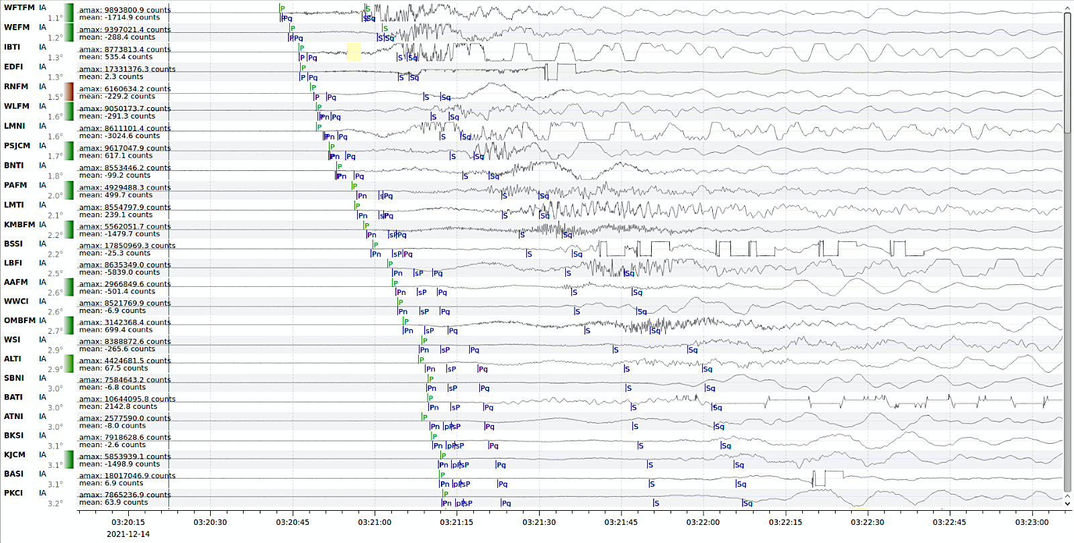
A comprehensive report of M 7.5 14th December 2021 Flores Sea Earthquake: rapid observation, tsunami warning and aftershock distribution
O5.2-854
CTBTO
Recorded earthquake signal to 3.2⁰ from the epicentre.

Slide 5
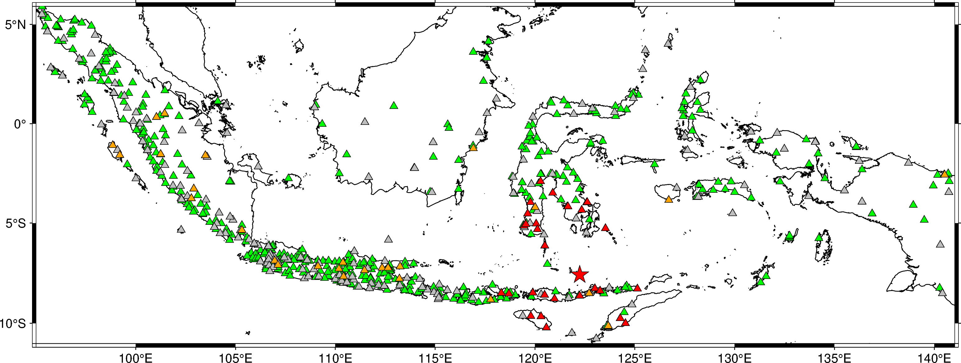
A comprehensive report of M 7.5 14th December 2021 Flores Sea Earthquake: rapid observation, tsunami warning and aftershock distribution
O5.2-854
Indonesian MCGA (BMKG) Accelerometer network
669
sensors.
31 sensors (▲) around the epicenter of M 7.5 Flores Sea earthquake (★) clearly detected strong ground motion.

Slide 6
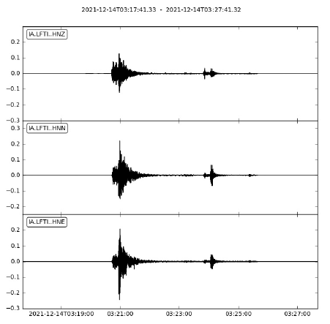
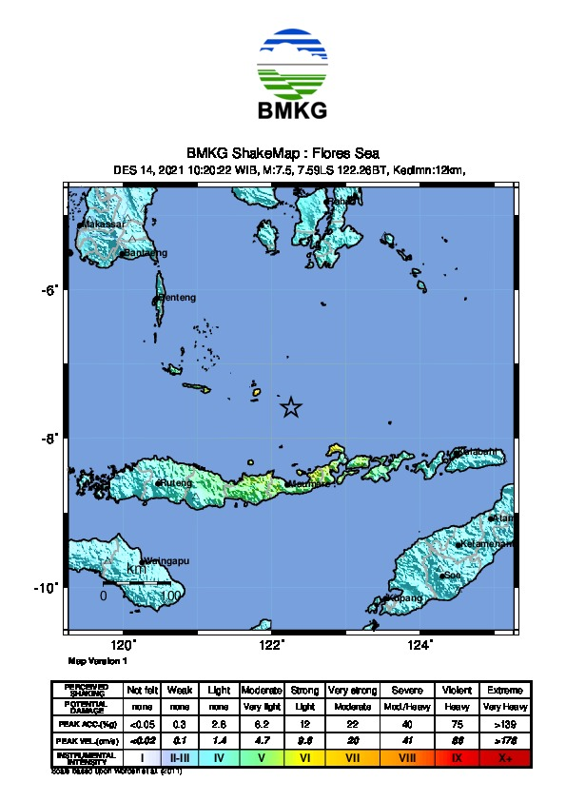
A comprehensive report of M 7.5 14th December 2021 Flores Sea Earthquake: rapid observation, tsunami warning and aftershock distribution
O5.2-854
Rapid earthquake intensity map issued after the dissemination of earthquake parameter.
M 7.5 Flores Sea earthquake caused strong horizontal ground motion. The highest earthquake intensity recorded to VI in MMI scale.

Slide 7
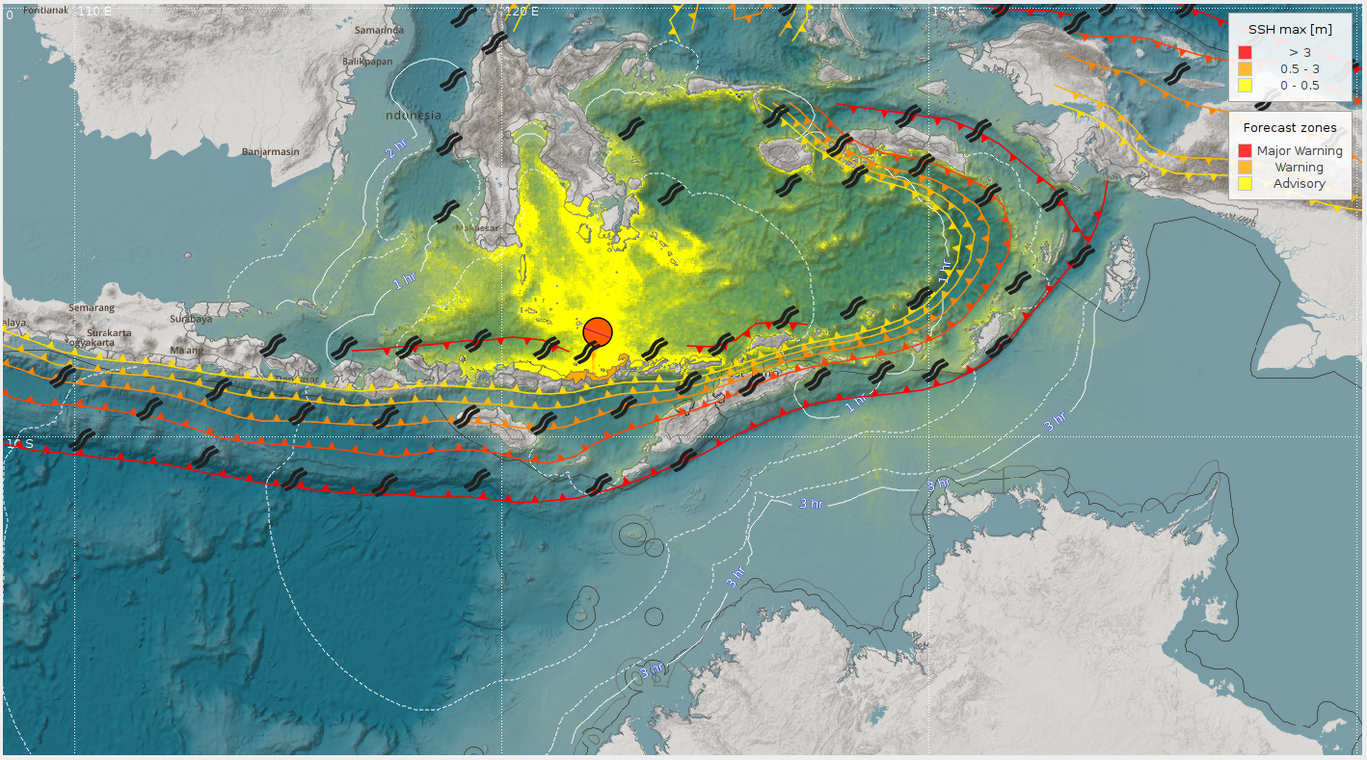
A comprehensive report of M 7.5 14th December 2021 Flores Sea Earthquake: rapid observation, tsunami warning and aftershock distribution
O5.2-854
1st Tsunami modeling triggered by M 7.5 Flores earthquake

Slide 8
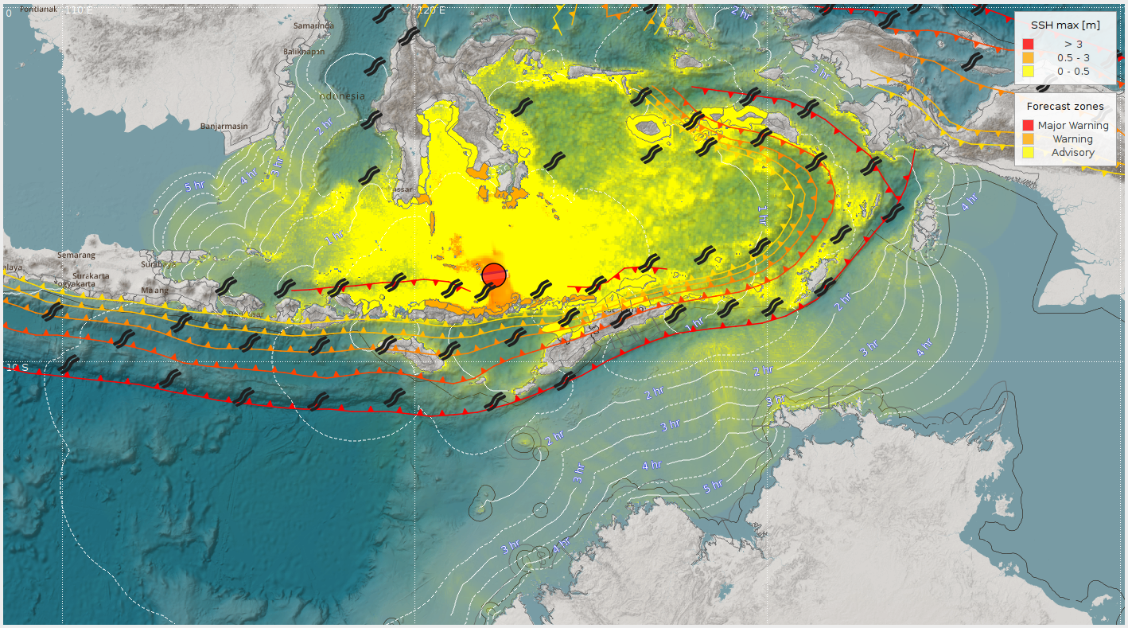
A comprehensive report of M 7.5 14th December 2021 Flores Sea Earthquake: rapid observation, tsunami warning and aftershock distribution
O5.2-854
Updated Tsunami modeling incorporating moment tensor sulution

Slide 9
A comprehensive report of M 7.5 14th December 2021 Flores Sea Earthquake: rapid observation, tsunami warning and aftershock distribution
O5.2-854
TSUNAMI EARLY WARNING TIMELINE
03:20:23
03:25:06
03:39:29
04:17:28
05:27:30
Main shock origin time
Tsunami early warning I
Tsunami early warning II
Tsunami early warning III
Tsunami early warning IV
Modelling-based tsunami impact
Updated parameter, estimation time arrival
Sea-level monitoring confirmation:
03:36 at Marapokot (0.07 m)
03:39 at Reo (0.07 m)
End of warning

Slide 10
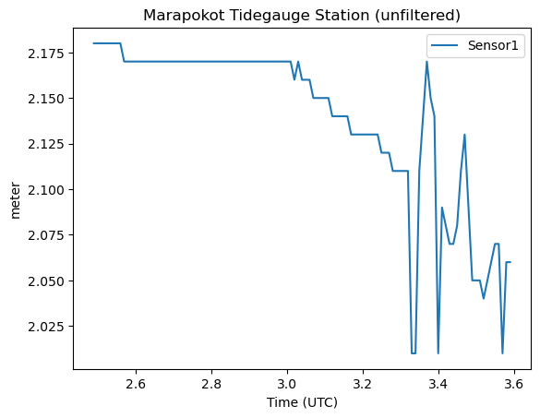
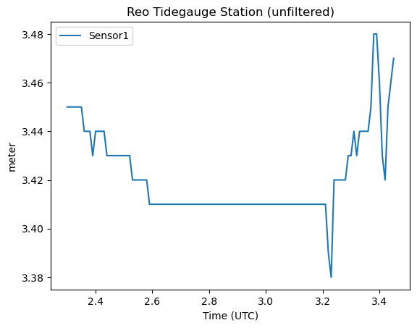
A comprehensive report of M 7.5 14th December 2021 Flores Sea Earthquake: rapid observation, tsunami warning and aftershock distribution
O5.2-854
Sea-level monitoring at Marapokot station and Reo station near the epicenter

Slide 11
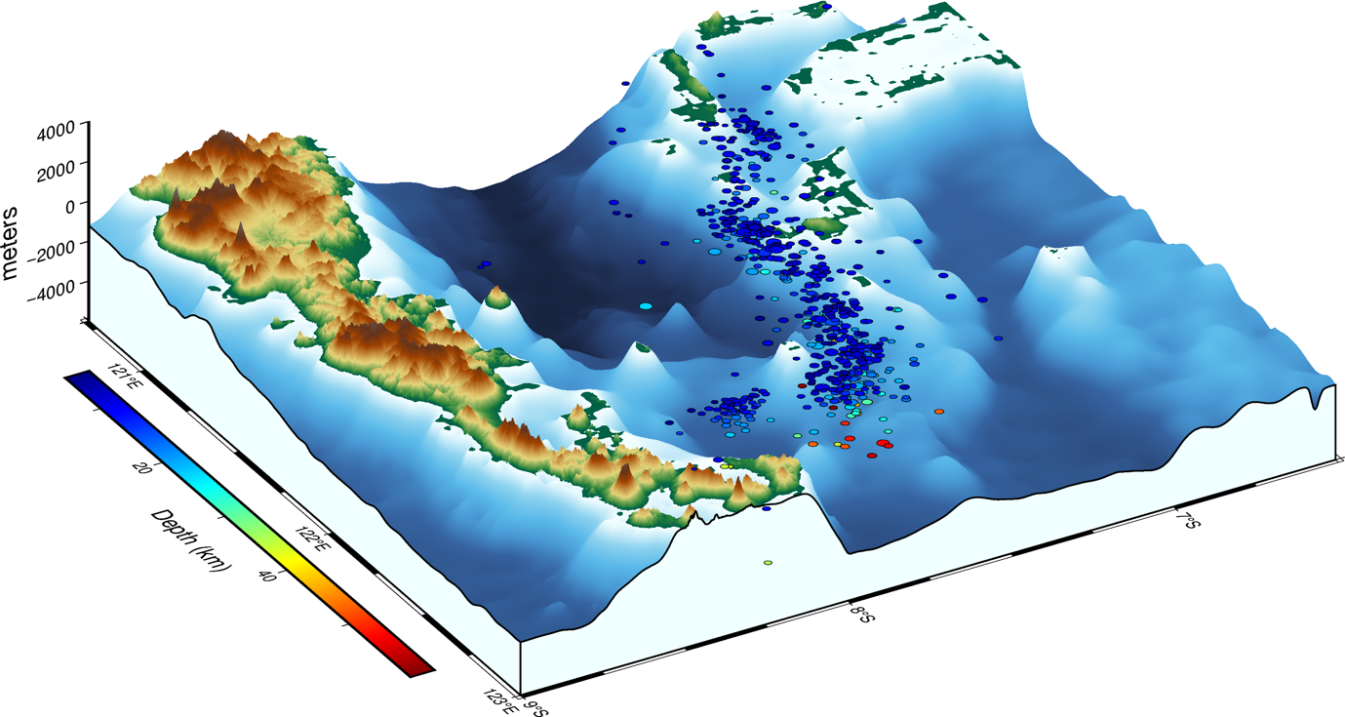
A comprehensive report of M 7.5 14th December 2021 Flores Sea Earthquake: rapid observation, tsunami warning and aftershock distribution
O5.2-854
3D seismicity distribution of M7.5 2021 Flores Sea.

Slide 12
A comprehensive report of M 7.5 14th December 2021 Flores Sea Earthquake: rapid observation, tsunami warning and aftershock distribution
O5.2-854
Seismicity distribution and source parameters of M7.5 2021 Flores Sea.
Initial location: seiscomP (Weber et al., 2007)
Relocation: DD technique (Waldhauser & Ellsworth, 2000)
750 events
until
8 days
after mainshock

Slide 13
A comprehensive report of M 7.5 14th December 2021 Flores Sea Earthquake: rapid observation, tsunami warning and aftershock distribution
O5.2-854
Four active earthquake clusters.
distinguished by distinctive pattern of high-density earthquake distribution over geographical longitude
4
3
2
1

Slide 14
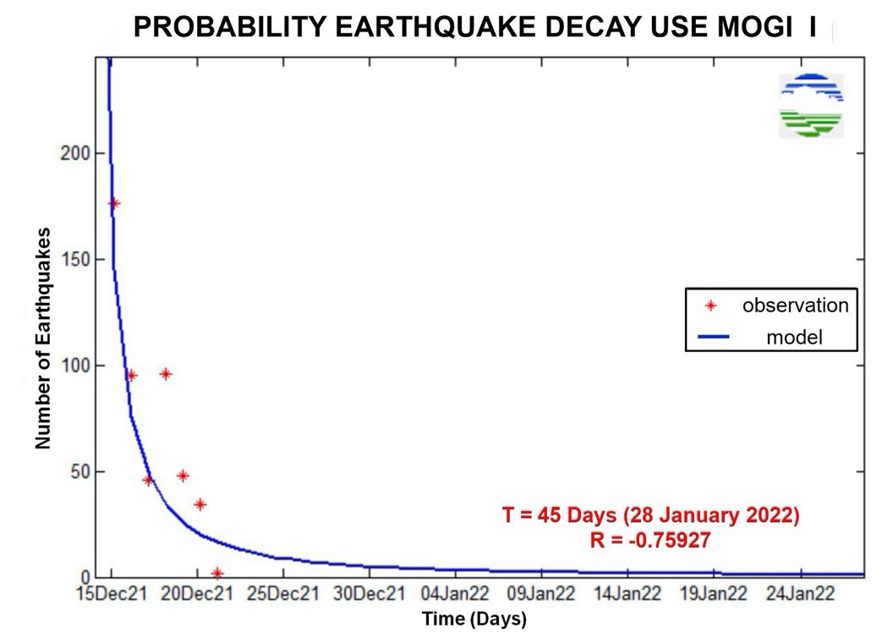
A comprehensive report of M 7.5 14th December 2021 Flores Sea Earthquake: rapid observation, tsunami warning and aftershock distribution
O5.2-854
Aftershock observation
(✦)Daily aftershock productivity following the mainshock until 21 December 2021
(⎯)Aftershock decay model (Utsu, 1957)
$$n\left(t\right)=n_{1}t^{−h},0<t<t_{0}$$
$$h=rate of frequency decrease$$

Slide 15
A comprehensive report of M 7.5 14th December 2021 Flores Sea Earthquake: rapid observation, tsunami warning and aftershock distribution
O5.2-854
Thank you for your kind attention

