Slide 1

Importance of IMS Data for the Tsunami Warning Centre in Bangladesh
MD. GOLAM RASUL
Chief Geologist and Director
Bangladesh Atomic Energy Commission and TPOC & Principal User, NDC-BD

Slide 2
OUTLINEs OF THE PRESENTATION
Country Overview
Geographical and Tectonic Setup of Bangladesh
Possibilities of Tsunami Occurrence
BMD Activities
IMS Station (AS007, BRDH) & NDC-BD
Tsunami Warning Agreement (TWA) with the CTBTO and Opportunity for NDC-BD

Slide 3
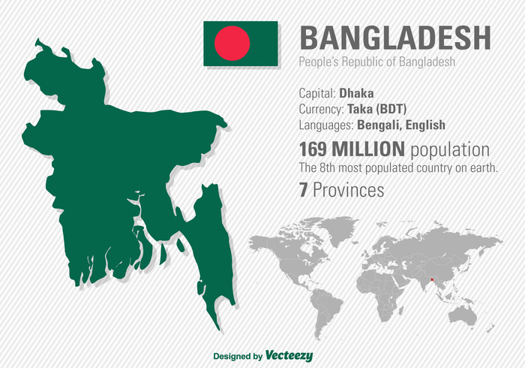
COUNTRY OVERVIEW
NDC@AECD, BAEC
Dhaka
AS 007 BRDH
Bariadhala, Chattogram
Area : 147,570 Sq. km
GDP per Capita : US$ 2458 (2021)
GDP growth rate : 5.3% (2023)

Slide 4
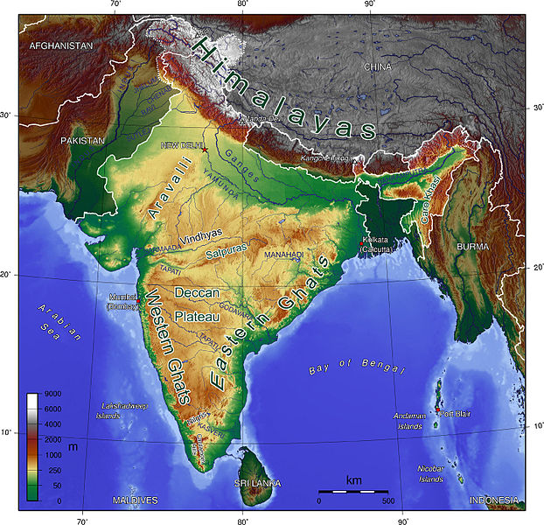
Geographical Location of Bangladesh
Bangladesh
Bay of Bengal
The geographical location of Bangladesh is at the northern most part of the Bay of Bengal having a funnel shaped ending at the southern coast.

Slide 5
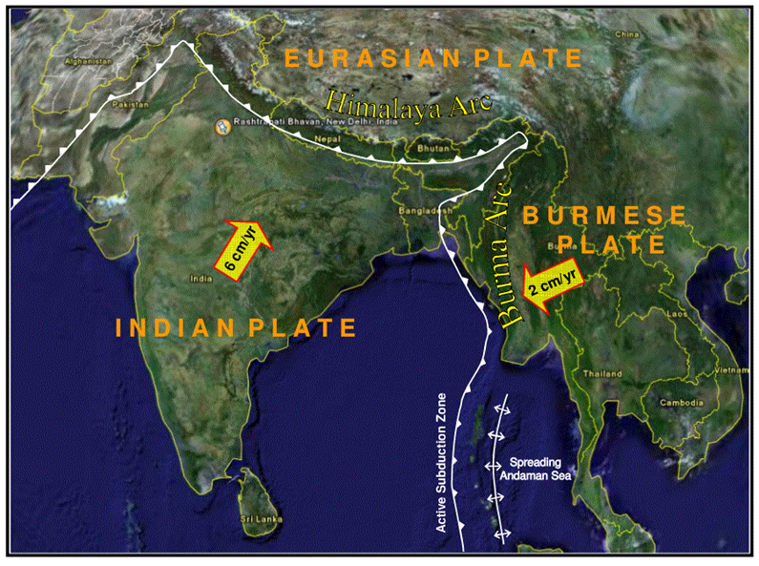
Regional Tectonic Setup of Bangladesh with respect to Plate Configuration
Tectonically, the region is at the junction of the Indian and the Eurasian plate making an active tectonic zone of the world.

Slide 6
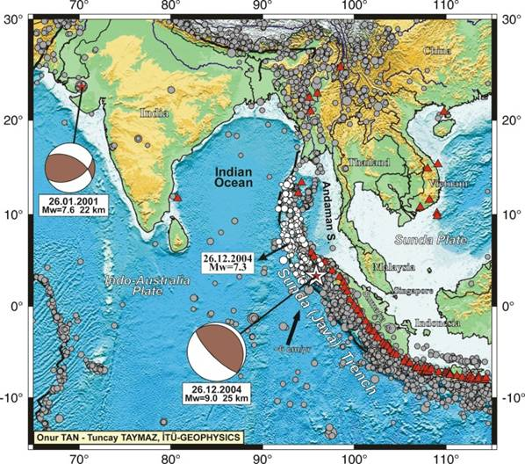
Regional Seismic Map
Quite frequent earthquake activity occurs along the plate margin at the region, some parts of which is under the ocean stretching down to one of the most tectonically active area in Indonesia.
Therefore, possibility of earthquake in the ocean is likely to occur in any place of the region that can result to tsunami at the area.

Slide 7
Possibilities of Tsunami Occurrence in BD

Slide 8
Possibility of Tsunami in Bangladesh
Bangladesh
Active Seismic Zone
Plates are slowly changing their directions.
It shows the subduction zone is active and could generate a devastating tsunami in the near future

Slide 9
Possibility of Tsunami in Bangladesh
Bangladesh
Teknaf-Andaman Seismic Gap
Active Seismic Zone
Another major concern is the north-Andaman-Teknaf subduction zone, or seismic gap.
According to experts, there is a 600 km seismic gap along the subduction zone north of the Bay of Bengal from Andaman to Teknaf.

Slide 10
Possibility of Tsunami in Bangladesh
Bangladesh
Teknaf-Andaman Seismic Gap
Active Seismic Zone
Enough energy is stored in this seismic gap to cause strong earthquakes in our country. And if it is under the sea, then that earthquake can create a tsunami. Experts fear strong earthquake and tsunami in Bangladesh.
The expected rupture of the seismic gap runs from north-east to south-west direction.

Slide 11
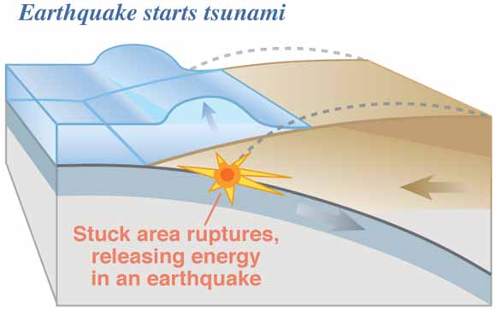
26 December Tsunami
Burma Plate
Indian Plate

Slide 12
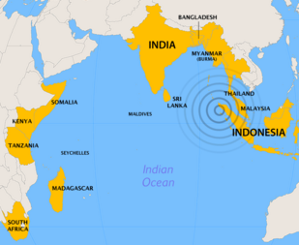
Directly affected by Tsunami occurred on 26 Dec 2004
(Marked by Yellow Color)

Slide 13
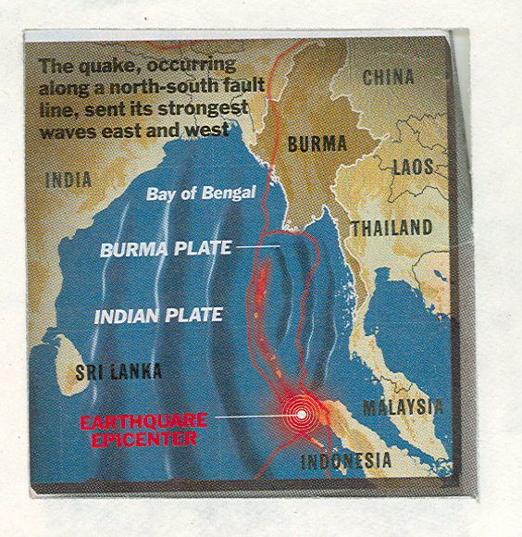
Bangladesh was safe during the 2004 tsunami because the direction of the friction was north-south giving rise to a east-west moving wave.
Earthquake Epicenter
On Dec 26, 2004, a massive underwater quake measuring 9.3 caused a huge tidal wave or tsunami in the western Bay of Bengal. It was the second biggest earthquake recorded in the region and was caused by friction between the Indian and Burmese plates.

Slide 14
Possibility of Tsunami in Bangladesh
Bangladesh
Teknaf-Andaman Seismic Gap
Active Seismic Zone
The expected rupture of the seismic gap runs from north-east to south-west direction.

Slide 15
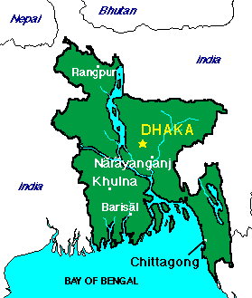
Possibility of Tsunami in Bangladesh
If a tsunami is generated in the Bay of Bengal from this subduction zone, it will directly assail the coastal areas including Barisal, Patuakhali, Noakhali, Cox's Bazar and Snadwip and India's Orissa, West Bengal.

Slide 16
OUTLINE
BMD Activities

Slide 17

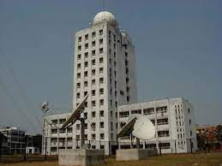
Bangladesh Meteorological Department (BMD) ACTIVITIES
The Bangladesh Meteorological Department is the national meteorological organization of Bangladesh.
Bangladesh Meteorology Department (BMD) is authorized to monitor earthquake and tsunami by Bangladesh Meterological Act 2018.

Slide 18
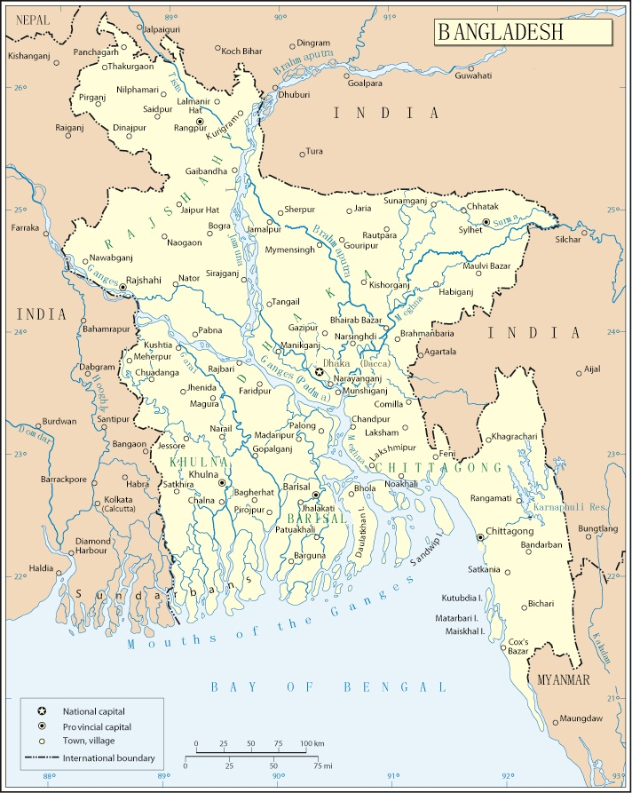
Bangladesh Meteorological Department (BMD) ACTIVITIES
stage stations
stage stations
cv
stage stations
Countrywide Distribution of Seismic Stations

Slide 19
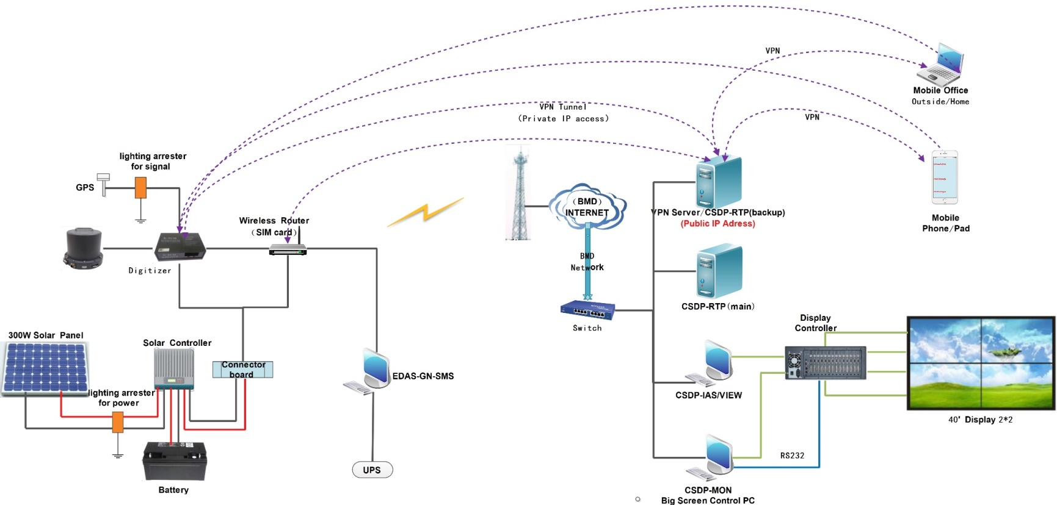
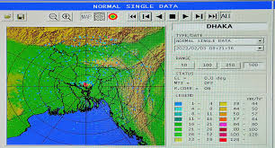
Bangladesh Meteorological Department (BMD) ACTIVITIES
Topological Diagram of
Bangladesh Digital Seismic Network

Slide 20
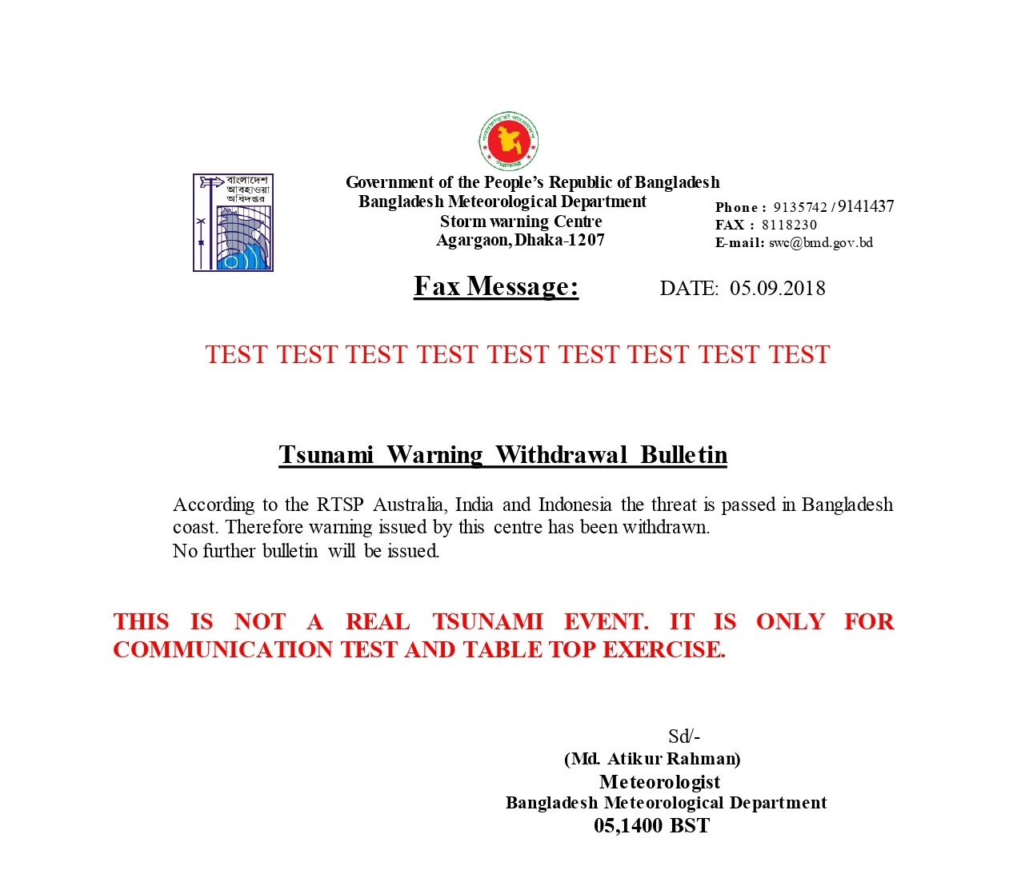
Bangladesh Meteorological Department (BMD) ACTIVITIES
There is no designated Tsunami Warning Centre (TWC) in Bangladesh yet .
BMD issues Tsunami Warning in Bangladesh on the basis of the information from
IOTWC (Indian Ocean Tsunami Warning Centre, India), Indonesian Tsunami Warning Center and Australian Tsunami Warning Center.

Slide 21
IMS Station (AS007, BRDH) & NDC-BD

Slide 22
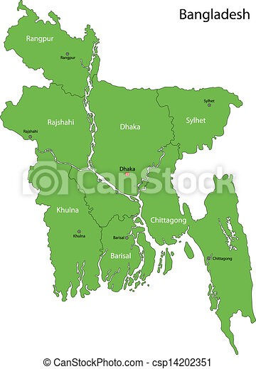
International Monitoring System
IMS Station (AS007, BRDH) & NDC-BD
NDC
The Auxiliary Seismic Station (AS007) at Bariadhala (BRDH), Chattogram is the only station under CTBTO in Bangladesh as a component of International Monitoring System (IMS).
BRDH-AS007

Slide 23
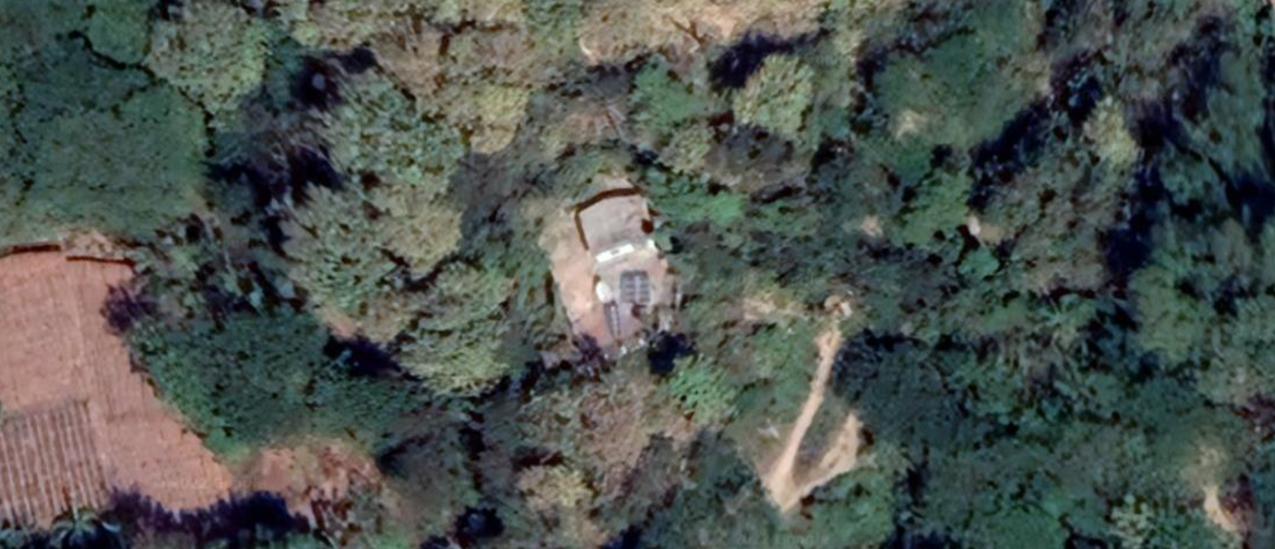
IMS Station (AS007, BRDH) & NDC-BD
-Station Detailed-
Station Name: BRDH Latitude: 22.7 N
Technology: Auxiliary Station (AS) Longitude: 91.6 E
Treaty Number: AS007 Located: In a reserve forest
Location: Bariadhala, Chattogram Approx. 22m (70ft) above ground
Country: Bangladesh

Slide 24
IMS Station (AS007, BRDH) & NDC-BD
Bangladesh, a CTBT signatory country since 24 October, 1996
It is the 54th state to ratify CTBT on 8 March 2000.
Bangladesh Atomic Energy Commission (BAEC) was nominated as the Institution to cooperate with CTBTO to establish the AS007 station.
The station was established mainly to monitor the activities of nuclear testing through earthquake occurrence in the region.
To accomplish the goal, the station started its data transmission to IDC, Vienna using Guralp system from 3rd February, 2011 and has been accredited as an internationally certified station on 8th December, 2011.

Slide 25
HISTORY OF TECHNICAL COOPERATION
[2004-2017]
Year | Achievements
2004 | The station site was selected at Bariadhala, Chattogram
2005 | The selected land was handed over to BAEC
2007-2009 | ToR preparation for site preparation and construction, installation support, initial testing and finalization of the implementation procedure of the station
2010 | Site preparation, Construction of the seismic station.
2011: | Installation of solar panel, GCI equipment and seismic equipment and transmission of seismic data started..
3rd Feb, 2011 | Transmission of seismic data started..
8th December, 2011 | The station has been accredited as an internationally certified.
2017 | Upgradation with the installation of advanced GCI system.

Slide 26
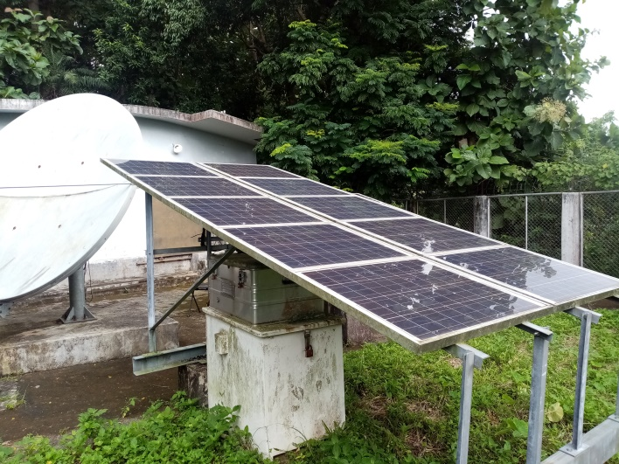
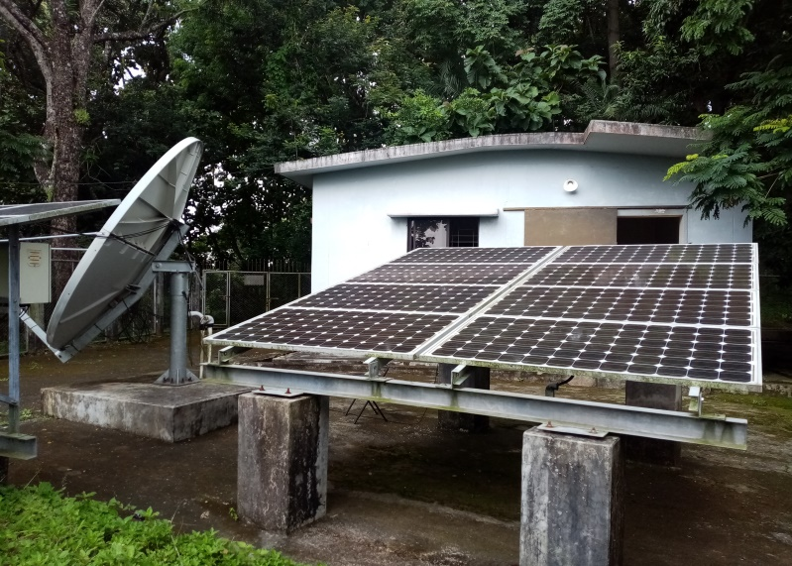
IMS Station (AS007, BRDH) & NDC-BD
The station has been accredited as an internationally certified.
(8th December, 2011)

Slide 27
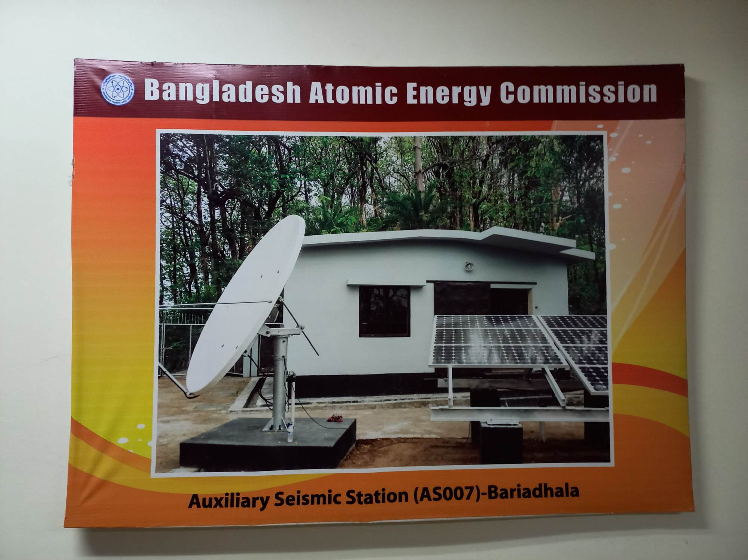
IMS Station (AS007, BRDH) & NDC-BD
Establishment of Auxiliary Seismic Station AS007

Slide 28
HISTORY OF TECHNICAL COOPERATION
Status of National Data Centre (NDC)
Bangladesh has established the NDC with the financial and technical support from CTBTO to receive all monitoring data and analysis reports.
NDC-in-a-box was supplied and installed during the establishment of NDC to analyze seismic data.
Requisition is submitted for CBS installation.

Slide 29
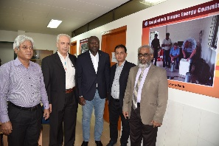
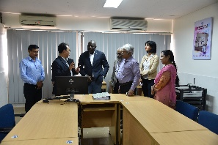
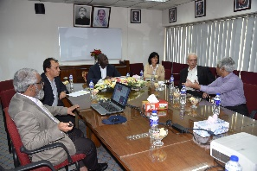
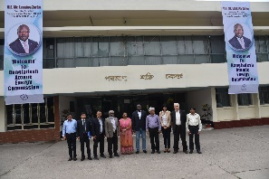
IMS Station (AS007, BRDH) & NDC-BD
National Data Centre (NDC)
On October 2018, Executive Secretary of CTBTO visited to National Data Centre in Bangladesh.

Slide 30
Tsunami Warning Agreement (TWA) with the CTBTO

Slide 31
TSUNAMI WARNING AGREEMENT
CTBTO and UNESCO: Partners in Disaster Mitigation
Although the Asian tsunami created a great tragedy too many people, it also did a lot to educate us globally, and to bring awareness to tsunamis and earthquakes in general.
Similarly, the tragedy of the situation brought awareness to the need for a global alert system in order to minimize deaths associated with tsunamis.
The CTBTO and the Intergovernmental Oceanographic Commission (IOC) of the United Nations Educational, Scientific and Cultural Organization (UNESCO) agreed to share efforts and data in the field of tsunami early warning systems following the 2004 Indian Ocean tsunami that killed more than 230,000 people.
Tsunami warning agreement (TWA) with the Comprehensive Nuclear-Test-Ban Treaty Organization (CTBTO) is needed for strengthening the country’s ability to issue faster and more precise safety warnings in case of a tsunami.

Slide 32
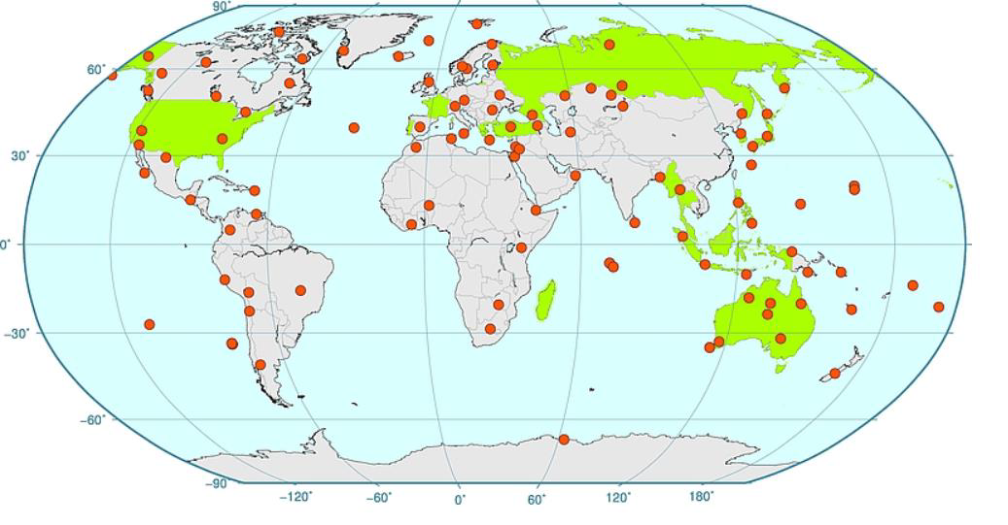

TSUNAMI WARNING AGREEMENT
Present Status of Map
Ref: Abdelouaheb Agrebi
CTBTO presentation slide
The Auxiliary Seismic Station (AS007), established in Bangladesh, is designed for TEWS (Tsunami Early Warning System).

Slide 33
TSUNAMI WARNING AGREEMENT
Proposal for establishing of TWC in Bangladesh
Bangladesh does not have any Tsunami arrangement/agreement yet, however, as per CTBTO, the Auxiliary Seismic Station (AS007), established in Bangladesh, is designed for TEWS (Tsunami Early Warning System). Therefore, any arrangement regarding TEWS is possible to initiate.
Bangladesh is hosting an International Monitoring System (IMS) station (AS007, BRDH) and a National Data Center (NDC-BD) since 2011, and hence invited to establish a Tsunami Warning Agreement (TWA) with the CTBTO, thus benefiting from relevant IMS data to reinforce and complement early tsunami warning system.
So, considering the authority of BMD and the establishment of CTBTO under BAEC, IOC/UNESCO can think of establishing a Tsunami Warning Centre in Bangladesh in collaboration with CTBTO.

Slide 34
TSUNAMI WARNING AGREEMENT
Important of IMS Data for Tsunami Warning
IMS seismic data are used to help tsunami warning
in identifying depth phases
in tracking horizontal earthquake rupture
using for LP and BB estimate of magnitudes.

Slide 35
TSUNAMI WARNING AGREEMENT
How NDC can contribute in TWC in Bangladesh
NDC-BD could be strengthened for analyzing events by establishing Capacity Building System (CBS) installation.
The CBS establishment could be helpful in integrating data acquisition, processing and analysis using the NDC in a box software and in investigating different incident events.
Relevant officials from BMD, Tsunami Warning Laboratory at Department of Disaster Management could be added as AUTHORIZED USERS of NDC-BD for having access of IMS Data and IDC Products as well as to build a combined national team for this purpose.

Slide 36
PROPOSED TWC-BD ESTABLISHMENT
National Data Centre-Bangladesh (NDC-BD)
AS-007, BRDH
Principal Point of Contact
Principal Users-2
Regular Users-7
Bangladesh Atomic Energy Commission,
Geology Department of Dhaka University and Jahangirnagar University
Scope of adding more users
Scope of analyzing IMS data for civil and scientific application
Scope of analyses different seismic events for Tsunami Early Centre

Slide 37
CONCLUSIONS
Tectonically, the region is at the junction of the Indian and the Eurasian plate making an active tectonic zone of the world.
Possibility of earthquake in the ocean is likely to occur in any place of the region that can result to tsunami at the area.
Bangladesh is hosting an International Monitoring System (IMS) station (AS007, BRDH) and a National Data Center (NDC-BD) since 2011.
Hence invited to establish a Tsunami Warning Agreement (TWA) with the CTBTO, thus benefiting from relevant IMS data to reinforce and complement early tsunami warning system.
Strengthen NDC-BD by establishing Capacity Building System (CBS) installation is prime requisite.
Building a national team to work together from different organizations to able to access IMS data for TWC as well as other civil and scientific applications.

Slide 38
Promotional text
The necessity of installation of a Tsunami Warning Centre and strengthen of NDC-BD in Bangladesh

Slide 39
THANK YOU

