Slide 1
The Auxiliary Seismic Network of the International Monitoring System
Challenges and Opportunities: an IMS perspective
José PEREIRA, Irene BIANCHI, Stefka STEFANOVA, Hideaki KOMIYAMA
CTBTO/IMS/MFS/M
O4.4-747
Presentation Date: 20 June 2023

Slide 2
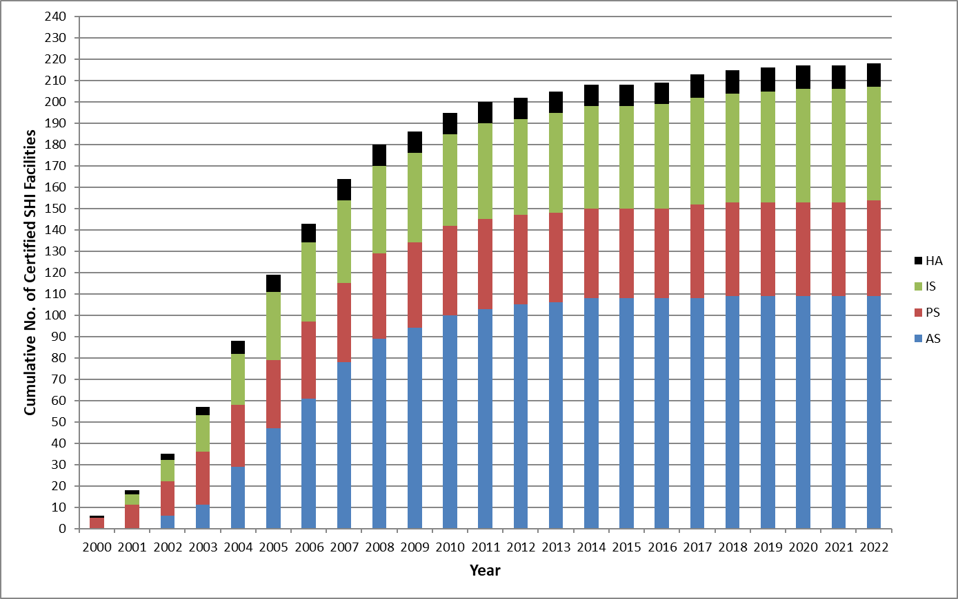
1.Observation
O4.4-747
Cumulative Number of Certified SHI Facilities (2000-2022)

Slide 3
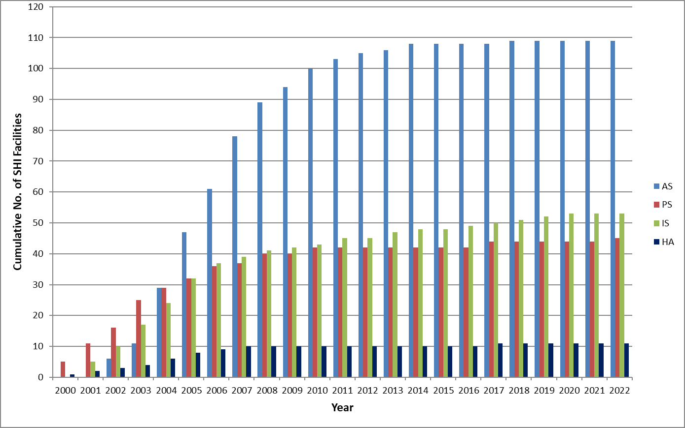
1.Observation
O4.4-747
Number of Certified SHI Facilities per Station Group
2022
AS | 109
PS | 45
IS | 53
HA | 11
Total | 218

Slide 4
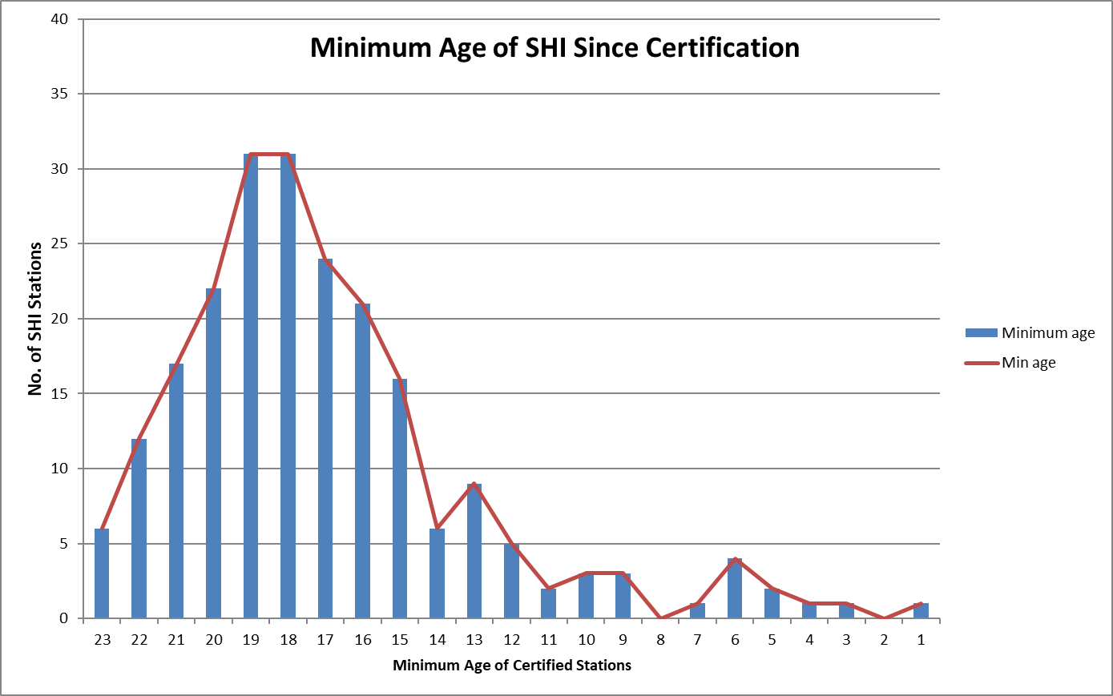
1.Observation
O4.4-747
Minimum Age of Certified SHI Facilities

Slide 5
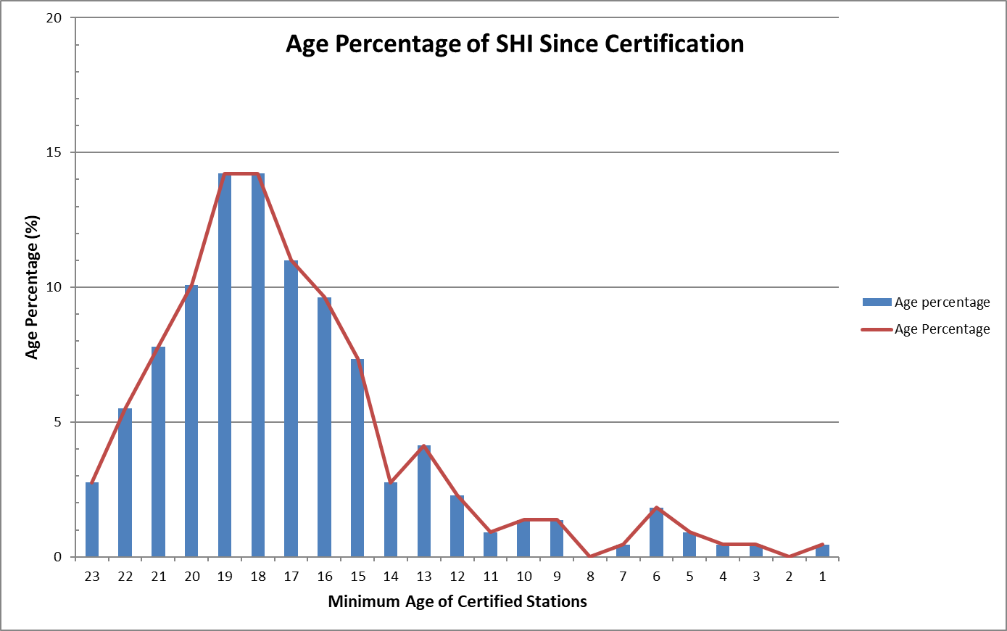
1.Observation
O4.4-747
Certified SHI Facilities Grouped by Age Percentage
85% of SHI are 10 Years or More
75% of SHI are 15 Years or More

Slide 6
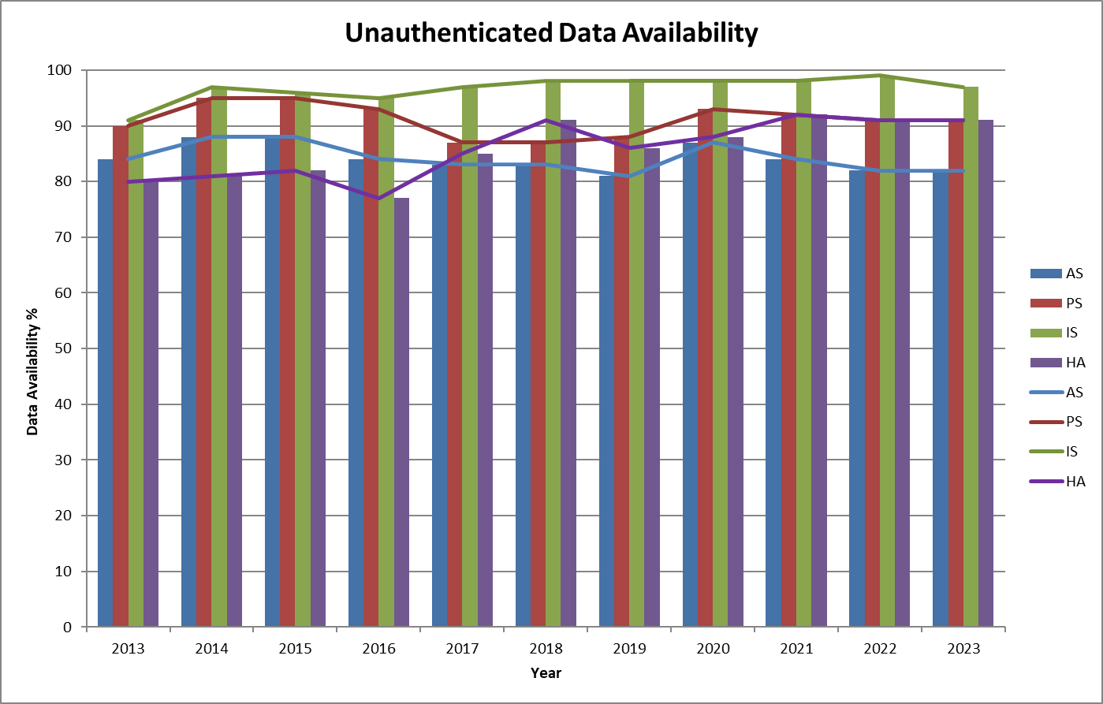
1.Observation
O4.4-747
SHI Unauthenticated Data Availability

Slide 7
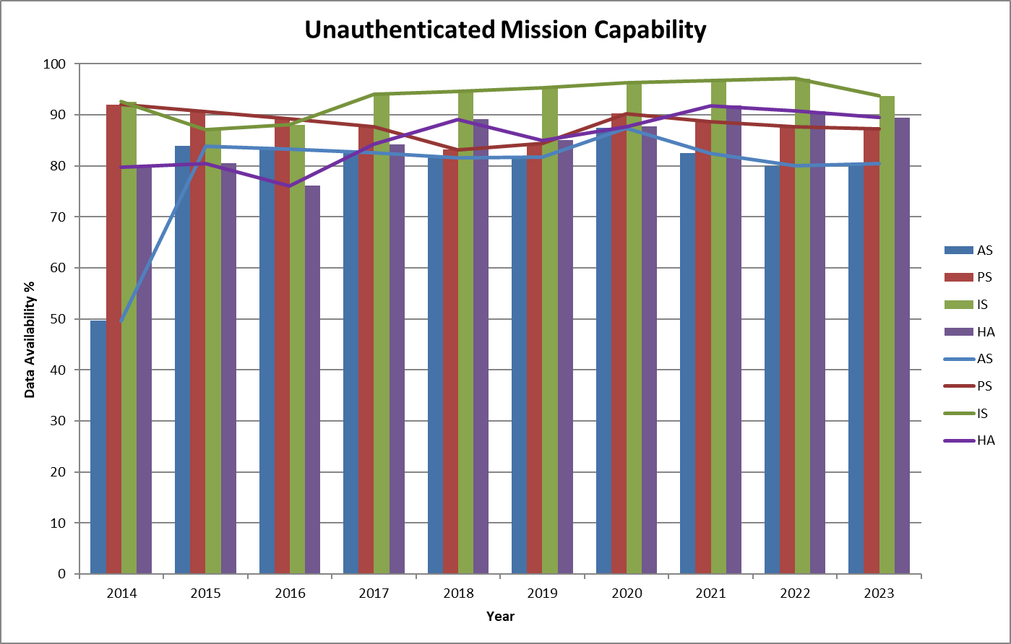
1.Observation
O4.4-747
SHI Unauthenticated Mission Capability

Slide 8
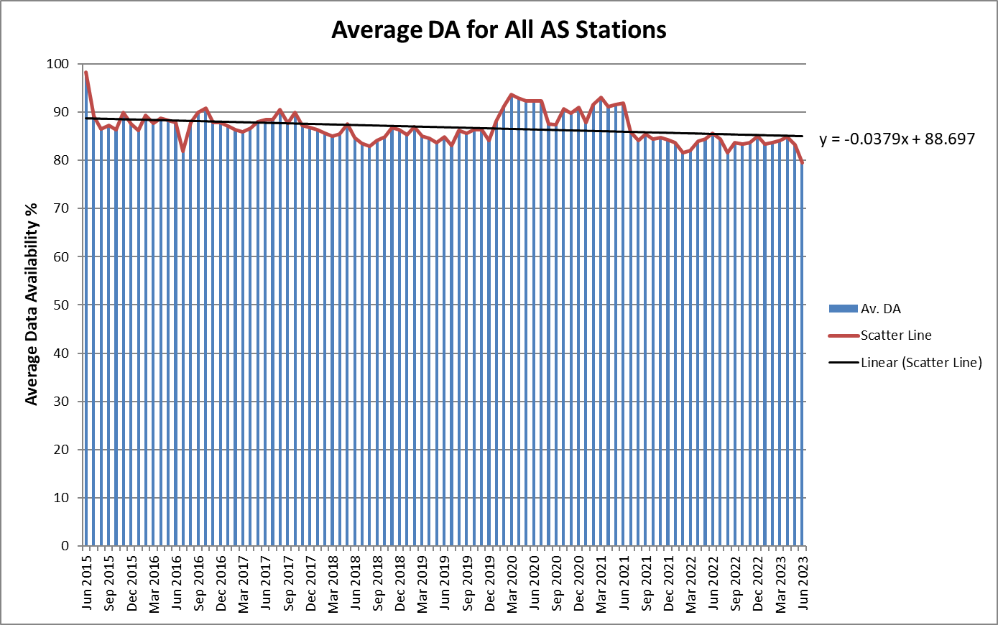
2. Experiment
O4.4-747
Average Data Availability for All Certified AS Facilities (109)

Slide 9
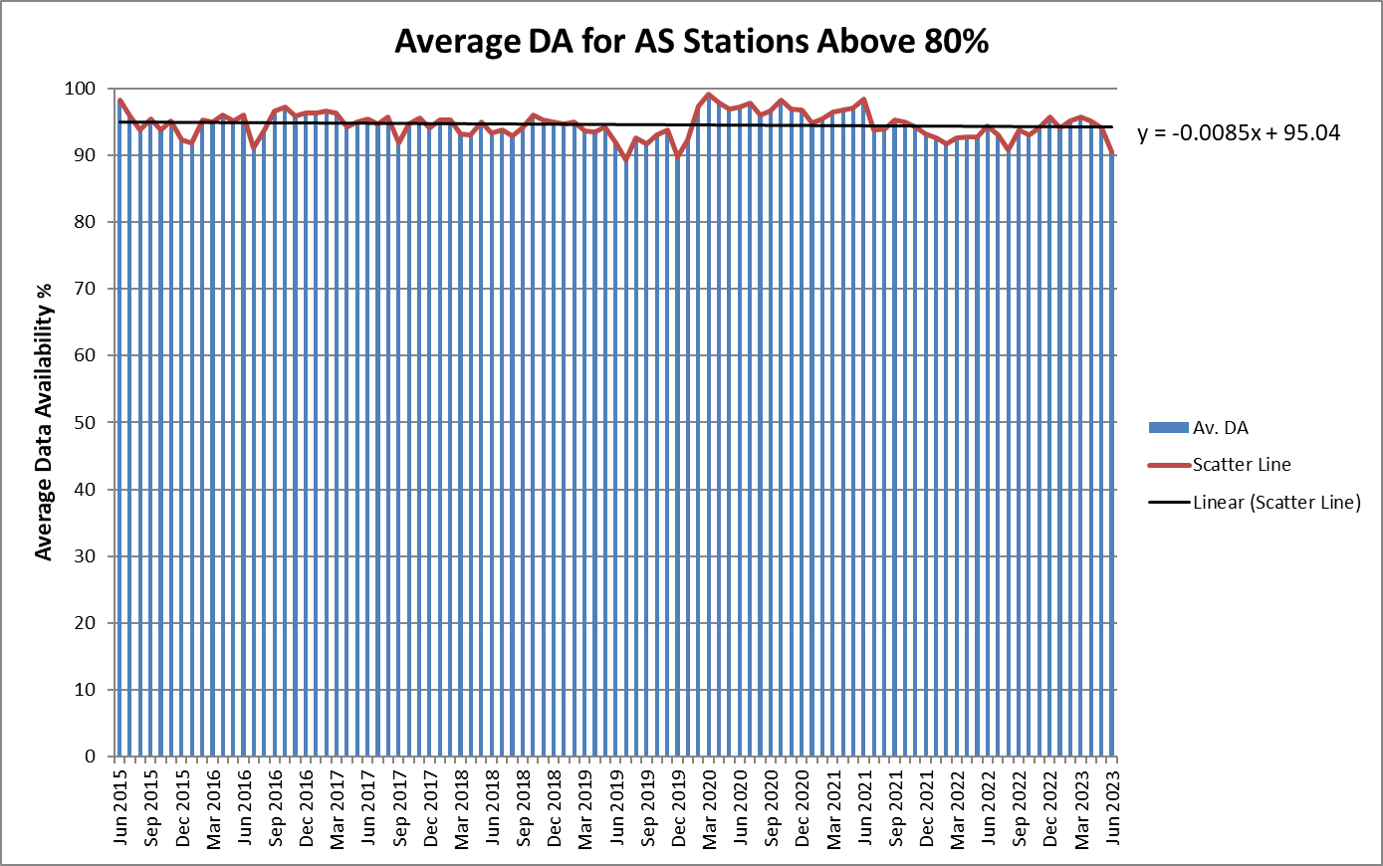
2. Experiment
O4.4-747
Average Data Availability for AS Stations Above 80% DA (85/109 stations, 78%)

Slide 10
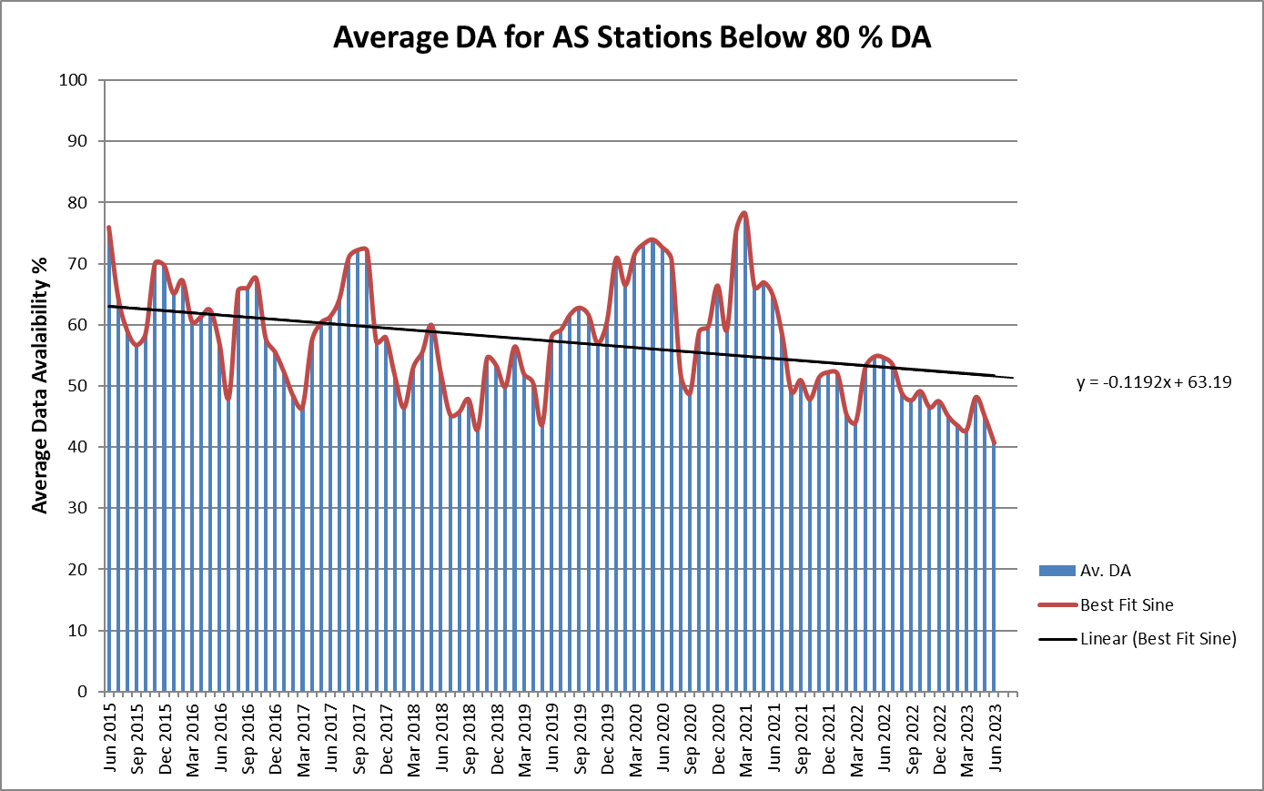
2. Experiment
O4.4-747
Average Data Availability for AS Stations Below 80% DA (24/109, 22%)

Slide 11
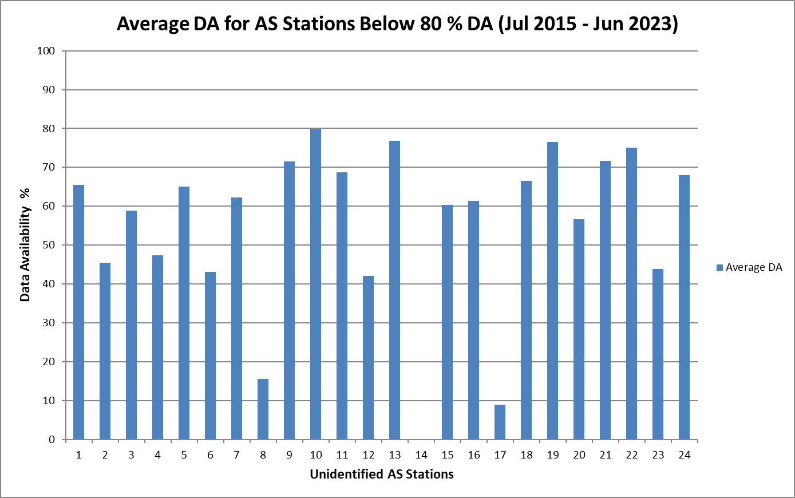
2. Experiment
O4.4-747
Average Data Availability for AS Stations Below 80% UDA
(Jul 2015 – Jun 2023)

Slide 12
3. Analysis of Results
O4.4-747
Result 1:
Average Data Availability for the AS sub-network is consistently below the other technologies and shows a moderate downtrend.
Result 2:
A subset of 85 Auxiliary Seismic stations, or 78% of the AS group, have consistently shown more than 80 % average Data Availability and 60 % of AS stations have a DA above 90 % over the last 9 years producing a stable performance.
Result 3:
A subset of 24 Auxiliary Seismic stations or 22 % of the AS group have consistently shown less than 80 % average Data Availability over the last 9 years. (Problem)

Slide 13
4. Hypothesis
O4.4-747
So, why is this happening?
H1. After certification, AS stations are maintained by the host country and do not benefit from continued financial support from the PTS.
Isolated financial support is limited to data authentication and data transport. This limitation may result in decreased maintenance levels and a slower response.
H2. Increasing age and number of stations leads to a heavier workload. This may result in a slower response.

Slide 14
5. Verification of Hypothesis: H1 – Limited Support
O4.4-747
AS Stations targeted for support under Voluntary Contribution scheme:
13 stations received financial and technical support from the European Union between 2018 and 2023
Stations are located in countries facing financial difficulties to support their stations.
12 PTS or Contractor technical visits took place
4 more stations are scheduled to receive financial support until end of 2023 under EU, Italy and Germany voluntary contributions.

Slide 15
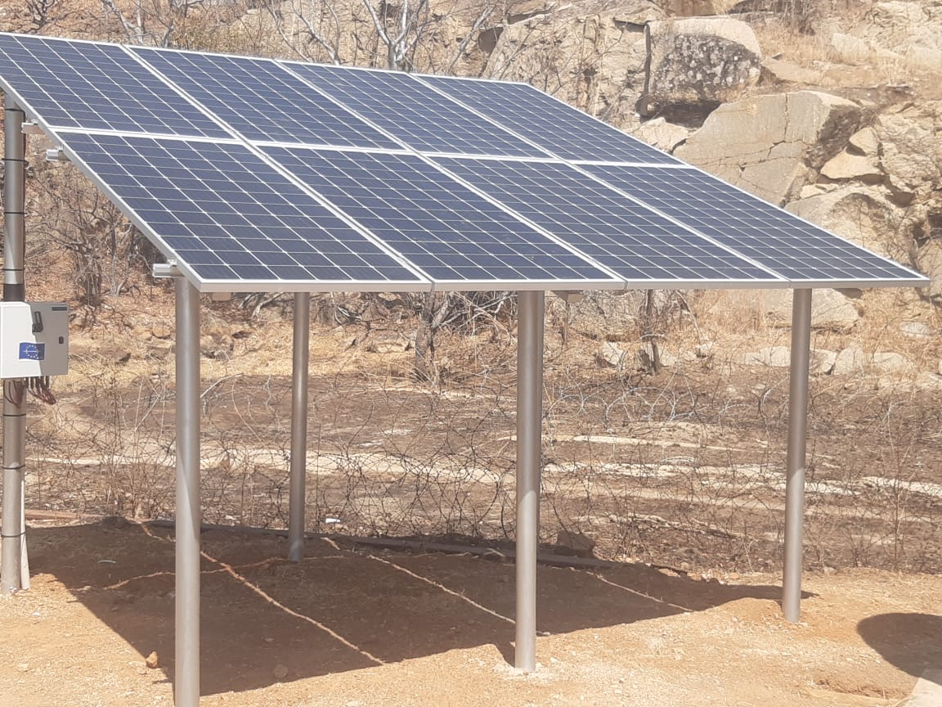
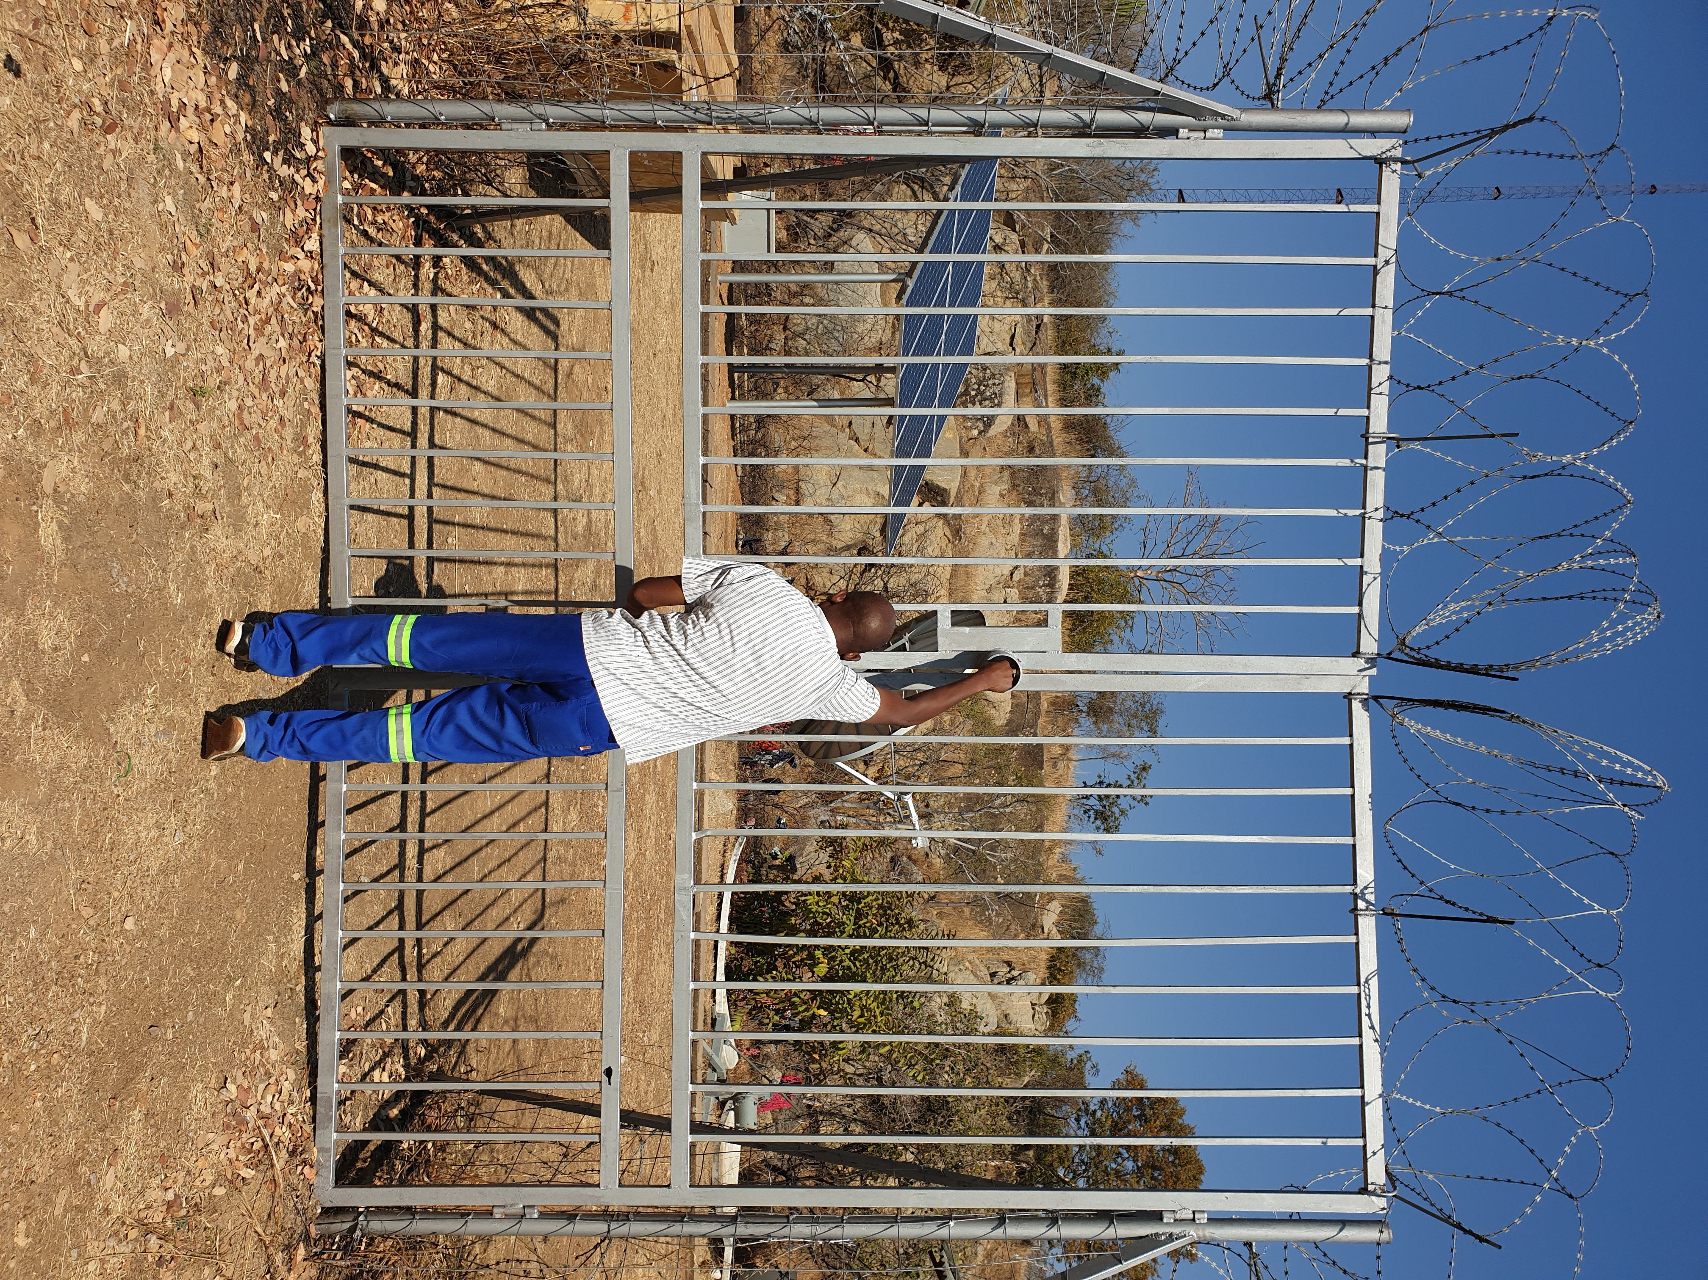
5. Verification of Hypothesis: H1 – Limited Support
O4.4-747
AS 119, Zambia
Establishment of a new hybrid power system and security

Slide 16
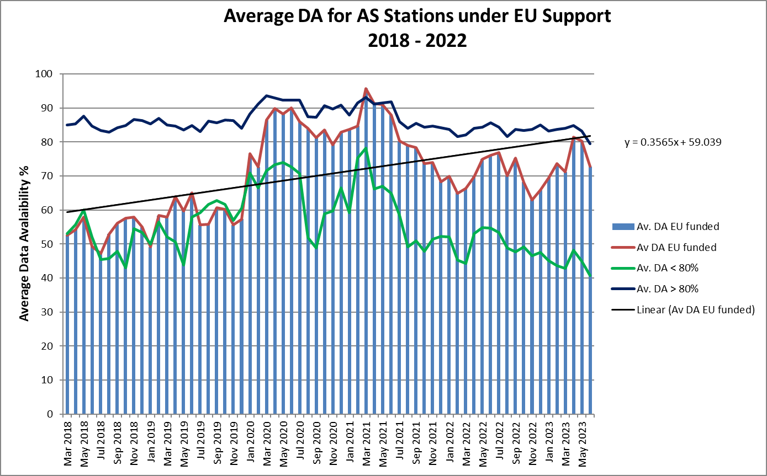
5. Verification of Hypothesis: H1 – Limited Support
O4.4-747
Average DA for AS Stations targeted for EU support

Slide 17
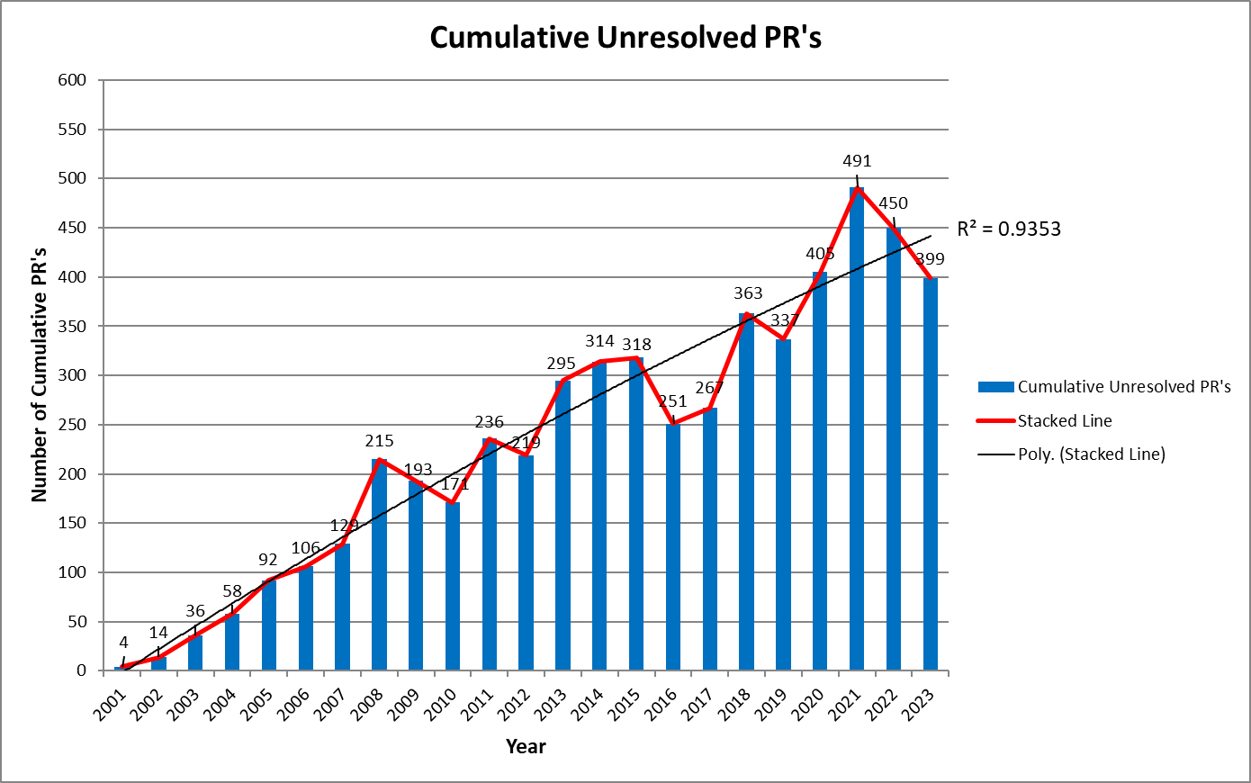
5. Verification of Hypothesis: H2 –Workload
O4.4-747
Problem Reports created for AS Stations

Slide 18
6. Conclusions and Recommendations
O4.4-747
C1. Limited financial support in AS stations is impacting performance in a sizeable subset of stations.
R1a. Continuation and possible increase in volume of VC support is recommended (this is the case for the next cycle of the EU VC).
R1b. Sustained support on selected stations may lead to performance improvements.

Slide 19
6. Conclusions and Recommendations
O4.4-747
C2. Increased workload may have an impact on speed of response leading to possible station performance degradation.
R2a. Stabilization of performance through R1a and R1b may lead to better supportability by reduction of workload.
R2b. Improved efficiency of operation and maintenance through training and support of station operators.

Slide 20
Thank you
O4.4-747

