Slide 1
Modernization and Sustainment
Jon Magnus Christensen
Head of Department National Data Centre
NORSAR
O4.4-742
20 Jun 2023

Slide 2
Agenda
O4.4-742
Modernizing: Saved expenditure + increased uptime and quality
Capitalizing: Establishment, Sustainment, Operation, Re-establishment

Slide 3
Modernization through new work processes
O4.4-742
Generational shift at NORSAR facilitated a modernization of the operational department through establishment of new work processes and use of new support technology
New support technology enabled increased State-of-Health monitoring and remote control of infrastructure.
Renewed co-operation agreements with local caretakers meant a smaller and more agile combined team
Able to increase data availability, mission capability and data quality
Documentation, planning, risk mitigation and HSE-focus results in better uptime and less quality issues overall

Slide 4
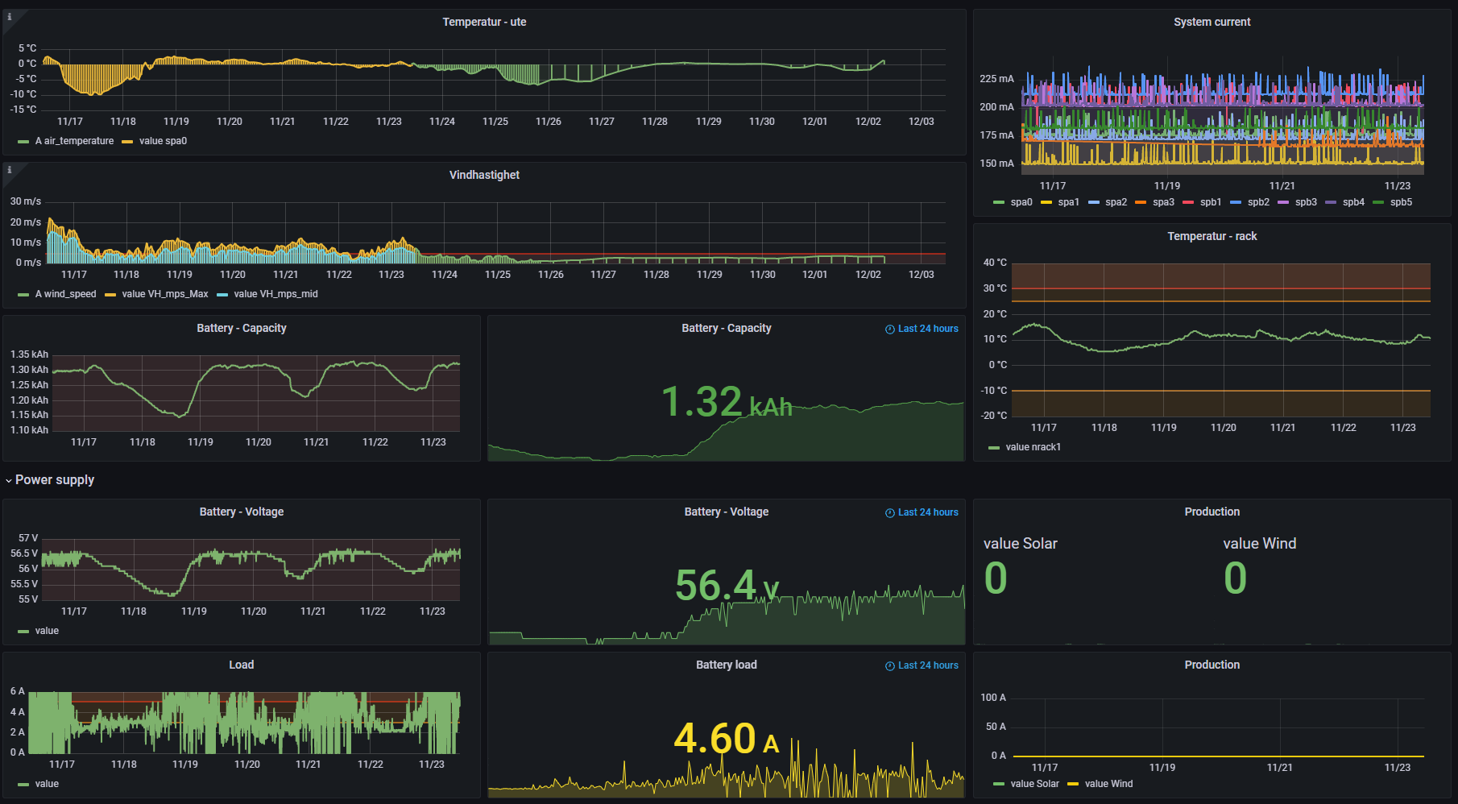
Modernization through State-of-Health monitoring
O4.4-742
Legacy system only showed half the picture – snapshots of status
All State-of-Health data now stored in a time series data base
Alarm thresholds tuned for individual parameters
Visualization through Grafana

Slide 5
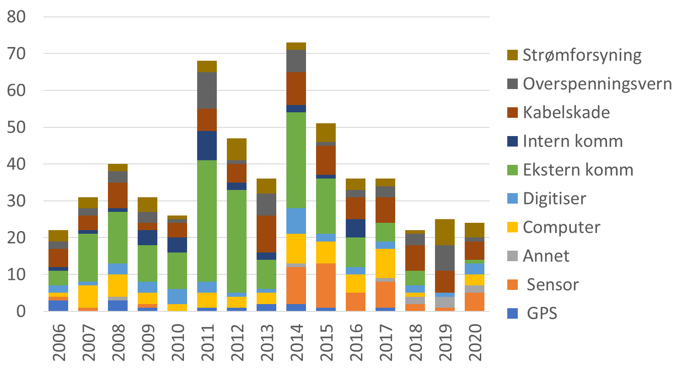
Modernization through root cause analysis
O4.4-742
Power supply
Power protection
Cable damage
Internal comm.
External comm.
Digitizer
Computer
Other
Sensor
GPS

Slide 6
Modernization through risk management
O4.4-742
What can go wrong?
What is the probability?
What are the consequences?
Is this risk acceptable?
How to mitigate?
Is the mitigated risk acceptable?

Slide 7
Establishment – NORSAR PS27
O4.4-742
NORSAR PS27 established in 1968
Inflation adjusted numbers show an investment equivalent of 70 million USD in 2022 – contributed in kind
7 out 22 subarrays of initial deployment still in operation and today known as PS27
Capitalization costs not reflected in CTBTO books
Certification costs minimal (106 kUSD)
Sustainment costs for instrument replacement 2011 included (~1.2 MUSD)
Underground cabling design life extended through verification by third-party as an alternative to replacement (estimated costs exceeding ~5 MUSD)
Re-establishment of station represent a substantial investment
Not reflected in any plans or books

Slide 8
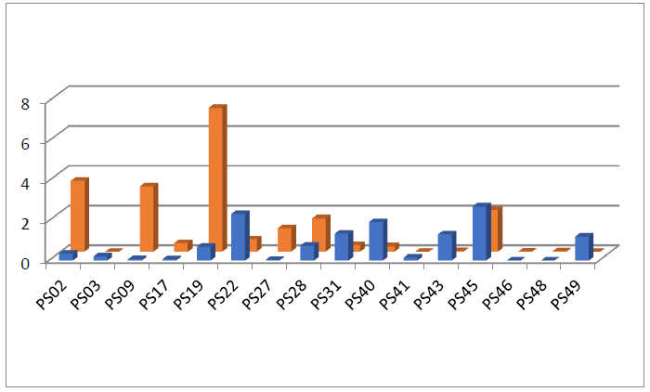
Booked installation and sustainment costs
O4.4-742
Installation costs not reflected in the books + several stations not reflected at all
Infrastructure costs can exceed instrumentation costs by a lot
Real costs need to be accounted for in a long-term sustainment plan
Lessons learned
Detailed overview of design lifetime of per equipment group
Alternative strategies per group in order to not replace usable equipment
Installation costs (blue) Sustainment costs (orange)
From: Programme and Budget Performance Reports (CTBT-PTS-INF.1619-VOLUME-2)

Slide 9
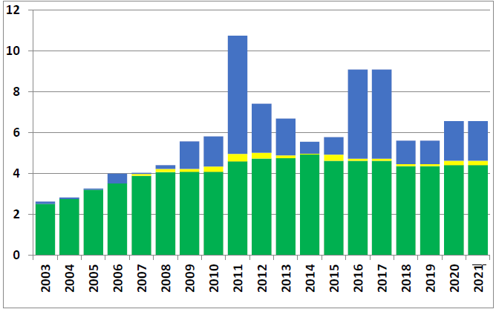
Running costs primary seismic network
O4.4-742
Challenge
Erratic sustainment costs
Overall PCA costs stable
Who should own the currency exposure?
Big variations in sustainment costs – (size, geography, etc.)
Hard to define and establish best practice
Contributions in kind – not mapped
PCA (green), maintenance (yellow) and sustainment costs (blue) for the entire primary seismic network, on an annual basis.
From: Programme and Budget Performance Reports

Slide 10
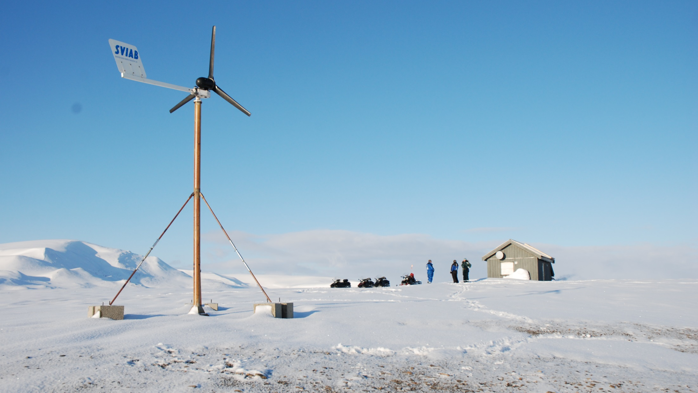
Protect the investment
O4.4-742
Methods to asses infrastructure value, state of health and replacement/refurbishment costs
Methods for prioritization
Cost effectiveness (CapEx vs. OpEx, life cycle management)
Detection capability of the IMS
Broad process with involvement from PTS, State Signatories and Station Operators needed in order to create sound technical decision basis

Slide 11
O4.4-742
Thank you!

