Slide 1
Performance Evaluations of Radioxenon Isotopic Ratio Flags and Possible Optimizations
Emily Gordon¹, Abdelhakim Gheddou², Jolanta Kusmierczyk-Michulec², Boxue Liu², Michael Schoeppner³, Martin Kalinowski²
¹The University of Texas at Austin ²CTBTO Preparatory Commission
³Work performed while at CTBTO
O3.6-769
Presentation Date: 20 June 2023

Slide 2
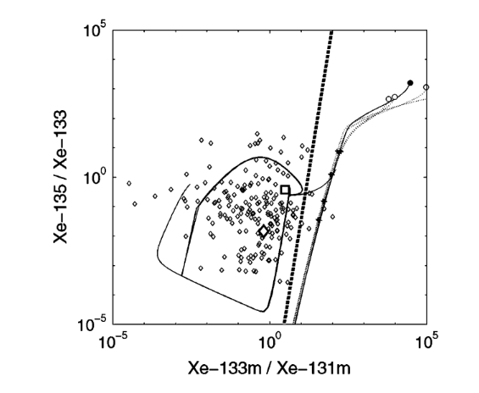
Introduction – Radioxenon Ratios
O3.6-769
In a 4-isotope plot, ratios of xenon radioisotopes can be separated into “reactor domain” and “test domain”
The threshold to separate the domains is the red screening line
Problem: Four isotopes need to be quantified to apply screening line but often only two are detected.
Simplified approach applicable for only two isotopes: threshold for isotopic ratios implemented for event screening flags using the green threshold lines.
Limitation: Only prompt and early releases yield a ratio that is distinct from signatures of civilian facilities.
Reactor domain
test domain
Kalinowski and Pistner (2006)

Slide 3
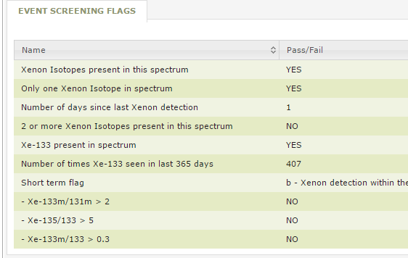
Introduction – Event Screening Flags
O3.6-769
The current implementation of the screening flags almost never shows “Yes”.
Goal: Enhancing the methodology
What ratio thresholds are more effective?
What is the best method for ratio calculations?
Could Xe-131m/Xe-133 be used in addition?
These event screening flags are implemented in the Radionuclide Report showing results of air samples every 12 or 24 hours

Slide 4
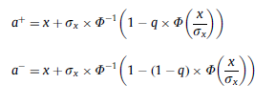
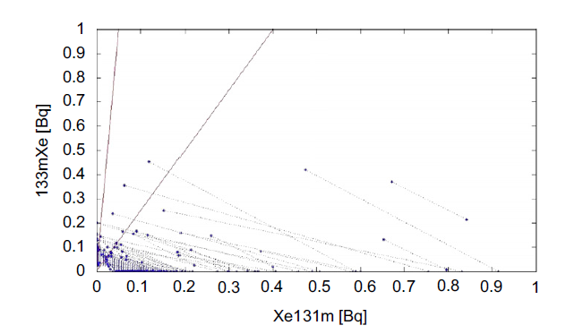
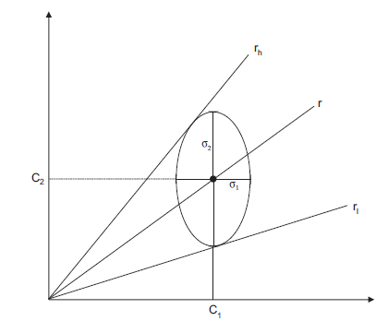
Methods – Combining Activity Uncertainties
O3.6-769
Uncertainties in radioxenon activity concentrations can be determined from counting conditions – what about uncertainty in activity ratios?
Current method: Bayesian analysis
Alternative method: Fieller’s Theorem
Uses a prior: nuclide activity cannot be < 0.
Produces a symmetrical confidence region
Interprets confidence region geometrically
Results in an asymmetrical confidence region
Zähringer and Kirchner (2008)
Ringbom and Axelsson (2014)

Slide 5
Methods – Setting Ratio Thresholds
O3.6-769
Dataset
Ratio and Screening Flag Calculation Methods
Stations |  | Dates
AUX04 AUX09 BRX11 CLX19 GBX66 GB68 JPX38 MXX44 | NOX49 NZX46 SEX63 USX74USX75 USX77 USX79 | August 2012 – October 2016
Parameter | Values
Activity Concentration Ratio | Xe-135/Xe-133 |  |  | Xe-133m/Xe-133
 | Xe-133m/Xe-131m |  |  | Xe-131m/Xe-133
Calculation Method | Bayesian Method |  | Fieller’s Theorem
Confidence Interval | 0 | 1$σ$ |  |  | 2$σ$
False Positive Rate | 1% | 5% |  |  | 10%
Total Samples: 35,794
Fifteen screening flag thresholds were produced for each radioxenon ratio by combining calculation parameters.

Slide 6
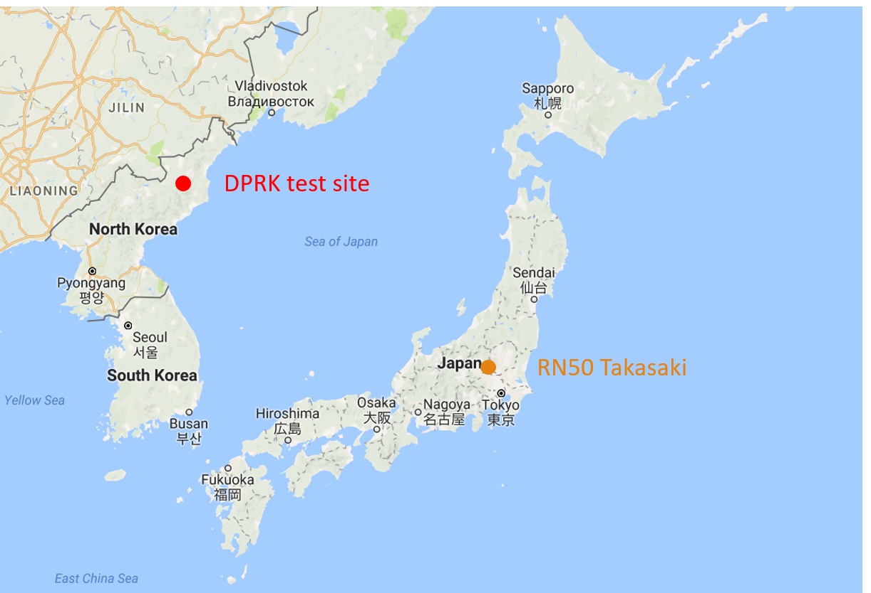
Methods – Scoring threshold values with hypothetical signatures
O3.6-769
Choosing sample dates from RN38 representing all seasons and with both isotopes present above MDC:
Simulation Dates
Xe-135/Xe-133 | Xe-133m/Xe-133 | Xe-133m/Xe-131m | Xe-131m/Xe-133
26 Jan 15 | 25 Jan 15 | 12 Jan 15 | 10 Jul 15
6 Mar 15 | 12 Mar 15 | 5 Apr 15 | 29 Dec 15
10 May 15 | 4 May 15 | 6 May 15 | 1 Feb 16
21 Jun 15 | 29 Aug 15 | 12 Jun 15 | 6 May 16
31 Aug 15 | 18 Sep 15 | 9 Sep 15 | 14 Aug 16
16 Nov 15 | 2 Nov 15 | 12 Nov 15 | 25 Oct 16
RN38 Takasaki
Simulation output: transport time T (h) and dilution factor D (m⁻³)
Combing original Xe activity concentration $C_{Xe}$ with hypothetical nuclear explosion signature $A_{hyp}$ released from the DPRK test site:
$$C=C_{Xe}+A_{hyp}∙D∙e^{−λ_{Xe}T}$$
Xe-135/Xe-133
Xe-135 Activity | 10¹²-10¹⁷ Bq
Xe-133 Multiplier | 10⁻⁵-10⁻²
Xe-133m/Xe-133
Xe-133m Activity | 10⁹-10¹⁴ Bq
Xe-133 Multiplier | 10⁻²-10¹
Xe-133m/Xe-131m
Xe-133m Activity | 10⁹-10¹⁴ Bq
Xe-131m Multiplier | 10⁻⁶-10⁻³
Xe-131m/Xe-133
Xe-131m Activity | 10¹⁰-10¹⁵ Bq
Xe-133 Multiplier | 10⁻³-10⁰
Notes:
6 samples from RN38 are selected representing all seasons and with both isotopes present above MDC.
ATM data from corresponding dates are used to find transport time from test site to RN38 in Takasaki.
Values for nuclear test releases are decay corrected for transport time, reduced according to dilution factor and added to those of the samples.
Resulting ratios compared to each screening line.

Slide 7
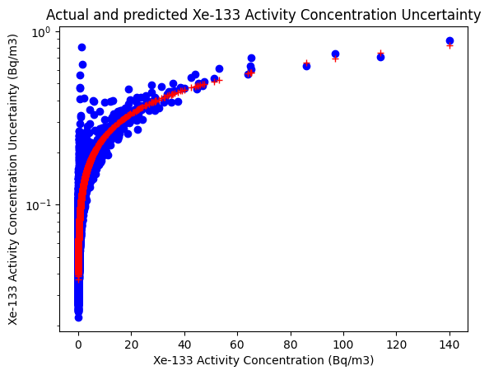
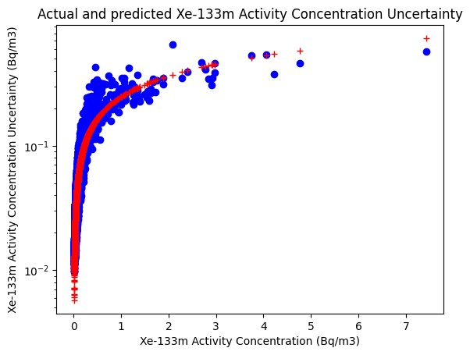
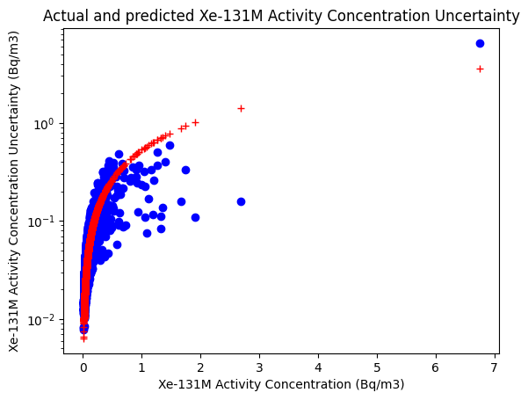
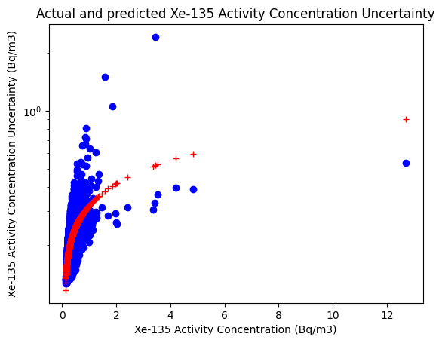
Methods – Predicting activity concentration uncertainty
O3.6-769
Assume uncertainty in activity concentration ($σ_{C}$) is a function of concentration C and fixed parameters:
$$σ_{C}=a∙\sqrt{b∙C+d}+f$$
Fitted Parameters
Parameter | Xe-131m | Xe-133 | Xe-133m | Xe-135
a | 68.71 | 0.04427 | 0.1793 | 0.1510
b | 0.8607 | 2.278 | 2.442 | 2.162
d | 3129 | -0.06150 | 0.02489 | -0.2787
f | 3844 | 0.03686 | -0.0344 | 0.1153

Slide 8
Results – Calculated screening flag thresholds
O3.6-769
Xe-135/Xe-133
Xe-133m/Xe-133
False Positive Rate | Threshold Calculation Method
 | Bayesian 1$σ$ | Bayesian 2$σ$ (5) | Geometric 1$σ$ | Geometric 2$σ$ | Ratio
1% | 2.91 | 1.09 | 29.12 | 21.81 | 7.33
5% | 2.16 | 0.68 | 6.83 | 5.26 | 5.49
10% | 1.81 | 0.51 | 2.34 | 2.00 | 4.76
False Positive Rate | Threshold Calculation Method
 | Bayesian 1$σ$ | Bayesian 2$σ$ (0.3) | Geometric 1$σ$ | Geometric 2$σ$ | Ratio
1% | 0.39 | 0.17 | 25.34 | 22.03 | 0.91
5% | 0.27 | 0.08 | 17.84 | 14.93 | 0.71
10% | 0.22 | 0.06 | 13.12 | 11.15 | 0.60
Xe-133m/Xe-131m
Xe-131m/Xe-133
False Positive Rate | Threshold Calculation Method
 | Bayesian 1$σ$ | Bayesian 2$σ$ (2) | Geometric 1$σ$ | Geometric 2$σ$ | Ratio
1% | 0.95 | 0.40 | 3.03 | 9.77 | 2.31
5% | 0.67 | 0.23 | 1.99 | 2.71 | 1.75
10% | 0.56 | 0.16 | 1.72 | 1.95 | 1.52
False Positive Rate | Threshold Calculation Method
 | Bayesian 1$σ$ | Bayesian 2$σ$ | Geometric 1$σ$ | Geometric 2$σ$ | Ratio
1% | 0.05 | 0.06 | 0.83 | 0.07 | 0.03
5% | 0.11 | 0.16 | 1.35 | 0.23 | 0.07
10% | 0.20 | 0.30 | 1.62 | 0.41 | 0.12
Only samples where both isotopes were present above the MDC were considered.
1300-1700 samples were applicable depending on the ratio.
(numbers) indicate thresholds from current IDC operations.
Notes:
6 samples from RN38 are selected representing all seasons and with both isotopes present above MDC.
ATM data from corresponding dates are used to find transport time from test site to RN38 in Takasaki.
Values for nuclear test releases are decay corrected for transport time, reduced according to dilution factor and added to those of the samples.
Resulting ratios compared to each screening line.

Slide 9
Results – Successful detections of hypothetical signatures
O3.6-769
Xe-135/Xe-133
Xe-133m/Xe-133
False Positive Rate | Threshold Calculation Method
 | Bayesian 1$σ$ | Bayesian 2$σ$ | Geometric 1$σ$ | Geometric 2$σ$ | Ratio
1% | 3 | 3 | 0 | 0 | 3
5% | 4 | 4 | 0 | 0 | 3
10% | 7 | 4 | 0 | 0 | 6
False Positive Rate | Threshold Calculation Method
 | Bayesian 1$σ$ | Bayesian 2$σ$ | Geometric 1$σ$ | Geometric 2$σ$ | Ratio
1% | 0 | 0 | 0 | 0 | 0
5% | 0 | 0 | 0 | 0 | 2
10% | 1 | 0 | 0 | 0 | 28
Xe-133m/Xe-131m
Xe-131m/Xe-133
False Positive Rate | Threshold Calculation Method
 | Bayesian 1$σ$ | Bayesian 2$σ$ | Geometric 1$σ$ | Geometric 2$σ$ | Ratio
1% | 4 | 4 | 0 | 0 | 4
5% | 4 | 4 | 24 | 0 | 4
10% | 4 | 4 | 24 | 24 | 4
False Positive Rate | Threshold Calculation Method
 | Bayesian 1$σ$ | Bayesian 2$σ$ | Geometric 1$σ$ | Geometric 2$σ$ | Ratio
1% | 0 | 0 | 0 | 72 | 0
5% | 24 | 24 | 24 | 72 | 24
10% | 49 | 50 | 24 | 72 | 49
Resulting ratios of combined real and hypothetical signatures were compared to calculated screening flag thresholds
Each calculation method was scored by tallying the number of “detections” – how often the screening flag is raised
Highest possible score is 144: 6 samples $×$ 24 release activity combinations
Notes:
6 samples from RN38 are selected representing all seasons and with both isotopes present above MDC.
ATM data from corresponding dates are used to find transport time from test site to RN38 in Takasaki.
Values for nuclear test releases are decay corrected for transport time, reduced according to dilution factor and added to those of the samples.
Resulting ratios compared to each screening line.

Slide 10
Conclusions and Future Work
O3.6-769
Conclusions
Future Work
New screening flag threshold values were determined for four radioxenon ratios, one more than in IDC operations.
Two methods for interpreting ratio confidence regions (Bayesian Method vs Geometric/Fieller’s Theorem) were compared over three uncertainty intervals (0-, 1-, 2-$σ$) and three false positive rates (1, 5, 10%).
No combination of calculation method and uncertainty interval was universally found to be superior. The optimal calculation method varied between radioxenon ratios and false positive rates.
Refine method for predicting activity concentration uncertainty.
Many test cases resulted in zero detections. Expand number of hypothetical signature test dates.
Notes:
6 samples from RN38 are selected representing all seasons and with both isotopes present above MDC.
ATM data from corresponding dates are used to find transport time from test site to RN38 in Takasaki.
Values for nuclear test releases are decay corrected for transport time, reduced according to dilution factor and added to those of the samples.
Resulting ratios compared to each screening line.

Slide 11
References
O3.6-769
Kalinowski, Martin B., and Christoph Pistner. "Isotopic signature of atmospheric xenon released from light water reactors." Journal of environmental radioactivity 88.3 (2006): 215-235.
Zähringer, Matthias, and Gerald Kirchner. "Nuclide ratios and source identification from high-resolution gamma-ray spectra with Bayesian decision methods." Nuclear Instruments and Methods in Physics Research Section A: Accelerators, Spectrometers, Detectors and Associated Equipment 594.3 (2008): 400-406.
Axelsson, A., and A. Ringbom. "On the calculation of activity concentrations and nuclide ratios from measurements of atmospheric radioactivity." Applied Radiation and Isotopes 92 (2014): 12-17.
Notes:
6 samples from RN38 are selected representing all seasons and with both isotopes present above MDC.
ATM data from corresponding dates are used to find transport time from test site to RN38 in Takasaki.
Values for nuclear test releases are decay corrected for transport time, reduced according to dilution factor and added to those of the samples.
Resulting ratios compared to each screening line.

