Slide 1
A Baseline for Source Reconstruction Using Forensic Radionuclide Event Analysis and Reconstruction
Pieter De Meutter^{1,2}, Andy Delcloo² and Ian Hoffman³
1: SCK CEN, 2: RMI, 3: Health Canada
O3.6-460
Presentation Date: 20 June 2023

Slide 2


Contents
O3.6-460
Introduction
Methods and data
Results
Conclusions

Slide 3
Introduction: context
O3.6-460
Inverse modelling allows a determination of the source parameters of a radioactive atmospheric release by combining atmospheric transport modelling and airborne radionuclide measurements in a statistically coherent manner:
y ≈ M x
A series of inverse modelling experiments was set up using ¹³³Xe observations associated with the former Medical Isotope Production Facility (MIPF) at Chalk River Laboratories (CRL)
Purpose: to establish a baseline for source reconstruction to test data, methods and settings
vector of radionuclide observations
source-receptor sensitivities as obtained by ATM
source parameters (release location, timing, amount, ...)
Inverse modelling enhances Treaty verification as a technique to link radionuclide detections to a potential source

Slide 4
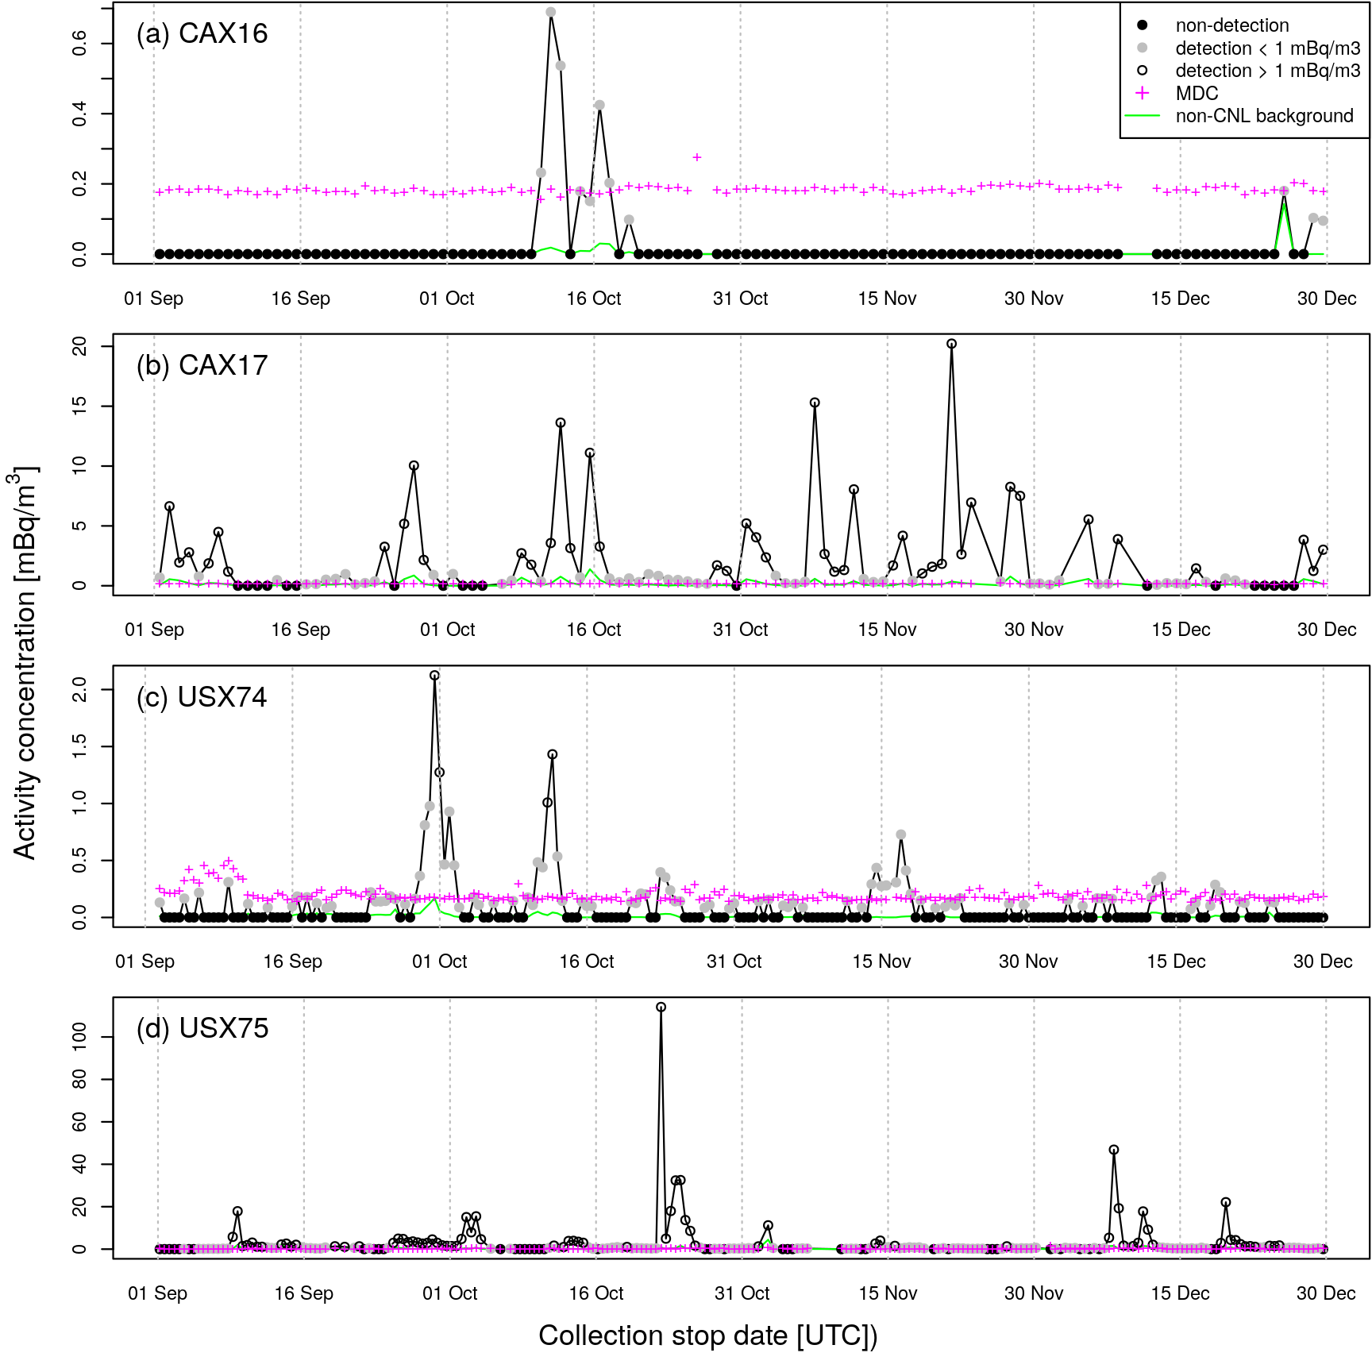
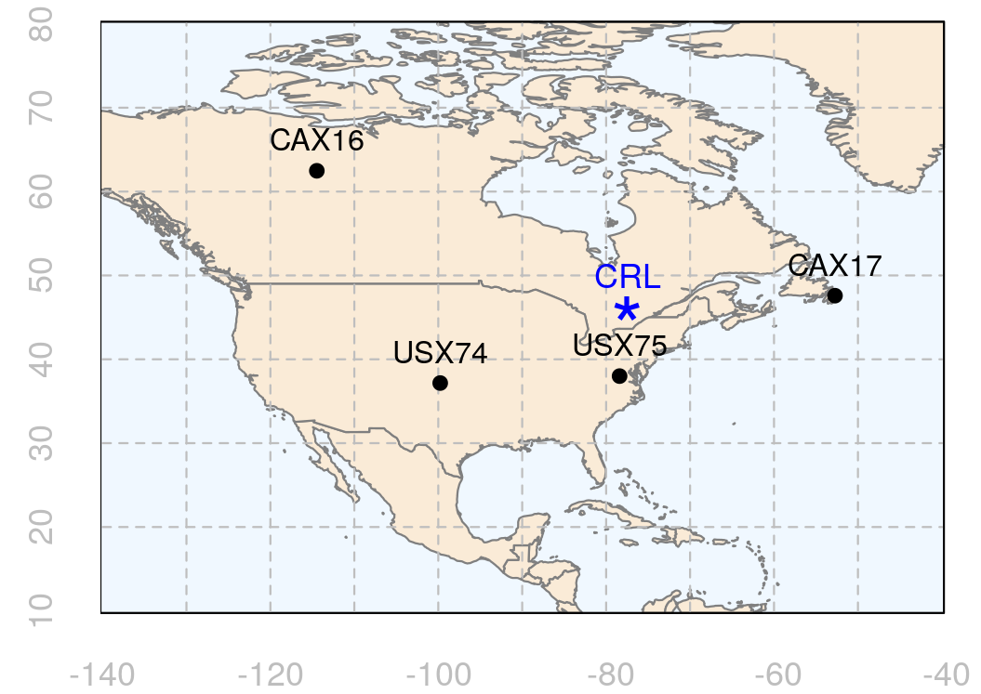
Introduction: description of case studies
O3.6-460
¹³³Xe observations at CAX16, CAX17, USX74 and USX75 for the period 1 September 2014 – 30 December 2014 (120 d)
Two sets of case studies:
  8 cases with 15 d of observations
  24 cases with 5 d of observations
Aim: Can we reconstruct the source location of CRL?
Figure right →
Xe-133 observations at four IMS stations + calculated Xe-133 background from non-CRL sources (Kalinowski 2023)
← Figure left map showing the location of CRL and IMS stations

Slide 5
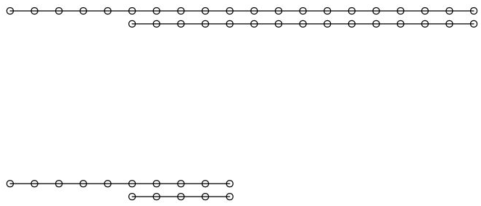
Methods and data: source localization
O3.6-460
FREAR
Bayesian inference
infer source term
infer source location
y = M x
Cost function
optimize source term
for each grid box
y = M x
maximum-in-time PSR using Pearson / Spearman correlation
for each grid box
correlation between y and M
Accumulated-in-time FOR
for each grid box
area where M[y>0] > 0 for any time
Flexpart + ECMWF
ECMWF input: 3-hourly at 0.5° x 0.5° for full NH
Flexpart output: daily at 0.5° x 0.5°, 0 – 100 m, full NH
source term: n release segments
5-day cases: 10 days of releases
15-day cases: 20 days of releases
x
10 days of releases
5 days of observations
20 days of releases
15 days of observations
CTBTO SRM (Flexpart + ECMWF)
3-hourly output at 1° x 1°, 0 – 500 m

Slide 6
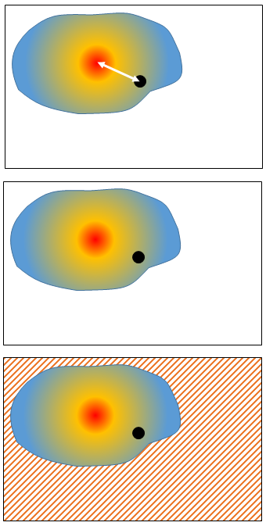
Methods and data: verification metrics
O3.6-460
Verification metrics for source location
Distance [0, ∞]
Quantile at true location [0, 1]
Fraction of domain excluded [0, 1]
The “fraction of domain excluded” is calculated using the following thresholds:
^{*: associated with detections}
Bayesian inference | source location probability = 0
Cost function optimisation | residual cost > 2
maximum-in-time PSR | maximum-in-time correlation < 0.1
accumulated-in-time FOR | < 50% of SRS* overlapping
source location probability,
(-1) * residual cost, ...
True source location
(1)
(2)
(3)

Slide 7
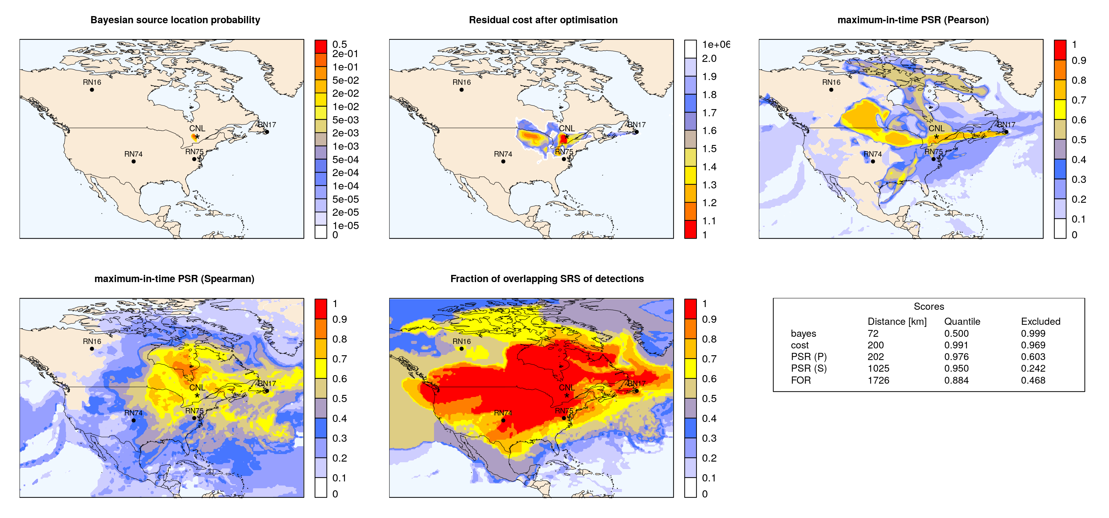
Results: example of different inverse modelling methods and verification metrics
O3.6-460

Slide 8
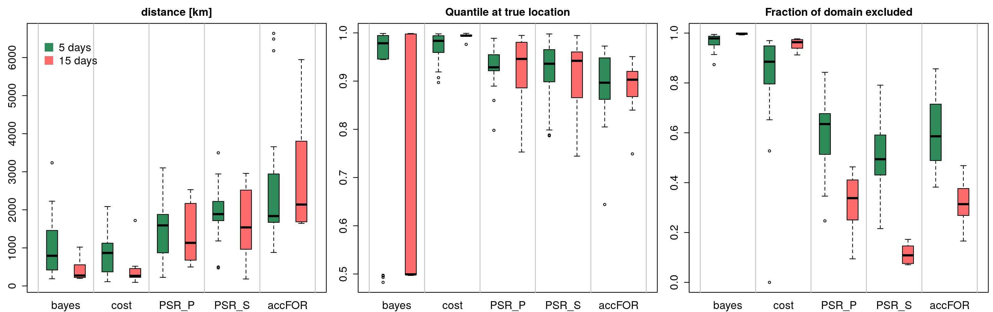
Results: comparing 5 days and 15 days of observations
O3.6-460
More observations (15 days vs 5 days) allows for improved source location:
significant decrease in distance (800 km to 270 km for Bayesian inference and cost function approach)
significant increase in fraction of domain excluded
For PSR, only a small reduction in distance score and deterioration in fraction of domain excluded

Slide 9
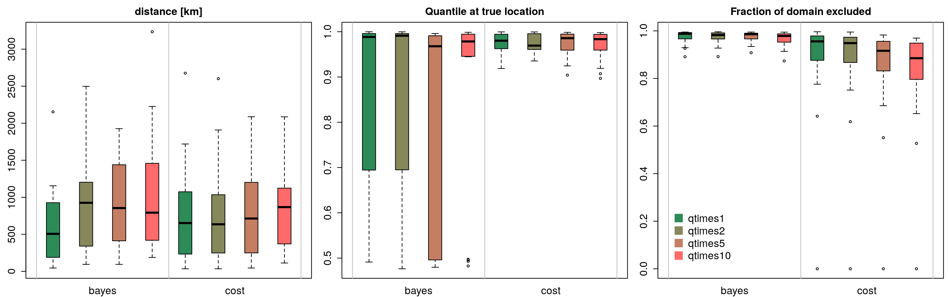
Results: effect source parameterization
O3.6-460
10 days of releases
5 days of observations
constant release
two 5-day release segments
five 2-day release segments
ten daily release segments
The source term parameterization can have an important impact on the source reconstruction
Adding extra degrees of freedom to the source term parameterization generally results in a better reconstruction of the true source but can result in an ill-conditioned problem

Slide 10
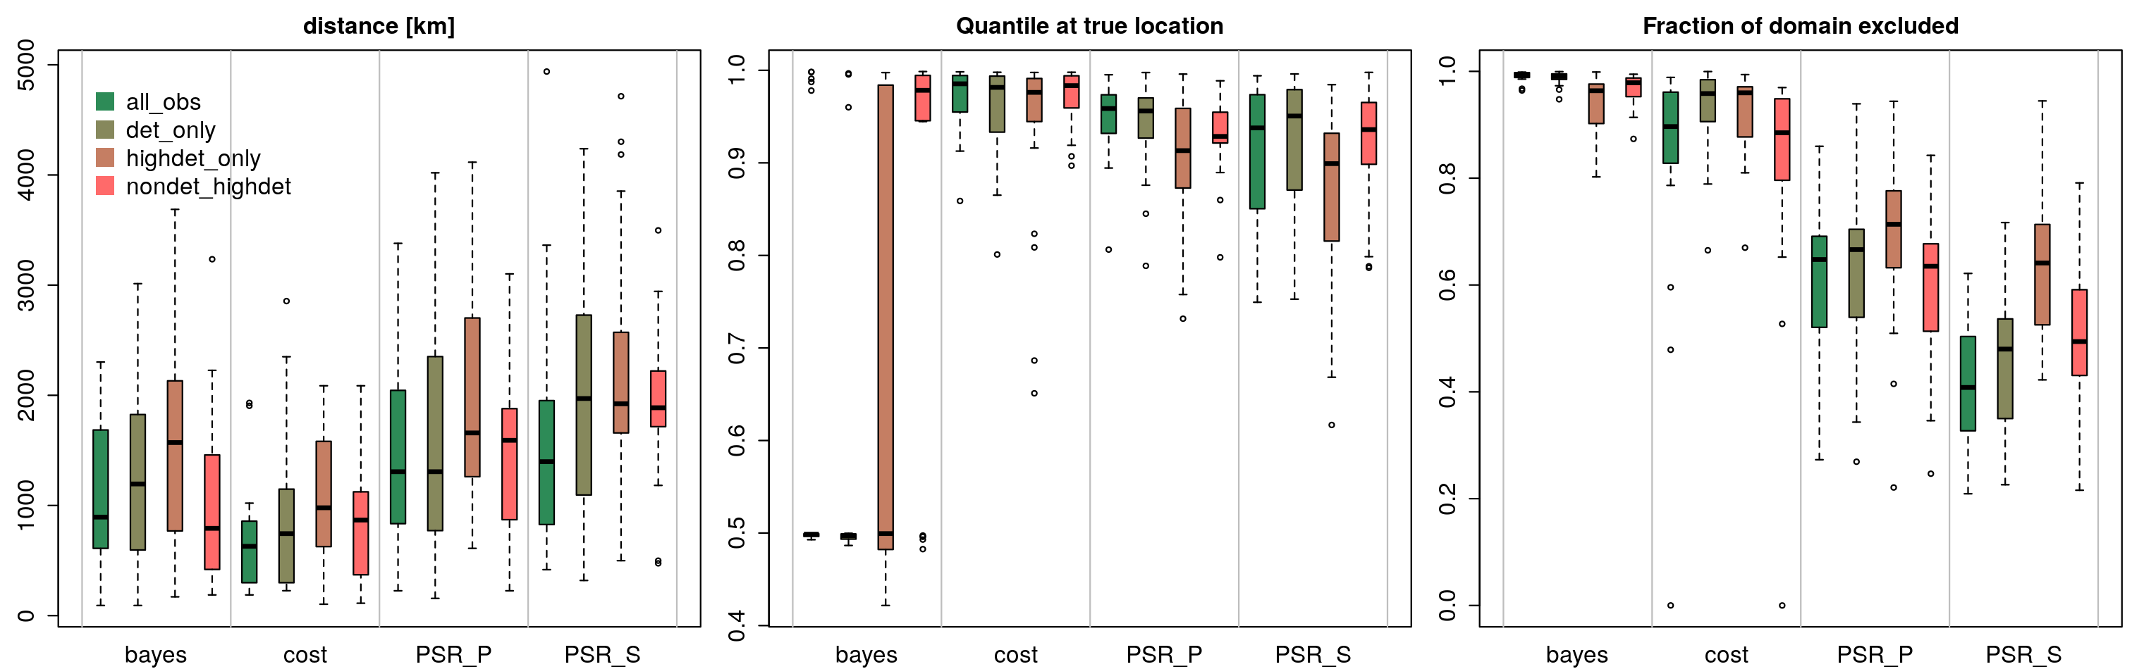
Results: selection of observations (1/2)
O3.6-460
all observations
detections only
“high” detections only (obs > 1 mBq/m³)
non-detections and “high” detections only
10 days of releases
5 days of observations
Including non-detections generally improve the source localization
For Bayesian inference, reconstruction using non-detections and “high” detections gives best results

Slide 11
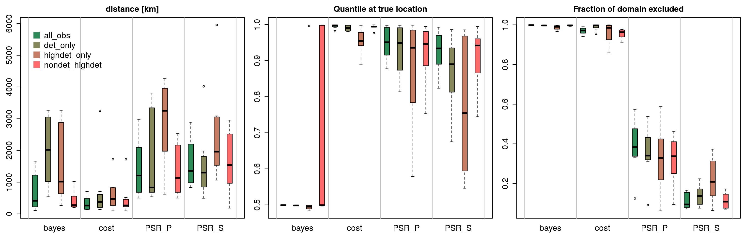
Results: selection of observations (2/2)
O3.6-460
all observations
detections only
“high” detections only (obs > 1 mBq/m³)
non-detections and “high” detections only
20 days of releases
15 days of observations
Bayesian inference and cost function performance significantly deteriorated when using detections only
Cost function method is less sensitive to non- and small detections (due to the cost function by design)

Slide 12
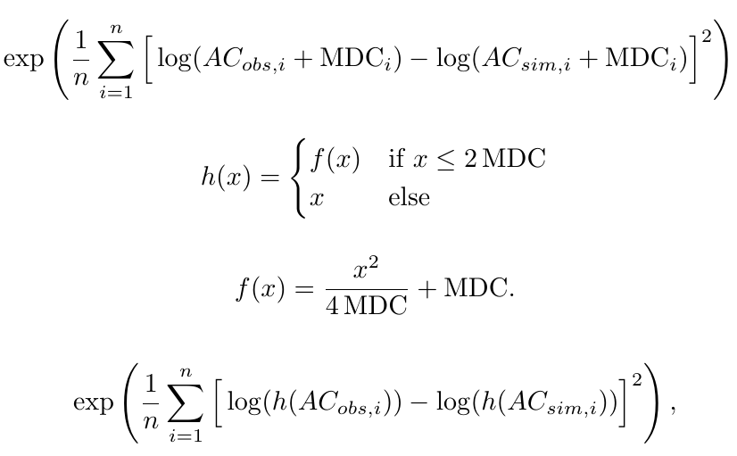
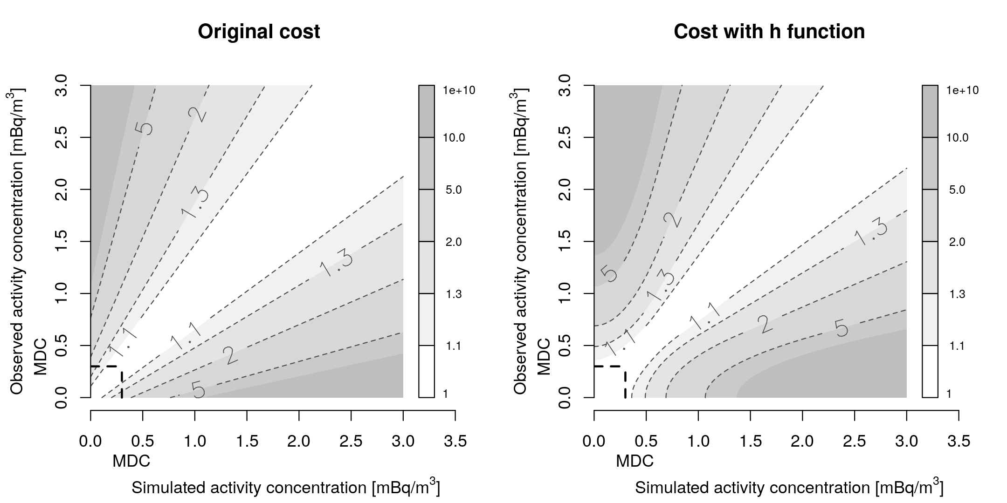
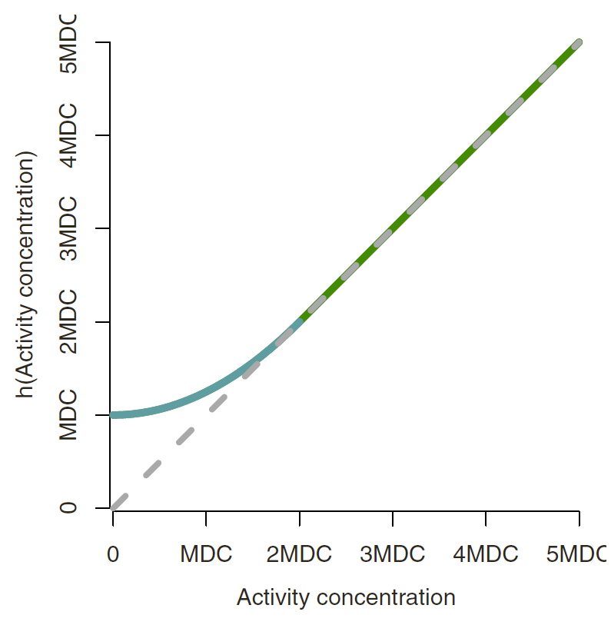
Results: Testing a new cost function (1/2)
O3.6-460

Slide 13
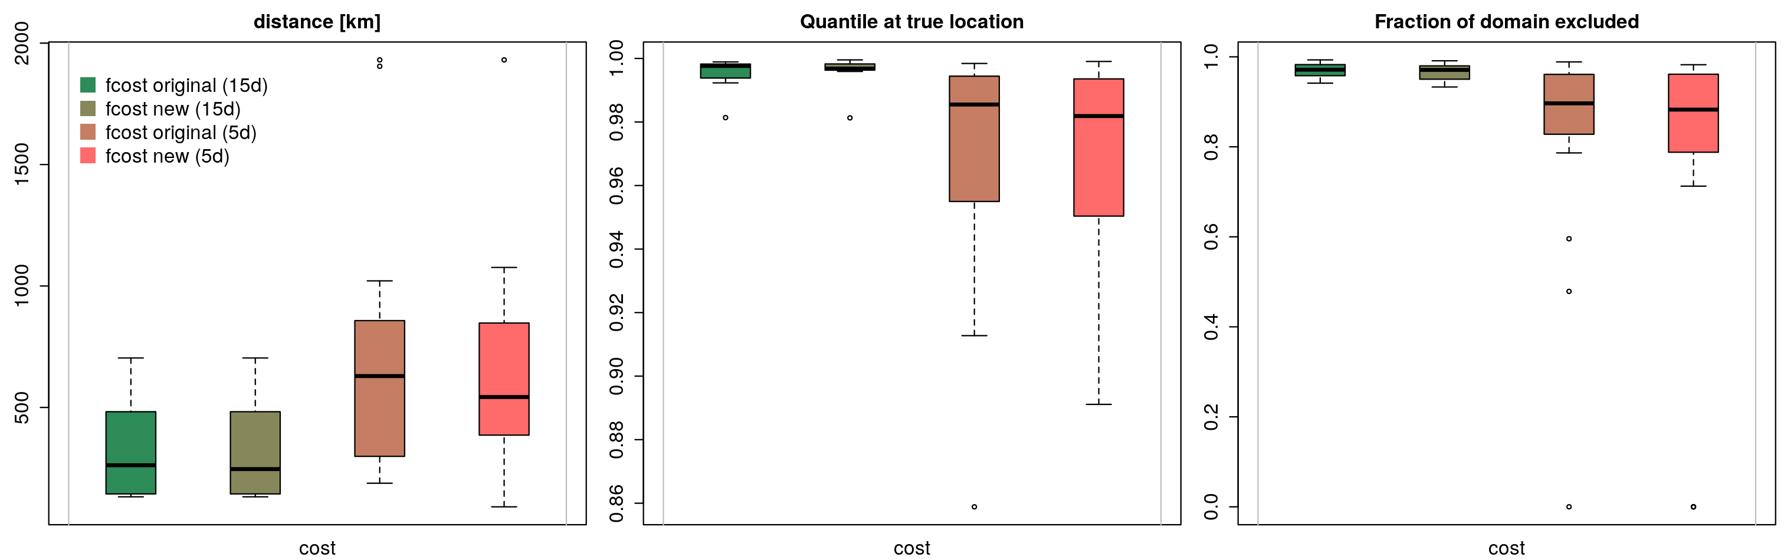
Results: Testing a new cost function (2/2)
O3.6-460
original cost function – 15 days
new cost function – 15 days
original cost function – 5 days
new cost function – 5 days
We expect this new cost function to be slightly more sound. How does it perform on our set of test cases?
Effect of new cost function on scores is neutral / small improvement

Slide 14
Conclusions
O3.6-460
Two sets of case studies have been defined for inverse modelling using real-world IMS ¹³³Xe observations:
  8 cases using 15 days of observations and 24 cases using 5 days of observations
These sets allow for a:
  comparison of data (observation selection, NWP input, ...), methods (inverse modelling methods, source parameterizations, ...), test new developments on inverse modelling
Bayesian inference and cost function optimization can localize the source within 800 km (5 d of observations) / 270 km (15 d of observations) [median value for these test cases]
Bayesian inference and cost function optimization are able to exclude a large fraction of the location search domain, contrary to PSR and FOR based methods
In case of Bayesian inference:
  The true source location sometimes falls outside the possible source region (note: other methods do not optimize for source location)
  Deterioration when using detections only

Slide 15
Thank you for your attention!
O3.6-460
Questions?

