Slide 1
The development of an association algorithm for radionuclide measurements
Paul Eslinger, Harry Miley, Brian Schrom
Pacific Northwest National Laboratory, USA
O3.6-364
Presentation Date: dd June 2023
This Low Yield Nuclear Monitoring (LYNM) research was funded by the National Nuclear Security Administration, Defense Nuclear Nonproliferation Research and Development (NNSA DNN R&D). The authors acknowledge important interdisciplinary collaboration with scientists and engineers from LANL, LLNL, NNSS, PNNL, and SNL.

Slide 2
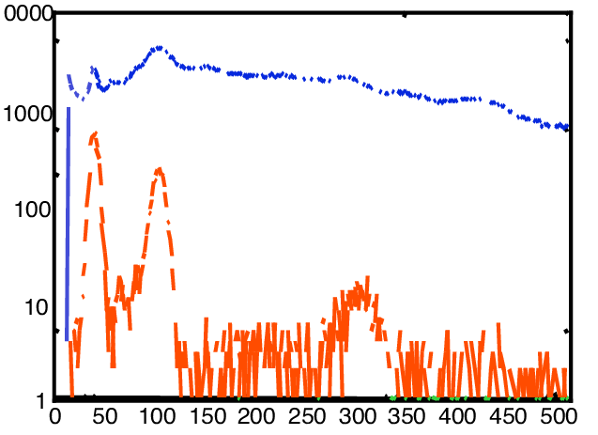
Goal: Implement a Radionuclide Data Pipeline that Focuses on Release Events rather than Samples using Data Fusion
O3.6-364
IMS System
Spectrum and Analysis
Sample Flagged as L5/LC
Sample Automated RN Report
Sample Reviewed RN Report
Sensitivity & Selectivity
IDC Algorithm and Lists
Transport Parameter Calculations
Analyst Review
Fused Event Bulletin
Waveform Fusion
Bayesian Analyses
Analyst Review
Detect Anomaly
Find Associated Samples
Estimate T₀, Release Strength, Location
EVENT Bulletin 1
EVENT Bulletin 2
Includes local BKG

Slide 3
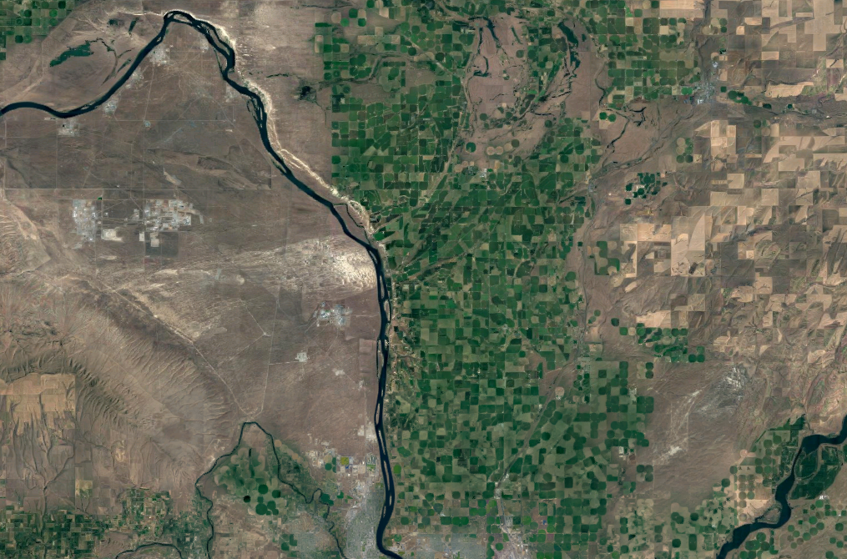
What is ‘Sample Association’?
O3.6-364
6
Selecting the measurements to use in forming a release event
Detect: 3 & 4
Locate: 2, 3, 4, & 5
Ignore: 1 & 6
Concept:
Use air measurements from inside and near the plume to define the event
Exclude measurements a long distance from the plume
5
3
2
1
4
7
Source of RN
Detectable Plume
RN Sample

Slide 4
Summary and Status
O3.6-364
A first-generation automated association approach has been constructed
Objectively selects neighbor samples in time and space
Returns results quite similar to what an expert analyst would pick
This tool uses transport calculations averaged in some way…
Full year of past air transport
Current season for several years (e.g. Spring ‘20, Spring ’21, Spring ‘22)
Custom period, such as last two weeks
The atmospheric transport model computations can be accumulated over time

Slide 5
Computational Approach
O3.6-364
Approach
Conduct a large set of atmospheric transport runs for RN sampling locations
79 stations for one year (2014 meteorological data)
Examine predicted detections at each station for a large number of possible release events spread across the globe
Synthetic releases every 3 h for a year at 100,000 locations
Build a huge matrix of “detect/not detect” status on all release events for every RN station
Define an “affinity” for plumes that pass over more than one station
Given that station “A” has detected some subset of the releases, what fraction of those same releases are detected at station “B”?
Can precompute and store “affinities” for each sampling location

Slide 6
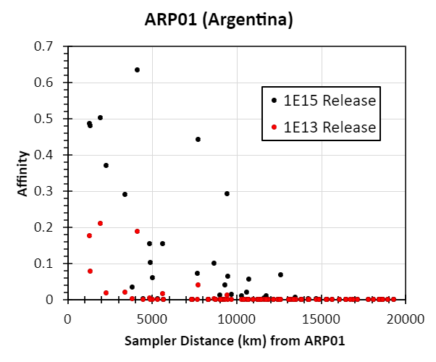
Example Affinity Results for ARP01
O3.6-364
For large releases, stations that most often have detections from the same plume can be a long distance apart.
Example calculations:
Releases of ¹³³Xe and current sampler detection limits
The affinity value depends on the release magnitude
Smaller releases have lower, more limited affinity
79 Station network

Slide 7
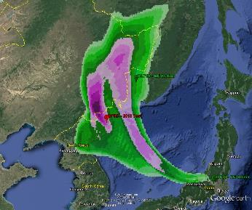
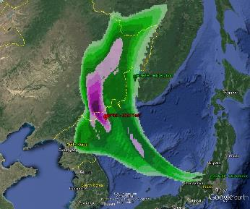
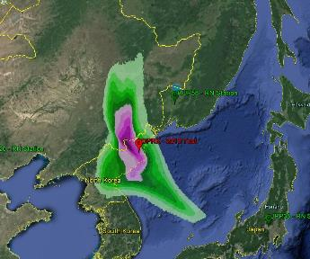
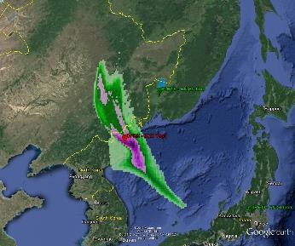
Affinity Matches Expectations from Past Event Analysis
O3.6-364
Example Affinity to JPX38 (Takasaki) for a 10¹³ Bq ¹³³Xe Release Event
A. One detect
B. One detect, one non detect
Station Dis (km) Affinity (Name)
RUP58 1058 0.2463 Ussuriysk
JPP37 1518 0.2126 Okinawa
RUP60 2412 0.0931 Petropavlovsk
CNP20 2019 0.0454 Beijing
PHP52 2988 0.0439 Tenay
USP78 4157 0.0417 Midway
MNP45 2964 0.0391 Ulan Bataar
USP71 4950 0.0237 Sand Pt AK
RUP56 3210 0.0167 Peleduy
CNP22 2877 0.0166 Guangzhou
USP77 3284 0.0148 Wake Island
THP65 4603 0.0117 Bangkok
USP80 2595 0.0105 Guam
DPRK 2013
C. Two detects
D. Three detects, two non detects

Slide 8
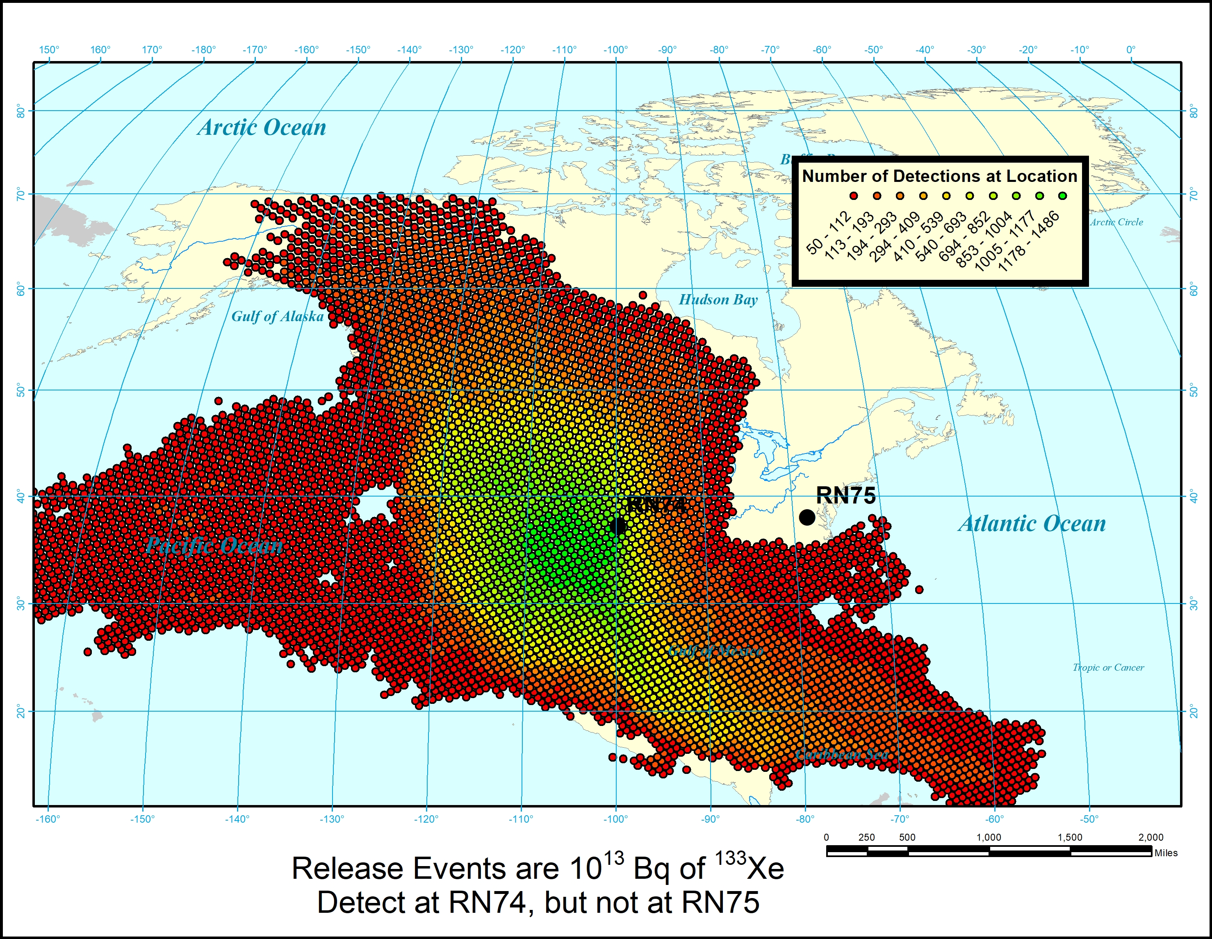
Other Uses of the Affinity Data
O3.6-364
Approach
Use the matrix of “detect/not detect” status on all releases for every sampler
Compare common detections at pairs or groups of samplers
Build a map of detections that matches your detection rules
Example: Detect release at RN74 but not at RN75
How many of the 100,000 releases have consistent detections?

Slide 9
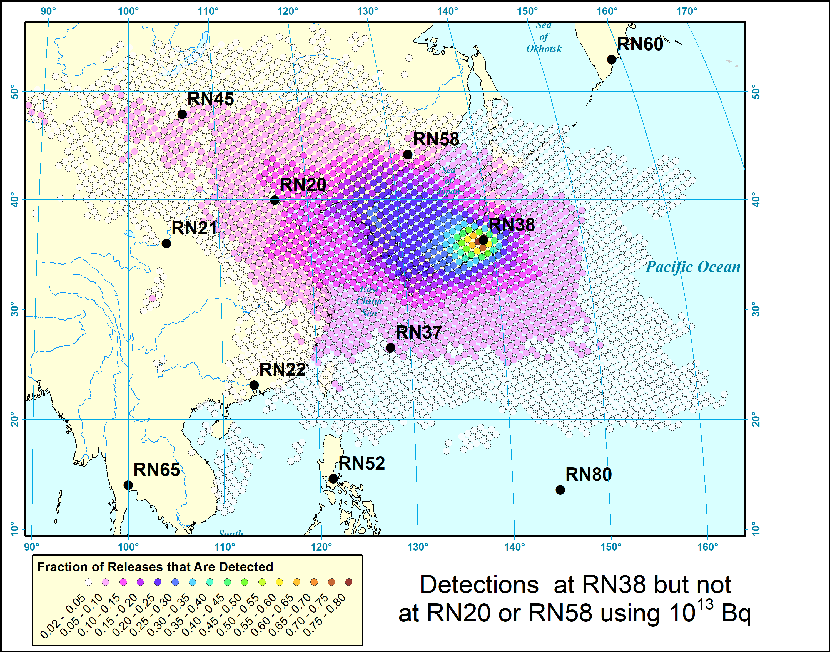
A More Complex Joint-Association Example
Using Historical Meteorological Data
O3.6-364
Data Set
Use the matrix of “detect/not detect” status on all releases for every sampler
Build a map of detections that matches your detection rules
Releases every 3 h of 10¹³ Bq of ¹³³Xe at 100,000 locations
Noble gas detectors at RN20, RN38, and RN58
How many releases are consistent with detections at RN38 but not RN20 or RN58?

Slide 10
Conclusions
O3.6-364
A sample association approach has been constructed that can be automated for screening analyses
Objectively selects neighboring samples in time and space
Returns results quite similar to what an expert analyst would pick
Uses averaged historical air movement
Once developed, the data matrix of “detection status” for release events becomes a lookup table
Provides an initial selection of other samples an analyst might examine when evaluating a first detection
Provides an initial look at possible source regions
The initial sample association is a launching point for analyst review

Slide 11
Questions?
O3.6-364
Questions?

