Slide 1
Detection and Modeling of Timing Errors at Seismic Arrays
Nick Ackerley
Canadian Hazards Information Service
Natural Resources Canada
O3.5-820
Presentation Date: 20 June 2023

Slide 2
Summary
O3.5-820
Small timing errors were present at Yellowknife Seismograph Array (YKA), for many years after 2013 upgrade
varying with time, stations affected apparently random
Timing errors at YKA are mostly quantized!
positive integer multiples of ~0.125 s = 5 samples
increase monotonically with time at a given station (reset by reboots?)
Issue disappeared after a datalogger firmware upgrade on 2020-04-08
issue fixed in DM24 firmware v106b57d
Because the errors are quantized, they are correctible!
Exceptions: two episodes of non-quantized timing errors,
R1 October – December of 2015
B4 December 2021 – March 2022

Slide 3
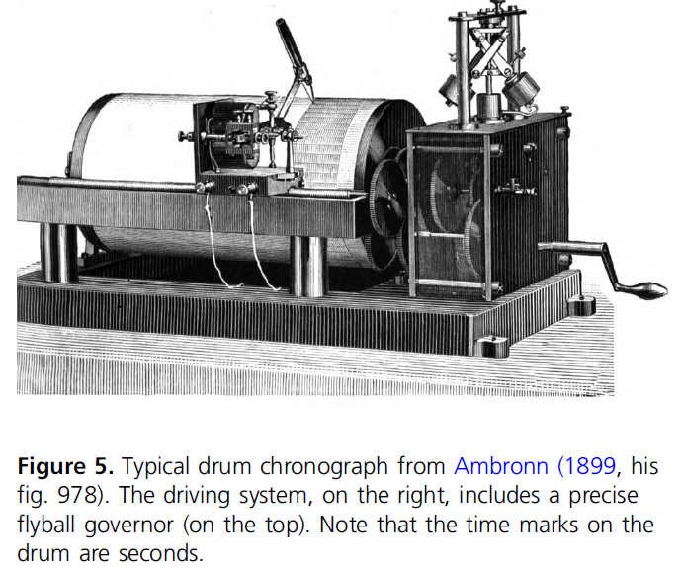
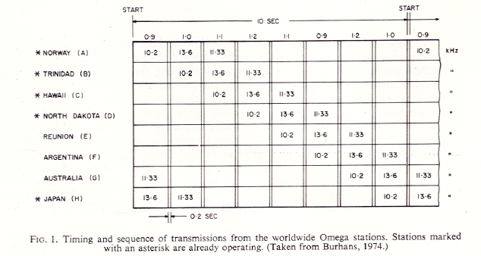
A Brief History of Timing
3
O3.5-820
~1900: solar observations (e.g. Dominion Observatory, Ottawa) => local clock => time marks
1929: shortwave e.g. CHU, Dominion Observatory
1960s: atomic clocks
1970: CHU moved from Dominion Observatory to National Research Council
1970s: timing applied at central site, subject to transmission delays
1974: GOES time code service (geostationary satellite, to 2004)
1980s: Omega (land-based VLF, portable) – excellent timing but for leap seconds
1990s: GPS (satellite) & NTP (internet)
➔ Problem solved? Sadly, no.

Slide 4
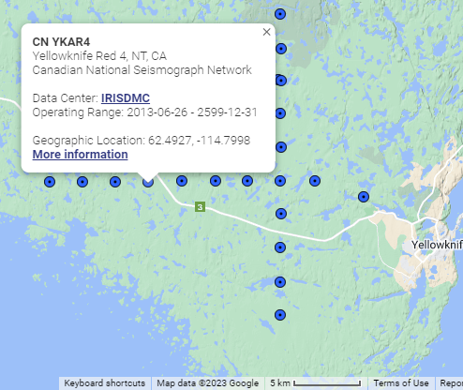
Yellowknife Upgrade
O3.5-820
Upgrade in 2013 first major since 1989
Old system:
Digitizers: Nanometrics RD-3, 16-bit, 20 sps
Timing: central GOES (later GPS) with correction for telemetry & propagation
New system:
Digitizers: Guralp CMG-DM24S3EAM (IMS preferred), 24-bit, onboard authentication & CD1.1, 40 sps
Timing: independent GPS at each station
Same S-13 short-period sensors & 2 km spacing
Edwards, W.N., 2014. The Yellowknife Seismic Array: Comparative Study Between the 2013 Upgrade and its 1989 Predecessor; Geological Survey of Canada, Open File 7559, 39 p. https://doi.org/10.4095/293841.

Slide 5
Issue Raised by John Vidale
O3.5-820
Studying rotation of inner core using “repeater” sources observed at IMS arrays
Observed timing differences between repeaters at YKA but not ILAR, only when one is post-2013 upgrade
2016-08-07: YKR6, YKB9
2017-01-18: YKR5, YKB2, YKB3, YKB7, YKB9
2017-06-20: YKR3, YKB7
2017-06-20: YKR3, YKR5, YKR6, YKB1, YKB2, YKB7
2017-06-20: YKR3, YKR5, YKR6, YKB1, YKB2, YKB7, YKB9
2017-12-15: YKR3, YKR6, YKB1, YKB2, YKB7, YKB6, YKB9
Wang, W., & Vidale, J. E. (2022). Seismological observation of Earth’s oscillating inner core. Science Advances, 8(23), eabm9916.

Slide 6
6
Dead Ends
6
O3.5-820
Are the GPS engines malfunctioning in some way (e.g. not getting a good enough view of the sky)?
We weren’t systematically archiving GPS state-of-health ➔We are now
Available log files (< 1 month) showed no offsets > 25 us
Is this an effect of temperature-dependence of damping?
a 10% variation in the damping would result in a 2.7° phase shift at 2 Hz, and a 7.5ms delay
Can’t explain ~100 ms delays
Co-located sensors: needed for most obvious method e.g. Ringler et al. (2021).
Can/should be done at many CNSN stations
Repeating earthquakes: e.g. Yang, Song & Ringler (2022)
Not common enough to get good time-resolution of timing errors
IDEA: use well-recorded events to estimate inter-station timing
DPRK nuclear test SNR too low
Use earthquakes from distant source zones!
Ringler, A. T., Anthony, R. E., Wilson, D. C., Auerbach, D., Bargabus, S., Davis, P., ... & Klimczak, E. (2021). A review of timing accuracy across the Global Seismographic Network. Seismological Research Letters, 92(4), 2270-2281. https://doi.org/10.1785/0220200394.
Yang, Y., Song, X., & Ringler, A. T. (2022). An Evaluation of the Timing Accuracy of Global and Regional Seismic Stations and Networks. Seismological Research Letters, 93(1), 161-172. https://doi.org/10.1785/0220210232

Slide 7
Multi-Channel Cross-Correlation
7
O3.5-820
VanDecar & Crosson (1990):
Accurate estimation of relative phase arrival times from teleseisms
Least-squares problem is over-determined because independent offset estimates can be obtained from all pairs
Addition of zero-mean constraint
Proposed use: tomographic inversion across regional networks
Additions:
Upsample 20, 40 to 100 sps for improved time resolution
Estimate and correct for moveout across array
VanDecar, J. C., & Crosson, R. S. (1990). Determination of teleseismic relative phase arrival times using multi-channel cross-correlation and least squares. Bulletin of the Seismological Society of America, 80(1), 150-169.

Slide 8
Multi-Channel Cross Correlation: Weak result
8
O3.5-820
Settled on:
±5 s around ak135 nominal arrival time
1-10 Hz bandpass
plot 95% uncertainty at ±2σ
Analyzed ~2500 events since 2010 with magnitude > 4.2 in South Sandwich Islands, south Atlantic (same bounding box as John Vidale)
Dropped channels with gaps
Made plots, like the one at the right, for all events in dataset shared by John Vidale
Weak/bad results typically happen due to low SNR and malfunction

Slide 9
Multi-Channel Cross Correlation: Overlap
9
O3.5-820
Between 2013-06-26 and 2014-04-02 both old and new instrumentation ran in parallel
For MCCC both arrays are treated as one
Confirmed observations of Edwards (2014):
Large offset at R7
persistent 0.1 s offset between YK and YKA

Slide 10
Multi-Channel Cross Correlation: Strong result
10
O3.5-820
Example at right is a typical excellent result, |σ|=7-15 ms
Confirms Vidale’s observation of significant timing error at R5, B7, B9, perhaps not so much B2, B3
Based on results like these, chose a limit of |σ|<30 ms for subsequent work, yielding ~500 results

Slide 11
Zero-mean arrival times
11
O3.5-820
Clear pattern across elements in array, but there are outliers …
Few outliers before 2013, after 2020 and in early 2016
By trial and error, found that B8 had no or very few outliers ➔ reference all delays to this station

Slide 12
Arrival times referenced to B8
12
O3.5-820
Delays are now mostly constant with time, albeit with jumps
Observed delays are “smeared out” in a consistent pattern
Can do better if we correct moveout
Quantized timing errors disappear in early 2020!
Additional “reset” of timing errors around 2016-01-01
Can we get a clearer picture by correcting station-specific delays?
 | EAM | DM24
As shipped | 10008 | v106b46
Before 2020-04-08 | 12433 | v106b46 (B0: v106b55r, B4: v106b40)
Since 2020-04-08 | 15781 | v107b27
Current | 15811 | v107b29

Slide 13
Moveout-corrected arrival times
13
O3.5-820
YKA upgrade
firmware upgrade
Used average MLE offsets 2016‑02‑01–2016‑03‑01 as moveout corrections
Quantization now clear!
Used MLE offsets 2018‑02‑01–2018‑06‑01 to estimate time shift quantum as 0.121 s
Just two episodes of non-quantized timing error:
R1: October – December 2015
R4: December 2021 – March 2022
 | EAM | DM24
As shipped | 10008 | v106b46
Before 2020-04-08 | 12433 | v106b46 (B0: v106b55r, B4: v106b40)
Since 2020-04-08 | 15781 | v107b27
Current | 15811 | v107b29

Slide 14
Distribution of timing errors
14
O3.5-820
Except for R1 and R4 timing errors after removal of quantized timing errors look gaussian
We used B8 as reference, could have used B0, R7 or R9
Error rate is extremely low – so some stations are never affected

Slide 15
Where else might we see this problem?
15
O3.5-820
Problematic firmware: 12433 <= EAM < 15781 and/or v106b46 <= DM24 (DSP) < v107b27
Guralp confirmed that data is sent from DSP to CPU in packets of 5 samples @ 40 sps = 0.125 s
Firmware release notes mention a “bin5” issue fixed in DM24 firmware v106b57d, in May 2012
As of 2019, the IMS uses 3 types of digitizers Guralp DM24, Kinemetrics Q330 and Nanometrics Europa-T
Guralp DM24S3AM digitizers are also in use at AKASG, ARCES, GERES, NOA, SPITS and WRA (as well as some infrasound arrays)
Figure adapted from: Gibbons, S. J. (2014). The applicability of incoherent array processing to IMS seismic arrays. Pure and Applied Geophysics, 171, 377-394. https://doi.org/10.1007/s00024-012-0613-2

Slide 16
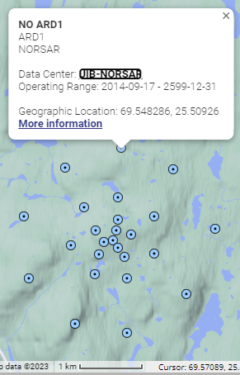
16
Compare: ARCES
16
O3.5-820
Same Guralp datalogger
Short-period ➔ broadband in 2014
Source zone: South Sandwich Islands ➔just 204/2550 useful
No persistent timing errors
Correlation decreases toward outermost rings
C: ~0.5 km, D: ~1 km

Slide 17
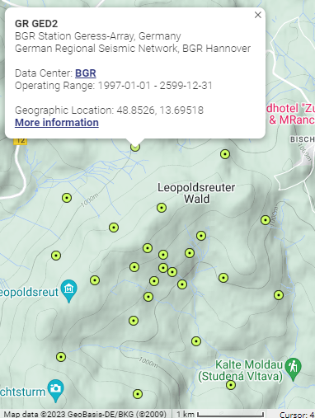
17
Compare: GERES
17
O3.5-820
Short-period sensors but different datalogger: AIM24S
Source zone: SantaCruz/Vanuatu ➔just 44/137 useful
➔need more events
No persistent timing errors

Slide 18
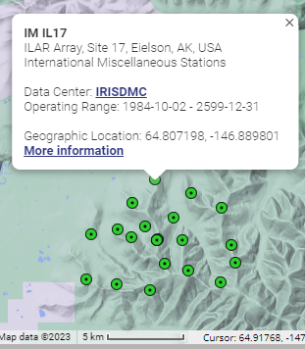
18
Compare: ILAR
18
O3.5-820
John Vidale reports no issues here
Short-period sensors with AIM24S datalogger
Source zone: South Sandwich Islands ➔ 486/2502 useful
No persistent timing errors, but
timing “jitter” is larger, and
moveout across array is less clear

Slide 19
Next Steps and Implications
19
O3.5-820
Next steps:
Check more IMS arrays.
➔ in progress
Model and publish quantized error vs. time for others to use.
➔ in progress
Try to remove constraint that teleseisms be in one source region, by fitting a plane wave.
➔ in progress
Study 2013 overlap offsets more closely.
➔ later
Implications:
Errors are correctible: John Vidale reports no anomalies after 2013, after correcting using this model
CTBTO array beamforming at YKA 2013-2020 was likely impeded by these timing errors
Must ensure that GPS SOH is archived indefinitely, even though it may not tell the whole story
Need more methods to validate timing in situ
Keep your firmware up-to-date!

Slide 20
Thank You!
20
O3.5-820
Acknowledgements
Thanks to John Vidale for pointing out this problem, and for his continued interest and engagement.
Thanks to fish at Guralp Support for his invaluable insights into the hardware and firmware.
Questions?
nicholas.ackerley@nrcan-rncan.gc.ca

