Slide 1
Current Status of NET-VISA Toward the Operational use for Nuclear Explosion Monitoring
Vera Miljanovic Tamarit¹, Noriyuki Kushida¹,
Ronan Le Bras¹, Megan Slinkard¹,
Sherif Ali¹, Geeta Arora², Nimar Arora²
¹CTBTO Preparatory Commission, ²Bayesian Logic Inc.
O3.5-424
20 June 2023

Slide 2
Overview of the presentation
O3.5-424
Background
Current OPS configuration
Test setup swaps the role of GA and NET-VISA
Recent performance
Result of analysis on 4 Feb 2023 (interim report)
Improvements to NET-VISA
Future work

Slide 3
Background
O3.5-424

Slide 4
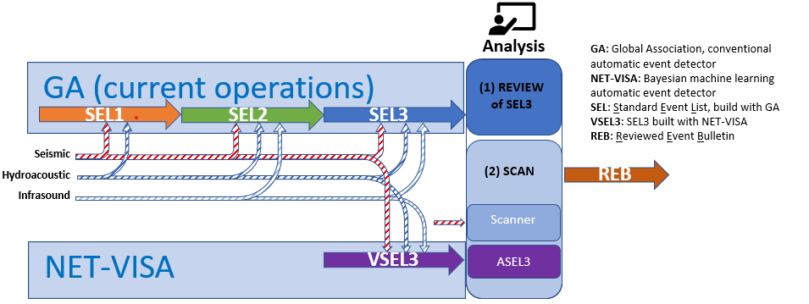
Current OPS configuration
O3.5-424

Slide 5
Setting up an analyst workstation
O3.5-424
A real time pipeline has been running since November 2021 on a virtual machine
The roles of GA and NET-VISA are inverted: GA is used as back-up
An analyst workstation (WS) has been set up so that a lead analyst can perform analysis
ASEL3 is also implemented
ASEL3 stores GA origins, computed with arrivals already retrieved.
The analyst will get ASEL3 origins via the “SCAN” button, after completing review of the NET-VISA generated SEL3
Events missed by NET-VISA but found by GA will be presented for review
An alternative LEB (NV LEB) is obtained. SEL3 and NV SEL3 can be compared to both this alternative LEB and the standard LEB

Slide 6
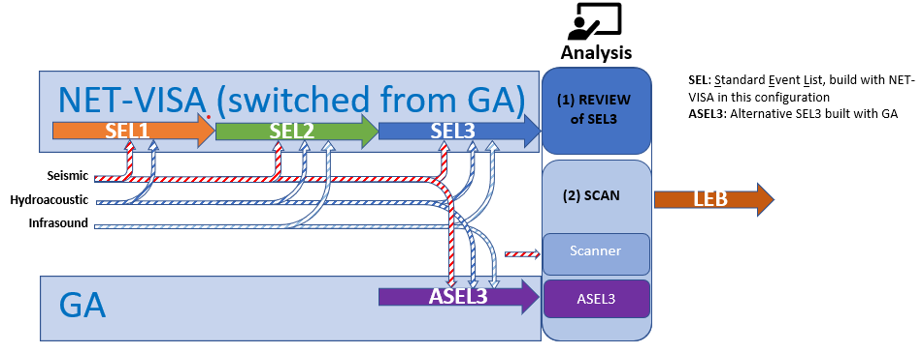
Test setup swaps the role of GA and NET-VISA
O3.5-424

Slide 7
Performance measurement
Primary metrics
O3.5-424
Following two main metrics are measured
Overlap: rate of REB events which are created by an automatic detector
Inconsistency: rate of events created by an automatic detector not in REB
Comparison criterion: weak-criterion (if two or more defining arrivals are shared by an automatic detector event and an REB event, that event is counted as an overlap event)
Two automatic event detectors are considered
GA (SEL3 in operation)
NV (NET-VISA for the real-time TEST pipeline)

Slide 8
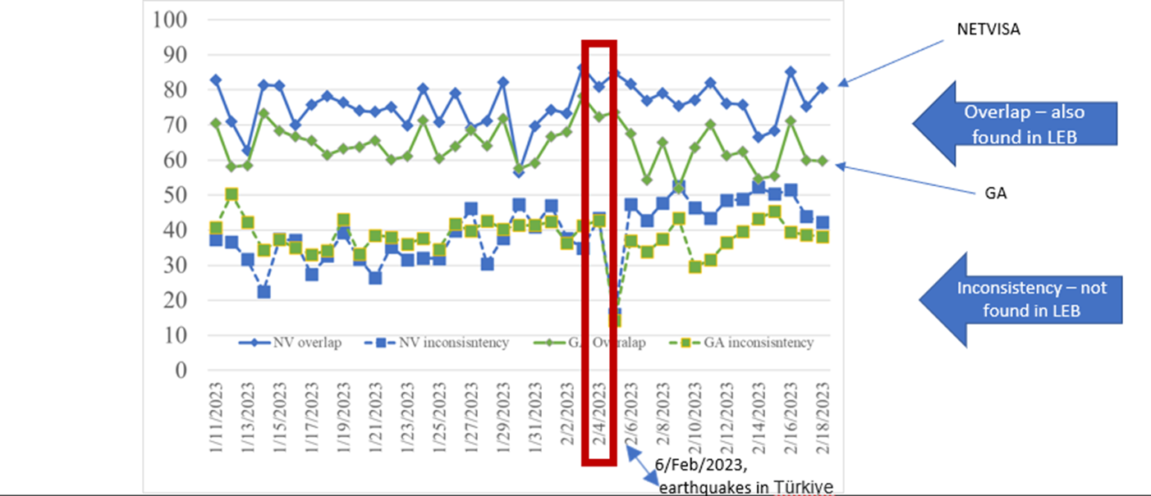
Recent performance of the real-time pipeline
O3.5-424

Slide 9
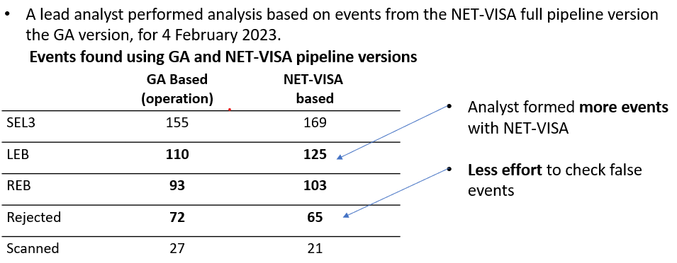
Result of analysis on 4/Feb/2023
O3.5-424

Slide 10
Recent improvements in NET-VISA
O3.5-424
Minor issues pointed out by the lead analyst have been corrected
In a marginal case, regional and tele-seismic phases, e.g. S and Sn appear on a station
Integration of RSTT/SSSC to NET-VISA has been completed, and installation on DVL is on-going
The final output has already been done with RSTT/SSSC (provided via the IDC libloc library).
This applies to the main computation (association process).
New confidence ellipse estimator has been developed, and is ready to be examined in DVL
Planning to install bug fixes to TST/OPS

Slide 11
Conclusion and future work
O3.5-424
A real-time full pipeline has been setup which used NET-VISA as primary associator, and the performance was investigated
Analyst review for a week is planned, and an interim report was briefed
As with the previous experiment, 10% more events are included in LEB for 4/Feb/2023
Also confirmed that the number of LEB and REB events increased by 10%

