Slide 1
Determination of the frequency response of seismic & infrasonic IMS station sensors using an on-site calibration approach
O3.1-698
Michaela Schwardt¹, Christoph Pilger¹, Thomas Bruns², Leonard Klaus², Samuel Kristoffersen³, Franck Larsonnier³, Lars Ceranna¹, Patrick Hupe¹, Peter Gaebler¹
¹Federal Institute für Geosciences and Natural Resources (BGR)
²Physikalisch-Technische Bundesanstalt (PTB)
³ Commissariat à l’énergie atomique et aux énergies alternatives (CEA)
BGR- B4.3 – Federal Seismological Survey, CTBT (German NDC)

Slide 2
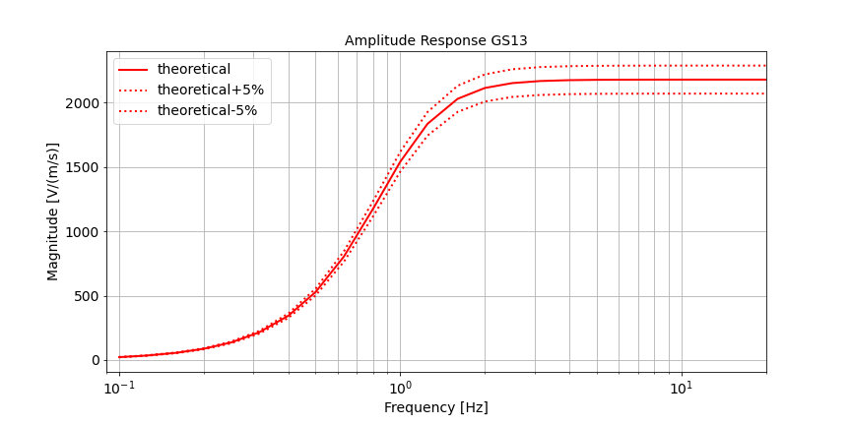
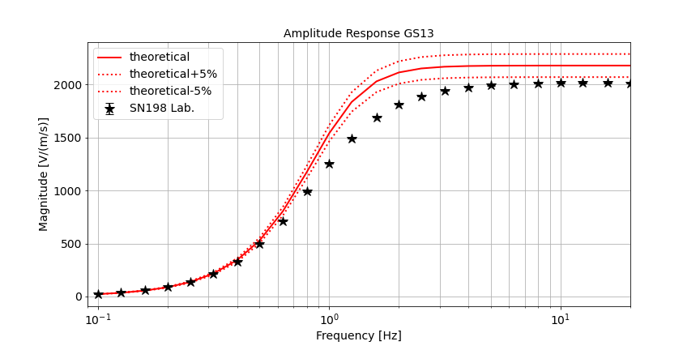
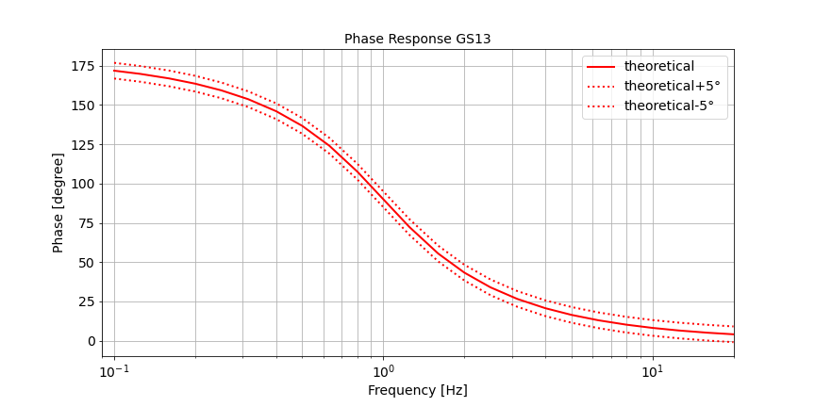
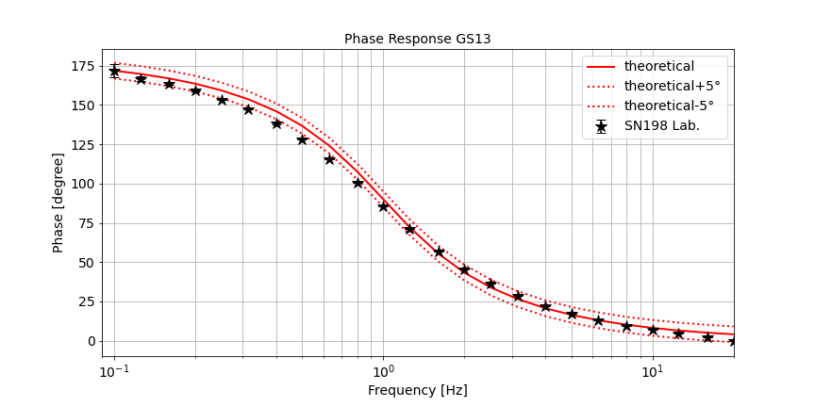
Need for on-site calibration procedures
O3.1-698
Missing standards & calibration procedures
In the low-frequency range down to 0.01 Hz reliable calibration procedures, which include traceability to SI, are currently missing → rely on the manufacturer's specifications
Joint Research Project 19ENV03 Infra-AUV*
Development of primary & secondary calibration methods
Establish procedures, which allow permanent on-site calibration without any interruptions of the recordings
Consideration of traceability & measurement uncertainties
* https://www.ptb.de/empir2020/infra-auv/home/

Slide 3
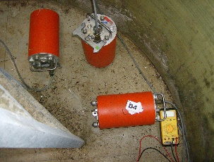
Need for on-site calibration procedures
Interruption of measurements
Violation of technical requirements
O3.1-698
Laboratory
Field Sensors
X
?
Seismometer in a vault
multi-component calibration system of PTB
If the field sensor will not come to the laboratory,
the laboratory calibration will go to the field sensor. (freely adapted from Francis Bacon, “Of Boldness”, 1625)
Installation of a laboratory calibrated instruments as reference sensor

Slide 4
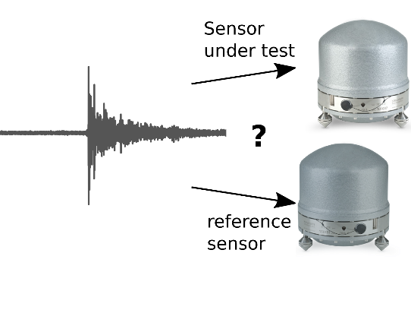
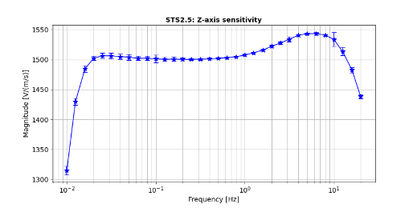
Development of on-site calibration methods
O3.1-698
Existing calibration methods are “relative”
They rely on sensor comparison using a common excitation signal & calculate a gain ratio between the sensors to characterize "errors" in the transfer function (e.g., Pavlis & Vernon, 1994; Sleeman et al., 2006)
Application of a modified approach of Gabrielson (Gabrielson, 2011; Charbit et al., 2015; Green et al., 2021)
Determination of the gain ratio between a co-located reference sensor (REF) and station sensor under test (SUT) and inclusion of various similarity measures (e.g., coherence, cross-correlation)
Ensures traceability to SI
SUT & REF measure the same coherent signal
Known response of REF
(Amplitude & Phase)

Slide 5
Algorithm behind the on-site calibration approach
Filter*¹ within Pass-bands
O3.1-698
Advantages?
The filtering & the choice of the window length allows a better determination of the response function within the individual frequency ranges
Longer data segments with larger windows enable analysis of the low frequency range
Raw data signal
Division into segments
Segment i
Calculations of similarity measures & cross-/auto-spectral densities
9 Windows, 50% overlap
Similarity measure* ≥ Threshold?
*Similarity measures:
Magnitude-squared cohereny (MSC)
Cross-correlation
Cross-Array coherency*²
Determination of gain ratio between REF & SUT
$$Gain Ratio=\frac{G_{XX}}{G_{XR}}$$
Calculation of frequency response function (amplitude & phase) of SUT using traceable response of REF
*¹ Ensure stationarity of time series (Charbit et al., 2015)
^{*2} Cross-Array coherency (Green et al., 2021)

Slide 6
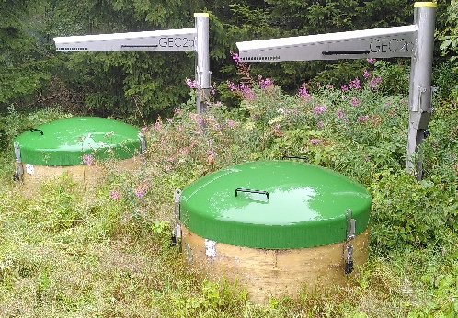
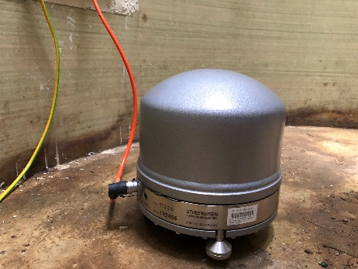
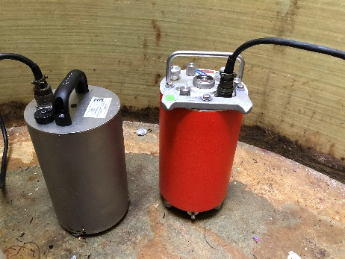
Fieldtest for the on-site calibration of seismometers
O3.1-698
CMG-3T & GS13
Laboratory calibration of 2 vertical station seismometers (GS13) and a 3-component seismometer (STS2.5) by PTB
Full frequency response is known & traceable to SI; uncertainties are given
Installation of the calibrated seismometers at the station in August 2022
260 days of continuous data have been recorded
Removal of STS2.5 in May 2023 for a laboratory re-calibration
ca. 2m
STS2.5
STS2.5
CMG-3T
GS13

Slide 7
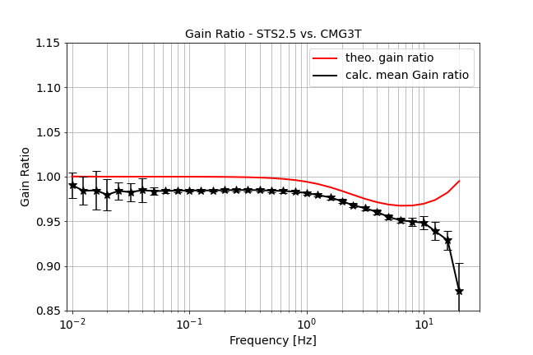
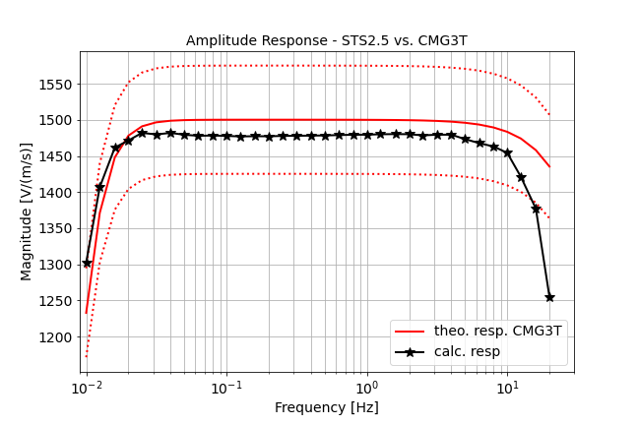
Co-located 3-component seismometer STS2.5 vs. CMG-3T (vertical component)
O3.1-698
Calculation of complex gain ratio on a daily basis
mean over 260 days
Similarity measures taken into account: MSC ≥ 0.98 XC ≥ 0.8
0.05 - 8 Hz: low standard deviations
> 8 Hz: high standard deviations, deviation from nominal value (> ±5% of nom. Value)
< 0.05 Hz: high standard deviations
mean gain ratio
CMG-3T (SUT) & STS2.5 (REF)
Calc. Amplitude Response

Slide 8
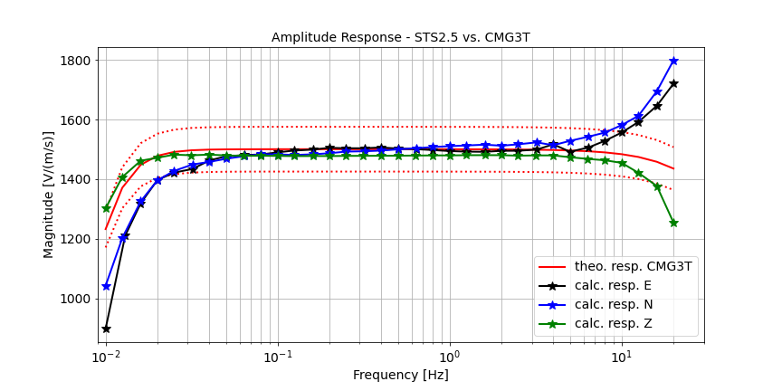
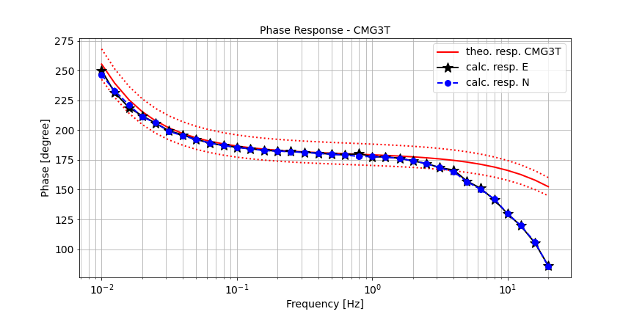
Co-located 3-component seismometer STS2.5 vs. CMG-3T – Amplitude & Phase
O3.1-698
Below 0.05 Hz and above 5 Hz the transfer functions for the horizontal components could only be determined with high standard deviation in the laborator by now! The reference is back in the laboratory for re-calibration!

Slide 9
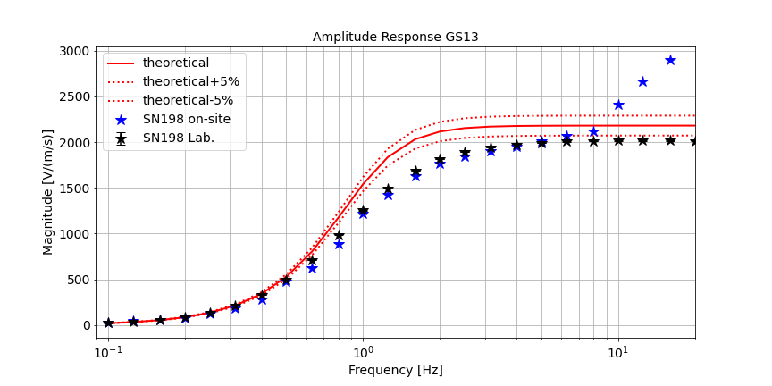
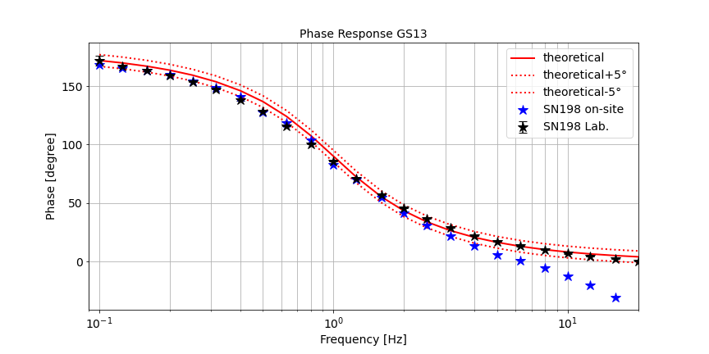
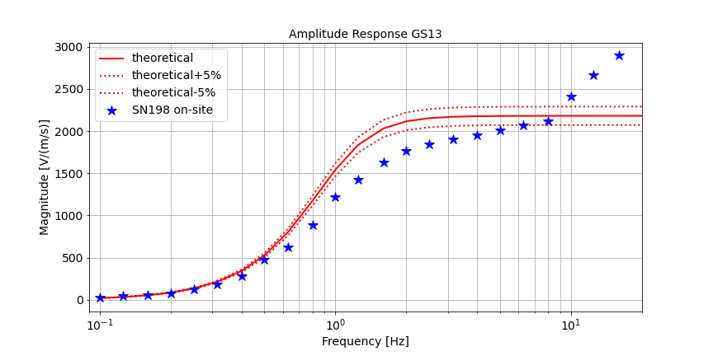
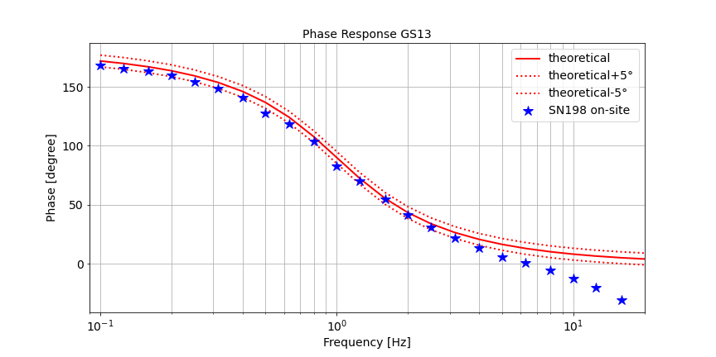
Co-located broadband & short-period seismometer GS13 vs. STS2.5 (Z-component)
O3.1-698
Cross-check
Both sensors are laboratory calibrated ↔ verification of the method
! Caution different input gain (1x vs. 8x) & pre-amplifier (40V/V) ↔ effects must be taken into account
GS13 (SUT) & STS2.5 (REF)
Similar behavior at high frequencies (>5 Hz) to the 3-component seismometers

Slide 10
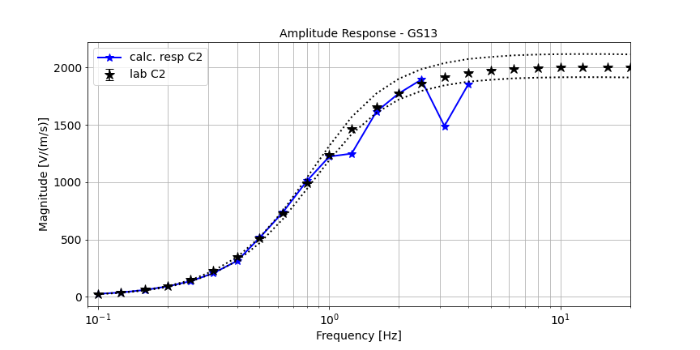
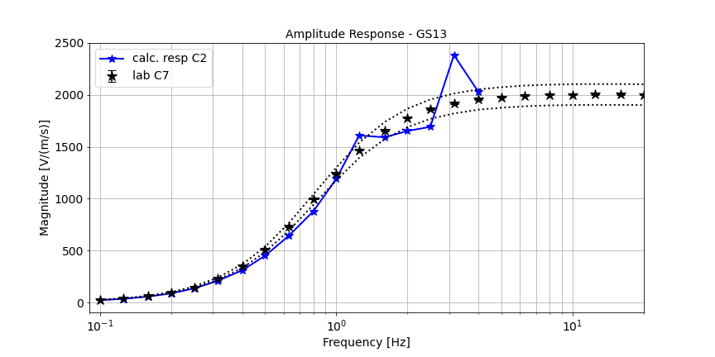
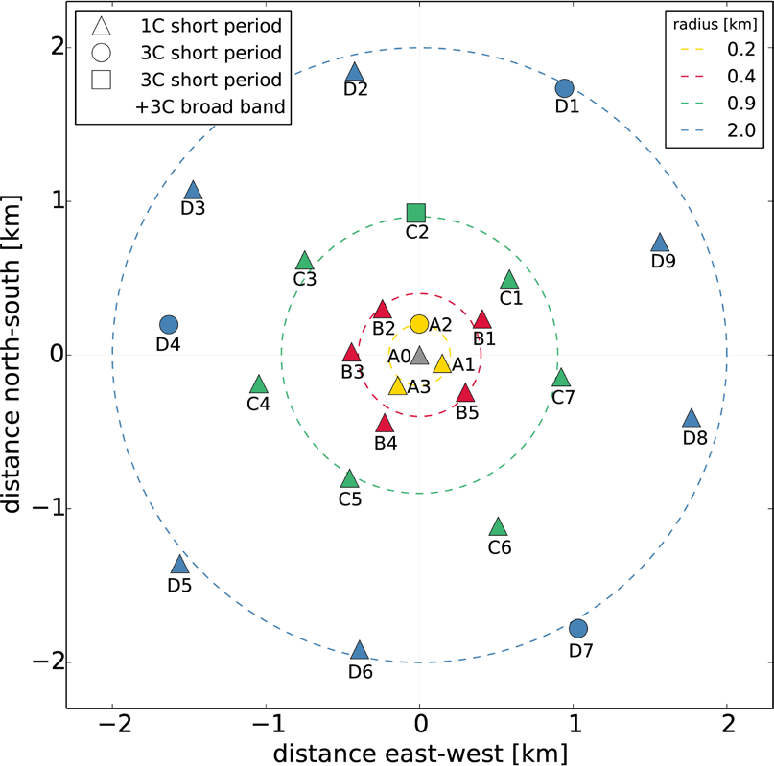
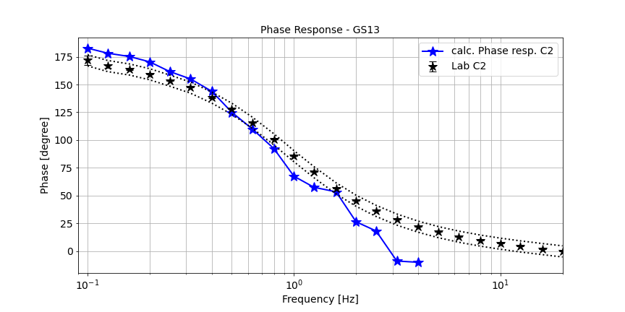
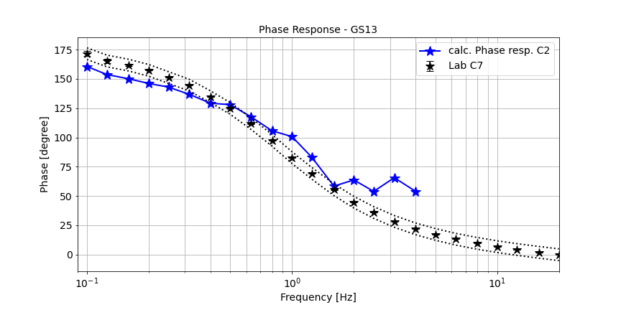
Station-wide seismometer calibration?
SUT: C2
REF: C7
In a subsequent step, we aim at the calibration of all sensors of a station using a single temporary and stationary reference sensor.
Comparison between 2 laboratory calibrated GS13 seismometer
SUT: C7
REF: C2
O3.1-698
< 1 Hz ✓ > 1 Hz ✗ still work to do!
Distance between sensors: ≈ 1425m

Slide 11
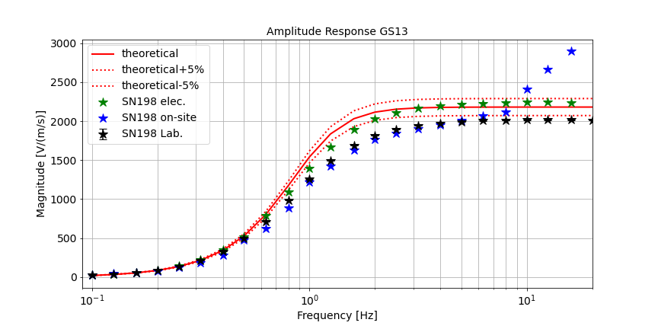
Summary
O3.1-698
Added value
Cross-check shows that the on-site calibration method provides values comparable to those obtained in the laboratory
the results are closer to the true values than those of the electrical calibration (former calibration method)
Open Points
Uncertainty propagation
Cause of deviation for frequencies > 5 Hz
On-Site calibration with traceable calibrated reference allows for a traceable calibration of station sensors without interrupting the measurements!

Slide 12
THANK YOU!
O3.1-698
Acknowledgements
This project 19ENV03 Infra-AUV has received funding from the EMPIR Programme co-financed by the Participating States and from the European Union’s Horizon 2020 research and innovation programme. We would like to thank everyone at PTB involved in the laboratory calibration of the sensors, as well as everyone from BGR responsible for the installation of the sensors at the stations
References
Charbit, M., Doury, B., & Marty, J. (2015). Evaluation of infrasound in-situ calibration method on a 3-month measurement campaign. In Infrasound Technology Workshop 2015 (ITW2015).
Gabrielson, T. B. (2011). In situ calibration of atmospheric-infrasound sensors including the effects of wind-noise-reduction pipe systems. The Journal of the Acoustical Society of America, 130(3), 1154-1163.
Green, D. N., Nippress, A., Bowers, D., & Selby, N. D. (2021). Identifying suitable time periods for infrasound measurement system response estimation using across-array coherence. Geophysical Journal International, 226(2), 1159-1173.
Schwardt, M., Pilger, C., Gaebler, P., Hupe, P., & Ceranna, L. (2022). Natural and Anthropogenic Sources of Seismic, Hydroacoustic, and Infrasonic Waves: Waveforms and Spectral Characteristics (and Their Applicability for Sensor Calibration). Surveys in Geophysics, 43(5), 1265-1361.
* https://www.ptb.de/empir2020/infra-auv/home/

Slide 13
O3.1-698

Slide 14
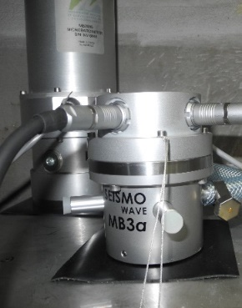
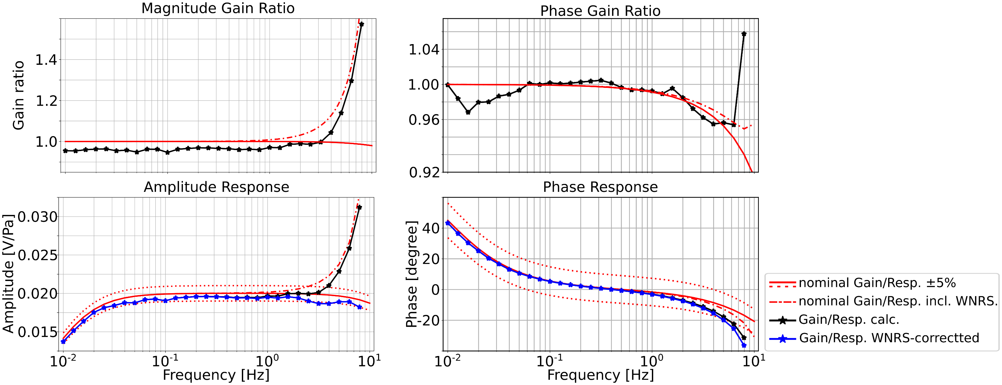
Calibration of an Infrasound station including the wind-noise reduction system
O3.1-698
REF: MB2005 (single inlet) SUT: MB3a (WNRS, 96 inlets)
Calculation of gain ratio for each day (>80 days), averaging over all days
Similarity measures: Coherency (MSC) >0.98 Cross-Array Coherency >0.6 (Green et al., 2021)

Slide 15
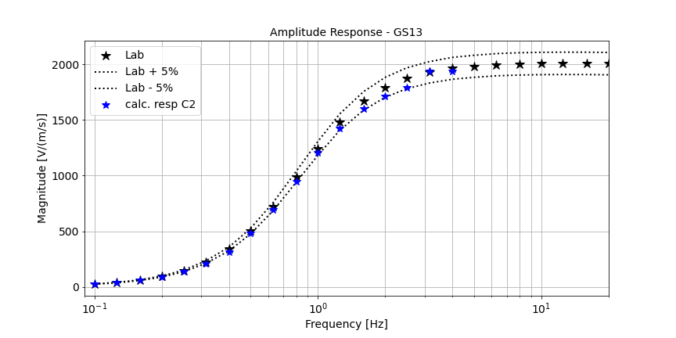
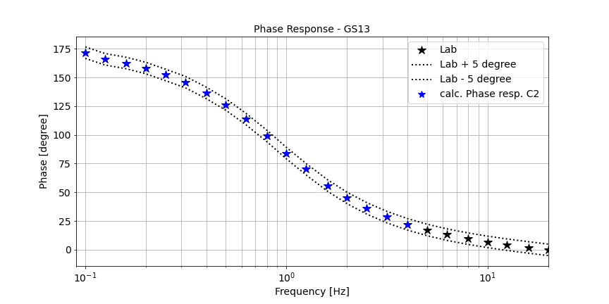
Station-wide seismometer calibration?
SUT: C2
REF: C7
In a subsequent step, we aim at the calibration of all sensors of a station using a single temporary and stationary reference sensor.
Comparison between 2 laboratory calibrated GS13 seismometer
SUT: C7
REF: C2
O3.1-698
After averaging:
< 1 Hz ✓ > 1 Hz ✗ still work to do!
Distance between sensors: ≈ 1425m

