Slide 1






Interlaboratory comparison on infrasound sensors (results of PTSAVH.A-C1)
D. Rodrigues¹, R. Barham², B. Doury³, T. Gabrielson⁴, A. Kramer³,
F. Larsonnier⁵, J. Marty⁶, J. Merchant⁷, R. K Rembold⁸, Y. Sid Ahmed³,
C. Smith⁴, C. Talmadge⁹, P. Vincent⁵
¹LNE - France, ²ASN – UK, ³CTBTO, ⁴PennState – US, ⁵CEA – France,
⁶UC Berkeley - US (with contributions from former affiliation 3), ⁷SNL – US, ⁸with contributions from former affiliation 7, ⁹UMiss - US
O3.1-676
22 June 2023

Slide 2

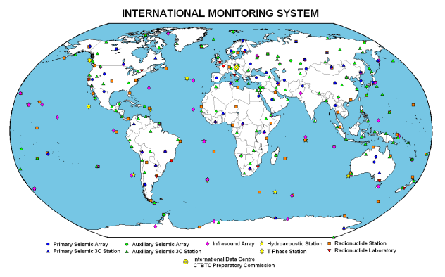
Introduction
O3.1-676
Quality assurance for IMS measurement systems
The Preparatory Commission for the Comprehensive Nuclear-Test-Ban Treaty Organization (CTBTO) has the responsibility to promote and be ready to uphold the Nuclear-Test-Ban Treaty when it comes into force.
One of the main instruments of the verification regime is the International Monitoring System (IMS).
The Provisional Technical Secretariat (PTS) underlines the importance of ensuring data quality.
  Operational Manual (CTBT/WGB/TL-11,17/17/REV.7)
  QA program for infrasound measurement systems presented to WGB in 2019 (ECS/WGB-52/PTS/8)
This includes the use of accurate and regularly calibrated measurement systems.

Slide 3
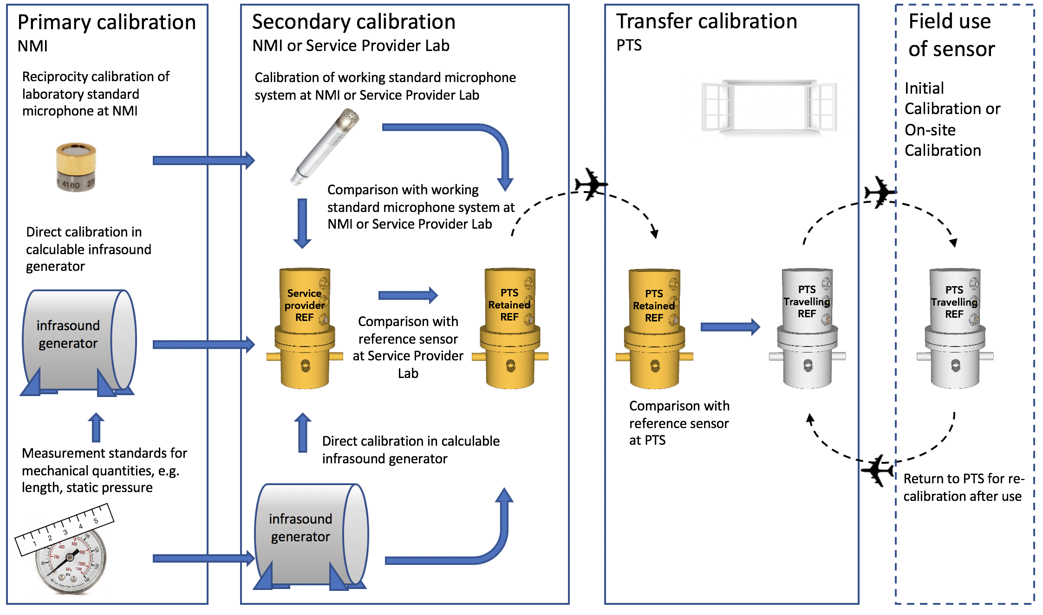
Introduction
O3.1-676
Establishing measurement traceability for IMS infrasound measurements¹
¹ Traceability as introduced in the Quality Assurance Infrastructure for IMS Infrasound Measurements (ECS/WGB-52/PTS/8)

Slide 4
Introduction
O3.1-676
Objective of the Inter-Laboratory comparison
ILC
Validation & verification of calibration methods
Identification of problems in laboratories
Continuous monitoring of laboratories performances
Education of participating laboratories
Provision of additional confidence to customers
Validation of uncertainty claims
Inter-Laboratory comparisons (ILC) aims to check the ability of laboratories to deliver accurate and equivalent calibration results.
ILCs consist in testing the same samples by different laboratories and in comparing the results.
ILCs offer many benefits and gains for participating laboratories.
It is an important element required in ISO/IEC 17025 for ensuring data quality.

Slide 5
Introduction
O3.1-676
Background
2015 / 2016 : Two pilot studies (PS1 & PS2) concerning the calibration of infrasound sensors were completed.
  Main conclusions & recommendations from PS1 & PS2
    Include a monitoring of the sensors’ stability
    Evaluate rigorously the uncertainty budgets
    Ensure that infrasound reference sensors used by the laboratories are traceable to the SI
    Use as far as possible standard procedures
    Determine the influence of environmental conditions
    Define a technical protocol that clearly prescribes test requirements, and agreement from participants
It was agreed that preparations for the comparison would be initiated by taking into consideration these recommendations.
The comparison has been denoted PTSAVH.A-C1 as the first formal interlaboratory comparison.

Slide 6
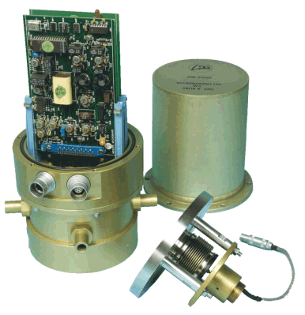
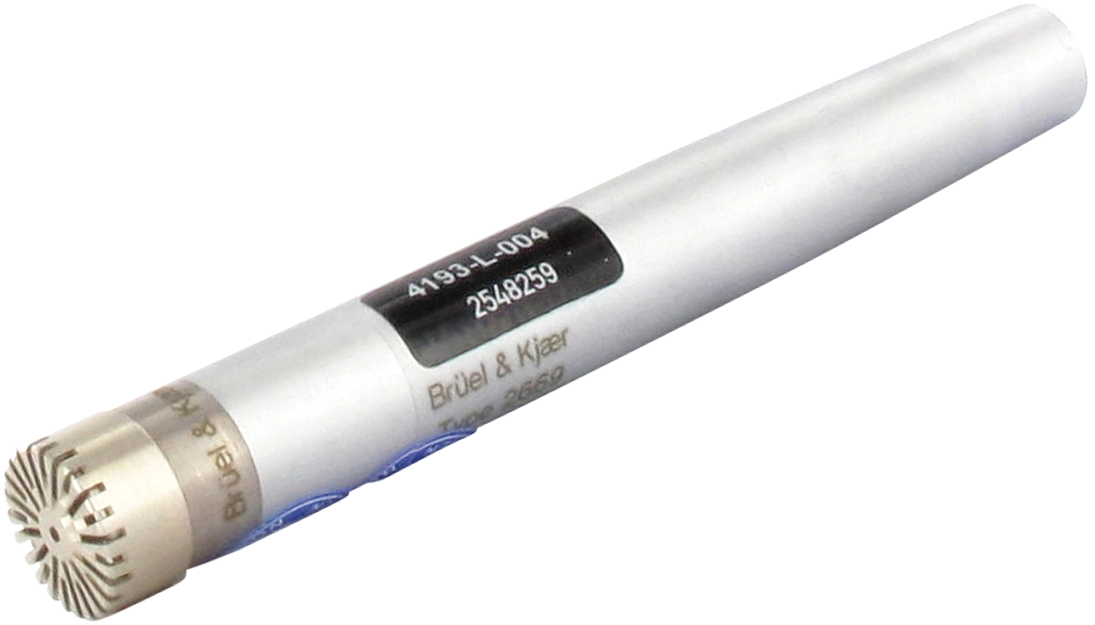
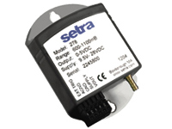
Technical protocol
O3.1-676
General overview
The comparison was organized by CTBTO
The role of pilot laboratory was undertaken by the LNE
Two MB2005 infrasound sensors, two B&K type 4193 microphones and two SETRA type 278 barometric pressure sensors were circulated.
The infrasound sensors were circulated to each participant in turn (June 2020 – January 2021).
Stabilities of sensors were monitored at the beginning and at the end of the measurement phase of the comparison.
Participant | Acronym | Country
Commissariat à l'énergie atomique et aux énergies alternatives | CEA | France
Laboratoire National de métrologie et d’Essais | LNE | France
Penn State University | PSU | USA
Provisional Technical Secretariat (participation as observer) | PTS | Austria
Sandia National Laboratories | SNL | USA
University of Mississippi | UMISS | USA

Slide 7
Description of participants’ measurement systems
O3.1-676
CEA
Comparison method with a B&K type 4160 reference microphone
LNE
PSU
Primary calibration method based on reciprocity (through SNL facilities)
SNL
UMISS
Comparison method with a B&K type 4193 reference microphone (high freq.) and a SETRA type 278 reference barometric pressure sensor (low freq.)
Comparison method with a B&K type 4193 reference microphone (high freq.) and a SETRA type 278 reference barometric pressure sensor (low freq.)
Primary calibration method using a laser pistonphone for B&K microphones and SETRA barometers
Comparison method with a B&K type 4160 reference microphone for MB2005 microbarometers

Slide 8




Method for the analysis of the results
O3.1-676
Performance statistics: Reference Values & Degrees of Equivalence
The methodology used for the analysis of the results is based on the international standard ISO 13528:2015.
  The Reference Values are defined as a “consensus value from participant results“ (section 7.7).
  Interpretation :
Successful performance
$$D_{i}$$
  Warning
  Laboratories are encouraged to address and confirm the validity of their measurement uncertainty estimates
0
Uncertainty to the degrees of equivalence
Failure performance
Need to review the measurement uncertainty estimates, or to correct a measurement issue
Measurement uncertainty to the participant’s result

Slide 9
Results & analysis
O3.1-676
MB2005 - Amplitude of the frequency response
Reported results
Degrees of equivalence per laboratory
LAB1
LAB2
LAB3
LAB4
LAB5

Slide 10
Results & analysis
O3.1-676
MB2005 - Phase of the frequency response
Reported results
Degrees of equivalence per laboratory
LAB1
LAB2
LAB3
LAB4
LAB5

Slide 11
Results & analysis
O3.1-676
MB2005 - Sensitivity
Degrees of equivalence per laboratory

Slide 12
Conclusion
O3.1-676
The aim of the comparison PTSAVH.A-C1 is to establish reliable equivalences for calibration of infrasound sensors.
  Successful performance was observed for the majority of the measurements.
  At specific frequencies, it remains a few cases of failure performance or else successful performance cannot be clearly established.
Strong progresses were achieved since PS1 & PS2 in calibration methods and uncertainties evaluation.
  Ex: DoE for amplitude of the frequency response for the MB2005 – PS2 vs PTSAVH-A.C1
LAB-A
PS2
5 % tolerance limit in
Operational Manual
LAB-A
PTSAVH-A.C1
LAB-B
LAB-B
LAB-C
LAB-C

Slide 13


Conclusion
O3.1-676
Impact of PTSAVH.A-C1
National Metrology Institutes
Primary reference standard: ≃ 0.3 % (@ 1 Hz)
Unbroken chain of calibrations
Calibration data directly supported by
PTSAVH.A-C1
Accredited / Expert Laboratories
Working standard: ≃ 0.5 – 1 % (@ 1Hz)
PTSAVH.A-C1 helps to provide additional confidence in calibration data produced at all the stages of the traceability chain
PTS Laboratory
Traveling references: ?
Under implementation with
the support of CTBTO
member states
On-site Initial Calibration
Permanent field references: ?
On-site Scheduled Calibration
Measuring equipment: ? 5 % req.

