Slide 1
Historical nuclear test and collapse data from the Livermore National Network between 1979-1992
Amanda Price, Rebecca Rodd
Lawrence Livermore National Laboratory
O2.5-138
Presentation Date: 20 June 2023
This work was performed under the auspices of the U.S. Department of Energy by Lawrence Livermore National Laboratory under Contract DE-AC52-07NA27344.
LLNL-PRES-849401

Slide 2
Overview
O2.5-138
Problem:
Historical geophysical data recorded during the era of nuclear testing is rare and limited. Efforts have been made to preserve and digitize data but have minimal quality control from decades of lost history and retiring personnel.
The Livermore National Network (LNN) presents a unique opportunity to recover non-reproducible, highly valuable datasets.
But it is not enough just to recover the data, as we also aim to mitigate any QC issues or potential undocumented transformations of the waveforms.

Slide 3
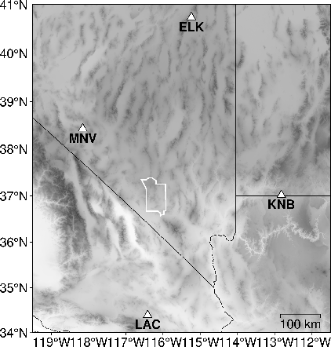
Lawrence Livermore Nevada Network (LNN)
O2.5-138
Four analog, broadband seismic stations were first deployed in the 1960s to record nuclear testing at the Nevada Test Site (NTS), now known as the Nevada National Security Site (NNSS)
LAC closed in 1999
MNV was adopted into the International Monitoring System (IMS) Primary array station NVAR
ELK operates under the US network and as an IMS Auxiliary station
KNB continues to operate under the UU network

Slide 4
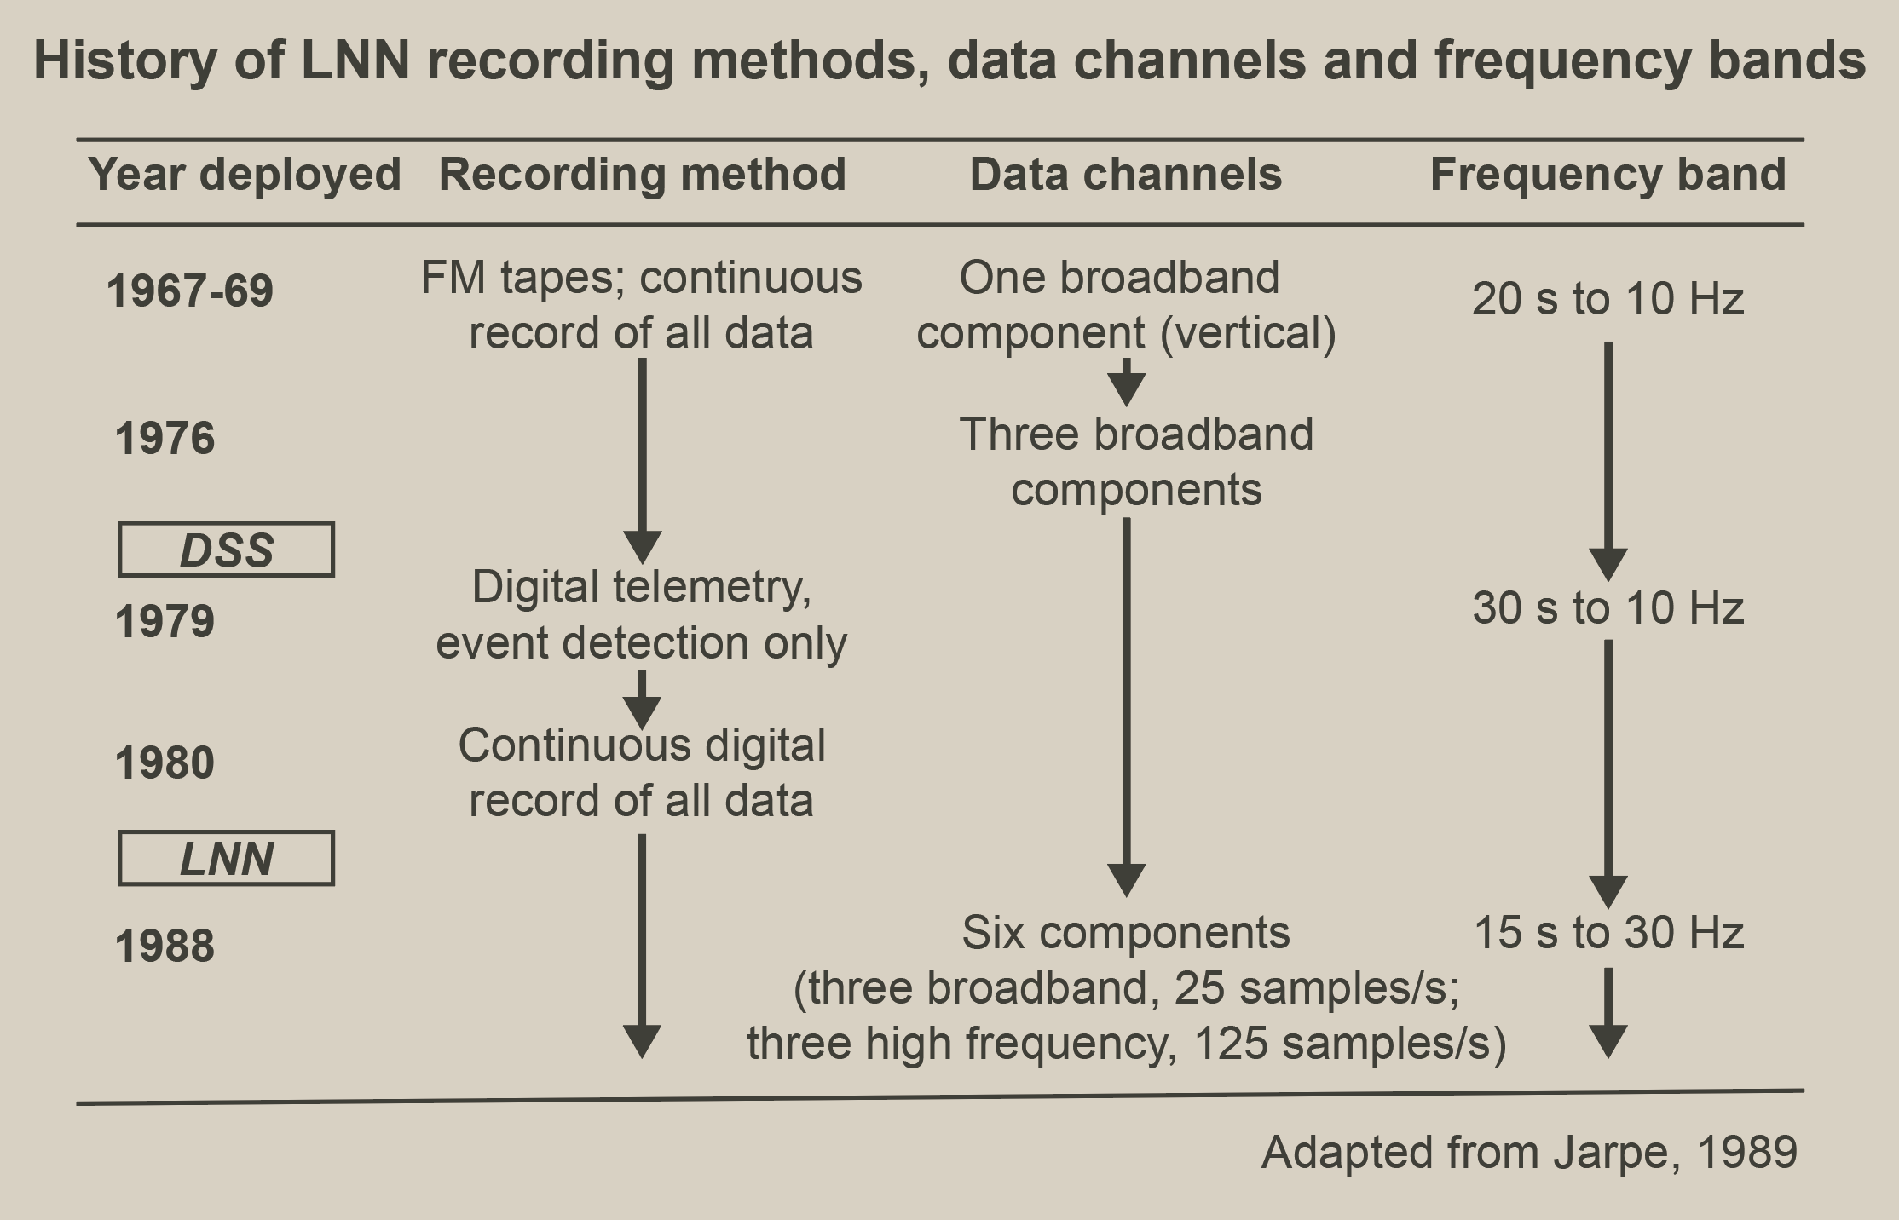
History of the Livermore National Network
O2.5-138

Slide 5
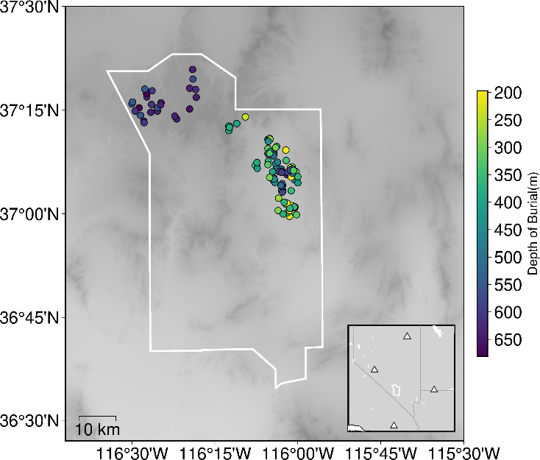
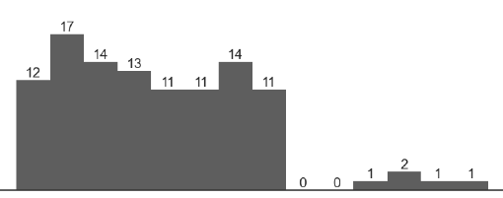
Recovered Legacy Events
O2.5-138
108 events were identified having previously been unreleased
Each event was manually reviewed for dead channels, non-seismic noise, spiking, gaps and timing issues
1979
1980
1981
1982
1983
1984
1985
1986
1987
1988
1989
1990
1991
1992

Slide 6
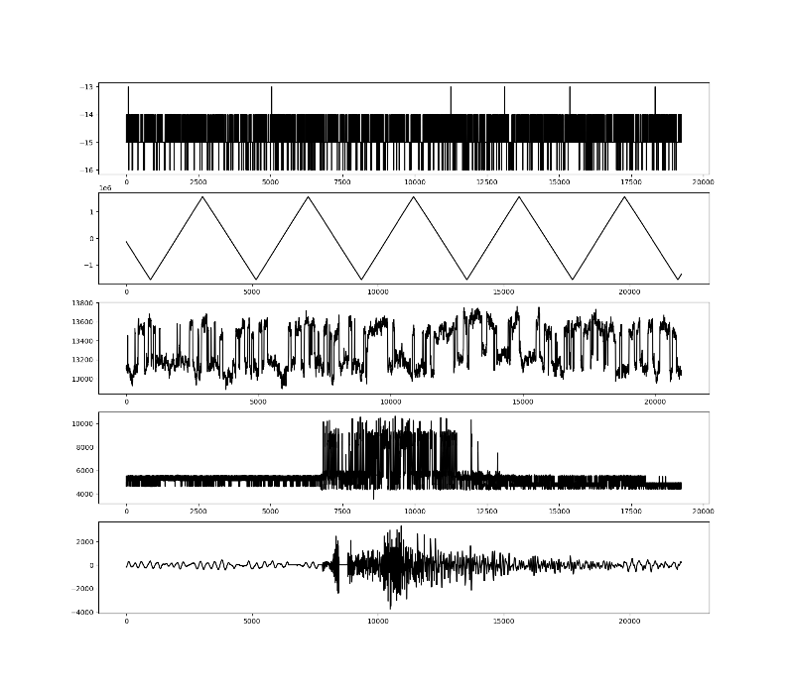
Quality Control Issues
O2.5-138
Digitizer noise
33 events were flagged with at least one QC issue
11 events were identified with at least a single waveform gap
5 events had significant timing issues with no or late arriving signals that suggest the waveforms were either mis-attributed to these events or had timing offsets large enough such that the arrival did not appear within the segmented waveform.
Non-seismic noise
Spiking
Spiking
Gaps

Slide 7
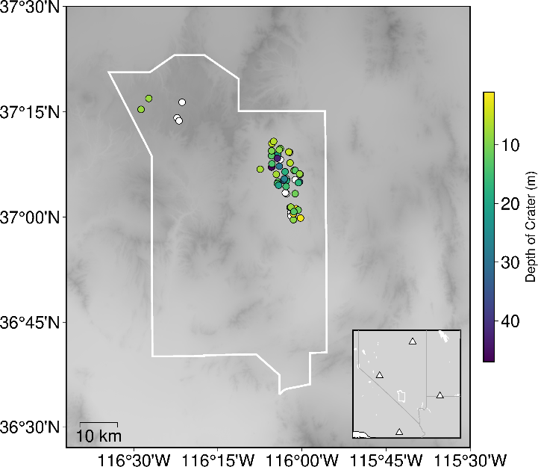
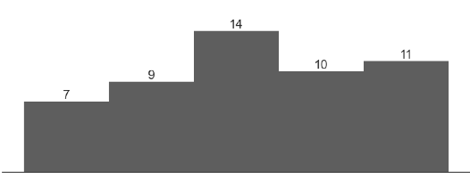
Recovered Cavity Collapses
O2.5-138
Underground nuclear explosions have the ability to create cavities which then can collapse, sometimes forming craters [Springer, 2002]
These events are important to understand in source discrimination and ground-truth events are rare
52 digitized nuclear explosion events and associated collapses were recovered with events ranging from 1979 to 1983
1979
1980
1981
1982
1983

Slide 8
Quality Control and Verification
O2.5-138
Event from file
disp (nm)
Event from database
Notes:
Collapse waveforms came with some rotated to the North and East directions.
Since the collapse waveforms were accompanied by their nuclear event precursor, we were able to compare the nuclear event to a database of existing waveforms

Slide 9
Quality Control and Verification
O2.5-138
Event from file
disp (nm)
Event from database
Correlation
coefficient
Rotate components to find match
Notes:
Effort was made to confirm they were not just mislabeled components by doing systematic rotation and checking the correlation coefficient with the existing database
Some channels were not rotated but were suspected of having a polarity switch, which could be seen in cross correlation

Slide 10
Quality Control and Verification
O2.5-138
Event from file
disp (nm)
Event from database
Correlation
coefficient
Rotate components to find match
disp (nm)

Slide 11
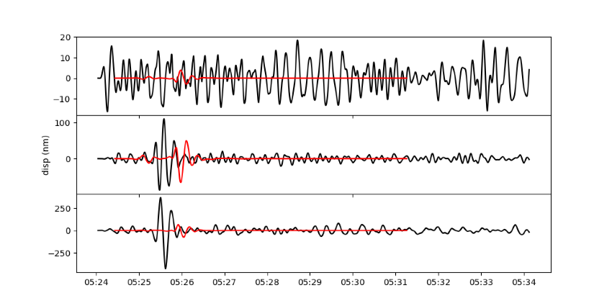
Quality Control and Verification
O2.5-138
n
To confirm the polarity switch, we used synthetics generated by MTinv assuming a collapse moment tensor
This technique also allows us to confirm any amplitude anomalies and timing issues
Collapse event waveform (black) for Nebbiolo on station KNB shows possible polarity reversal on e component.
Synthetic waveform (red) does not occur at the predicted arrival, but could be due to the lack of ground truth collapse time
e
v

Slide 12
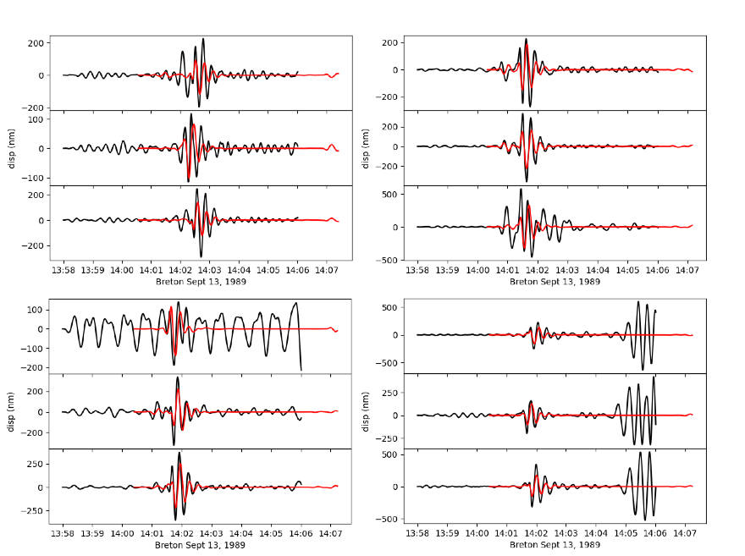
Quality Control and Verification
O2.5-138
n
n
Using a subset of moment tensor solutions developed by Chiang, et al [2014], we also are able to generate synthetic seismograms to confirm the polarity of the legacy nuclear events recovered
Figure shows recovered legacy event (black), Breton, shows no polarity reversal with the synthetic waveform (red)
e
e
v
v
ELK
MNV
n
n
e
e
v
v
KNB
LAC

Slide 13
Ongoing Work
O2.5-138
Further quality control work to identify gaps, repeated amplitudes, digitizer noise, etc
Automated QC analysis using Python-based seismic software package, Pycheron [Aur, et al 2021]
Further investigation into timing issues by using analyst picks
Additional efforts are being made to digitize analog seismic recordings prior to 1979 contained on 9-track and microfiche mediums
Use of ML techniques for expediting analog medium recovery as well as automated metadata cataloging, including handwriting translations

Slide 14
Summary
O2.5-138
We recovered 108 previously unreleased nuclear events from the LNN network
~30% of the recovered events had at least one QC data issue, of which, only 5 events had QC issues severe enough to exclude them from release
52 collapse events were recovered from research archives with unknown provenance
Using synthetics generated from pure collapse and moment tensor solutions allowed us to verify any rotation and polarity reversals that may have occurred

