Slide 1
Revisiting what a variety of tracers can tell about the occurrence of underground nuclear explosions
A. Pazdniakou¹,V.V. Mourzenko², J.-F. Thovert², E. Pili³, P. M. Adler¹
¹Metis, Sorbonne Université, Paris, France
²Institut P', CNRS - Université de Poitiers - ISAE-ENSMA, Poitiers, France
²CEA, DAM, DIF, F-91297 Arpajon, France
Wien, June 2023
Objectives:
In addition to the traditional radioxenon, study several tracers such as H₂O, radon, and CO₂
possibly observe emissions of these additional tracers at the test site
possibly combine observation of radioxenon at the monitoring site
with observations of H₂O and CO₂ at the test site
Table of contents:
Configuration and modelization
Outputs at the nuclear test site: H₂O and CO₂
Outputs at the nuclear test site and at the monitoring site: ¹³³Xe and Radon
4. Conclusion

Slide 2
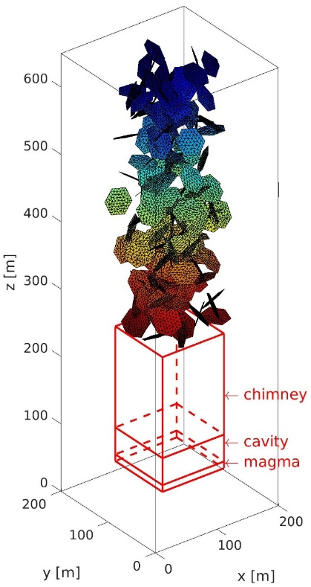
Configuration and modelization
Nuclear test site: Punggye-Ri nuclear test site (DPRK)
a parallelipipedon of size 200×200×650 m
Ground surface
Fluctuating atmospheric pressure
period 10⁵ s; amplitude 1000 Pa.
Embedding porous medium:
Permeability K_{m}=10⁻¹⁶ m² porosity ε_{m} = 0.01 or 0.05
Fracture network
192 or 384 fractures
aperture b = 1 mm
hexagons of radius R=20m
Simplified structure:
Permeability: K=10⁻¹⁴ m² porosity ε= 0.29
T=802.15 K
3 initial pressures P₀ =50, 100, 200 bars
Chimney
Cavity
Magma
Patriarche et al, Stereological analysis of fractures in the Roselend tunnel and permeability determination.
Water Resources Research, 43: W09421

Slide 3
Modelization: Pazdniakou et al. (2022), Two-Phase Flow, Heat and Mass Transfer and
Tracer Transport to the Atmosphere from Underground Nuclear Cavities
Through Fractured Porous Media. Pure and Applied Geophysics.
Porous medium
3D equations on the Darcy scale for flow, energy and tracer
Fractures
2D equations on the Darcy scale for flow, energy and tracer
plus exchanges with the surrounding porous medium
Numerical
- Meshing of the fractures (and all the bounding surfaces) by triangles, and of the porous medium by tetrahedra
- Discretization by the finite volume technique
- Solution by the conjugate gradient method
- Parallelization by OpenMP
Results:
at the test site (Punggye-Ri, DPRK) for an hypothetical 150 kt nuclear explosion, burried at 550 m
at the monitoring site (IMS JPX38-Takasaki, Japan):
includes a delay = 1 day and a dilution factor η = 7 10⁻¹⁸ s m⁻³
(see presentation O2.1-118 by Pili et al. on Thursday)

Slide 4
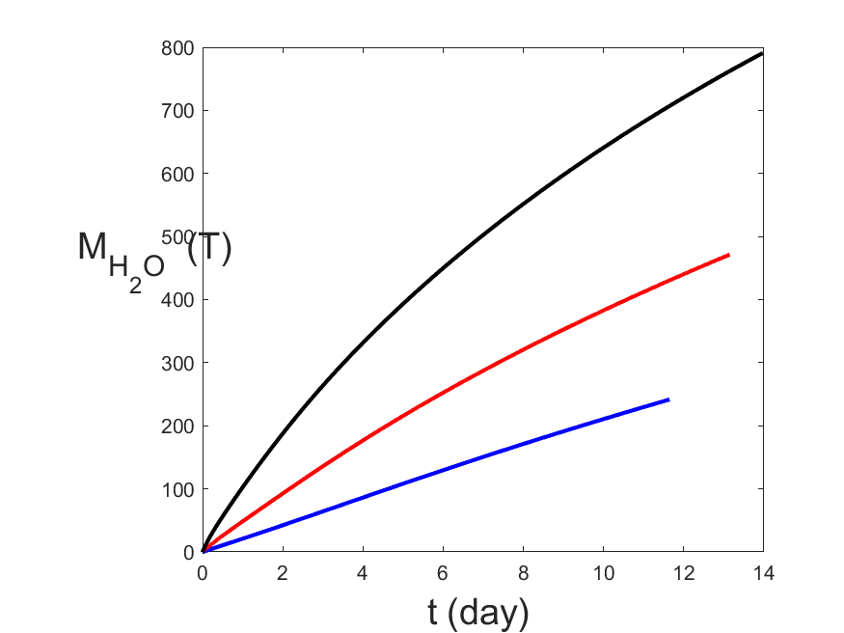
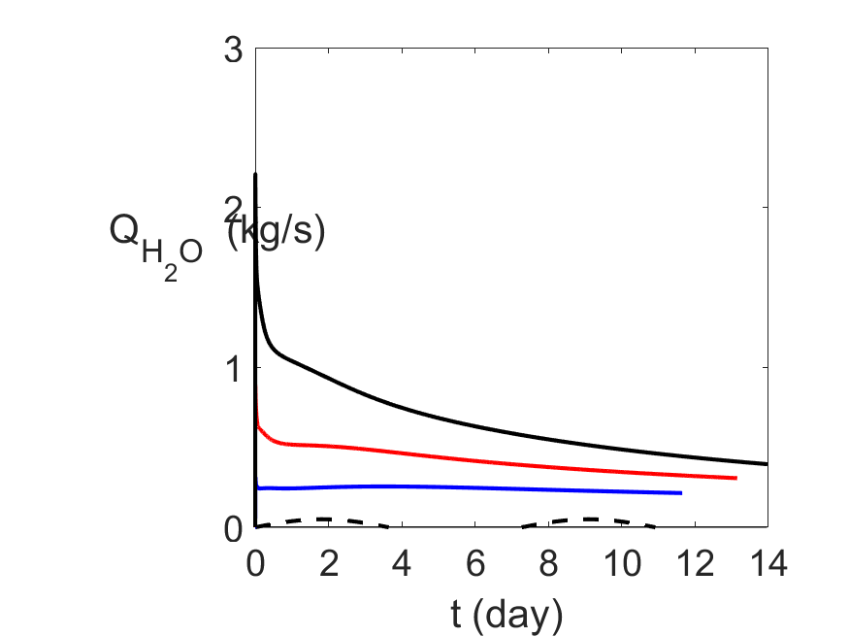
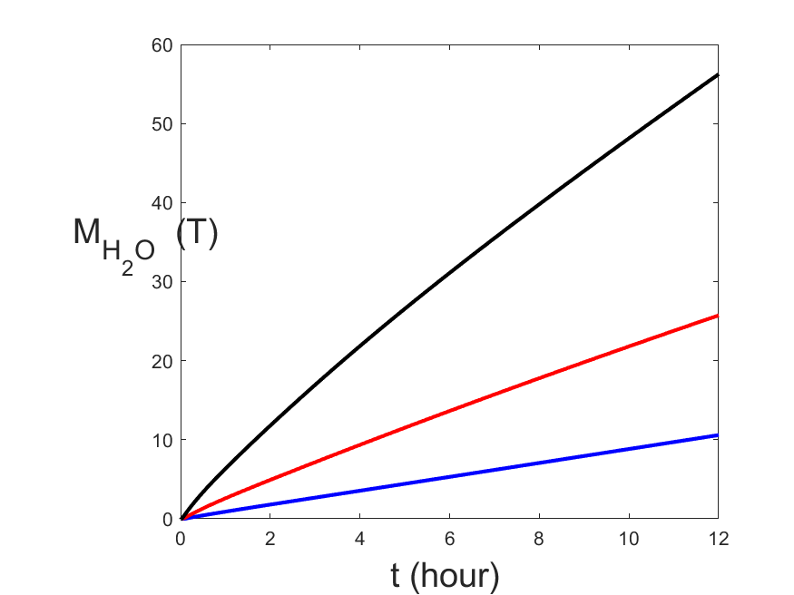
2. Outputs at the nuclear test site
2.1. H₂O
- Initial mass of water contained in the cavity ∼ 5000 T (sphere of radius 50 m; porosity 0.01)
Fractured porous medium with 192 fractures and porosity 0.05
Three initial cavity pressures after the collapse of the cavity roof and the formation of the chimney:
P₀ = 50 bars 100 bars 200 bars
Total mass
transferred
to the atmosphere
Mass flow rate
Detectable
by
satellite imaging?
To be compared with the 600 T contained in a standard
atmospheric column of 1000 m high above the test site, i.e. 15.5 g/m³
Notes:
comp_H20_1PHASE_PWORK_BG_T802.m
comp_M_H2O_BG_T802.png
comp_M_H2O_BG_T802_0_12h.png

Slide 5
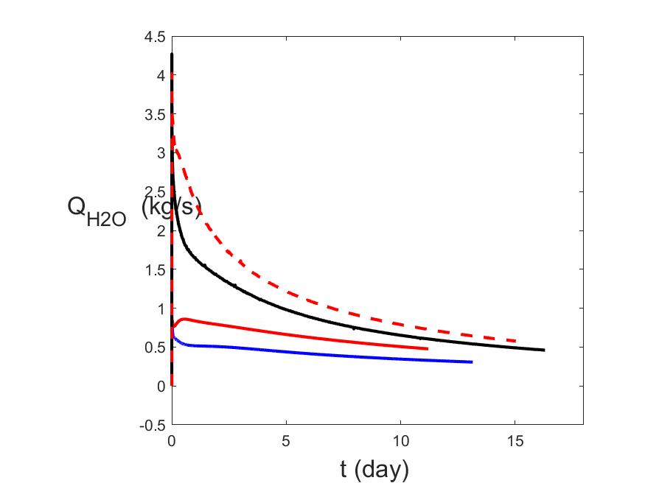
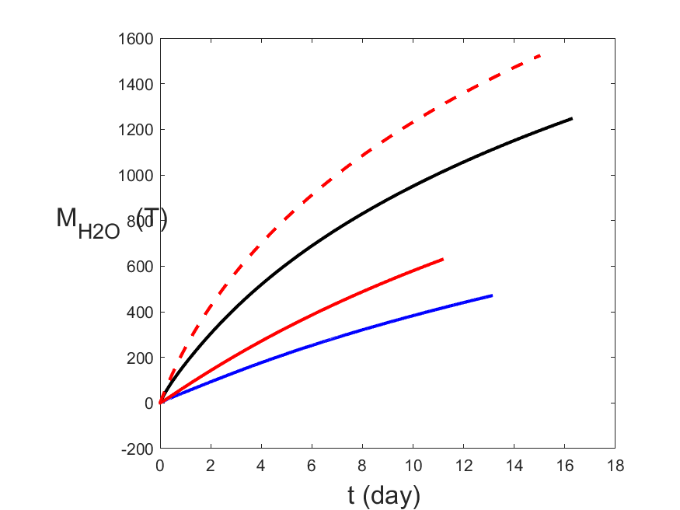
Influence of the petrophysical properties of the surrounding medium
When the porosity decreases, the initial mass flow rate increases
When the number of fractures increases, the initial mass flow rate increases
Nuclear test site
Nuclear test site
For P₀ = 100 bars
Convention Porosity Number
of fractures
blue 0.05 192
red 0.01 192
black 0.05 384
broken red 0.01 384

Slide 6
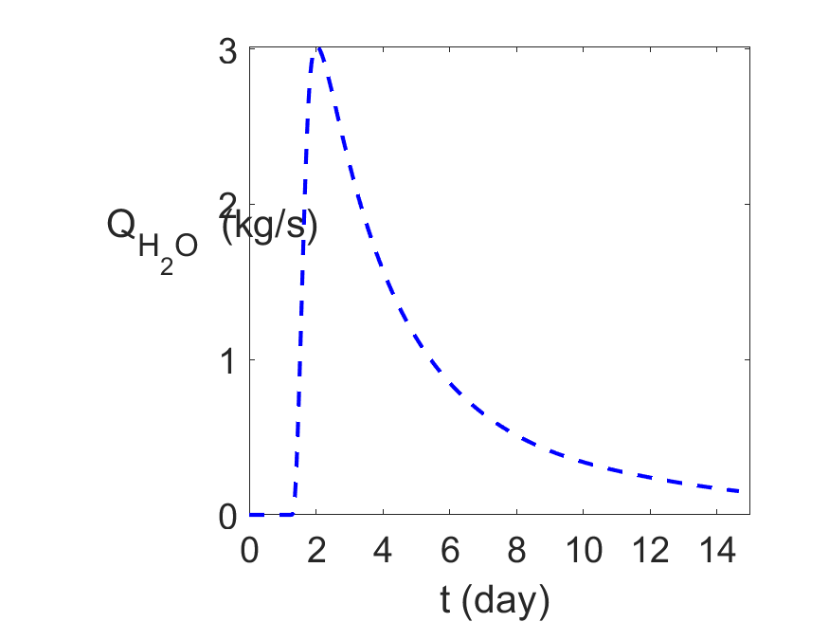
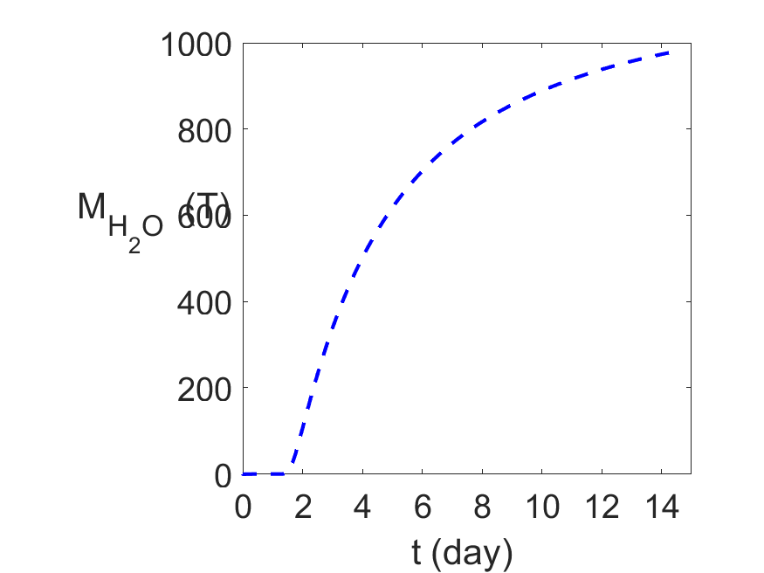
Comparison with an homogeneous model:
The fractured porous medium with ε = 0.05 and Nf= 192 is replaced by an equivalent homogeneous medium:
permeability K=6.48 10⁻¹³ m² and porosity ε=0.05 P₀= 100 bars
Delay to fill in the porosity!

Slide 7
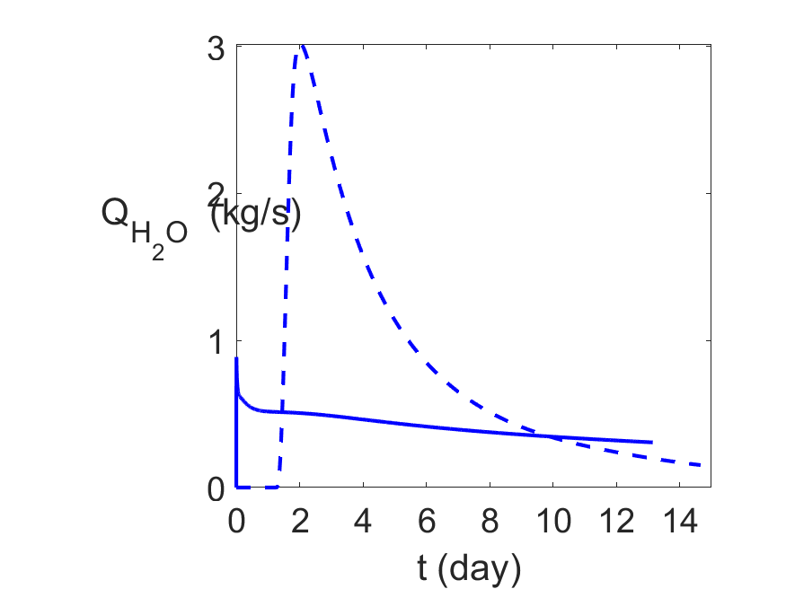
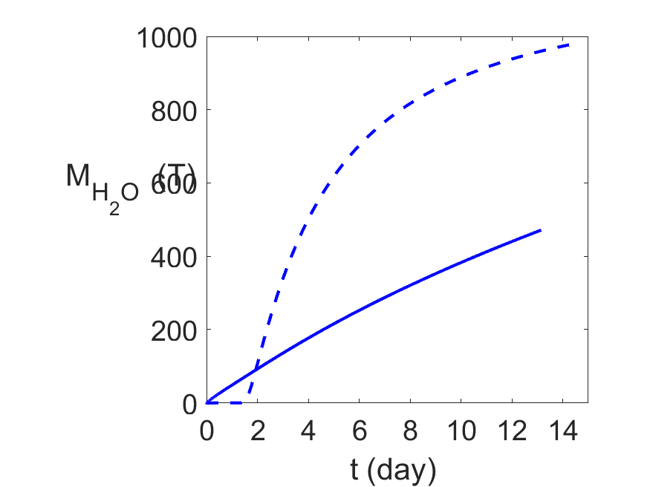
Comparison between the fractured porous medium model (solid line)
and the homogeneous one (broken line): P₀=100 bars ε=0.05 Nf=192
Orders of magnitude conserved!

Slide 8
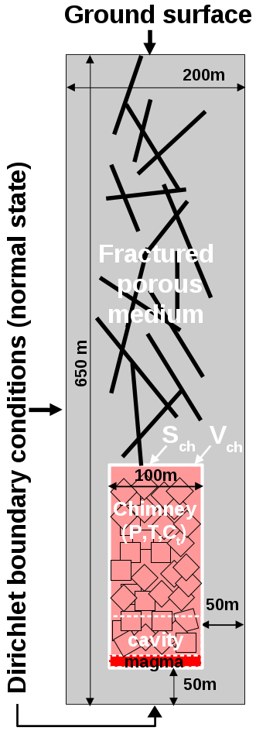
2.2. CO₂
Initially contained in a 10 m thick soil layer at the top of the medium
No fracture in this soil layer
Other properties of this layer:
permeability = 10⁻¹² m²,
porosity = 0.3
Diffusion coefficient calculated according to Archie’s law
Mass flow rate at the ground surface: 300 mg/m²/hour
Initial mass fraction (corresponds to equilibrium): 7.6 10⁻²
No source term in these preliminary calculations

Slide 9
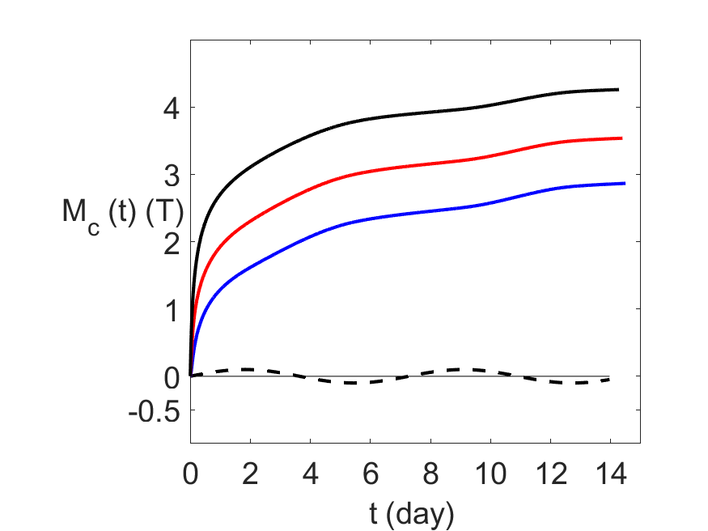
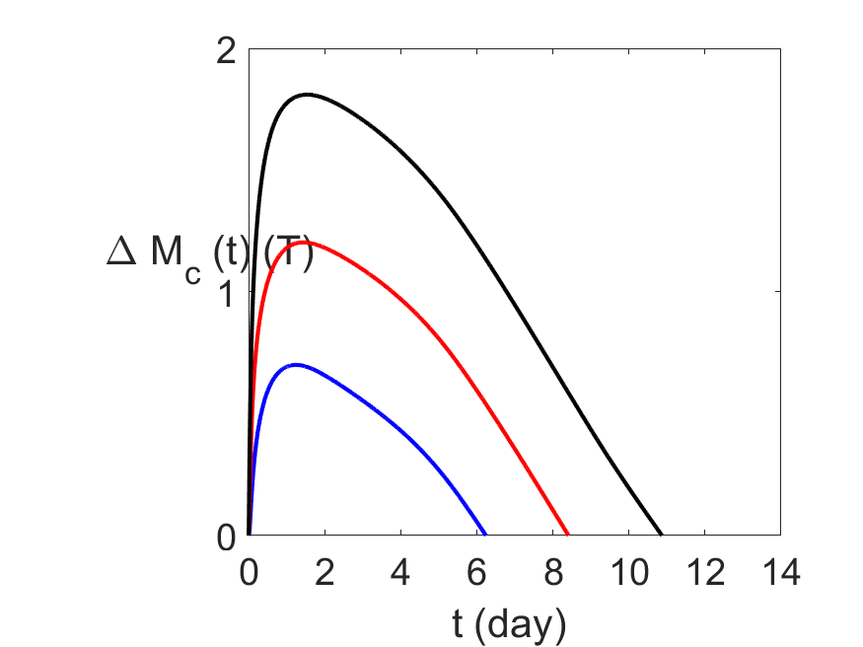
CO₂ mass Mc1 transferred to the atmosphere
Additional CO₂ mass transferred to the atmosphere:
DMc1(t) = Mc1-mass transferred with no test
P₀=
200 bars
100 bars
50 bars
Detectable
by
satellite imaging?
atmospheric pressure fluctuations
To be compared with
mass transferred to the atmosphere during 12 hours =144 kg

Slide 10
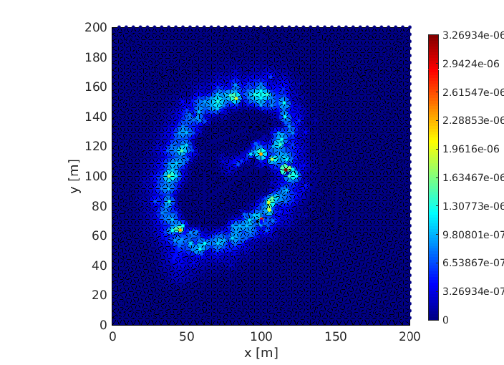
Actually the tracer fluxes at the ground surface are very localized
though they are significantly smoothed out by the soil layer

Slide 11
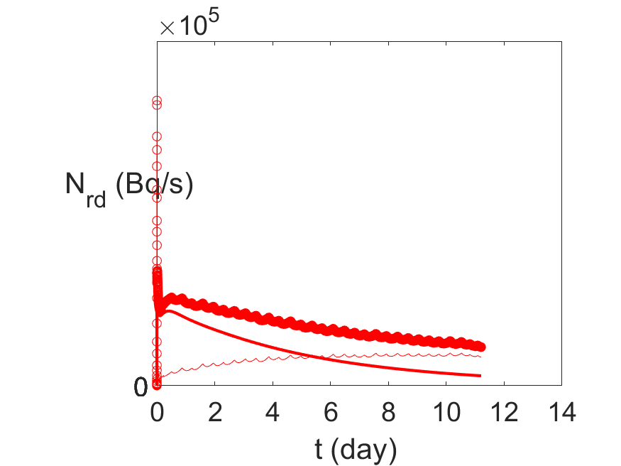
3. Outputs at the nuclear site and at the monitoring site
3.1. Radon
ε = 0.01 Nf=192 P₀ = 100 bars
Nuclear test site
Convention
Thin line = radon originated in the porous medium
Medium line = radon originated in the cavity
Thick line = sum
Notes:
add_radon_xe_CTBO.m voir aussi add_radon_xe.m pour les figures complètes

Slide 12
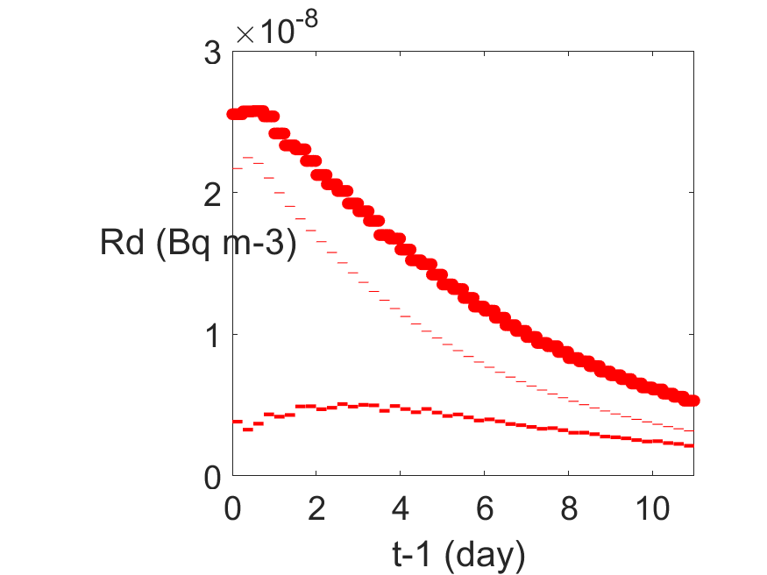
Monitoring site with 6 hours sampling
Desintegration number per 6 hours at the monitoring site:
delay = 1 day ⇒ t-1
λ = 1.5428 10⁻⁶ s⁻¹
η = 7 10⁻¹⁸ s m⁻³
Convention
Thin line = radon originated in the porous medium
Medium line = radon originated in the cavity
Thick line = sum
Order of magnitude of the ambiant value ∼ 50 Bq/s ⇒ hopeless
Notes:
seq_C_CTBO_mm3_rplusxe_dm2.png

Slide 13
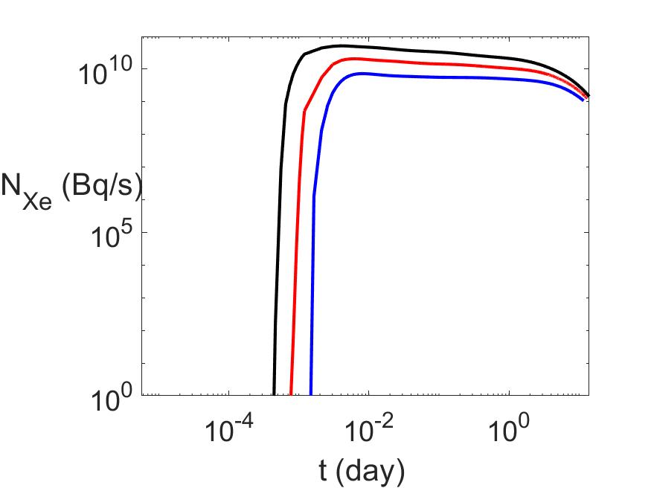
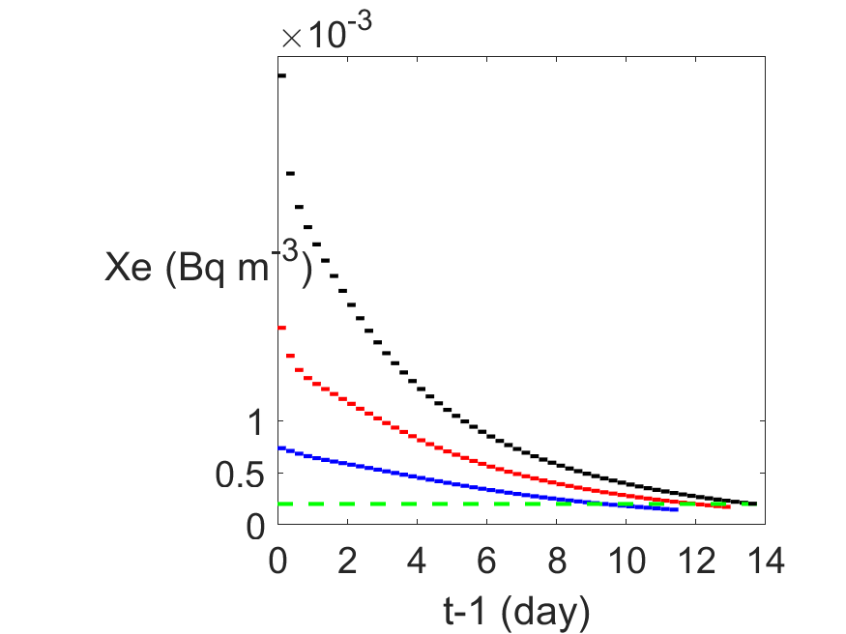
3.2. ¹³³Xe
Initially produced in the cavity: 1 mole, i.e. 133 g; dilution coefficient =7 10⁻¹⁸
ε =0.05 Nf=192 fractures for the three values of P₀
At the nuclear test site
At the monitoring site with 6 hours sampling
1 mn
1h
1d
1 w
detection limit
MDC¹³³Xe ~0,15 mBq/m³ for SAUNA III with a 6-hour sampling time (installed at JPX38), see Aldener et al. (2023)
~0,2 mBq/m³ for SPALAX NG with a 8-hour sampling time, see Topin et al. (2020).
Notes:
Pour le log_log 1 mole
comp_Bq_loglog_CEA_1PHASE_PWORK_BG_T802_1mole.m
comp_seq_C_CTBTO_Bq_BG_T802_1mole.png
comp_C_CTBTO_site_Bq_loglog_BG_T802_1mole.png
Pour le log_log: comp_Bq_loglog_CEA_1PHASE_PWORK_BG_T802.m donne comp_C_CTBTO_site_Bq_loglog_BG_T802.png
En linéaire: comp_Bq_CEA_1PHASE_PWORK_BG_T802.m donne comp_C_CTBTO_site_Bq_BG_T802.png et comp_seq_C_CTBTO_Bq_BG_T802.png

Slide 14
4. Concluding remarks
- Radon cannot be detected at the monitoring site
- H₂O and CO₂ outbursts could possibly be detected at the test site by satellite imaging depending on sensitivity
One day later, ¹³³Xe could be easily detected 1000 km away at the monitoring site considering the following scenario:
150 kt underground explosion at 550 m depth in a granitic rock
with a fracture network developed from the top of the chimney after cavity collapse

