Slide 1
Bayesian inversion of seismograms for source parameters of contained DPRK underground nuclear explosions
Anton Ziolkowski
University of Edinburgh
02.1-326
22 June 2023

Slide 2

DPRK TEST SITE AND MDJ SEISMIC STN
Mudanjiang (MDJ) seismic station in China is 373 km north of
Punggye-ri nuclear test site in the Democratic People’s Republic of Korea (DPRK).

Slide 3
DPRK TEST SITE AND MDJ SEISMIC STN
Mudanjiang (MDJ) seismic station in China is 373 km north of
Punggye-ri nuclear test site in the Democratic People’s Republic of Korea (DPRK).
From the seismograms recorded at MDJ, the goals are to recover
The source parameters and source time functions of the contained explosions
The Green’s function from the DPRK test site to MDJ.

Slide 4
OUTLINE
Ox.x-xxx
Contained DPRK underground nuclear explosions
Method (Ziolkowski, 2022)
Blake’s 1952 source model
Inclusion of free surface and key parameters
Inversion by Very Fast Simulated Annealing (VFSA)
Results: Green’s functions to Mudanjiang (MDJ) seismic station
Results: Source time functions
Conclusions

Slide 5
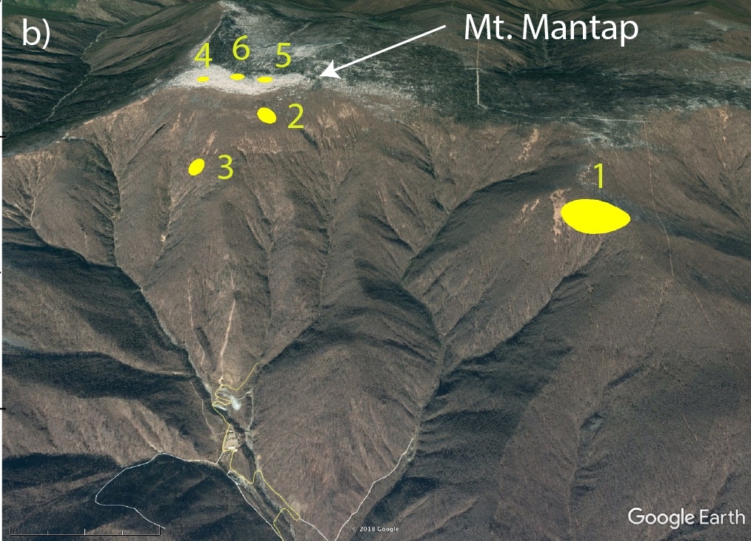


Relative epicenters constrained by InSAR-based ground displacement for 2016_01
2016_01
Constrained by InSAR
2017_09
N
2016_09
2009
2013
2006
Map View
Ellipses are 90%
probability areas
(Best Fit Gaussian)
Myers et al., SRL (2018)
Lawrence Livermore National Laboratory
Myers et al.,(SRL), 2018
5
LLNL-PRES-xxxxxx

Slide 6
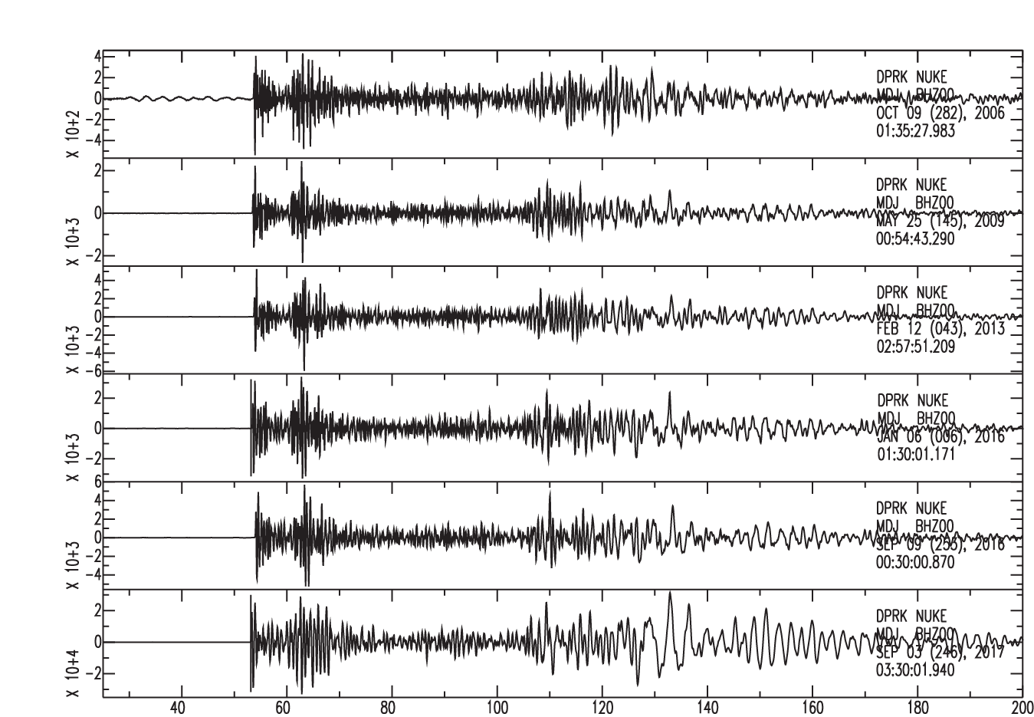
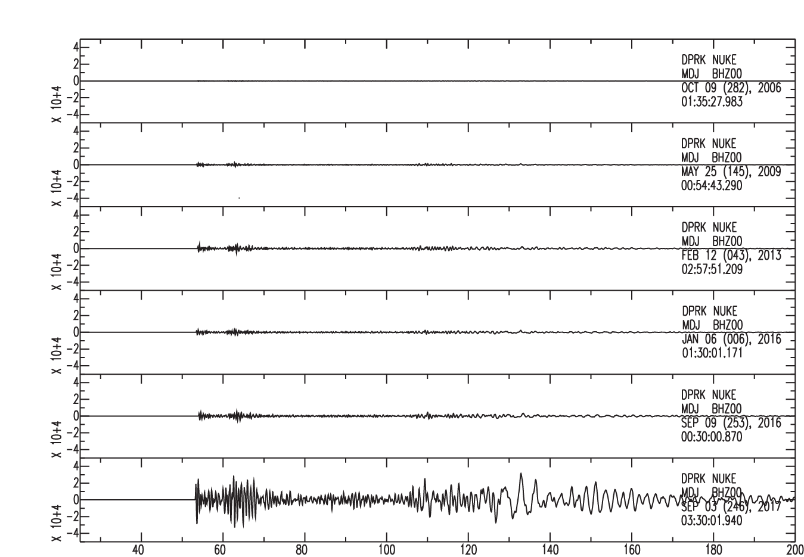
Seismograms recorded on common station are similar but variable amplitude
Trace normalized signals are similar
DPRK 6 is ~ 10 X larger than DPRK 5
N
Ellipses are 90%
probability areas
(Best Fit Gaussian)
Time (seconds)
Time (seconds)
Myers et al., SRL (2018)
Signals at publicly available seismic station MDJ about 350 km north
Lawrence Livermore National Laboratory
Myers (2019)
6
LLNL-PRES-xxxxxx

Slide 7
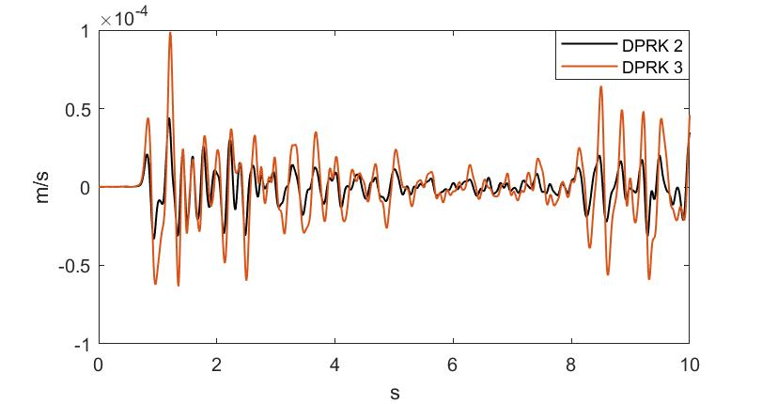
DPRK 2 and DPRK 3: Detail
The seismograms are different in detail, caused by differences in the source time function.
For example, DPRK 2 is smaller and more high frequency than DPRK 3.

Slide 8
METHOD
The contained explosions are all within about 1 km of each other.
The path from each explosion to the MDJ seismometer is the same.
The seismogram at MDJ for explosion is
We model and find its inverse filter from .
We estimate the Green’s function by convolving with :
We adjust the source parameters to minimise the differences among the different estimates of the Green’s function.

Slide 9
BLAKE’S SOURCE MODEL
Blake replaced the nonlinear zone surrounding the explosion by a cavity of radius a with internal pressure
and placed it in a homogeneous isotropic elastic medium.

Slide 10
BLAKE’S SOURCE MODEL
Blake replaced the nonlinear zone surrounding the explosion by a cavity of radius a with internal pressure
and placed it in a homogeneous isotropic elastic medium.
Blake’s 1952 model
r
Blake derived analytic expressions for the radial motion in the elastic zone, . The velocity potential
is velocity.
is reduced velocity potential (RVP).
is radiated pressure. is bulk modulus.
p₀(t)
a
ρ, c, σ
At the boundary the pressure is
continuous.

Slide 11
INCLUSION OF FREE SURFACE
The virtual source introduces a reversed-polarity pressure wave with time delay :
Virtual
Source
Mount Mantap is a granite peak. We assume isotropy.
Density kg/m³.
Bulk modulus Pa.
Normally Poisson’s ratio is 0.25 .
h
Free surface
Fundamental parameters to be found:
- resonant frequency
- Poisson’s ratio
- depth factor
- tensile strength of granite at radius a
All other parameters are derived from these parameters. Fracturing increases Poisson’s ratio and decreases P-wave velocity and tensile strength.
h
r
p₀(t)
a
ρ, c, σ

Slide 12
INVERSION WITH VFSA
In practice we use two sources, four parameters per source.
Very Fast Simulated Annealing (Sen, M. K. and P. L. Stoffa, 2013). For this problem:
  At each iteration each parameter is selected at random from its range;
  the source time functions are calculated,
  the Green’s functions are obtained by deconvolving the seismograms for the source time functions.
  the normalised root mean square difference (NRMSD) between the Green’s functions is the error.
  If the error is less than last time, we have a new model.
  If is greater we accept it with a reduced probability.
  At each iteration the temperature is gradually reduced.

Slide 13
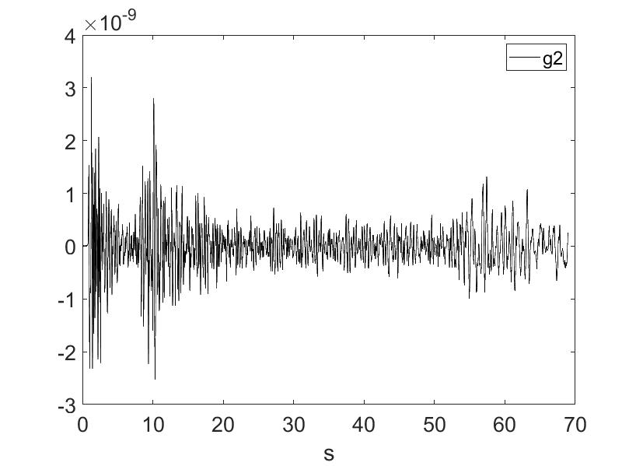
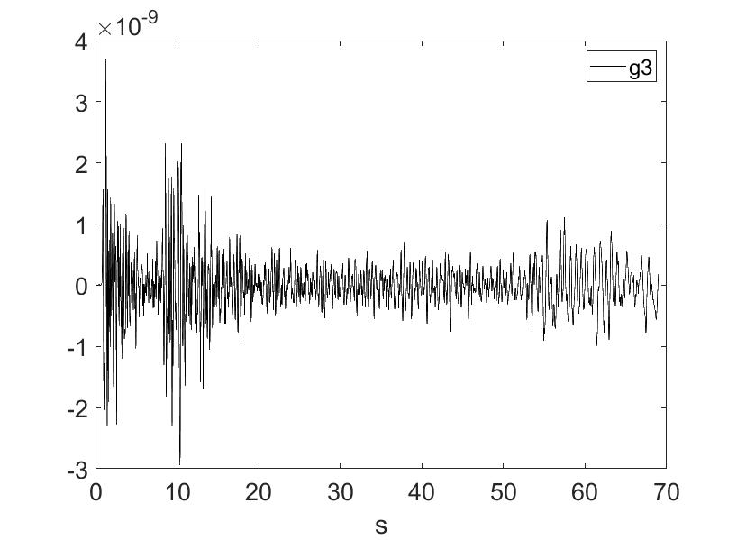
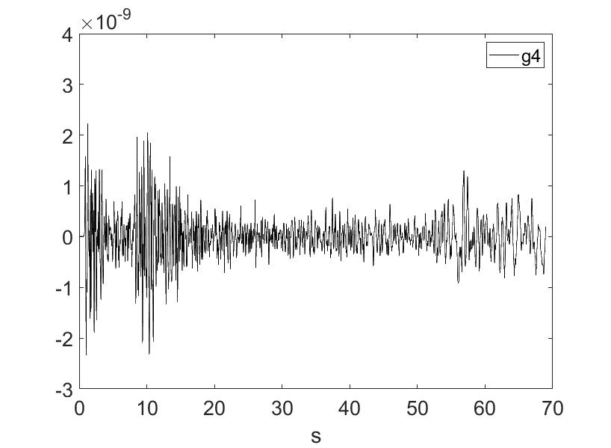
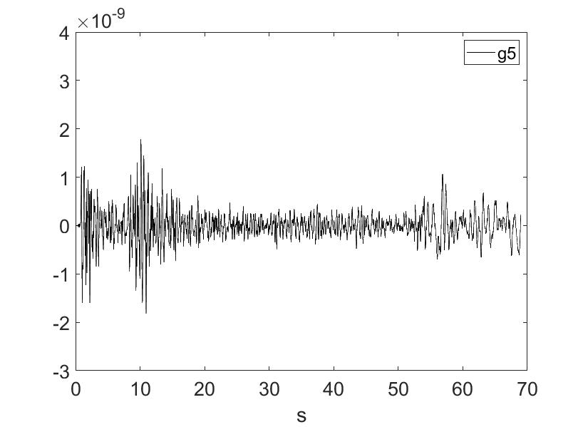
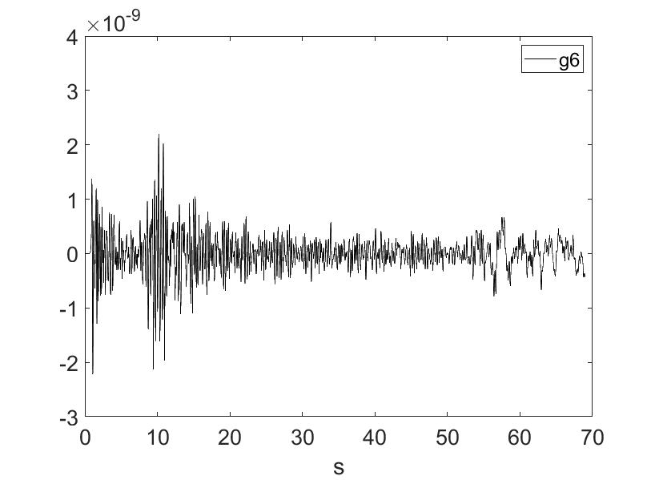
RECOVERED GREEN’S FUNCTIONS
For the inversion seismograms were truncated just before the Rayleigh wave arrival. The recovered Green’s functions should all be the same. They are very similar, but not identical.
Green’s functions:
All plotted on the same scale.

Slide 14
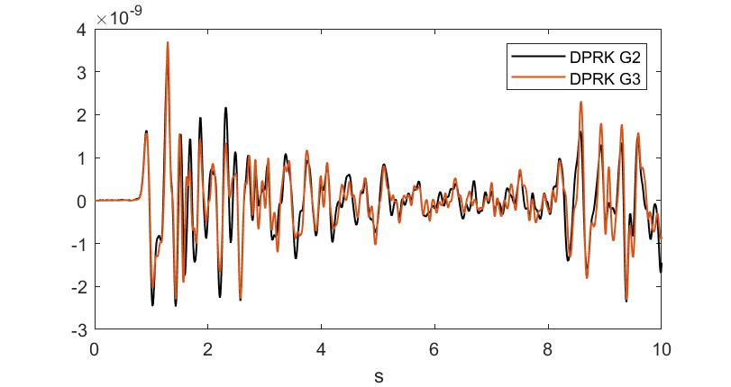
GREEN’S FUNCTIONS: DETAIL
Seismograms
DPRK 2 & DPRK 3
Green’s functions
DPRK 2 & DPRK 3

Slide 15
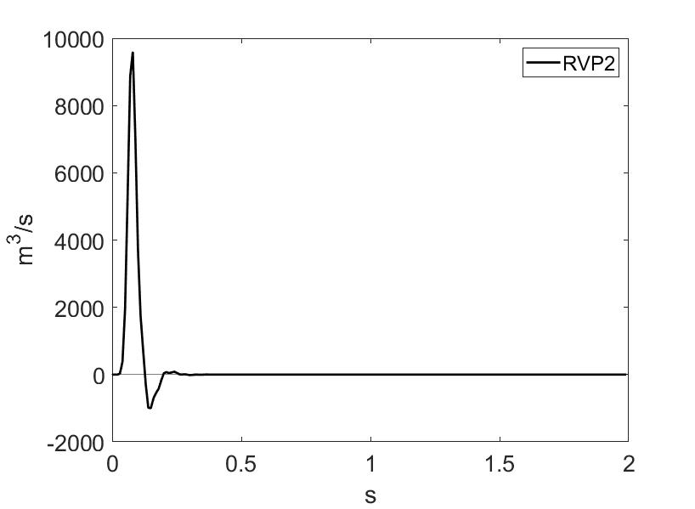
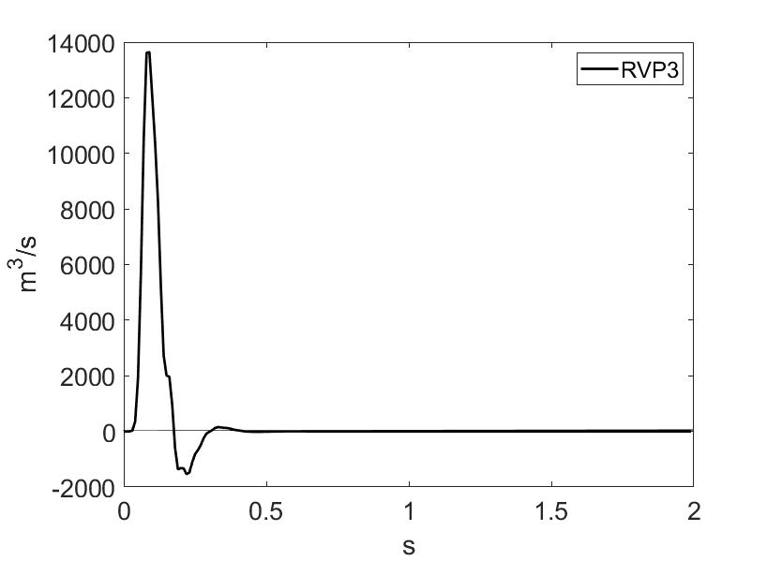
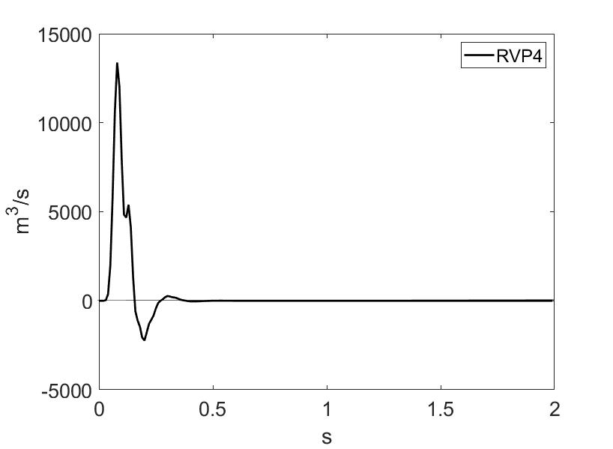
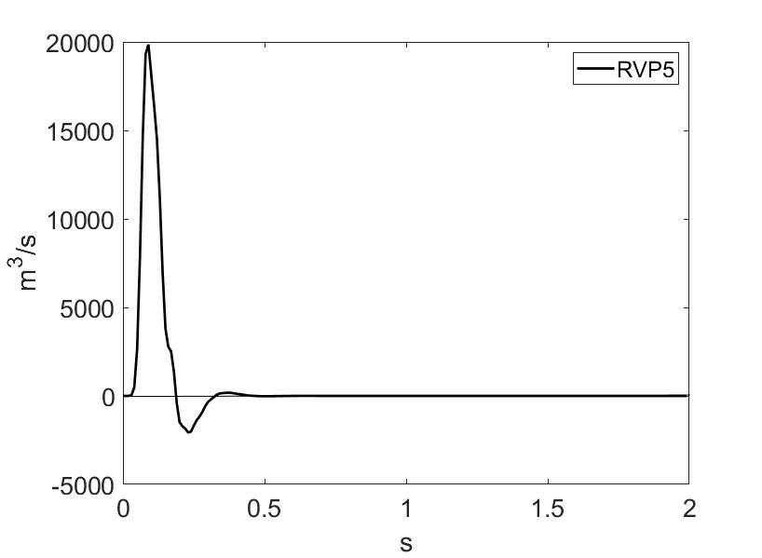
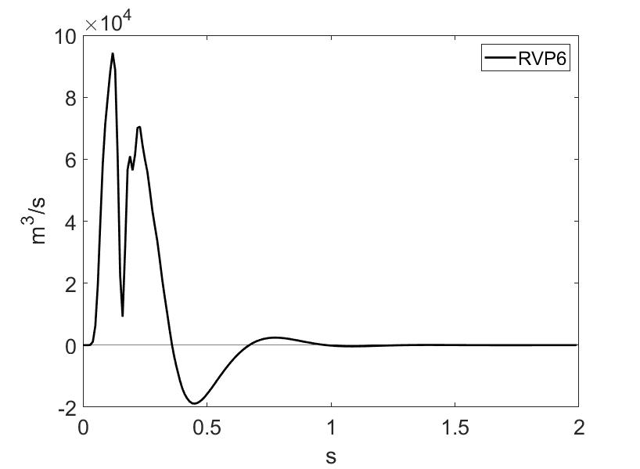
RECOVERED SOURCE TIME FUNCTIONS
Source time functions:
Individual scaling

Slide 16
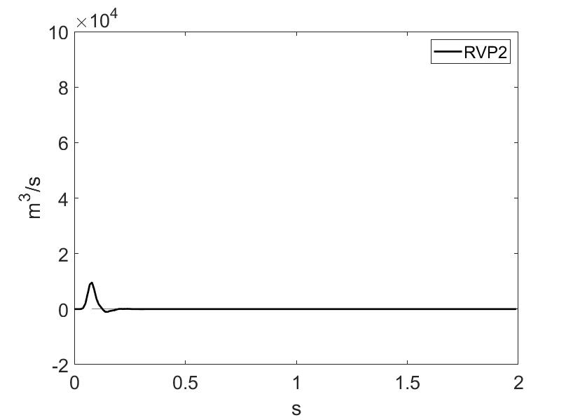


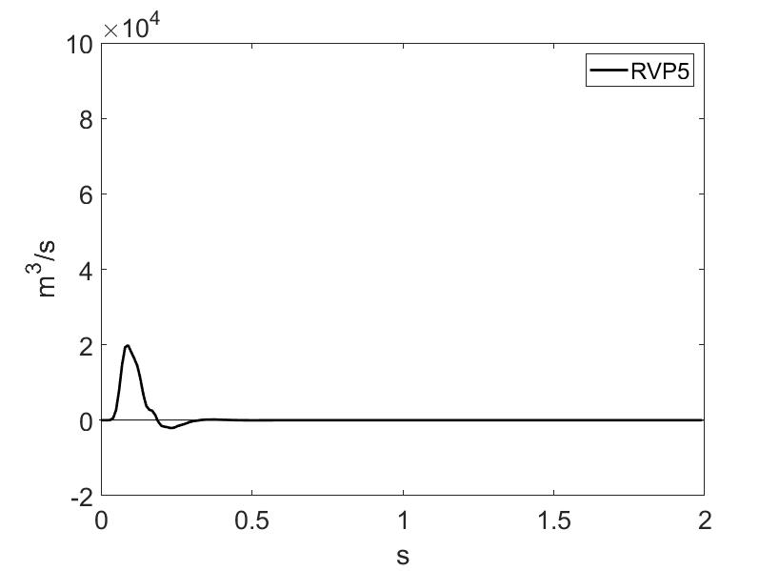
RECOVERED SOURCE TIME FUNCTIONS
Source time functions:
Equal scales

Slide 17
RECOVERED SOURCE PARAMETERS

Slide 18
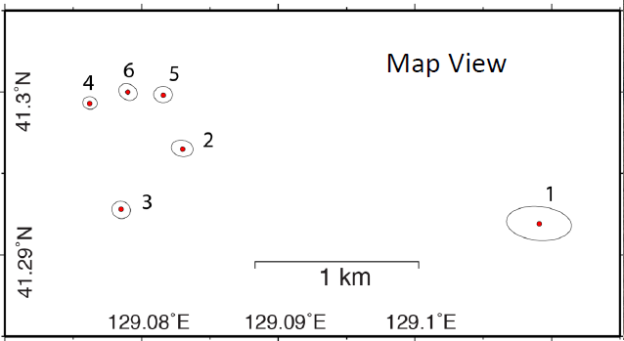
NONLINEAR ZONES
Elastic radius (m)
DPRK 2 140
DPRK 3 220
DPRK 4 170
DPRK 5 250
DPRK 6 460

Slide 19
NONLINEAR ZONES
Elastic radius (m)
DPRK 2 140
DPRK 3 220
DPRK 4 170
DPRK 5 250
DPRK 6 460

Slide 20
NONLINEAR ZONES
Elastic radius (m)
DPRK 2 140
DPRK 3 220
DPRK 4 170
DPRK 5 250
DPRK 6 460

Slide 21
NONLINEAR ZONES
Elastic radius (m)
DPRK 2 140
DPRK 3 220
DPRK 4 170
DPRK 5 250
DPRK 6 460

Slide 22
NONLINEAR ZONES
Elastic radius (m)
DPRK 2 140
DPRK 3 220
DPRK 4 170
DPRK 5 250
DPRK 6 460

Slide 23
NONLINEAR ZONES
Elastic radius (m)
DPRK 2 140
DPRK 3 220
DPRK 4 170
DPRK 5 250
DPRK 6 460

Slide 24
CONCLUSIONS
We have extracted estimated source parameters and source time functions of the DPRK contained underground nuclear tests 2009-2017 from the seismograms recorded at Mudanjiang (MDJ) seismic station.
The recovered Green’s functions between the DPRK test site and MDJ are very similar, but not identical.
The recovered source time functions can be used to estimate Green’s functions to other seismometers.
The two 2016 tests DPRK 4 and DPRK 5 created weak fractured zones close to the site of DPRK 6, causing DPRK 6 to behave differently from the other explosions.

Slide 25
Acknowledgments
I thank Steve Myers for permission to use slides from an excellent talk he presented in Edinburgh in 2019.
I thank many friends and colleagues with whom I have discussed this work over many years.
Finally, I thank the CTBTO for accepting this paper and for providing the funding to enable me to present it here.

Slide 26
REFERENCES
Blake, F. G., 1952, Spherical wave propagation in solid media: Journal of the Acoustical Society of America, Vol. 24, No. 2, 211-215.
Myers, S. C., S. R. Ford, R. J. Mellors, S. Baker and G. Ichinose, 2018, Absolute locations of the North Korean Nuclear Tests Based on Differential Seismic Arrival times and InSAR: Seismological Research Letters, 89(6), 2049-2058.
Richards, P. G. and W.-Y. Kim, 2007, Seismic signature: nature physics | VOL 3 | JANUARY 2007 | www.nature.com/naturephysics.
Sen, M. K. and P. L. Stoffa, 2013, Global optimization methods in geophysical inversion: Cambridge University Press.
Ziolkowski, A., 2022, Explosive source signature determination: Two unequal shots in the same hole: Geophysical Prospecting, DOI: 10.1111/1365-2478.13251.

