Slide 1
STM_toolkit: a Radionuclide Source-term Modeling Package for Rapid Scenario Determinations at the French NDC
Eric Pili¹, Pascal Achim¹, Aliaksei Pazdniakou²,
Pierre M. Adler², Sylvia Generoso¹
¹CEA, DAM, DIF, F-91297, Arpajon, France
²Sorbonne Université, Metis, 4 place Jussieu, 75252 Paris Cedex 05, France
O2.1-118
22 06 2023
Acknowledgments to Léa Pannecoucke, Loïc Martin and Bastien Pili for their participation to different stages of this project
during their internship at CEA.

Slide 2


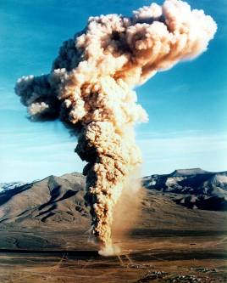
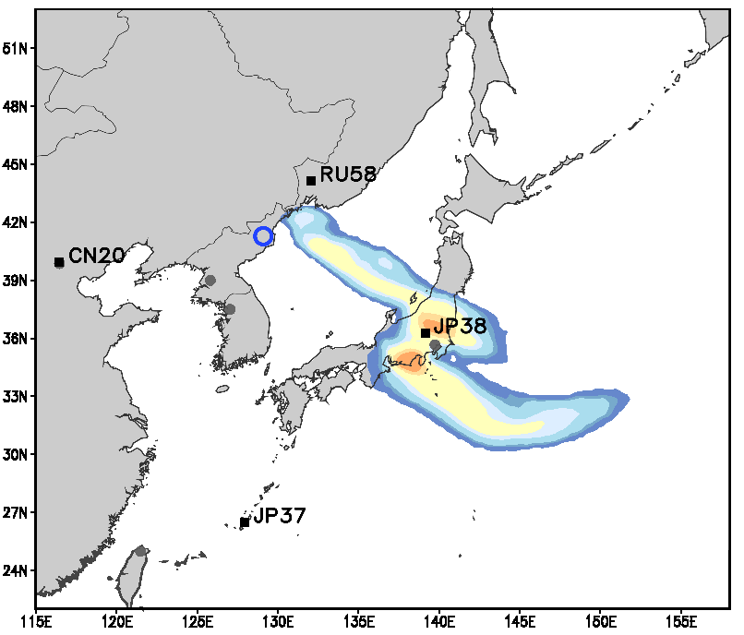
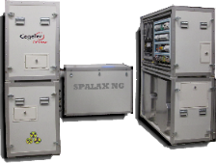
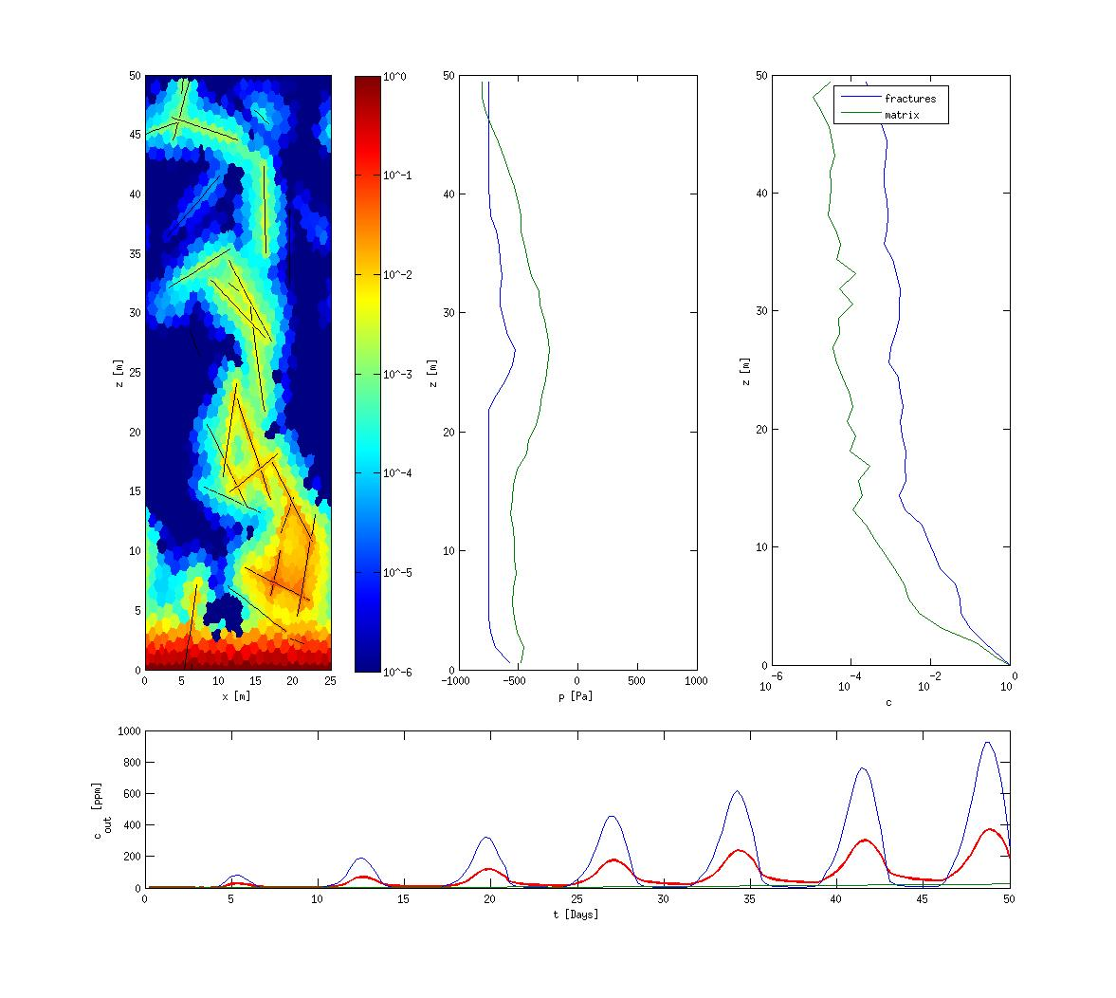
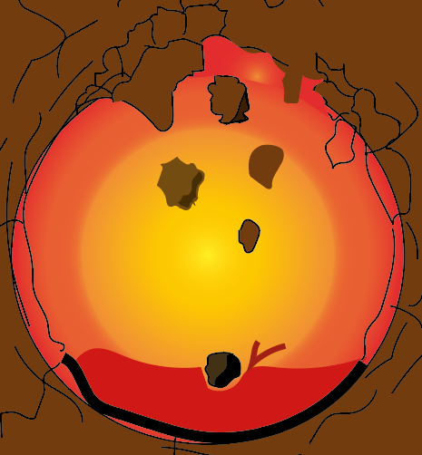
Some keywords about the detection of underground nuclear explosions from the monitoring of radionuclides
O2.1-118
Atmospheric release
Radionuclides recorded at monitoring stations
aerosols + radioxenon (^{131m}Xe, ¹³³Xe, ^{133m}Xe, ¹³⁵Xe)
Atmospheric Transport & Modeling
NDC
Forward ATM (needs atm. source term)
Backward ATM
Early venting
Late-time seepage
Example of monitoring system: SPALAX NG
(minutes – days)
(weeks – months)
French National Data Center
The atmospheric source term is different from the cavity source term.
The determination of the atmospheric source term (hence the activity concentrations recorded at monitoring stations) is not straightforward,
due to:
  Radioactive decay,
  Fractionation processes (elements and isotopes),
  Time-dependent gas fluxes through the rocks and at the ground surface,
  Dilution and dispersion of radionuclides in large amounts of air (both in rocks and in the atmosphere),
(+ atmospheric background and intrinsic characteristics of the monitoring systems).
The release at the ground surface must be estimated:
  From modeling of the relevant physical and chemical processes,
  Knowing the activity observed at the monitoring stations.
Atmosphere
Geosphere
Fracture network & porous medium
Radionuclide migration
Borehole or single fracture
Subsurface Transport
Underground Nuclear
Explosion
Cavity Source Term
Gases and aerosols,
including radionuclides
and H₂O vapor.

Slide 3
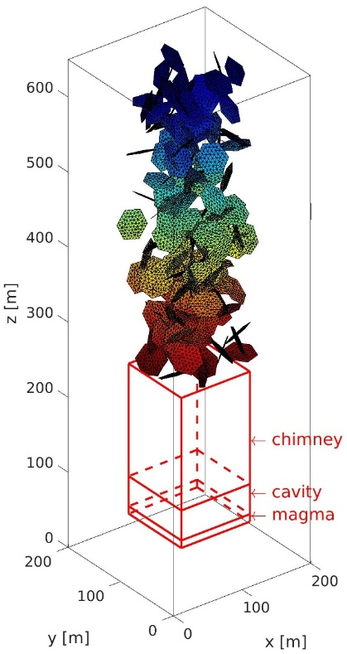


Rationales for rapid scenario determinations
following underground nuclear explosions (UNEs)
O2.1-118
Enhancing NDC expertise by providing ATM with a likely, physics-based, radionuclide source term emitted to the atmosphere (better than any arbitrary release of a fraction of the cavity source-term).
Advanced transport codes developed capacity to depict various aspects of the complexity
associated with UNEs (2 phases, non-isothermal, flow + transport), with:
  realistic 3D fracture networks (Pazdniakou et al., 2022),
  condensation of radionuclides in the nuclear cavity (Sun et al., 2022).
+
Provides higher-validity computations,
but requires higher-expertise modelers.
Time-consuming simulations, even with HPC:
  allow for slow construction of a knowledge base,
  can be used to validate simplified approaches.
Not handy to shape scenario & associated source-term, on a trial-and-error basis.
-
-
STM_toolkit (Source-Term Modeling toolkit): a modular software package allowing for rapid and step-by-step constructions of scenarios and their consequences in term of emissions of radionuclides following UNEs.
User-friendly graphical interface,
No requirement for expertise in geosciences,
Estimation of radionuclide activity vs. time, from the nuclear cavity to the monitoring stations with 4 tools.

Slide 4
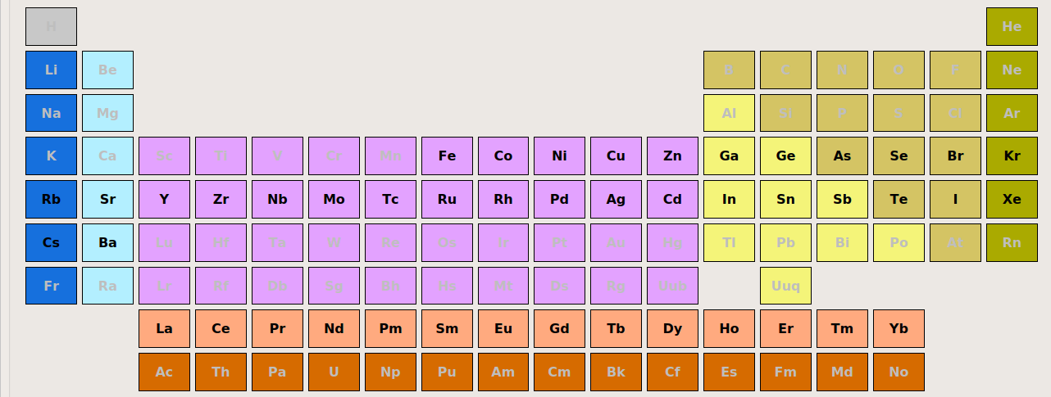
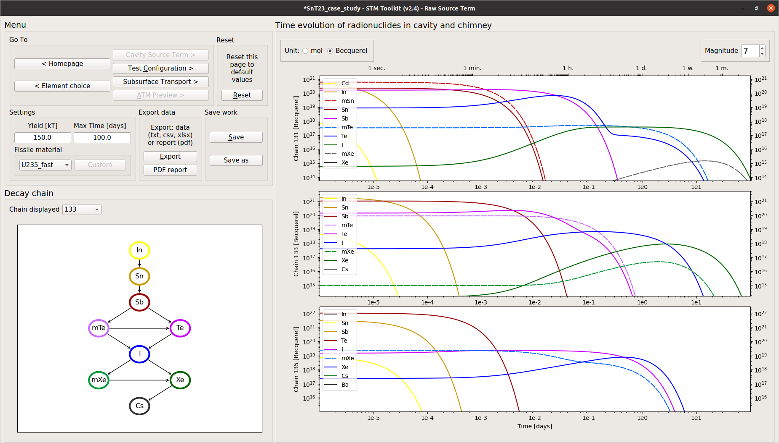
STM_toolkit
Tool #1: Cavity source term
Choice of radionuclides and determination of time-evolution in the cavity
O2.1-118
Choice of relevant fission products (gases and aerosols), with updates. β-decay isobars from mass 72 to 171, ~800 nuclides.
Choice of fissile materials (²³⁵U, ²³⁸U, ²³⁹Pu) and neutron energy (fast, high-energy, thermal).
Choice of nuclear database (ENDF, JEFF), with updates (half-lives, branching factors, independent yields).
Example of the ¹³³Xe decay chain
: time-evolution in a nuclear cavity (150 kt, ²³⁵U_{f} , single phase, closed system).

Slide 5
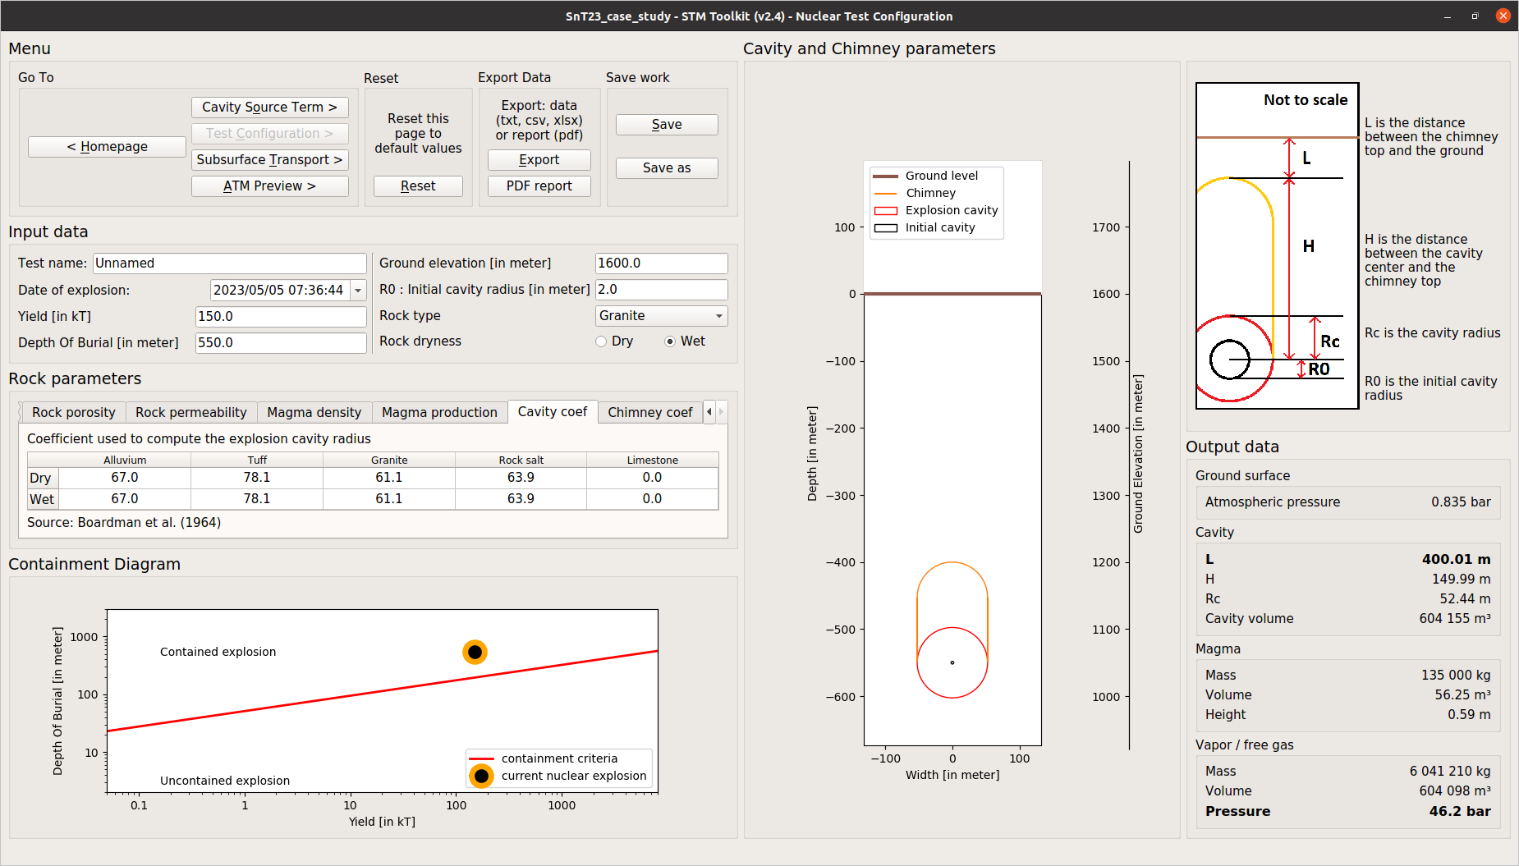
STM_toolkit
Tool #2: Nuclear-test configuration
Estimation of the geometrical features and pressure of carrier gas
O2.1-118
Inputs from data fusion (waveforms, satellite imaging…) and databases:
  Yield of explosion and Depth of Burial,
  Nature of rocks (granite, basalt, tuff, alluvium…),
  Water content (unsaturated/saturated).
Computations from empirical laws and parameters derived from former nuclear tests (e.g. Boardman et al 1964):
  Containment criteria,
  Development of cavity and chimney.
Outputs:
  Cavity radius,
  Height of chimney, distance to ground surface,
  Pressure of H₂O vapor in cavity = carrier gas.
Example of cavity (radius: ~50-m) and chimney (height: ~150-m) that could developed for a 150-kt nuclear explosion at 550-m depth in a saturated granitic rock. The gas pressure inside the cavity is ~50 bar.

Slide 6
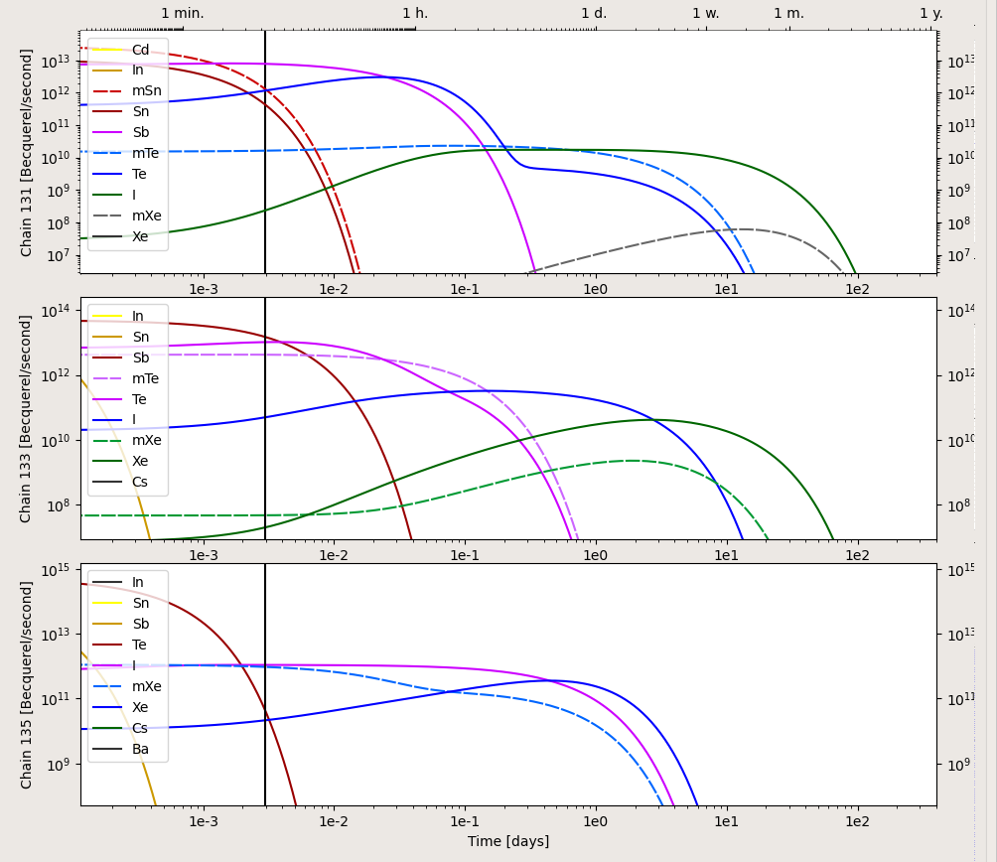
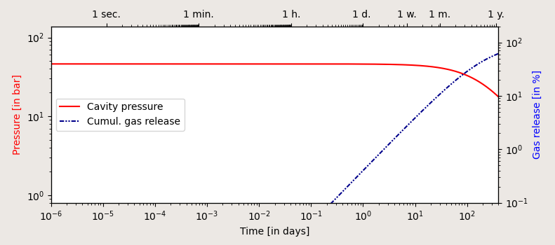
STM_toolkit
Tool#3: Subsurface transport
Estimation of radionuclide inventory released at ground surface over time
O2.1-118
Two settings considered:
borehole of given radius (potential delay before drilling),
single fracture of given aperture.
1D calculations of the time evolutions of:
Pressure in cavity (surface venting & seepage from cavity walls),
Fraction of carrier gas released at ground surface.
Convolution of gas release & cavity source term gives the radionuclide inventory released at ground surface.
131 decay chain
133 decay chain
Steady-state hypothesis not valid
Pressure in cavity
135 decay chain
Gas release
at ground surface
Example of radioxenon release computed at ground surface following a 150 kt nuclear explosion (²³⁵U_{f}) buried at 550 m. The release is from a 250-µm fracture starting at the tip of the chimney.
250-µm fracture
(400 m x 100 m)

Slide 7
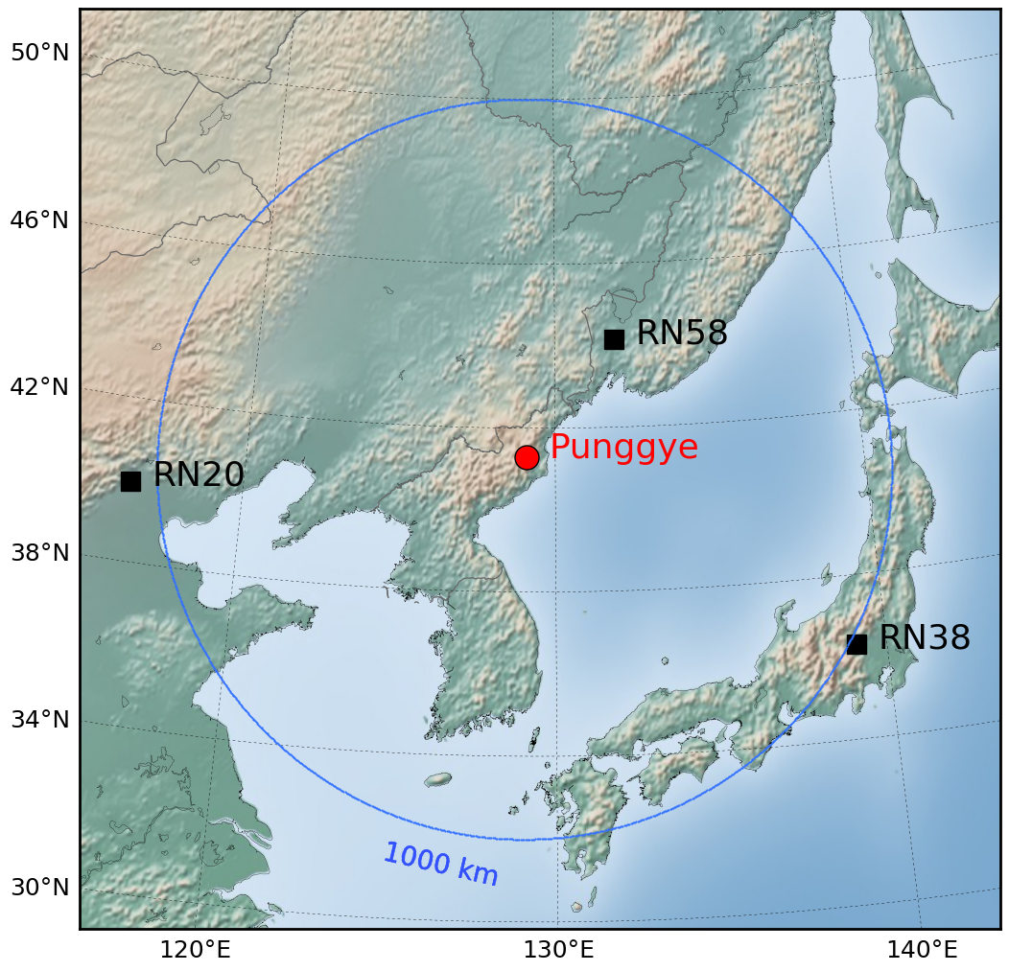
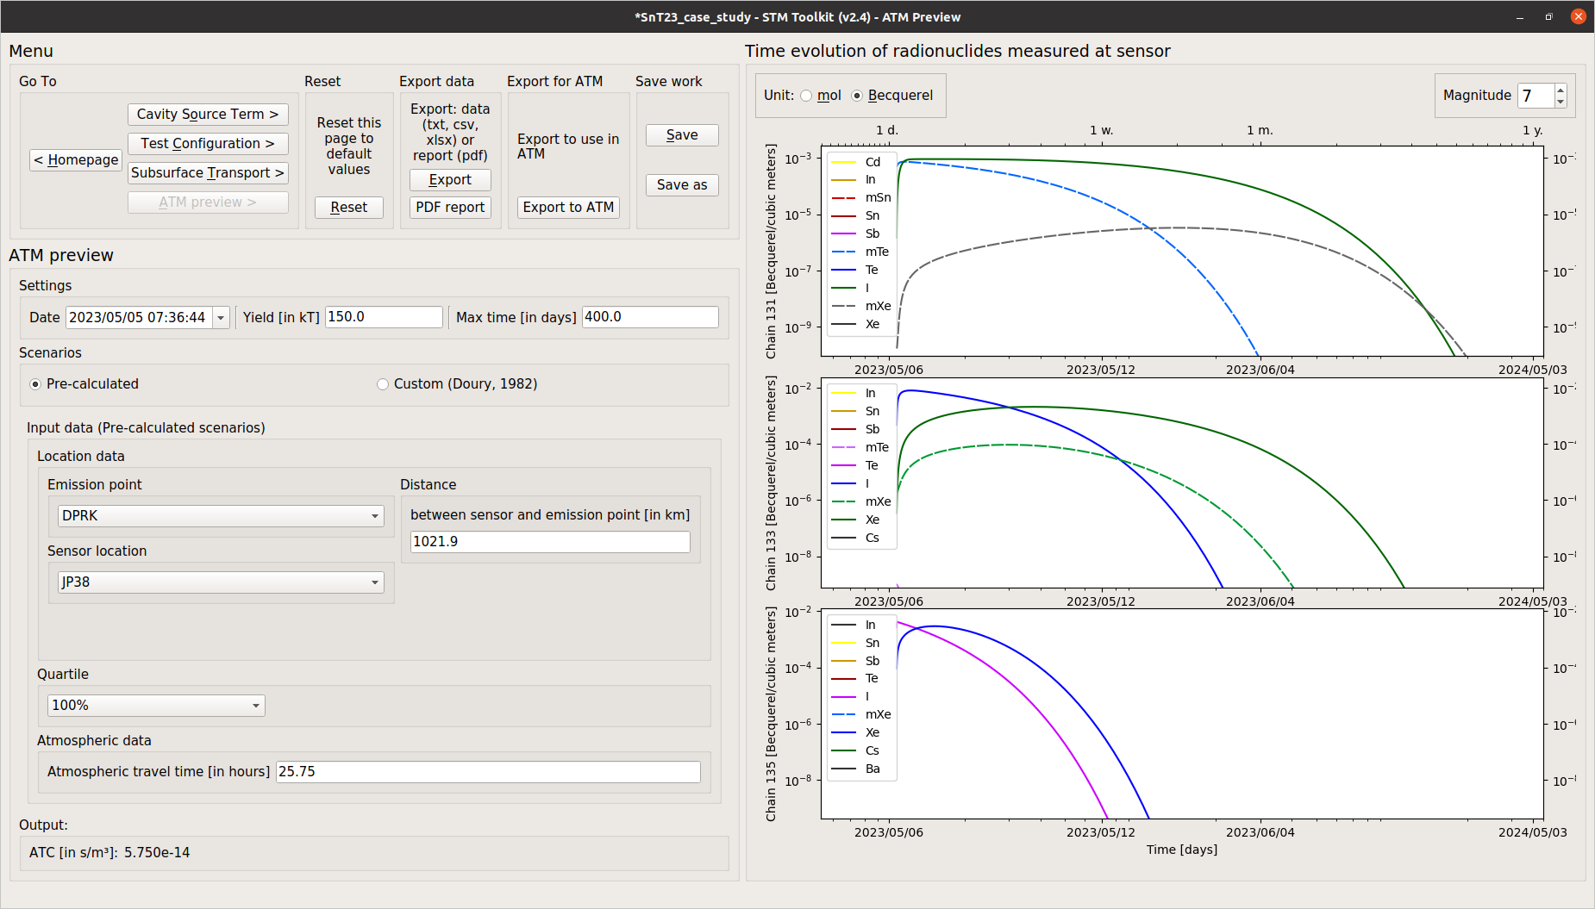
STM_toolkit
Tool #4: ATM preview
Estimation of radionuclide activities expected at monitoring stations
O2.1-118
Provides volume activity (Bq/m³) expected at relevant monitoring stations from conversion of radionuclide release (Bq/s) at ground surface on the nuclear test site.
Empirical determination of dilution factors (s/m³):
Obtained from Flexpart (Stohl et al., 1998) simulations of series of releases from a site of interest: 1 Bq over 1 second,
every hour, from Jan. 1st 00:00 to Dec. 31th 23:00, observed at nearby monitoring stations, with statistical distributions.
  Real conditions for past reconstruction of events or realistic conditions for future events.
Alternatively obtained from power-law rule (e.g. Eslinger et al., 2015).
Example of ¹³³Xe concentration activity (Bq/m³) expected at the RN38 monitoring station (Japan) following a 150 kt (²³⁵U_{f} ) underground nuclear explosion that would have occurred at a depth of 550-m at the Punggye-ri site (DPRK) in a granitic rock (water-saturated), with venting assumed to occur through a single fracture of aperture 250 µm, starting at the tip of the chimney, without any fractionation of the radionuclides:
¹³³Xe
Mean MDC*
*MDC: Minimum detection concentration (e.g., Topin et al. 2020, Brander et al. 2022, Aldener et al. 2023).

Slide 8
Conclusion
STM_toolkit: a Radionuclide Source-term Modeling Package for Rapid Scenario Determinations at the French NDC
O2.1-118
Achievements:
  STM_toolkit: a very handy and user-friendly software package for step-by-step, physics-based, source-term estimates of all relevant fission products, from the nuclear cavity to the monitoring stations.
  Use of realistic conditions from empirical laws and parameters, with input from data fusion.
  Rapid computations for trial-and-error determinations of scenario + source term, before export to ATM.
Work in progress:
  Adding fractionation of source-term by condensation in the nuclear cavity, following Carrigan et al. (2020) and Bourdon and Pili (2023).
  Allowing late-time seepage from barometric pumping.
  Further validating the code against documented situations.
Future developments:
  Addition of radionuclides other than fission products, addition of other carrier gases.
  Acceleration of subsurface transport simulations in more complex conditions by machine learning.
Aldener, M. et al., 2023. SAUNA III - The next generation noble gas system for verification of nuclear explosions. J. Env. Rad.
Boardman, C.R. et al., 1964. Responses of four rock mediums to contained nuclear explosions. J. Geophys. Res.
Bourdon, B., Pili, E., 2023. Thermodynamic determination of condensation behavior for the precursory elements of radioxenon following an underground nuclear explosion. J. Env. Rad.
Brander, S. et al., 2022. Phase II testing of Xenon International on Mount Schauinsland, Germany. J. Env. Rad.
Carrigan, C.R., Sun, Y., Pili, E., Neuville, D.R., Antoun, T., 2020. Cavity-melt partitioning of refractory radionuclides and implications for detecting underground nuclear explosions . J. Env. Rad.
Eslinger, P.W. et al., 2015. Atmospheric plume progression as a function of time and distance from the release point for radioactive isotopes. J. Env. Rad.
Pazdniakou, A., Mourzenko, V., Thovert, J.-F., Adler, P.M., Pili, E., 2022. Two-Phase flow, heat and mass transfer and tracer transport to the atmosphere from underground nuclear cavities through fractured porous media. PAGEOPH.
Stohl, A. et al., 1998. Validation of the lagrangian particle dispersion model FLEXPART against large-scale tracer experiment data. Atm. Env.
Sun, Y., Carrigan, C.R., Pili, E., Antoun, T., 2022. Implications of Underground Nuclear Explosion Cavity Evolution for Radioxenon Isotopic Composition. PAGEOPH.
Topin, S. et al., 2020. 6 months of radioxenon detection in western Europe with the SPALAX-New generation system - Part1: Metrological capabilities. J. Env. Rad.

