Slide 1
Machine Learning for Travel Time Emulation
Stephen C. Myers, Gemma Anderson, Nathan Simmons
Lawrence Livermore National Laboratory
O1.2-179
Presentation Date: 22 June 2023
This research was performed in part under the auspices of the U.S. Department of Energy by the LLNL under Contract Number DEAC52-07NA27344. This work was released under LLNL_PRES-849559

Slide 2
Take Away
O1.1-179
3D global models of seismic wave speed predict seismic phase arrival times more accurately than current (radially symmetric, 1D) models in operations. Using a 3D model would:
Aid the process of detection-event association (e.g. GA, NetVISA )
Improve seismic event location accuracy (e.g. iLoc, Bayesloc)
Ray tracing through global models in real time is too slow for operational use (0.1-1.5 sec)
Machine Learning for Travel Time Emulation (MaLTTE) makes using 3D models practical
Differences between MaLTTE and 3D model travel-time predictions are small compared to the inherent model and measurement errors.
MaLLTE computation time is fast (~0.00003 sec), well below operational requirements.
Revised MaLLTE manuscript submitted May 2023 (GJI)

Slide 3
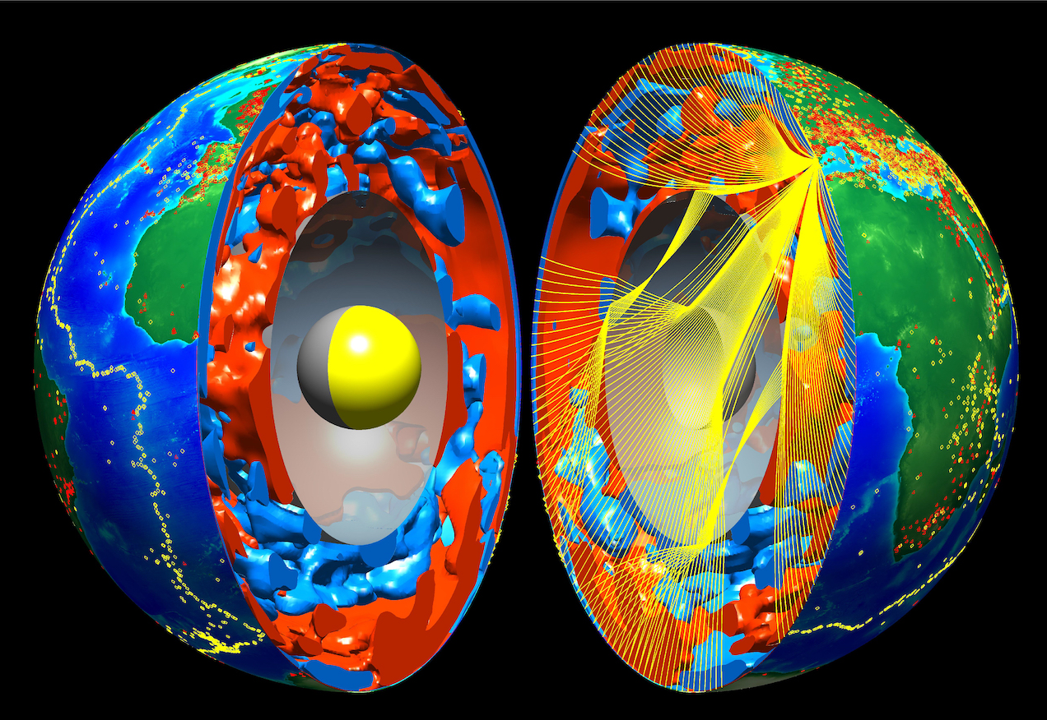
The LLNL G3D model is an example of a 3D earth model that may be used to improve seismic-event location accuracy
O1.1-179
Tomographic image of Earth’s interior and seismic ray paths
LLNL 3D models can compute seismic-phase travel times and uncertainties for virtually all phases used in monitoring
P -- First-arriving direct (non-reflected) P-wave (0 to about 99 degrees)
Pg -- P-wave restricted to bottom in the upper crust or shallower (0 to 5 degrees, unstable beyond 5 degrees)
Pb -- P-wave restricted to bottom in the lower crust (0 to 7 degrees, may be unstable in complex regions)
Pn -- P-wave restricted to bottom in the upper mantle above the transition zone (0 to about 25 degrees)
pP -- P-wave depth phase reflected off the surface of the solid part of the model (1 to about 100 degrees)
pwP -- P-wave depth phase reflected off the top of the water layer if one exists, same as pP otherwise (1 to about 100 degrees)
PP -- Double P-wave turning in the lower mantle and reflecting from the solid surface(about 53 to 180 degrees)
PwP -- Double P-wave turning in the lower mantle and reflecting from the top of the water layer if it exists (53 to 180 degrees)
PcP -- P-wave reflected off the outer core (0 to about 99 degrees)
PKPdf (alias PKP or PKIKP) -- P-wave bottoming in the inner core (115 to 179 degrees)
PKPab -- P-wave bottoming in the middle of the outer core (about 145 to 177 degrees)
PKPbc -- P-wave bottoming in the deep outer core (about 145 to 155 degrees)
PKPcd (alias PKiKP) -- P-wave reflecting from the inner core (upto about 155 degrees)
Ptz -- P-wave restricted to bottom in the transition zone (12 to about 30 degrees)
Plm -- P-wave restricted to bottom in the lower mantle (16 to about 99 degrees)
PmP -- P-wave reflected from the Moho (0 to about 5 degrees)
S -- First-arriving direct (non-reflected) S-wave (0 to about 99 degrees)
Sg -- S-wave restricted to bottom in the upper crust or shallower (0 to 5 degrees, unstable beyond 5 degrees)
Sb -- S-wave restricted to bottom in the lower crust (0 to 7 degrees, may be unstable in complex regions)
Sn -- S-wave restricted to bottom in the upper mantle above the transition zone (0 to about 25 degrees)
Stz -- S-wave restricted to bottom in the transition zone (12 to about 30 degrees)
Slm -- S-wave restricted to bottom in the lower mantle (16 to about 99 degrees)
SmS -- S-wave reflected from the Moho (0 to about 5 degrees)
sS -- S-wave depth phase reflected off the surface of the solid part of the model (1 to about 100 degrees)
SS -- Double S-wave turning in the lower mantle and reflecting from the solid surface(about 53 to 180 degrees)
ScS -- S-wave reflected off the outer core (0 to about 99 degrees)
SKS -- S-wave in mantle, P-wave turning in outer core (about 63 to 144 degrees)
SKKS -- S-wave in mantle, P-wave turning in outer core and reflecting off outer core from below (about 63 to 179 degrees)
N. Simmons, LLNL
LLNL G3D: Simmons et al., 2011, 2012,2015,2019
Model and software are openly available https://www-gs.llnl.gov/nuclear-threat-reduction/nuclear-explosion-monitoring/global-3d-seismic-tomography

Slide 4
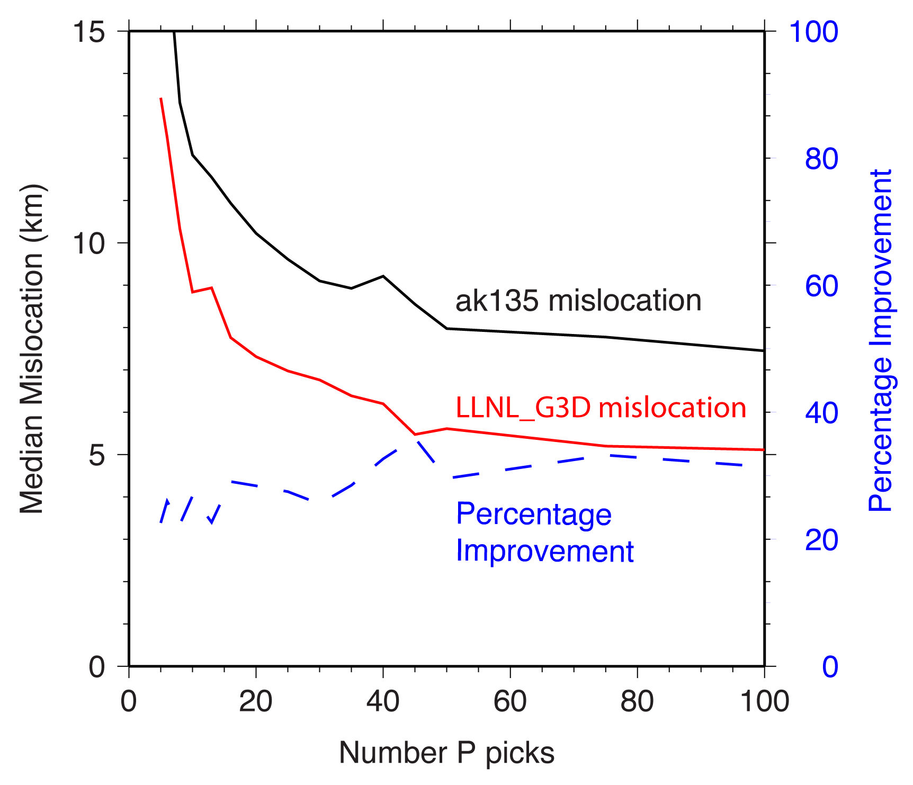
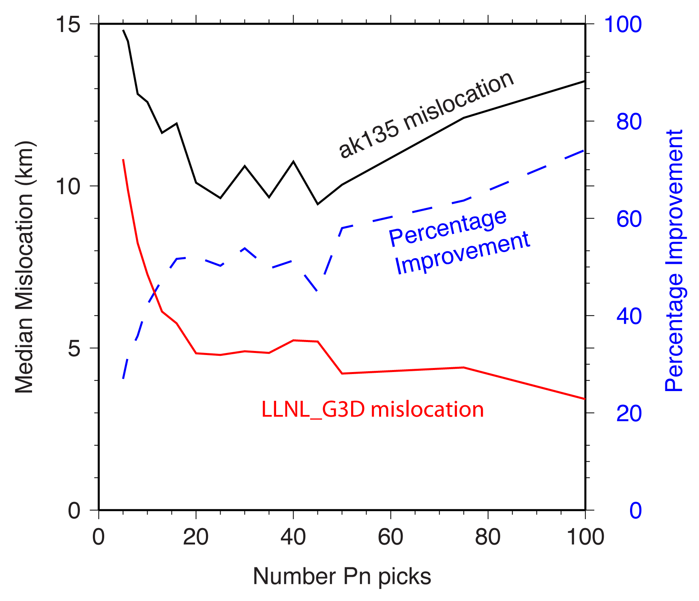
Travel times computed using LLNL G3D are accurate, and using them improves event location accuracy
O1.1-179
Travel time accuracy with LLNL-G3D and standard model (ak135)
Summary of seismic event epicenter accuracy using LLNL-G3D and standard model
Results from Myers et al., BSSA, 2015

Slide 5
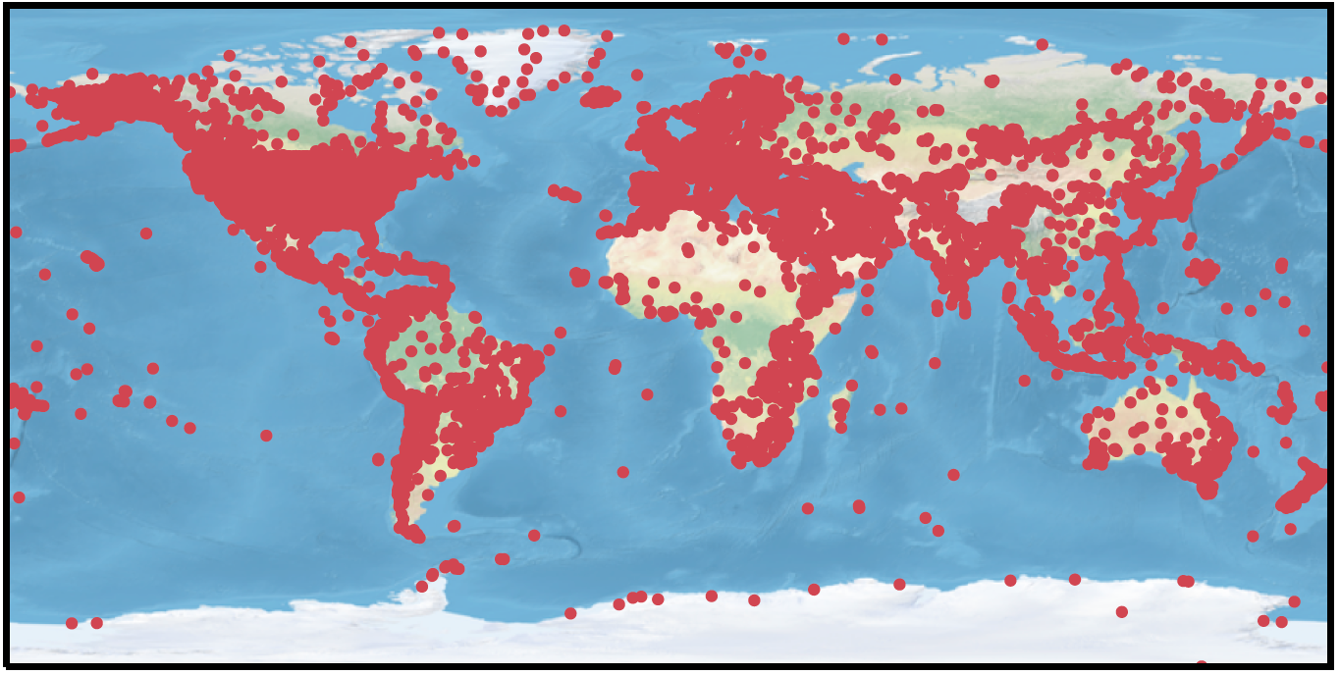
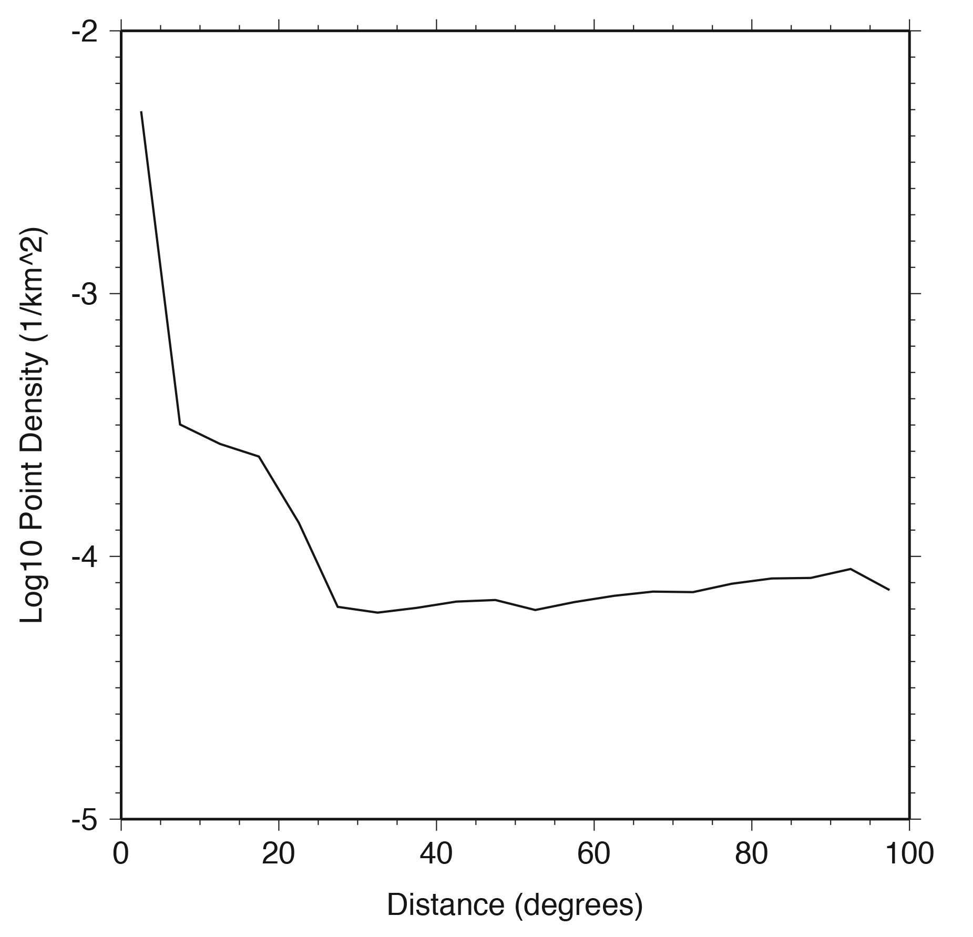
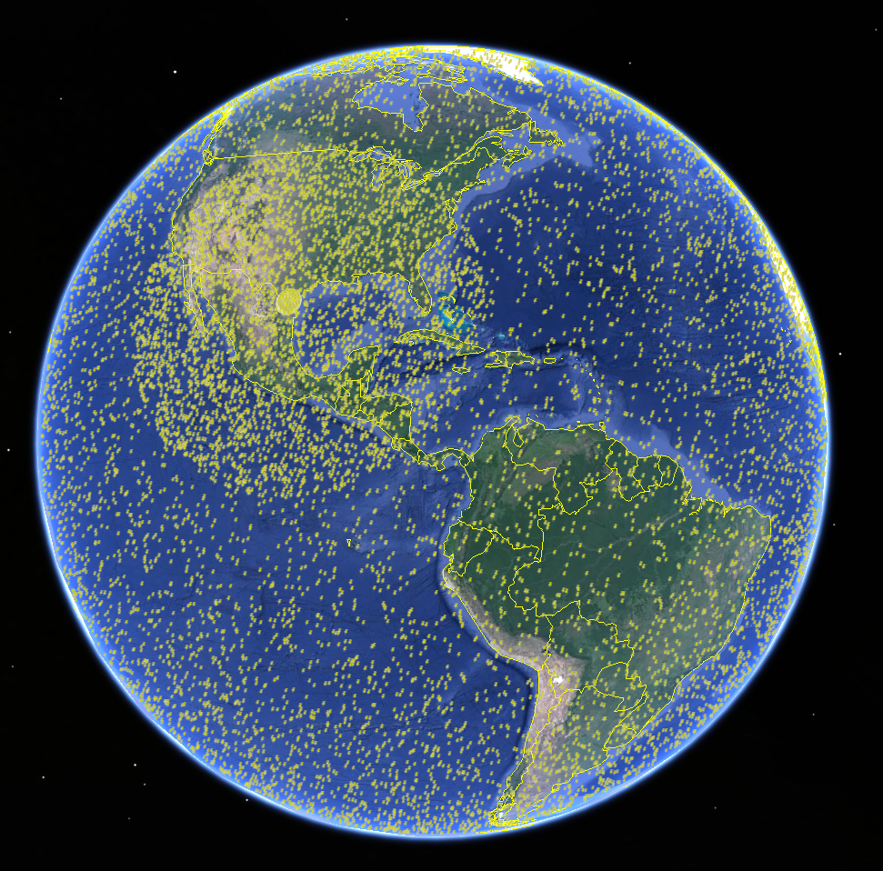
MaLLTE starts with a training set of ~20 million
LLNL G3D P-wave travel times
O1.1-179
Development of the training data set starts with 25,508 seismic stations listed in the International Seismological Centre (ISC) database (includes the IMS network)
The ISC database is reduced by removing stations that are within 0.25° (~25km) of another station
Training is divided into distance ranges where differences between 1D and 3D model predictions are approximately stationary (similar statistical properties).
Event sampling is dense for distance ranges where differences between 1D and 3D travel-times change over short distances
10,394 stations used for ML training
Example event sampling for one station
Station

Slide 6
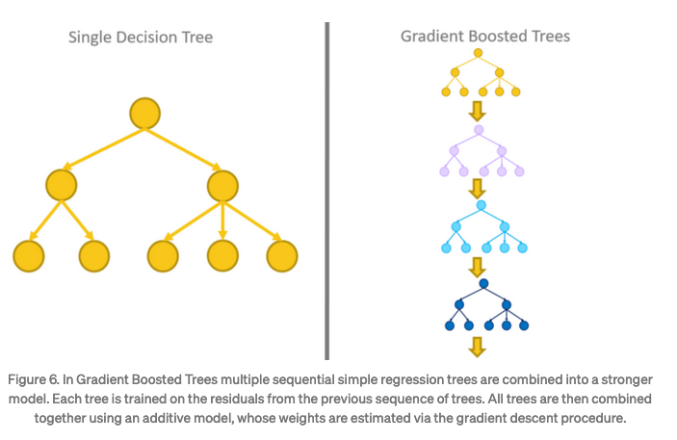
XGBoost is a simple ML approach and provides accuracy on par with much more complicated deep-learning
O1.1-179
XGBoost is an open-source software library that provides a regularizing gradient boosting framework for many languages including Java, Python, R, and C++.
XGBoost is fast compared to other gradient boosting methods and it typically has superior model performance. Training that required days on hundreds of computer cores is accomplished in hours on a few cores.
It is the go-to algorithm for Kaggle competition winners, dominating regression problems on tabular datasets.
Gradient tree boosting is a machine learning technique that produces a prediction model in the form of an ensemble of decision trees. Successive decision trees are trained on the residuals of the previous tree, and optimization can be guided by an arbitrary differentiable loss function.
MaLLTE training is under 3 hours on an AMD Rome CPU.
(We use commonly available computer hardware)
Figure taken from: https://medium.com/analytics-vidhya/ensemble-models-bagging-boosting-c33706db0b0b

Slide 7
MaLLTE error is tested for stations included in the training set and stations not included in the training set
O1.1-179
Local
Regional
Teleseismic
Error vs distance for stations not included in the training set
From Anderson, Myers and Simmons, 2023 (GJI)
MAE is Mean Absolute Error
From Myers et al., 2015

Slide 8
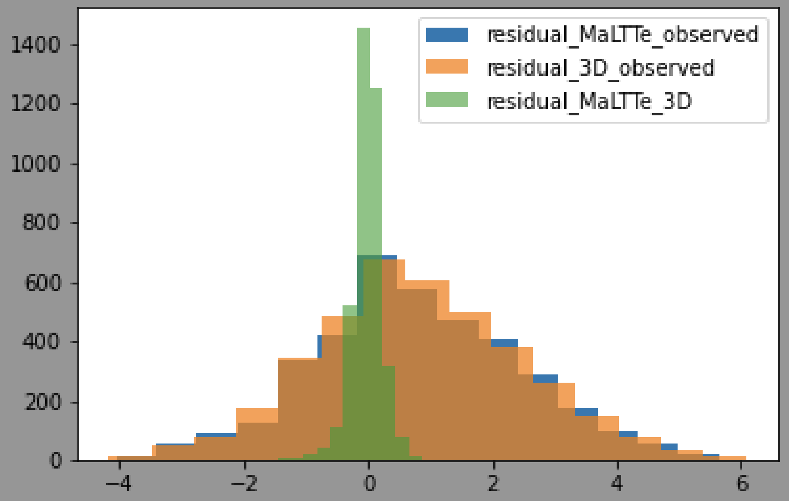
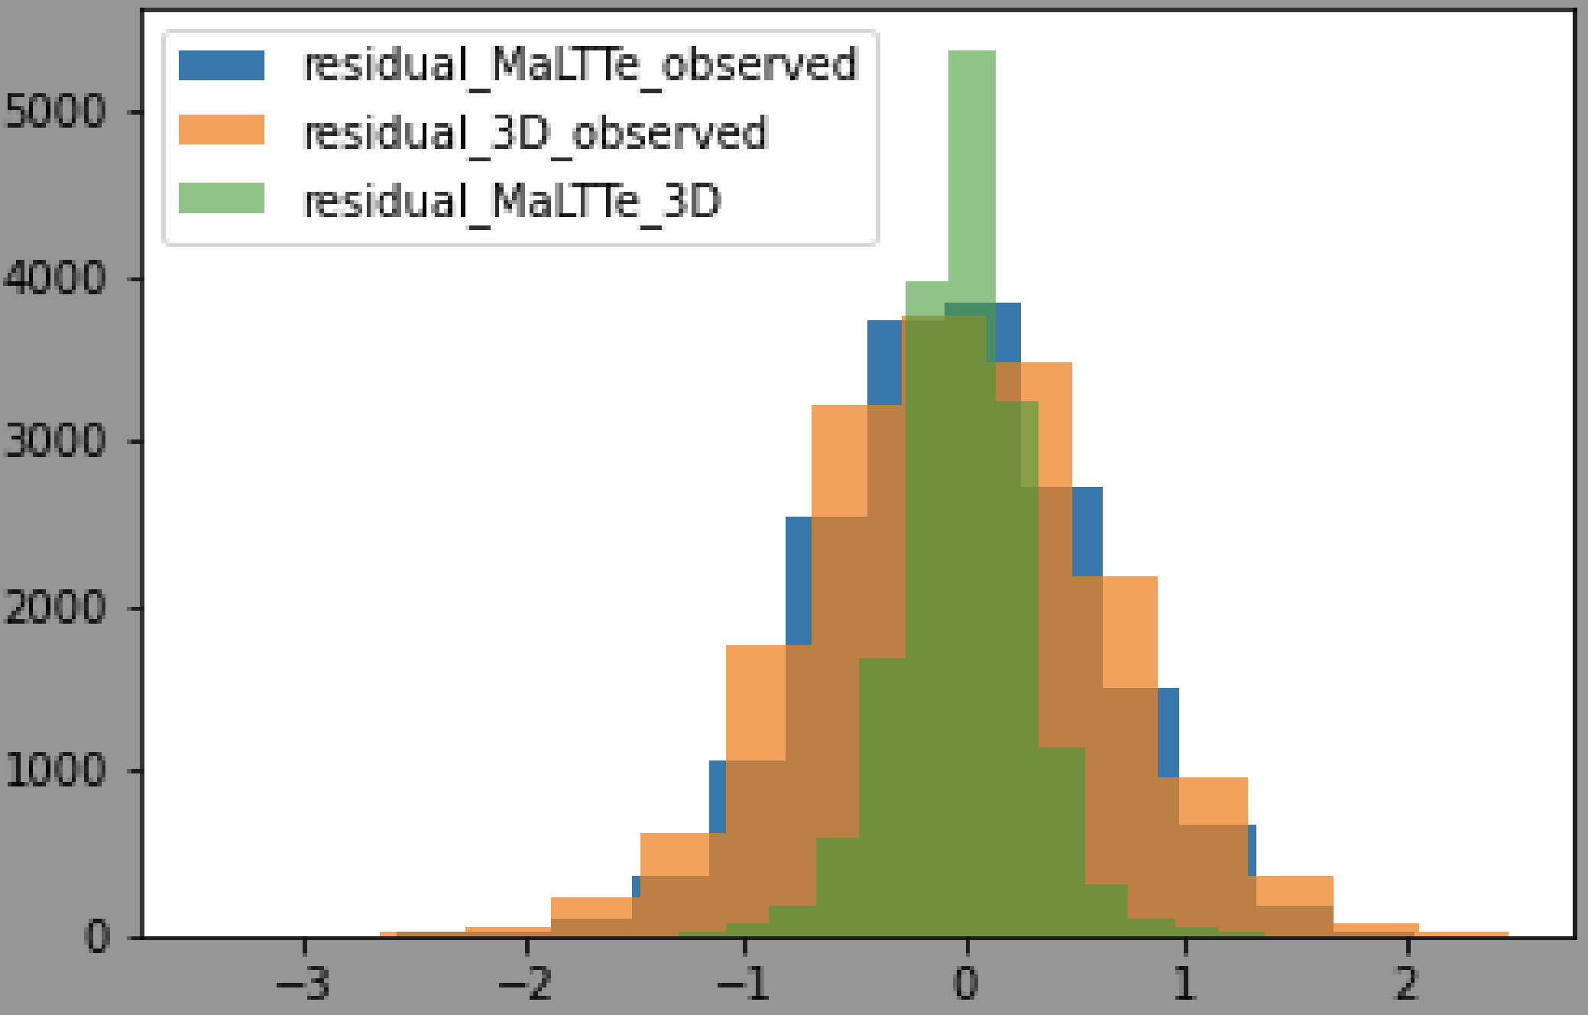
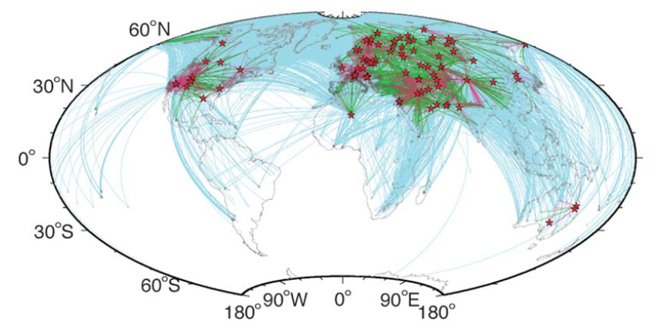
MaLLTE errors are small compared to inherent 3D model and arrival-time measurement errors
O1.1-179
Regional
We compared the MaLLTE – G3D residuals with G3D – observed arrivals for a global ground-truth data set of 116 events (Myers et al., 2015).
Residuals are similar: G3D=orange; MaLLTE=blue
MaLLTE errors (green) are small compared to model and arrival-time measurement errors.
Teleseismic
Ray coverage for GT data set
MaLLTE - 3D (MAE)
Regional 0.17 s
Teleseis 0.21 s
Note: Too few local-distance measurements to form meaningful statistics

Slide 9
MaLLTE travel times computation is fast and flexible
O1.1-179
MaLTTE
Input:
Event Latitude
Event Longitude
Event Depth (km)
Station Latitude
Station Longitude
Station Elev (km)
Phase
Output:
Travel Time (s)
~30 micro-sec
Entire code package
~2 Gbyte
* P-phase currently supported

Slide 10
Conclusions
O1.1-179
3D global models of seismic wave speed can significantly improve the accuracy of seismic travel time predictions.
Aids detection-event association
More accurate seismic-event locations
Seismic wave travel time computation time using a 3D model is too slow for operational systems.
MaLLTE is accurate to a few tenths of a second, which is much lower than 3D model and arrival-time measurement error.
Computation time using ML emulation is about 30 micro-seconds, well within operational needs.
Next steps: release the code and extend to other phases.

