Slide 1
Design of an atmospheric radiotracer experiment to improve local-scale transport modeling
Carolyn Seifert¹, Lynn Wood¹, Michael Foxe¹, Sean Stave¹, Miles Bodmer², Martin Keillor¹, Christine Johnson¹, James Ely¹, Ethan Alger³, Michael Brown⁴, Elizabeth Dzenitis³, Akshay Gowardhan³, Derek Haas⁵, Clayton Hudson⁵, Gordon Macleod⁴, Michael Moore¹, Rob Newsom¹, Khiloni Shah⁵, Walter Schalk⁶, Sonia Wharton³
¹Pacific Northwest National Laboratory
²Sandia National Laboratories
³Lawrence Livermore National Laboratory
⁴Los Alamos National Laboratory
⁵University of Texas at Austin
⁶National Oceanic and Atmospheric Administration
Presentation Date: 22 June 2023
O1.1-849

Slide 2

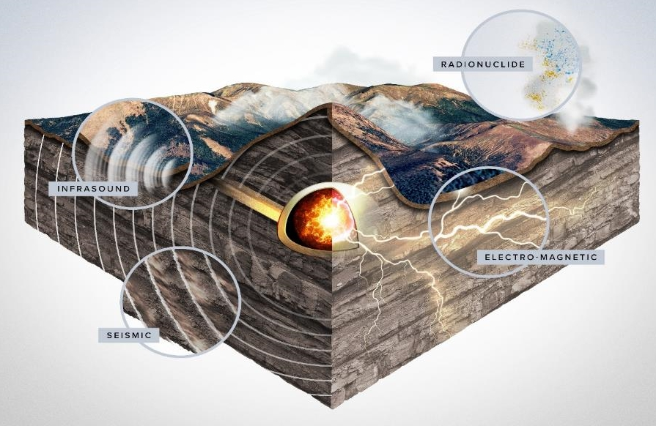
The Low-Yield Nuclear Monitoring Program (LYNM) includes a testbed for integrated field experiments.
O1.1-849
Design large-scale experiments to meet LYNM science objectives
Build an experimental testbed at the Nevada National Security Site instrumented with >1000 sensors below ground and at the surface
Execute multiple experiments to capture multi-physics signatures
  Chemical explosions (3)
  Electromagnetic source (1)
  Atmospheric tracers (3)
Collect and archive data
This presentation: an atmospheric radiotracer transport experiment to improve local modeling.

Slide 3
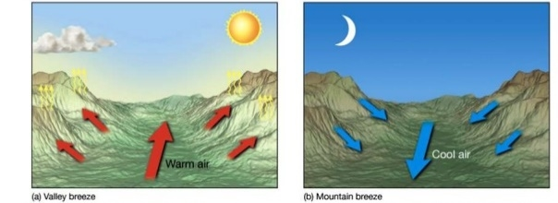
Complex terrain complicates near-field atmospheric transport of radionuclides, and empirical data are needed to inform and validate models.
O1.1-849
How does topography impact near-field atmospheric transport?
How do we optimize local radionuclide detection networks?
At what scale do local and regional atmospheric signatures converge?
Flow Features Found in Complex Terrain
To answer these questions, we designed a 5-km atmospheric radiotracer experiment:
Conduct 4 releases of ¹²⁷Xe gas and smoke in a complex terrain
Deploy sensors up to 5 km downwind
  22 real-time NaI(Tl)-based radioxenon sensors
  11 meteorological stations + 1 surface energy flux tower + 1 daily radiosonde
  2 scanning lidars + 8 optical video cameras
Analyze whole air samples from up to 5 locations to validate real-time data

Slide 4
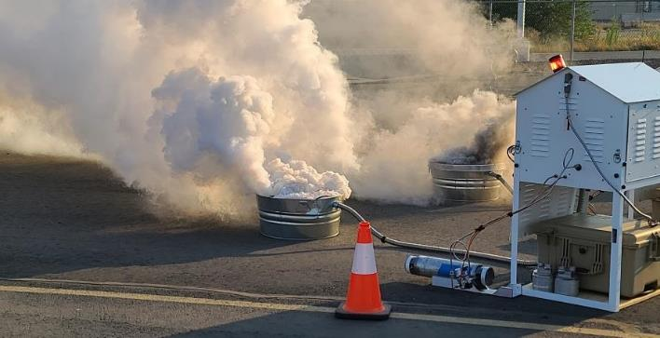
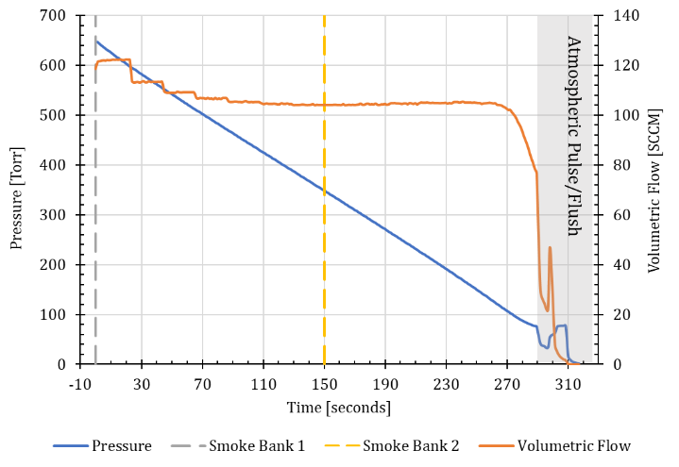
A tracer release system was engineered to simultaneously emit smoke and radioxenon gas into the air.
O1.1-849
¹²⁷Xe (half life of 36.4 days) was produced via irradiation of purified stable ¹²⁶Xe in a research reactor
Remotely conducted four ¹²⁷Xe releases, each ~550 MBq over 5 min
Smoke was produced using remotely ignited commercial smoke candles
(>1700 m³/min for 5 min)
Aliquots of source gas were collected to validate source activity
¹²⁷Xe and smoke releases were synchronized in time
Tracer release system during testing
Xe gas pressure and flow rate vs. time during one release

Slide 5
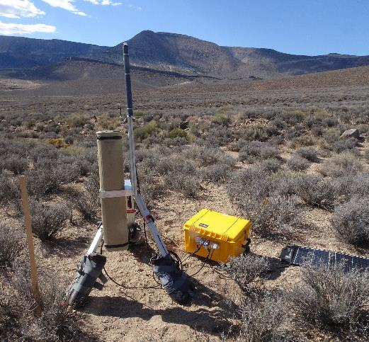
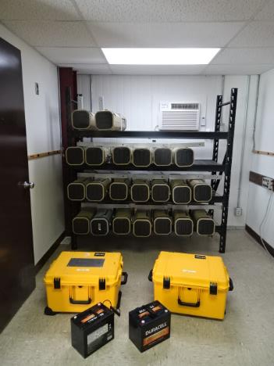
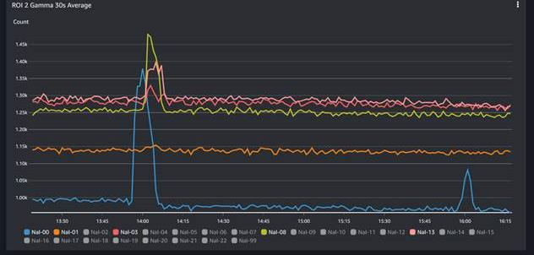
A network of 22 real-time NaI(Tl) sensors was deployed to detect the radioxenon plume at distances up to 5 km.
O1.1-849
Deployed NaI(Tl) sensor
Sensor kits
2L NaI(Tl) sensors packaged for field use
Sensors were remotely monitored via cellular network and cloud-based analysis software
Estimated ¹²⁷Xe detection threshold at <10 Bq/m³ (via simulations)
Estimated source dilution factors of 10⁻⁹ to 10⁻⁸ at 5 km
Real-time counts in selected NaI(Tl) sensors

Slide 6
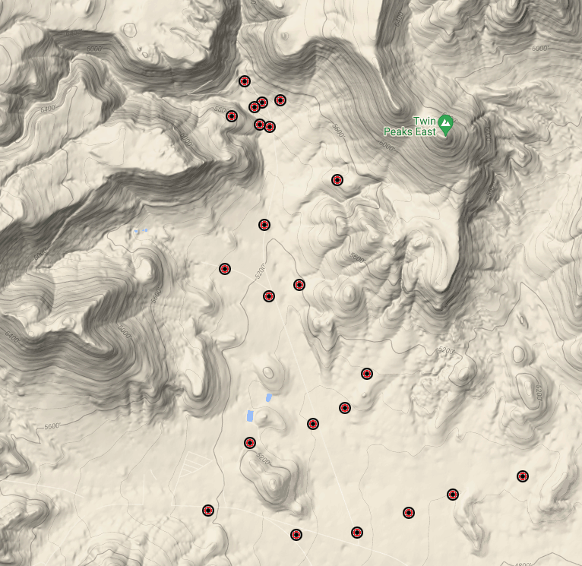
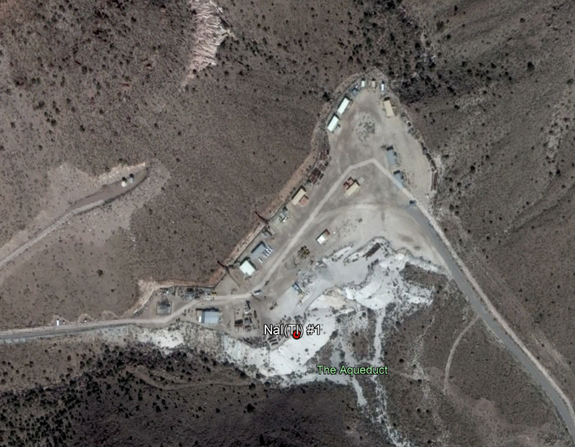
Radioxenon sensors were deployed in four arcs to capture plume crossing times up to 5 km away from two separate release points.
O1.1-849
Four releases from two locations: ¹²⁷Xe + smoke
10 met towers, surface energy flux tower, daily radiosonde release
Four arcs of Xe sensors out to 5km
Five whole air samplers co-located with Xe sensors
Apron 4
Two scanning lidars in center of valley
Apron 1
Cameras at release locations, on the hill, and downwind

Slide 7
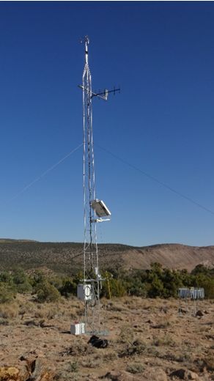
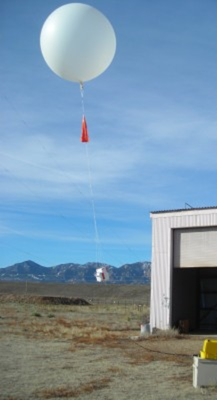
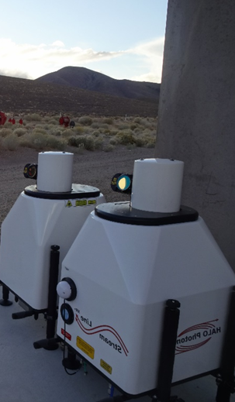
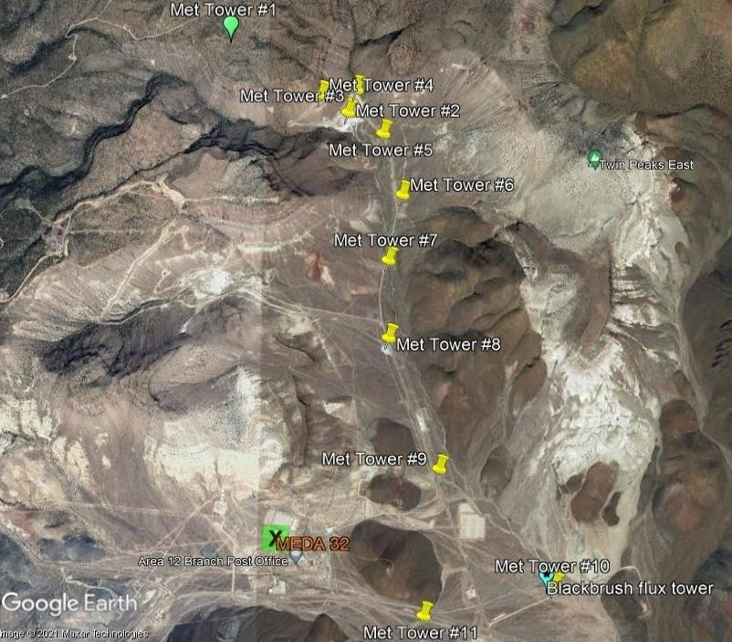
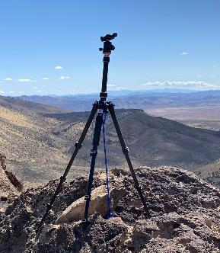
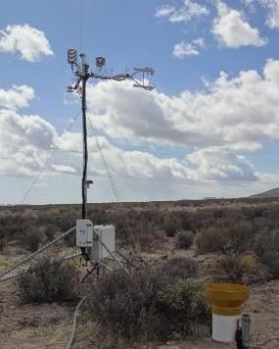
A dense network of meteorological sensors was selected and deployed to measure local atmospheric properties.
O1.1-849
Release location
Meteorology (Met) towers
Radiosondes
Scanning lidars
Scanning
lidars
Energy flux tower
Video cameras

Slide 8
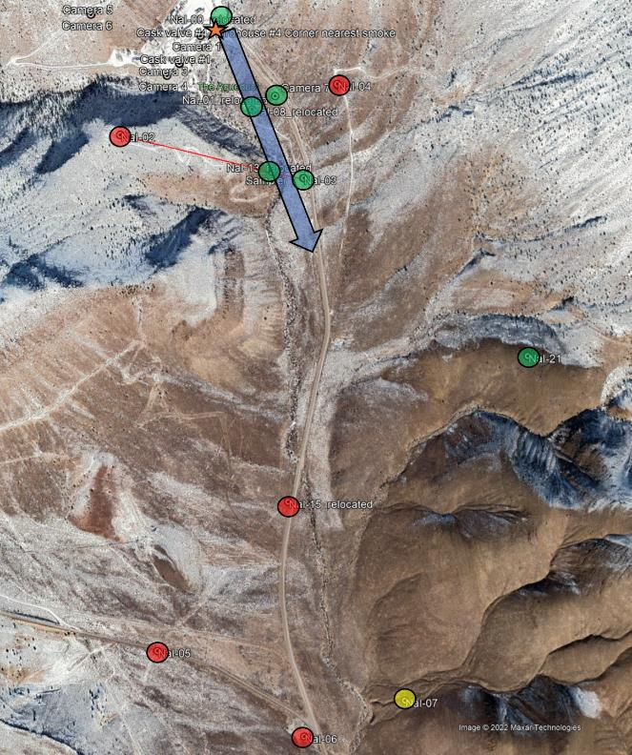
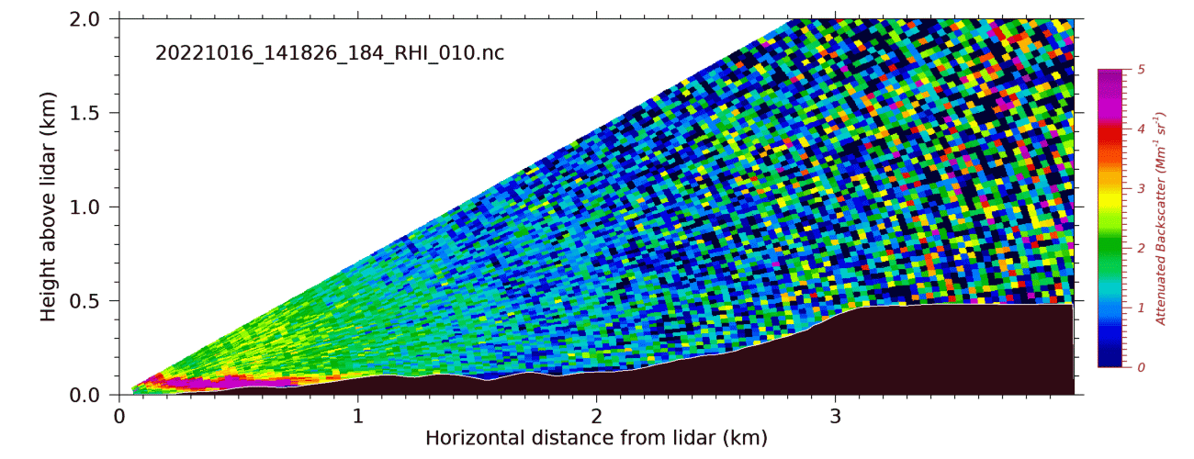
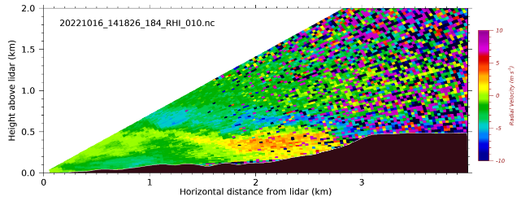
Experiment was successfully conducted and data analysis is underway. Selected Xe sensor and lidar data are shown here from one release.
O1.1-849
Sensor locations where Xe was detected (green) and not detected (red)
Background-subtracted count rates observed in 20-220 keV region of interest for selected NaI(Tl) sensors
Lidar backscatter and radial velocity measurements (vertical slice)
Backscatter @ 10º
Radial Velocity @ 10º

Slide 9
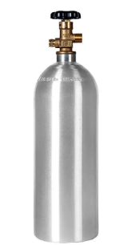
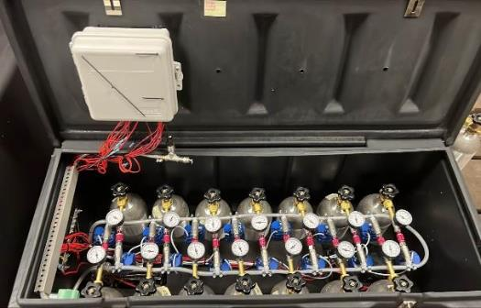
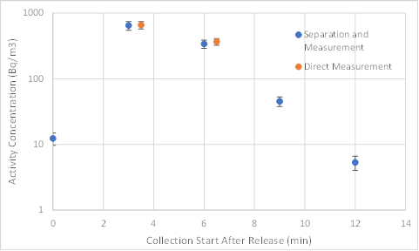
Whole-air samplers were designed to capture samples for later onsite and offsite laboratory analysis to confirm the real-time results.
O1.1-849
Whole air sampler
Samplers were programmed to collect at specified times after the release
Bottles were filled up to 80 psig (18 L) at collection time (~60 s to fill)
Whole-air samples were triaged onsite and later measured in a laboratory without and then with Xe separation
Some samples show detectable ¹²⁷Xe in laboratory measurements
Data analysis continues…
Sample
bottle
Lab analysis results from whole air samples
collected from one station from one ¹²⁷Xe release

Slide 10
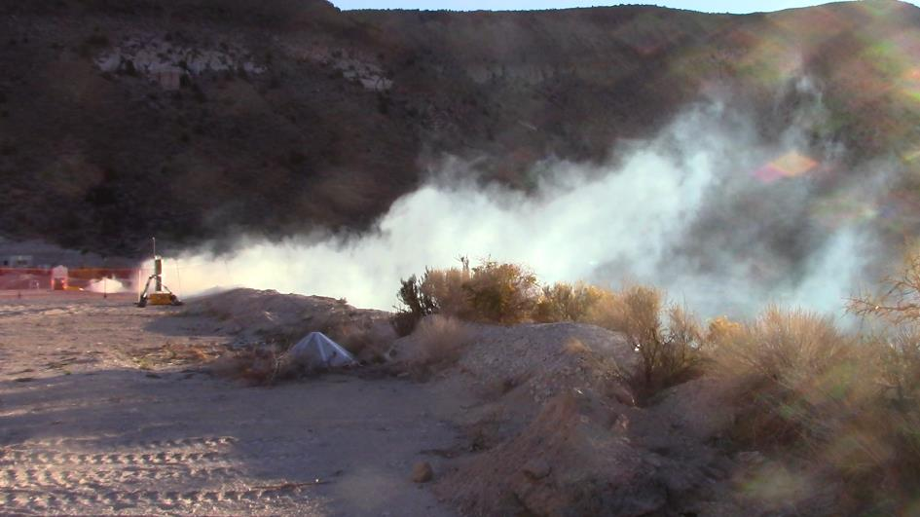
Summary
O1.1-849
Successfully designed and executed an atmospheric radiotracer experiment out to 5 km
Designed and deployed:
  Source release system
  Meteorological sensors
  Radioxenon sensors
  Whole air samplers
Performed four ¹²⁷Xe + smoke releases over 3 days
Data analysis is still underway
Photograph of smoke release test
This Low Yield Nuclear Monitoring (LYNM) research was funded by the National Nuclear Security Administration, Defense Nuclear Nonproliferation Research and Development (NNSA DNN R&D). The authors acknowledge important interdisciplinary collaboration with scientists and engineers from LANL, LLNL, NNSS, PNNL, SNL, UT, and NOAA.

