Slide 1
Long term IMS measurements as a passive probe for climate change
Läslo G. Evers, Jelle D. Assink and Shahar Shani-Kadmiel
Dept. Seismology and Acoustics, Royal Netherlands Meteorological Institute (KNMI), De Bilt, the Netherlands
O1.1-077
22 June 2023

Slide 2
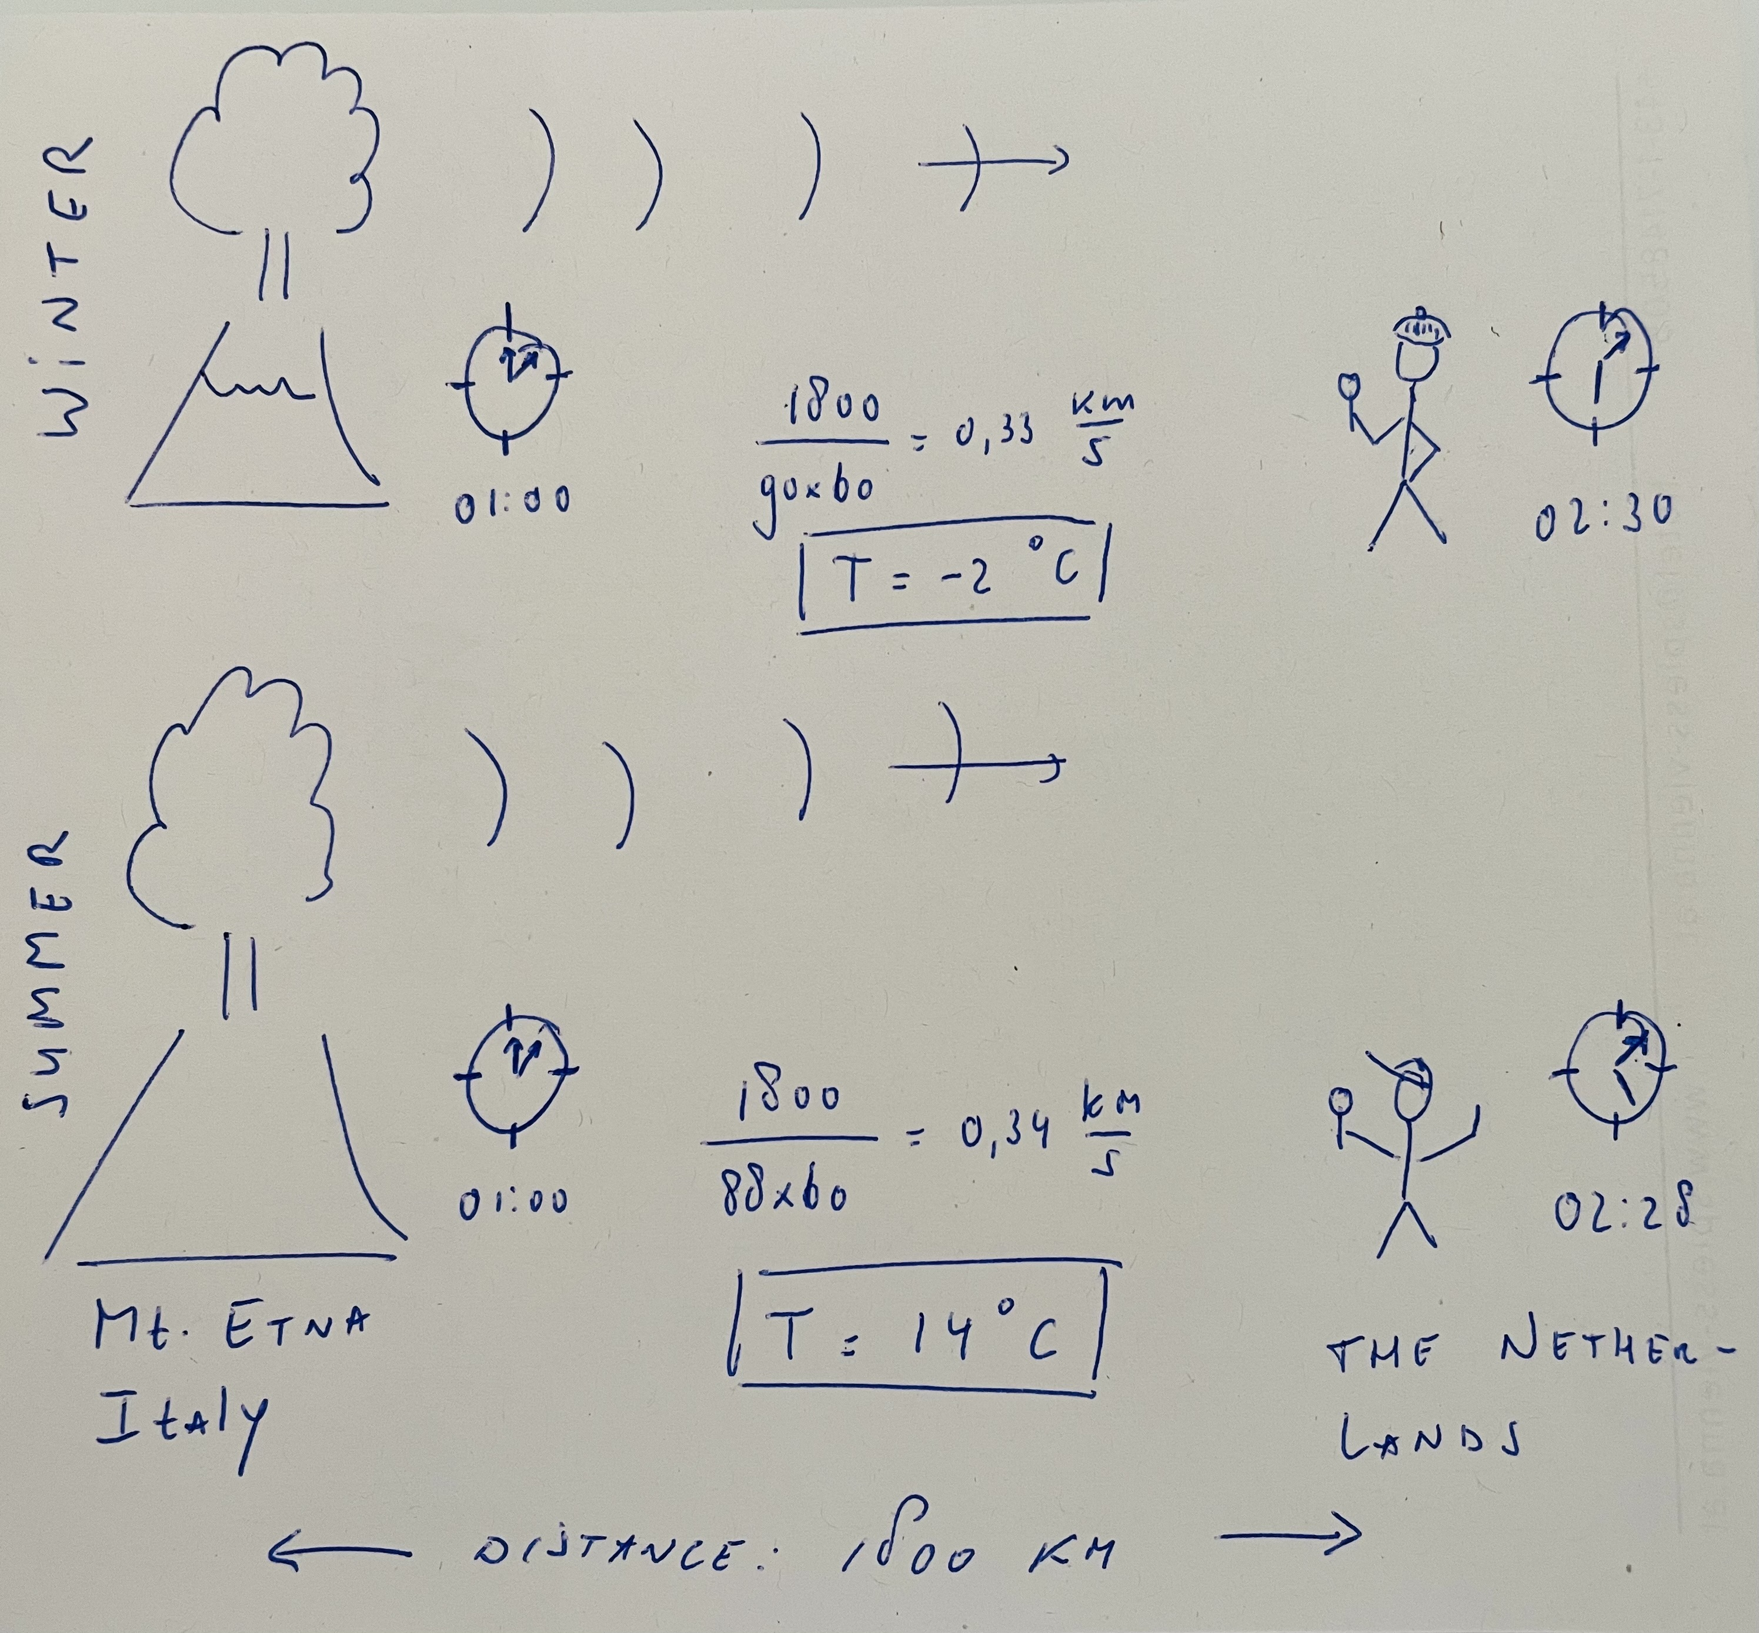
The IMS, acoustics and temperature
O1.1-077
The IMS is an excellent global geophysical sensor network very well capable of its verification task
Hydro-acoustic and infrasonic waves are globally and regionally detected from a wide variety of sources and ambient noise
The propagation velocity of these sound waves depends on the temperature of the ocean and atmosphere
Monitoring velocity changes over time might indicate temperature changes in the medium
Long term IMS measurements serve as an independent proxy for climate change

Slide 3
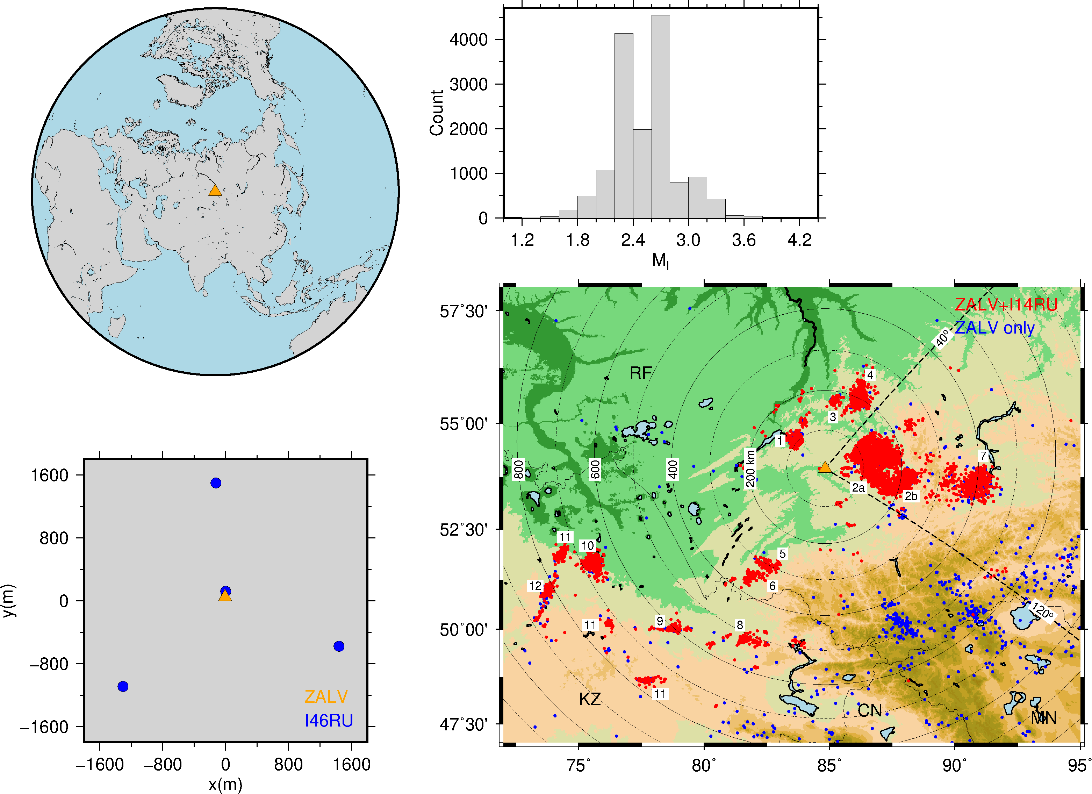
IMS infrasound station I146RU and seismic station ZALV
O1.1-077
REB 02.03.07-31.12.22:
14,698 seismo-acoustic events
Open-pit mines (red) in Russian Federation (RF) and Kazakhstan (KZ)
Local magnitudes (Ml) 1.1-4.3
Few seismic-only events (blue)
1,304 earthquakes in Altai Mountains

Slide 4
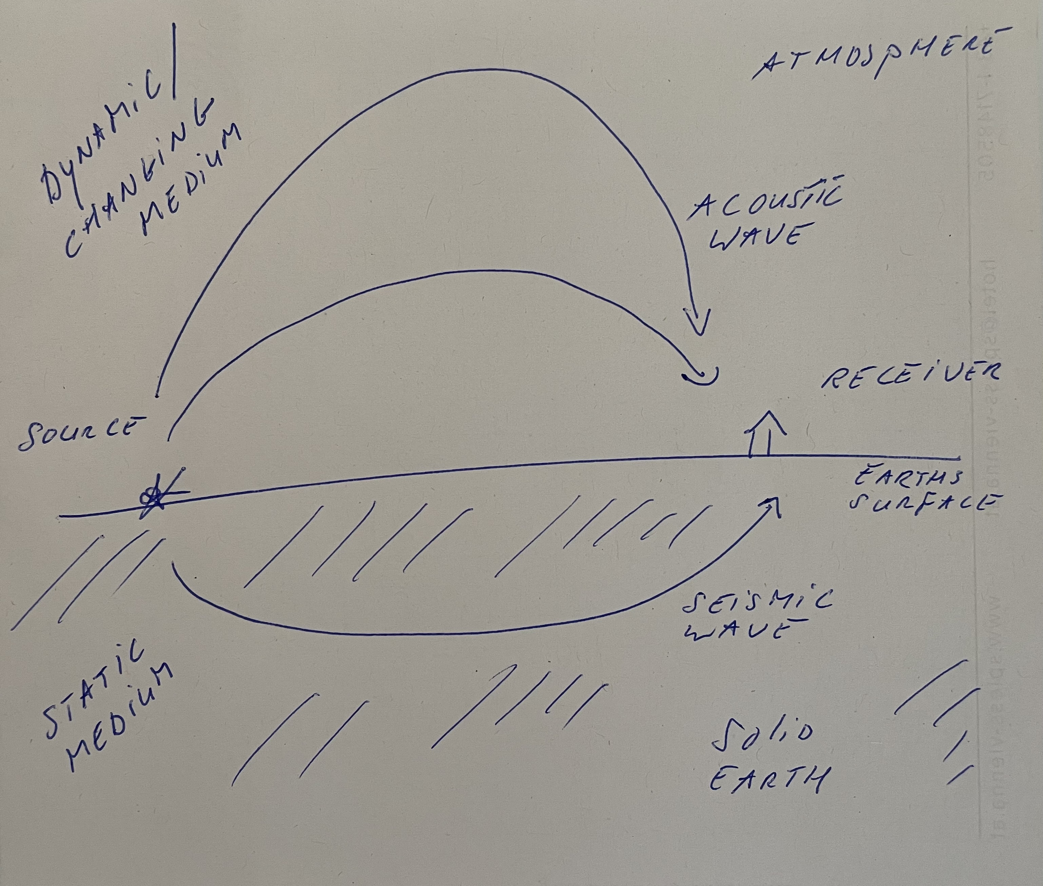
A Seismo-Acoustic analysis to retrieve acoustic velocity
O1.1-077
Recording of seismic and acoustic waves from open-pit mines
Seismic analysis gives location and origin time of explosions (from multiple regional seismic arrays)
Changes in acoustic travel time (ie, velocity) due to changes in atmosphere
Assumption: solid earth unchanged

Slide 5
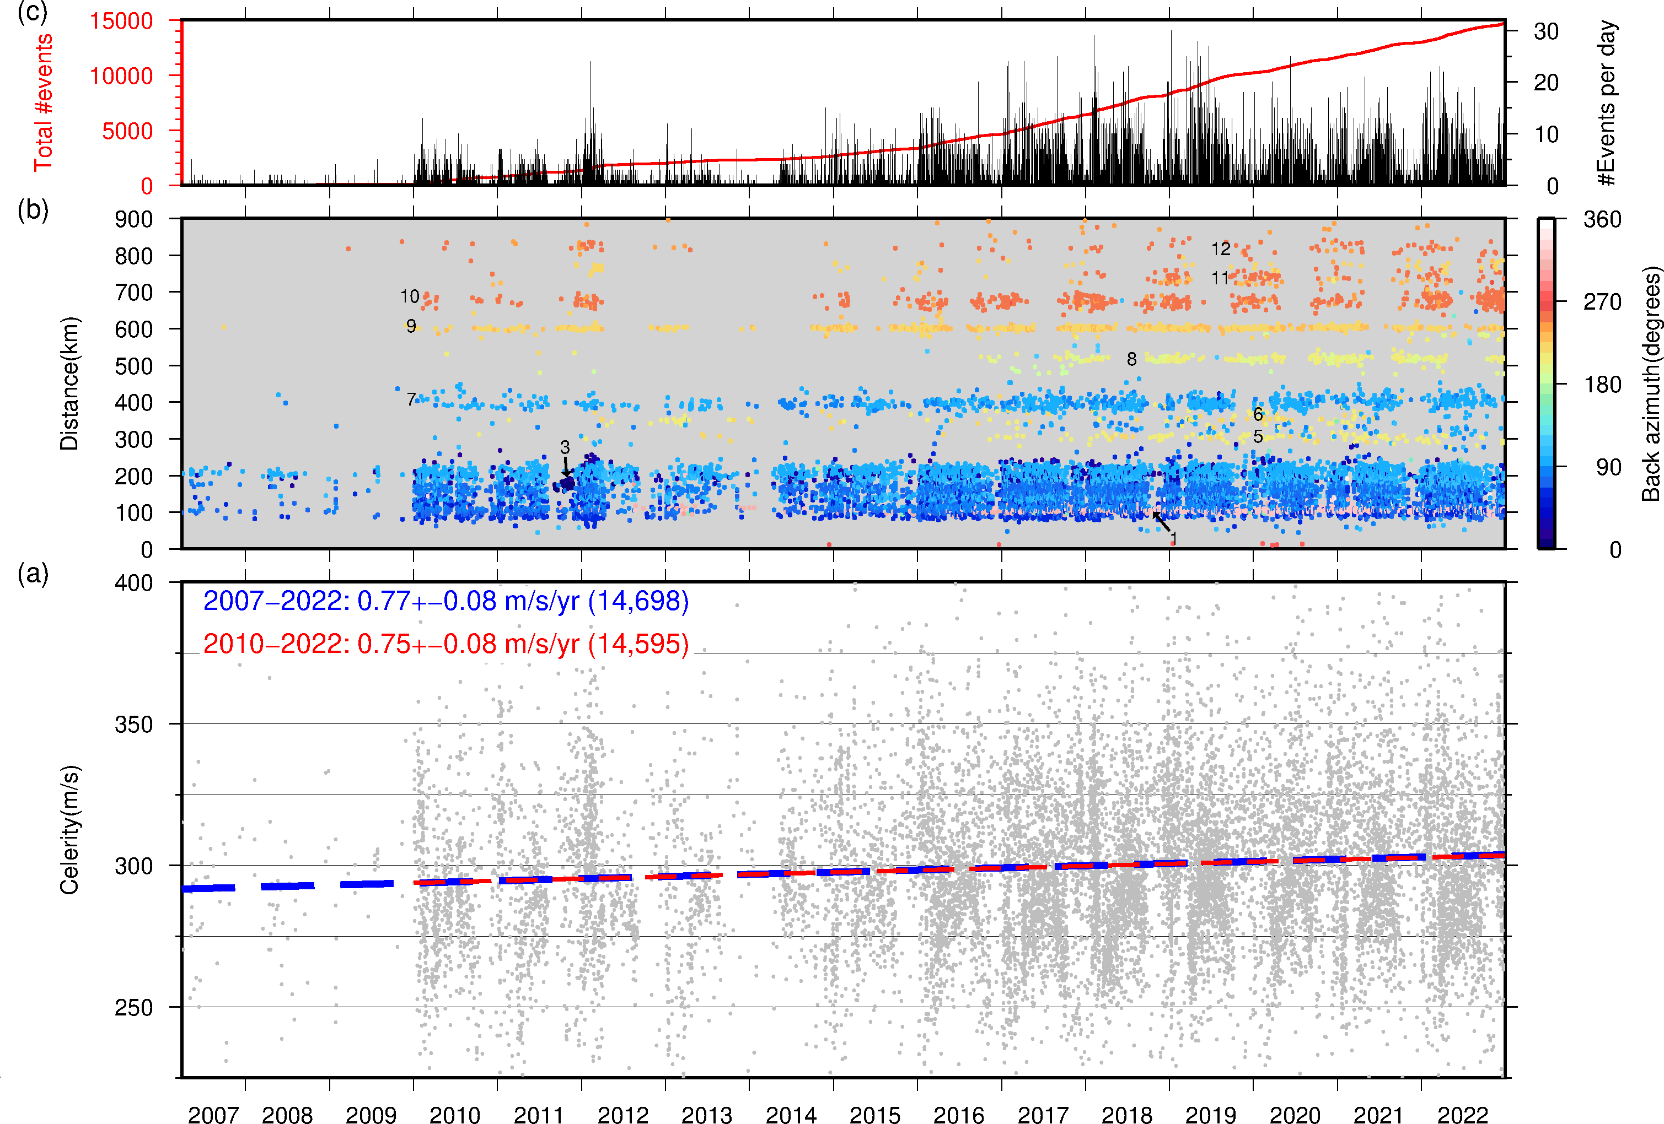
Results
O1.1-077
The celerity is the SR-horizontal distance divided by acoustic travel time
Distance and origin time from seismic analysis
Significant positive trend is celerity
Note: beautiful yearly recurring structure in celerity

Slide 6
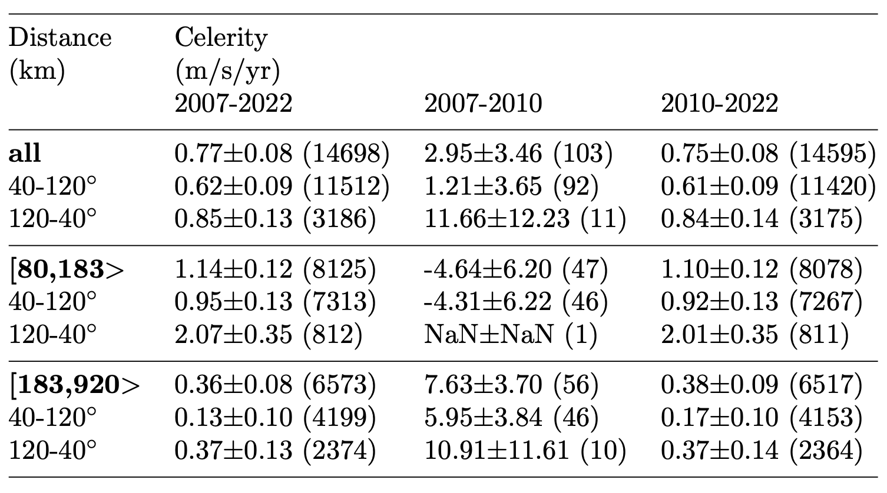
Results
O1.1-077
Changes in source distribution may lead to biases, ie, unequal sampling of time/space
Significant trends are found for all distances and back azimuths (2010-2022)
Trends larger for nearby sources (< 180 km) than those further away (< 900 km)

Slide 7
Concluding remarks
O1.1-077
First modeling results show observations are consistent with tropospheric warming of 0.5 K per decade
At the same time, the stratosphere is cooling at about the same rate. Might well explain difference between short (<180 km) and long range observations (<900 km)
Note: are refraction altitudes changing? Troposphere is expanding (~50m/decade) and stratosphere is contracting (~100m/decade), launch angles change as a function of time too
The IMS has been operational for tens of years and will stay operational for decades to come. Such long seismo-acoustic time series are very valuable for climate studies, ie, independent proxy.

Slide 8
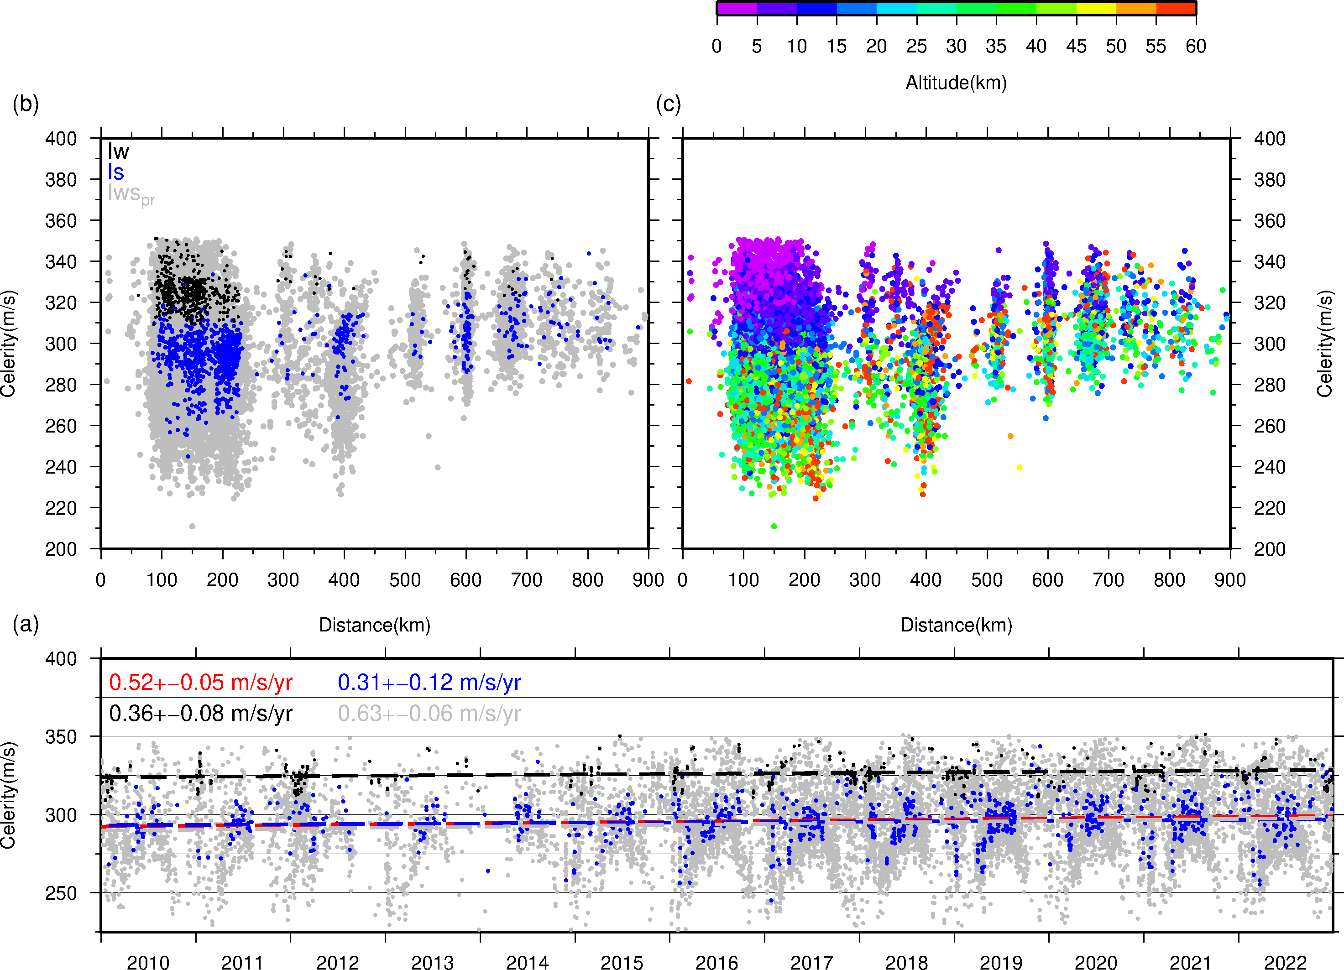
Observations and modelling
O1.1-077
Modeling is done on the basis of ray tracing and ECMWF ERA5 atmospheric specifications
Three types of infrasonic atmospheric trajectories are modeled: tropospheric returns (Iw), stratospheric returns (Is) and partial reflections (Ipr)

Slide 9
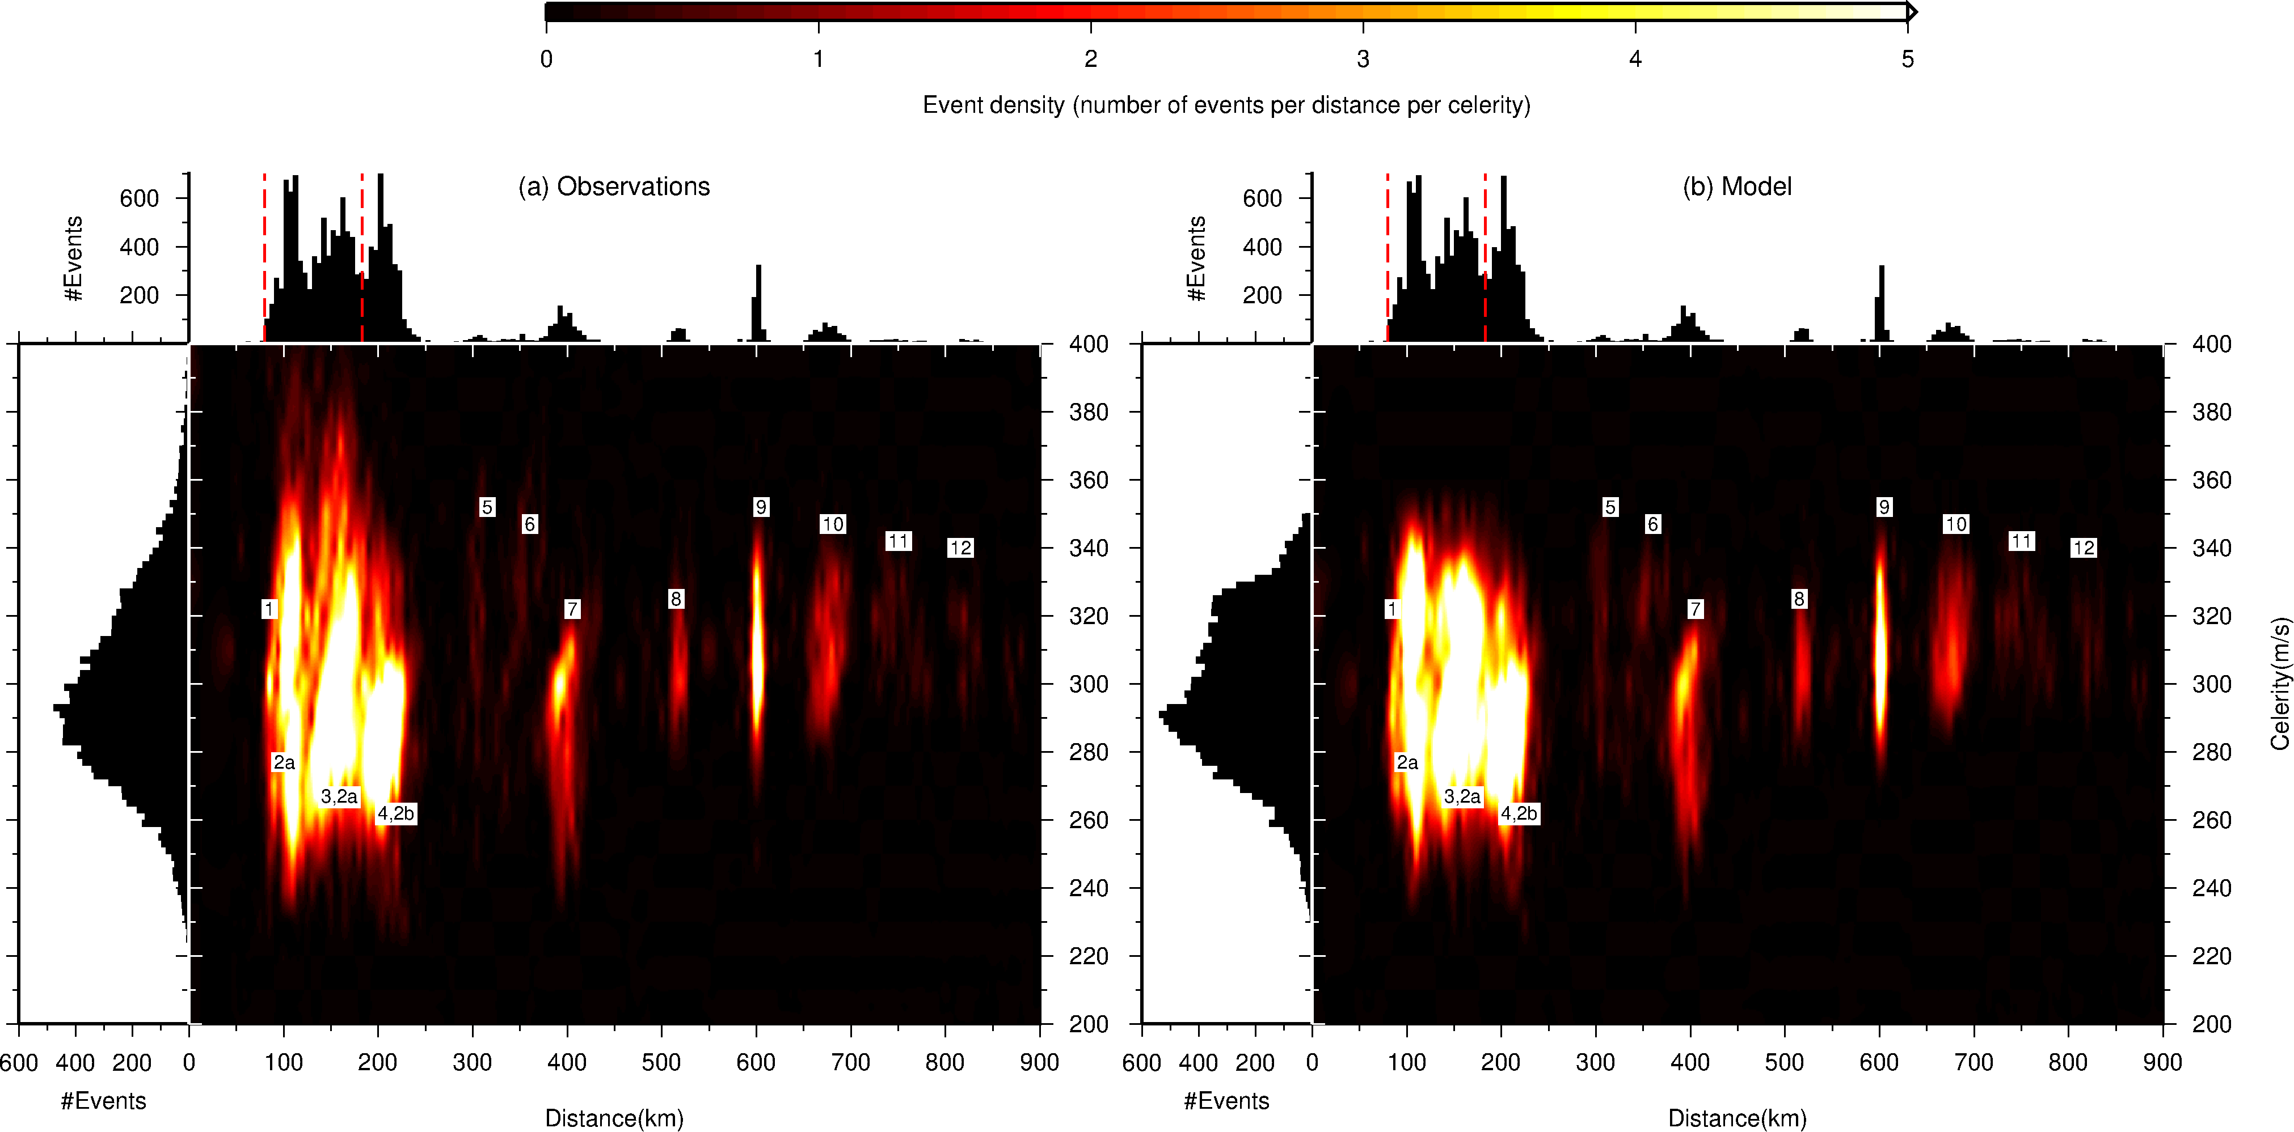
Observations and modelling
O1.1-077

