Slide 1
Relation between infrasound and rainfall
Andry Harifidy Ramanantsoa
Laboratory of Seismology and Infrasound
Institute and Observatory of Geophysics of Antananarivo
O1.1-442
Presentation Date: 22 June 2023

Slide 2
Ocean circulation plays a central role in climate regulation
Introduction
O1.1-442
Ocean circulation plays a central role in climate regulation
Rainfall in Madagascar : Indian Ocean Dipole, El Nino, Mozambique Channel Trough
Infrasound means general circulation
Endogenous knowledges
Objective:
Estimate by mean of infrasound behaviour during dry season the state of coming rainfall

Slide 3
Methodology and materials
O1.1-442
Infrasound sensor: MB2000
Data processing: DTKPMCC
Low Frequency infrasound detection from 2003 to 2023 (0.01 to ~0.5Hz)
Precipitation data from 2004 to 2022 ECMWF/ERA5 and local data
Infrasound parameters : Number of detection and frequency
Period: week 15 (Mid-April) to week 44 (Early November) during dry season

Slide 4
Methodology and materials
O1.1-442
Precipitation data from 2004 to 2022 (October-March)
YEAR | PRECIPITATION (mm) | YEAR | PRECIPITATION (mm)
2004 | 1344 | 2014 | 1077
2005 | 1125 | 2015 | 1290
2006 | 1041 | 2016 | 978
2007 | 1401 | 2017 | 801
2008 | 1185 | 2018 | 987
2009 | 1026 | 2019 | 1017
2010 | 930 | 2020 | 960
2011 | 951 | 2021 | 909
2012 | 1080 | 2022 | 909
2013 | 1098

Slide 5
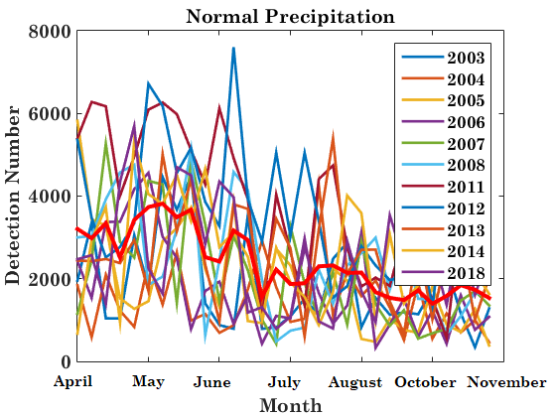
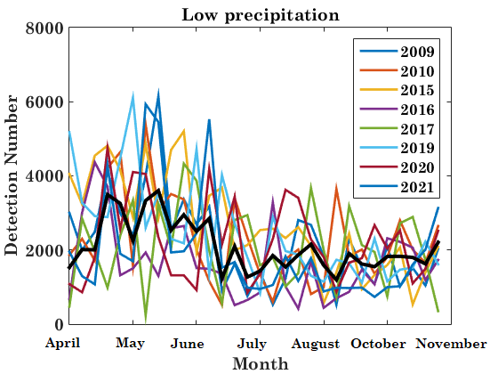
Results
O1.1-442
Variation of infrasound detection number from the week 15 (Mid April) to week 44 (Early November)

Slide 6
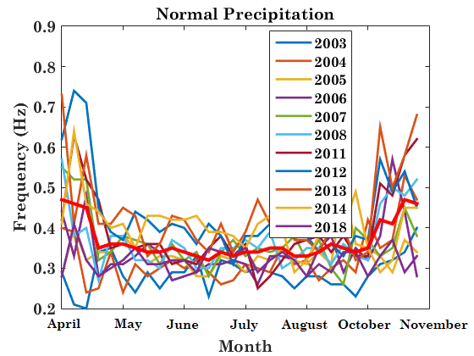
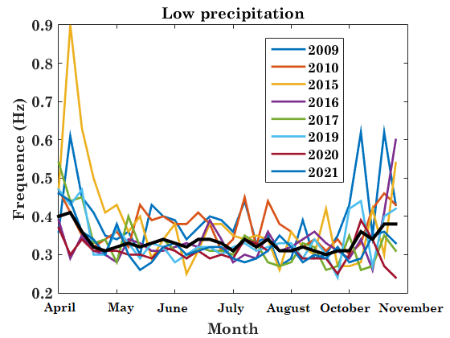
Results
O1.1-442
Variation of infrasound frequency from the week 15 (Mid-April) to week 44 (Early November)

Slide 7
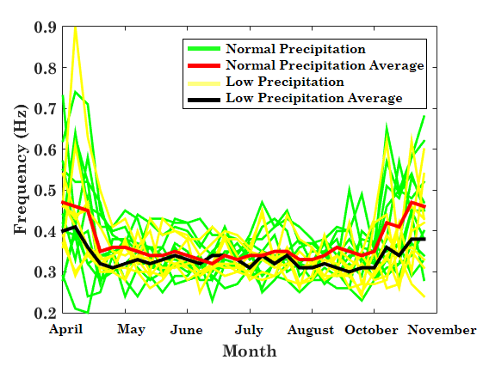
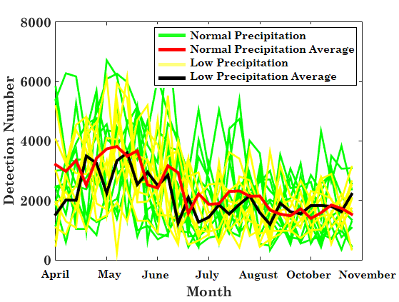
Discussion
O1.1-442
Standard deviation:
Normal precipitation 0.25 ≤ σ≤0.32
Low precipitation 0.22 ≤ σ ≤ 0.26

Slide 8
Conclusion
O1.1-442
Climate observation by infrasound is possible
First approach leads to a good results
Relationship between rainfall and infrasound is obvious
Further study need to be undertaken

