Slide 1
Infrasound observations at the station PVCI in 2019-2022 and identification of the sources
T. Šindelářová1, J. Baše1, M. Kozubek1, K. Podolská1, I. Bondár2, M. Pásztor2, 3, 4, C. Czanik3,4
1 Czech Acad Sci, Inst Atmospher Phys; 2 Inst Geological Geochem Res, Res Centre Astronomy Earth Sci, ELKH; 3 Inst Earth Phys Space Sci, ELKH; 4 Dept Geophys Space Sci Inst Geography Earth Sci, ELTE
O1.1-205
Presentation Date: 22 June 2023

Slide 2
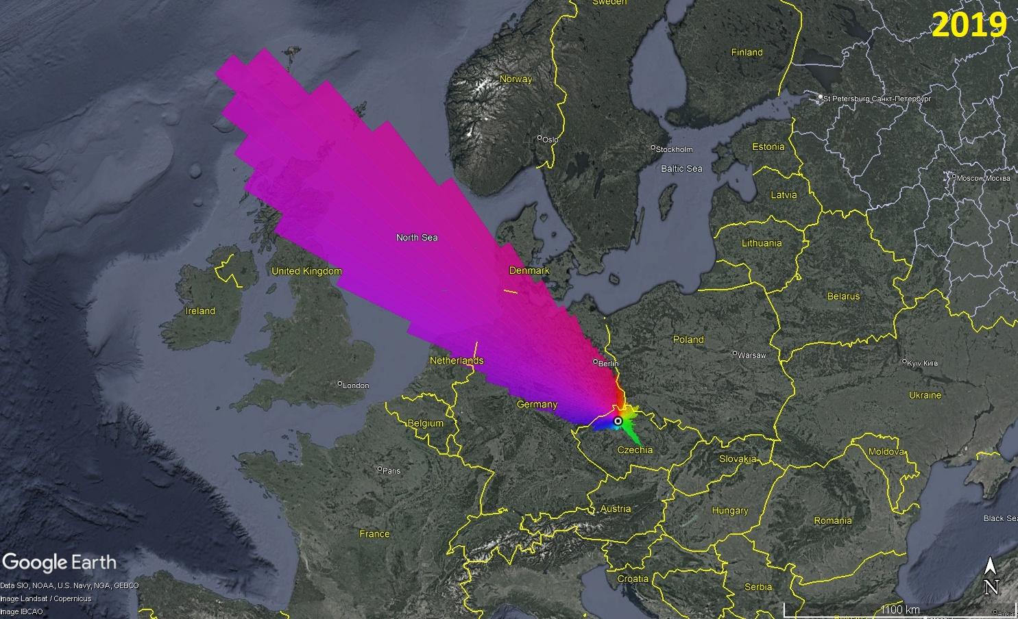
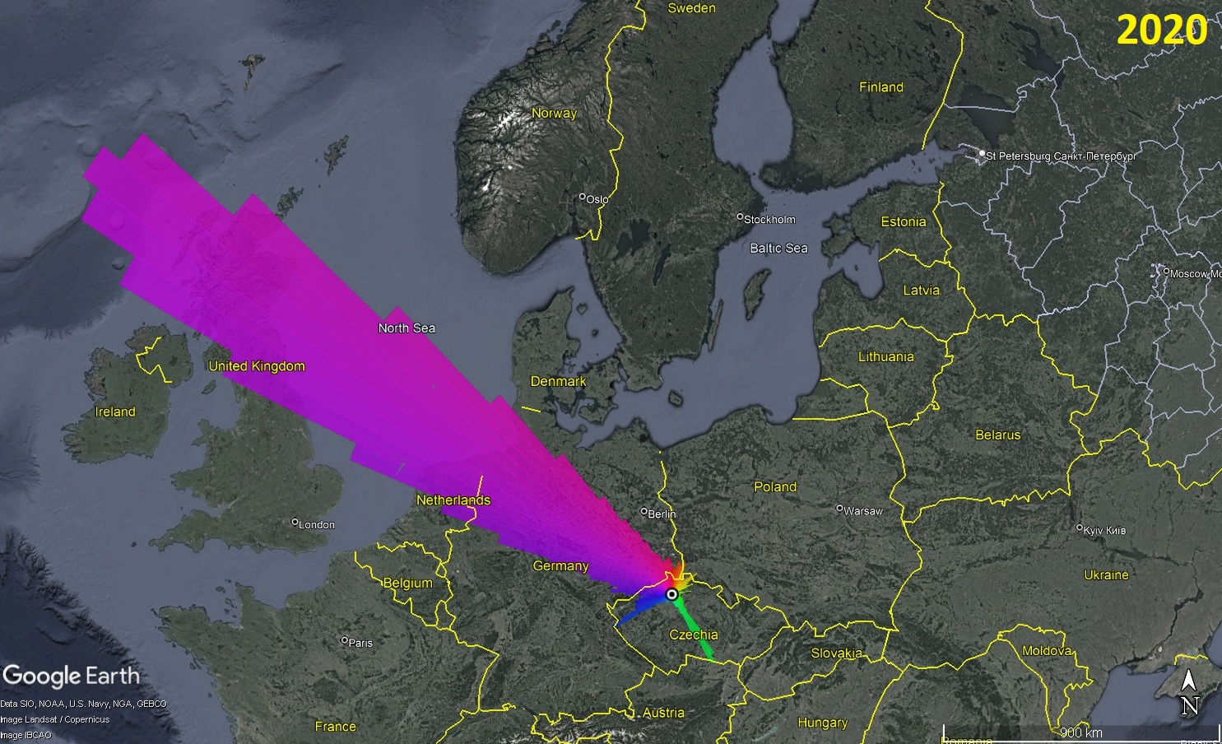
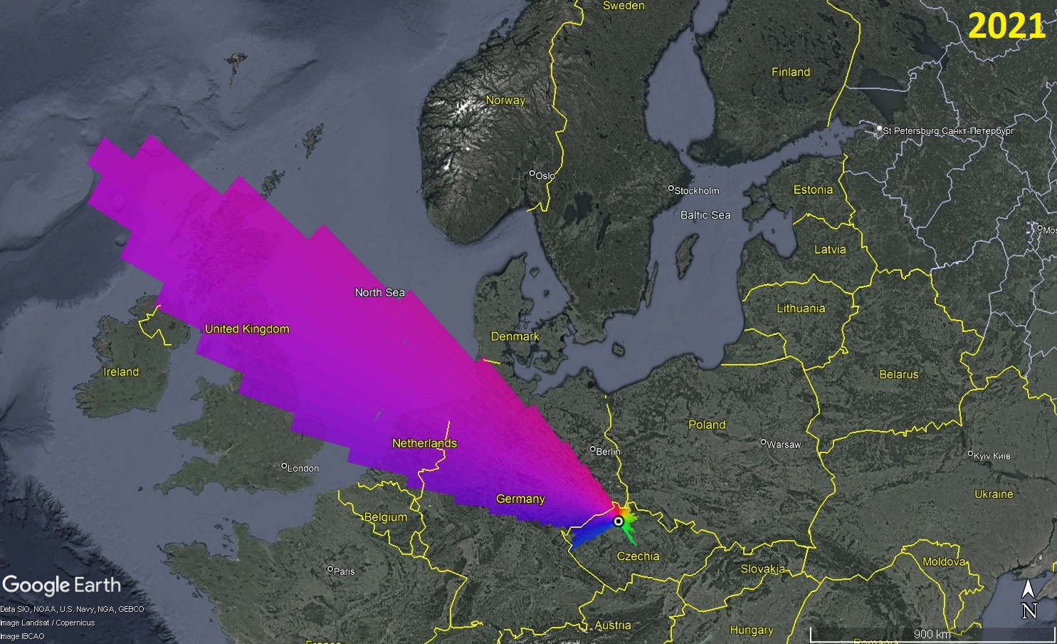
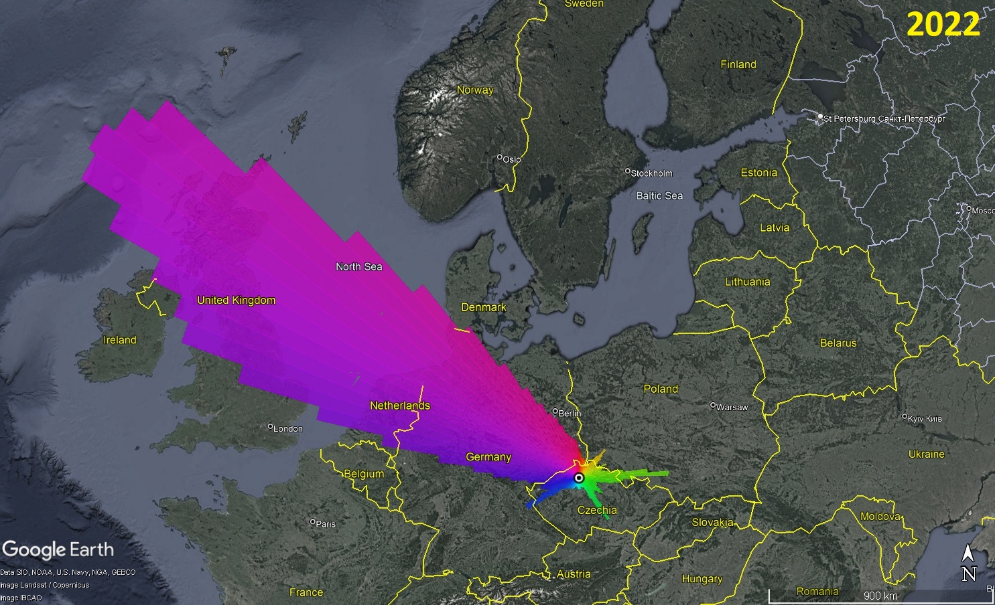
Overview
O1.1-205
Infrasound detections at PVCI in 2019-2022
Outline
microbarograph array PVCI
Infrasound observations
Characteristics of summer arrivals
Characteristics of winter arrivals
Discussion about possible signal sources
Summary

Slide 3
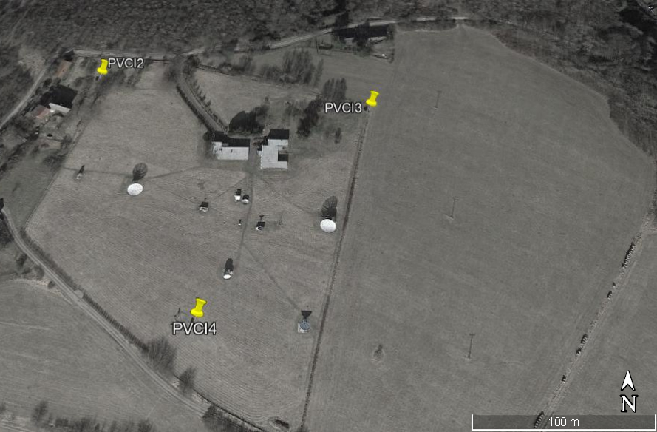
The microbarograph array PVCI
O1.1-205
The Czech microbarograph network, C9 – two stations: PVCI (50.53°N 14.57°E) and WBCI (50.25°N 12.44°E)
PVCI
Three elements
Array aperture 200 m
Operational range f = 0.05-4 Hz
In regular operation since 2014
Upgrade necessary

Slide 4
Methods of data processing
O1.1-205
Infrasound detections processed with DTK-GPMCC with 1/3-octave band settings, years 2020 – 2022
and with WinPMCC, year 2019
Seasonal summaries obtained using DTK-DIVA
A season defined according to the dates of solstices and equinoxes
Summer 21 April – 20 August
Winter 1 January – 20 February + 21 October – 31 December
Search for possible sources
based on measurements of a single station only → no localization procedure
on literature review: Infrasound Monitoring for Atmospheric Studies (A. Le Pichon, E. Blanc, A. Hauchecorne Eds., 2010) and The European Infrasound Bulletin (Pilger et al., 2018, Pure Appl. Geophys.)

Slide 5
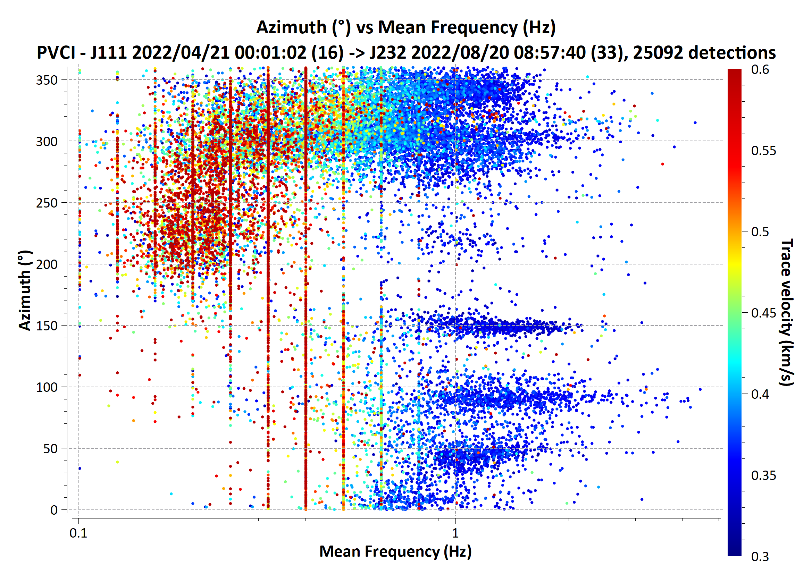
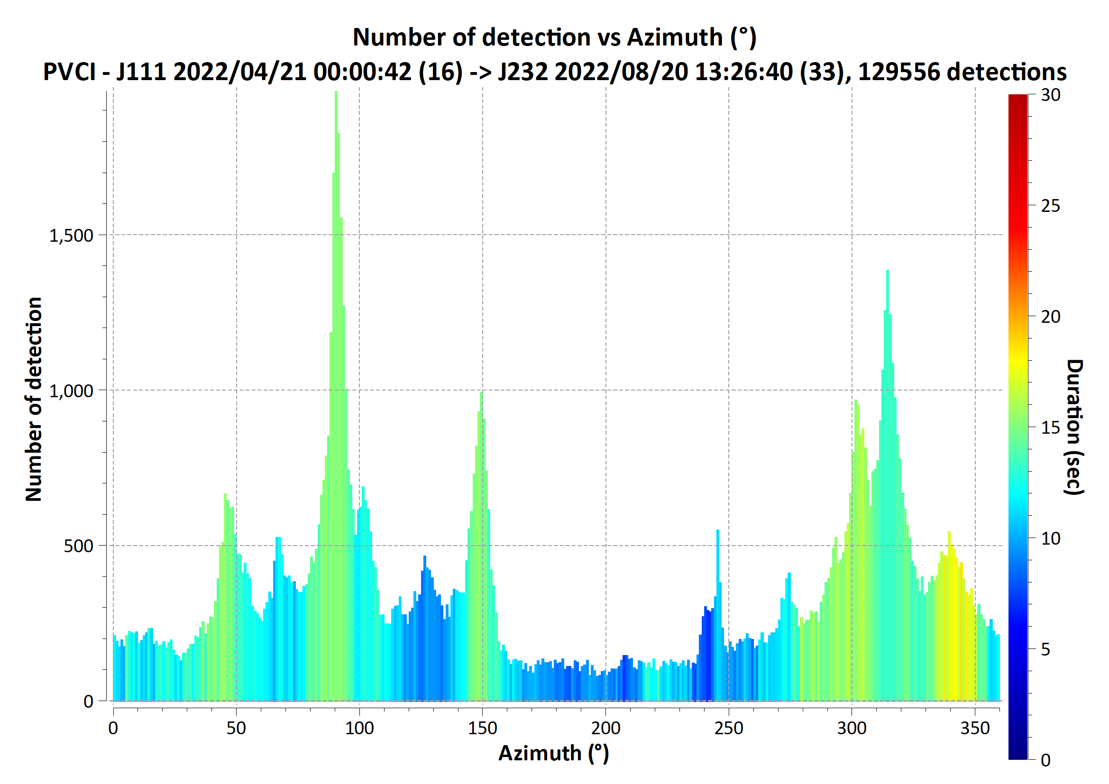
Observations in summer
O1.1-205
Summer 2022, 21 April – 20 August
2D histogram azimuth-frequency-velocity, signals of duration > 30 s
High trace velocities at BAZ 200 – 250°, f = 0.2 Hz. Possibly microbaroms propagating in the thermospheric waveguide (Lonzaga, 2015, JASA Express Letters)
1D histogram azimuth-duration, signals of frequencies > 0.7 Hz
Mainly anthropogenic origin expected (Pilger et al., 2018, Pure Appl Geophys)
2022 dominant BAZ 90°, not observed in 2019 – 2021
Significant back-azimuths and possible sources
40-50° industry in Poland: copper mines Polkowice – Lubin, refinery Plock
90° war in Ukraine, verified with the ISC bulletin
150° refineries Schwechat (A), Szazhalombatta (H), Slovnaft (SK)
200-250° microbaroms
260-310° industry in NW Bohemia: refinery Litvinov, surface mines
310-350° possible sources not known yet

Slide 6
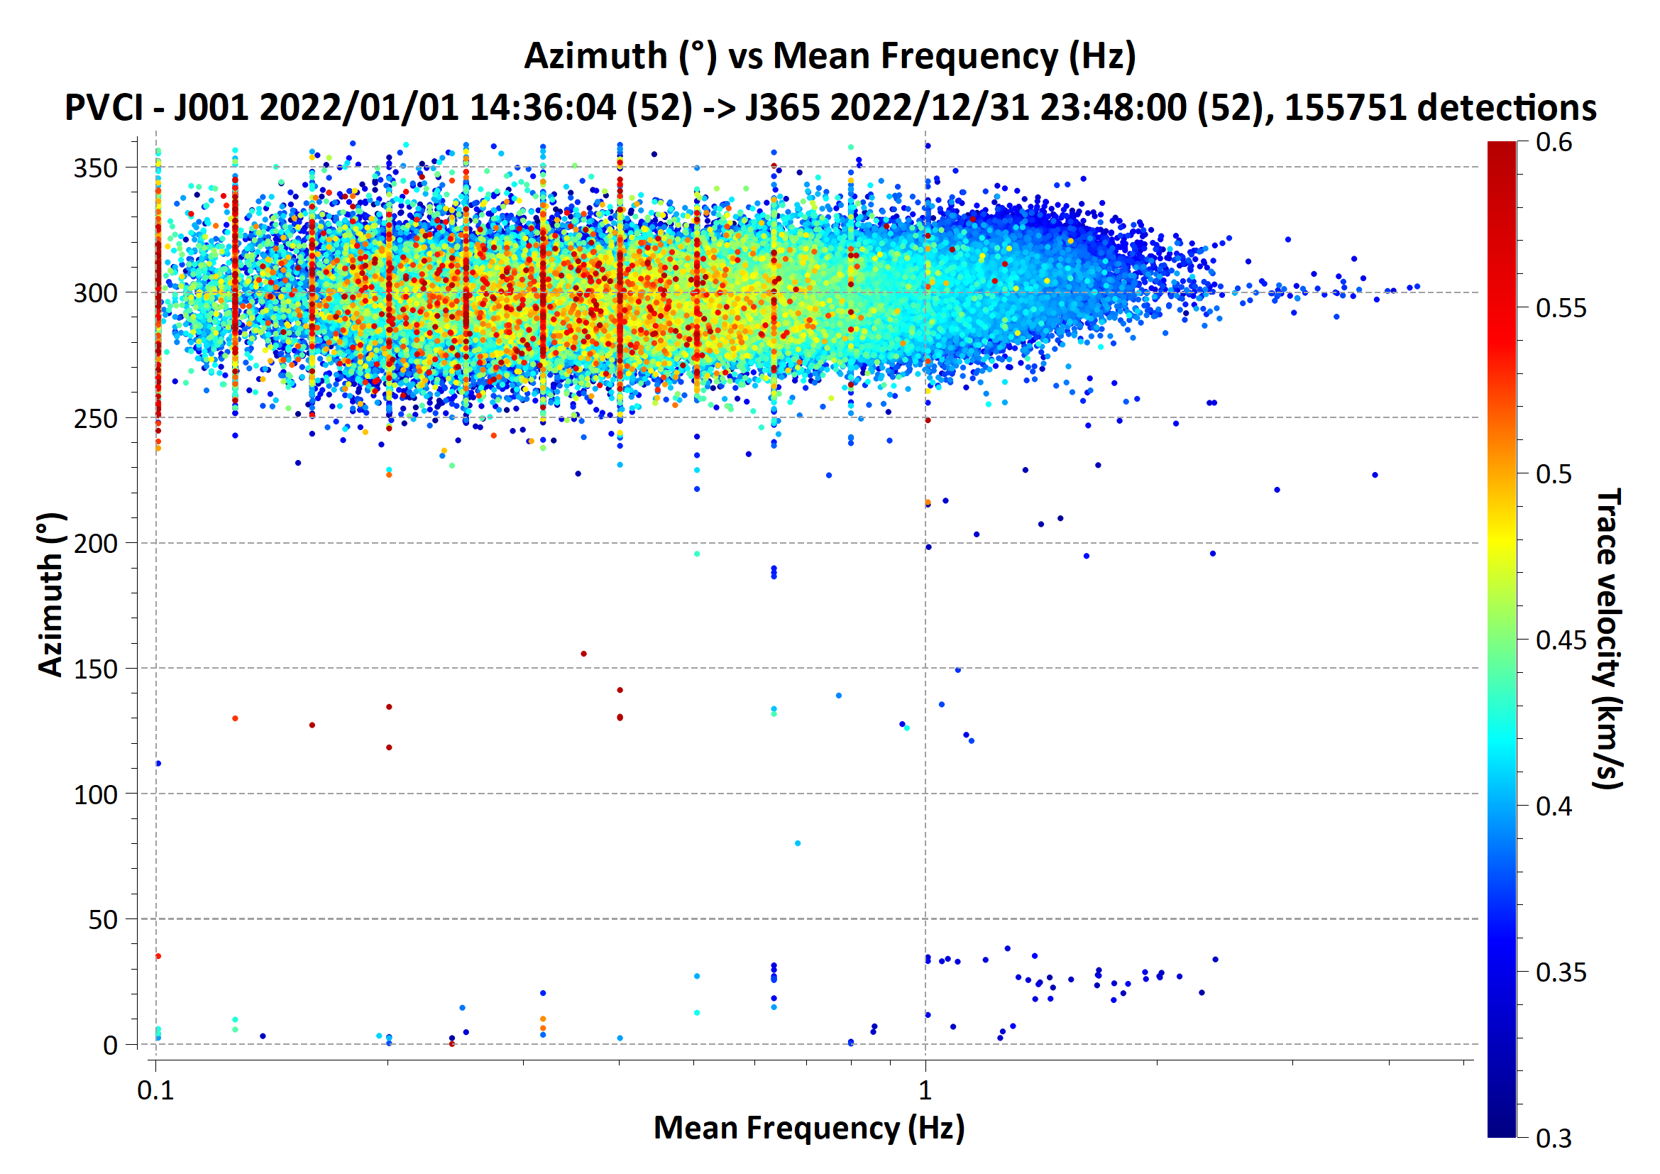
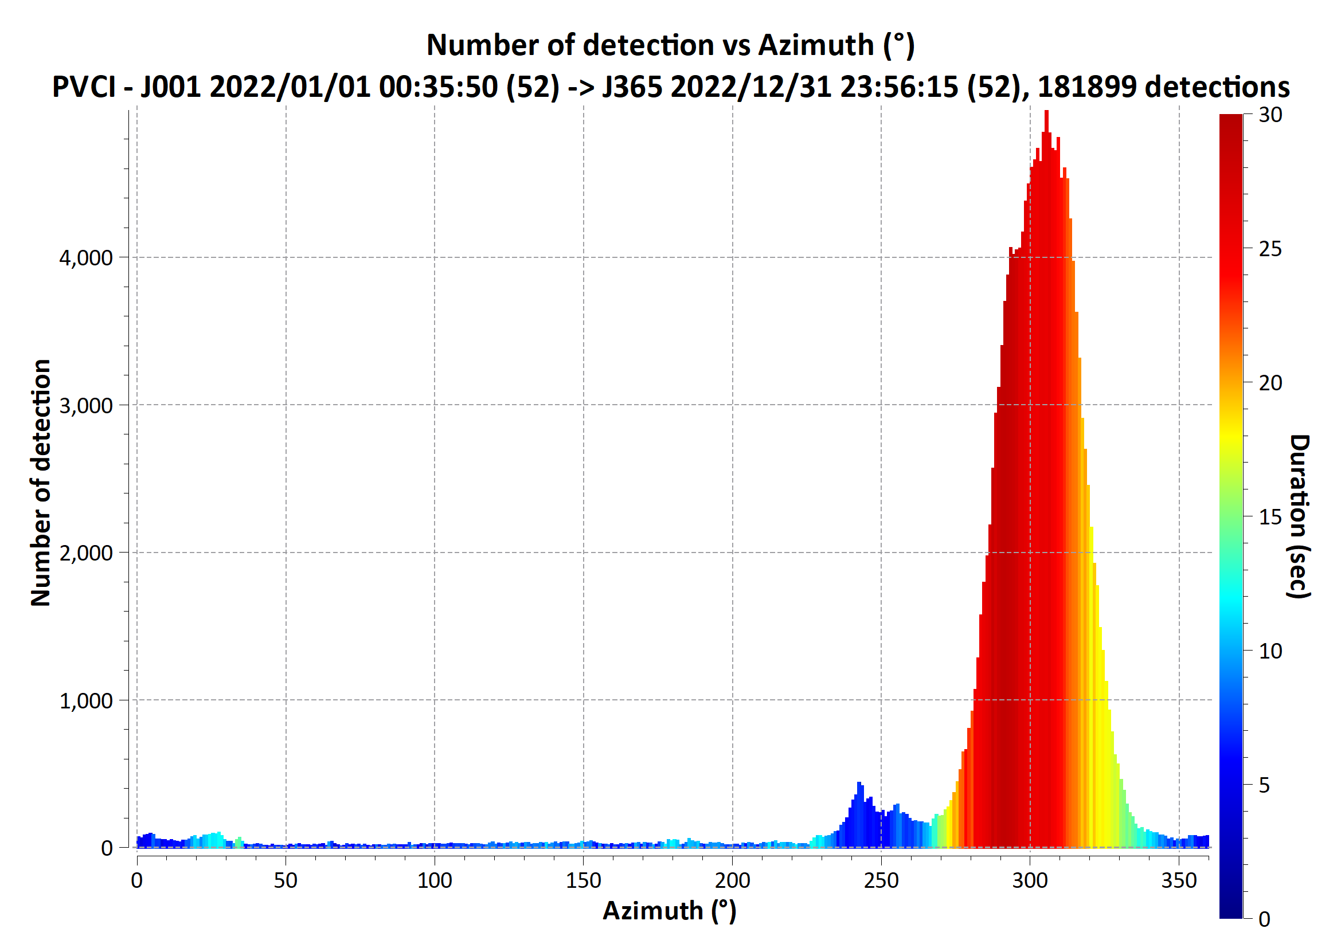
Observations in winter
O1.1-205
Winter 2022, 1 January – 20 February and 21 October – 21 December
2D histogram azimuth-frequency-velocity, signals of duration > 30 s
NW arrivals only
f = 0.1 – 2 Hz, maximum number of detections at 0.5 – 0.8 Hz microbaroms are not the only source observed in winter
1D histogram azimuth-duration, signals of frequencies > 0.7 Hz
Long duration of signals from NW, possible sources searched among the permanent and long-duration ones
Significant back-azimuths and possible sources
30° industry in Poland: Bogatynia- Turow surface mine and powerplant
240 – 340°
f = 0.2 Hz microbaroms
f > 0.5 Hz industry in NW Bohemia, refinery and chemical industrial complex Leuna (Germany), other unknown sources at 310-330°

Slide 7
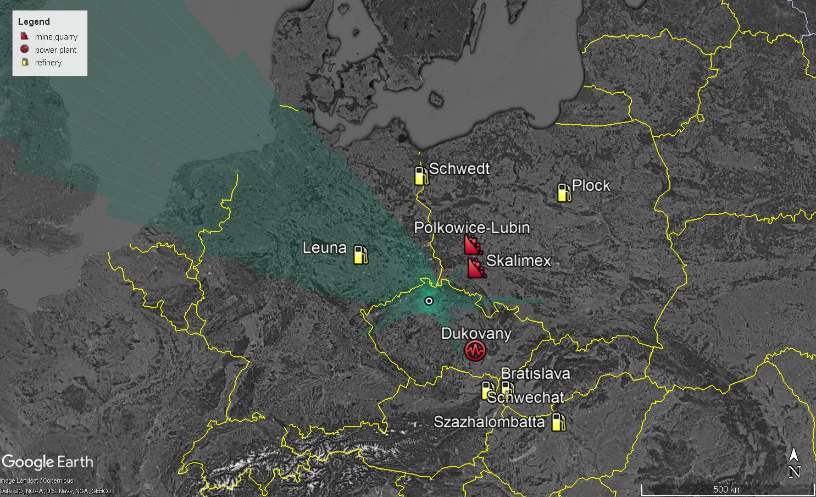
Possible regional sources of infrasound detected at PVCI
O1.1-205
Measurements of a single station
Literature review – the types of sources – searched for in the azimuths of signal arrivals
In the background back-azimuths observed in year 2022
Large refineries found in the directions of frequent arrivals of low-amplitude stable signals
Mines previously identified as a source in the European Infrasound Bulletin (Pilger et al., 2018)

Slide 8
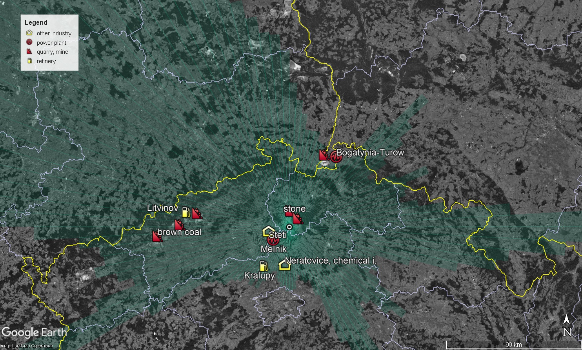
Possible local sources of infrasound detected at PVCI
O1.1-205
Sources mostly up to 50 km from PVCI
Direct signal propagation expected,
arrivals independent from the season of the year
Quarries
Industry: refineries, a chemical complex, a paper mill
Thermal powerplants
Surface brown coal mines (50 – 80 km)

Slide 9
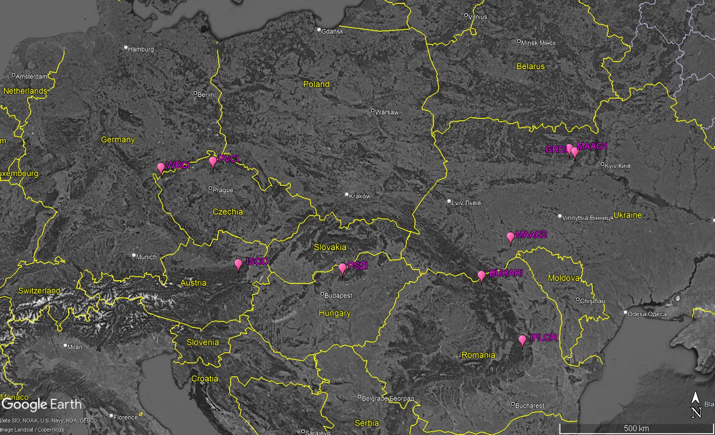
Central and Eastern European Infrasound Network
O1.1-205
Memorandum of cooperation, 2018
Austria, GeoSphere
Czechia, the Czech Academy of Sciences, Institute of Atmospheric Physics
Hungary, Research Centre for Astronomy and Earth Sciences of the Hungarian Academy of Sciences
Romania, National Institute for Earth Physics
Ukraine, National Space Facilities Control and Test Center, State Space Agency of Ukraine
Identification and monitoring of infrasound sources in Central and Eastern Europe
Central and Eastern European Infrasound Bulletin 2017-2020
Available at www.ceein.eu
Central and Eastern European Infrasound Bulletin 2021-2022
Available at www.ceein.eu
SnT 2023 e-poster P2.3-189 by I. Bondar et al.

Slide 10
Summary
O1.1-205
Microbarograph station PVCI
Dominant back-azimuths of 280 – 330° all year round
In winter NW arrivals only – likely no permanent local sources to the east of PVCI
In summer arrivals from NW and from 40-50° 150° 200-250°;
in 2022 also BAZ 90°
As possible signal sources identified: microbaroms, refineries and industry, mining activities
A verified source: war in Ukraine from 2022
Transient sources not presented today, but regularly detected at PVCI: North Sea sonic booms (~310°, verified), Aegean Sea sonic booms (~145°), convective storms

Slide 11
O1.1-205
Thank you for your attention
The acknowledgement:
DTK-GPMCC and DTK-DIVA software were kindly provided by Commissariat à l’énergie atomique et aux énergies alternatives, Centre DAM-Île-de-France, Département Analyse, Surveillance, Environnement, Bruyères-le-Châtel, F91297 Arpajon, France
The authors thank Alexis Le Pichon and Julien Vergoz for the training on infrasound data processing and for the support of CEEIN activities.

