Slide 1
The Data Fusion automatic processing pipeline at CTBTO
Joshua Kunkle, Noriyuki Kushida, Martin Kalinowski , Robin Schoemaker, Jolanta Kuśmierczyk-Michulec, Boxue Liu, Yuichi Kijima
CTBTO
PTS-520
Presentation Date: 22 June 2023

Slide 2
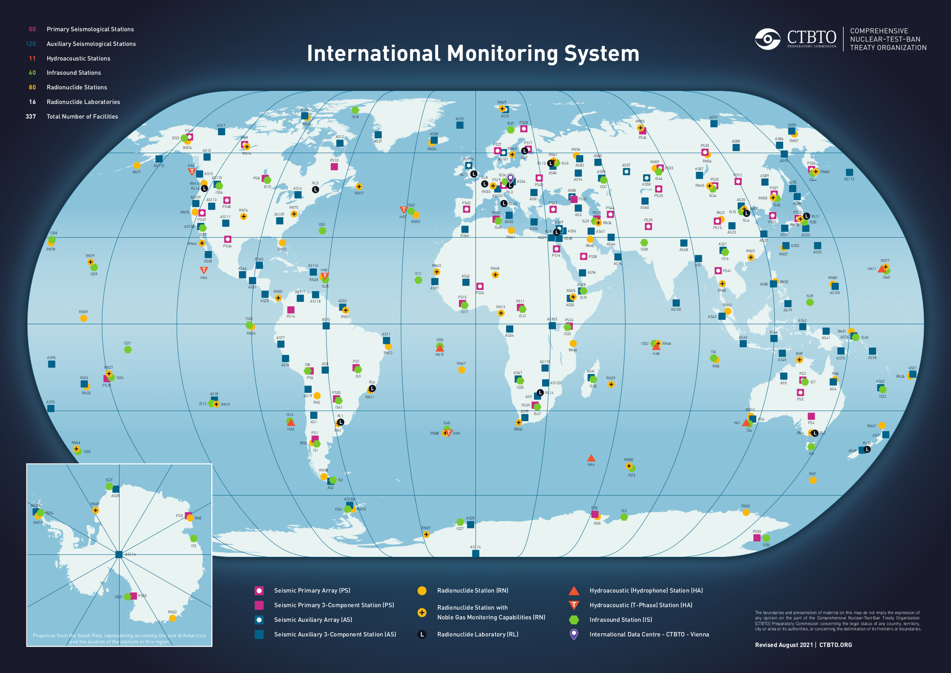
The International Monitoring System
PTS-520
The CTBTO monitors the earth for possible nuclear explosions through the International Monitoring System (IMS) which is composed of,
Data Fusion aims to provide the most comprehensive view of any event by matching information from Seismic, Hydroacoustic, Infrasound events to measurements at Radionuclide stations

Slide 3
Data Processing at the International Data Center
PTS-520
Station Processing
Global Association
Analyst Review
Products
Station Data
LEB
REB / SEB
SSEB
Seismic
Infrasound
Hydroacoustic
RRR
Radionuclide
ARR
SEL1/
SEL2/
SEL3
Atmospheric Transport Modeling

Slide 4
Data Fusion Pipeline at the International Data Center
PTS-520
Automatic
Station Processing
Global Association
Analyst Review
Products
Station Data
LEB
REB / SEB
SSEB
Seismic
Infrasound
Hydroacoustic
RRR
Data Fusion Pipeline
Radionuclide
ARR
SEL1/
SEL2/
SEL3
Fused Events
Atmospheric Transport Modeling

Slide 5
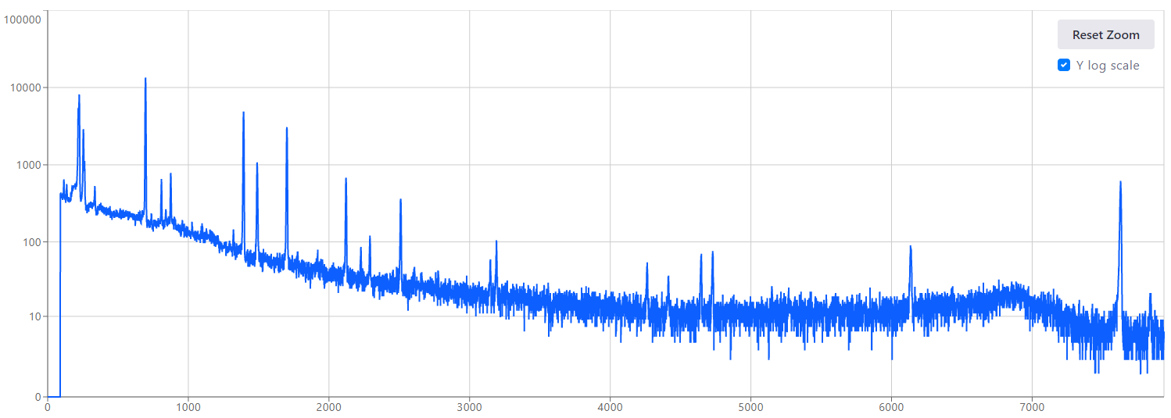
IDC processing Outputs
PTS-520
Waveform
Radionuclide
Data from multiple measuring stations are combined to produce the most likely event time and location with an error ellipse
Nuclide concentrations are extracted from gamma-ray energy spectra
Nuclides Quantified | Half-Life | Conc (uBq/m3) | RelErr (%) | Activ (uBq) | RelErr (%)
BE-7 | 53.290 D | 5.1eE+03 | 2.32 | 6.27E+07 | 2.32
PB-212F | 10.64 H | 4.01E+04 | 1.98 | 5.65E+07 | 1.98
Data fusion aims to join these two types of results to produce combined hypotheses

Slide 6
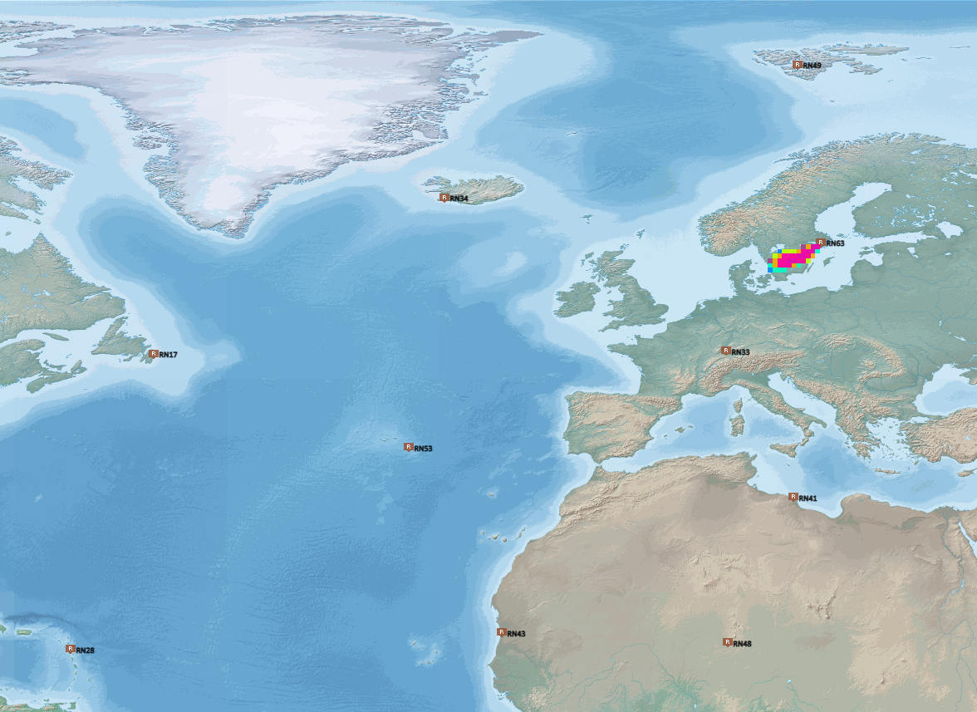
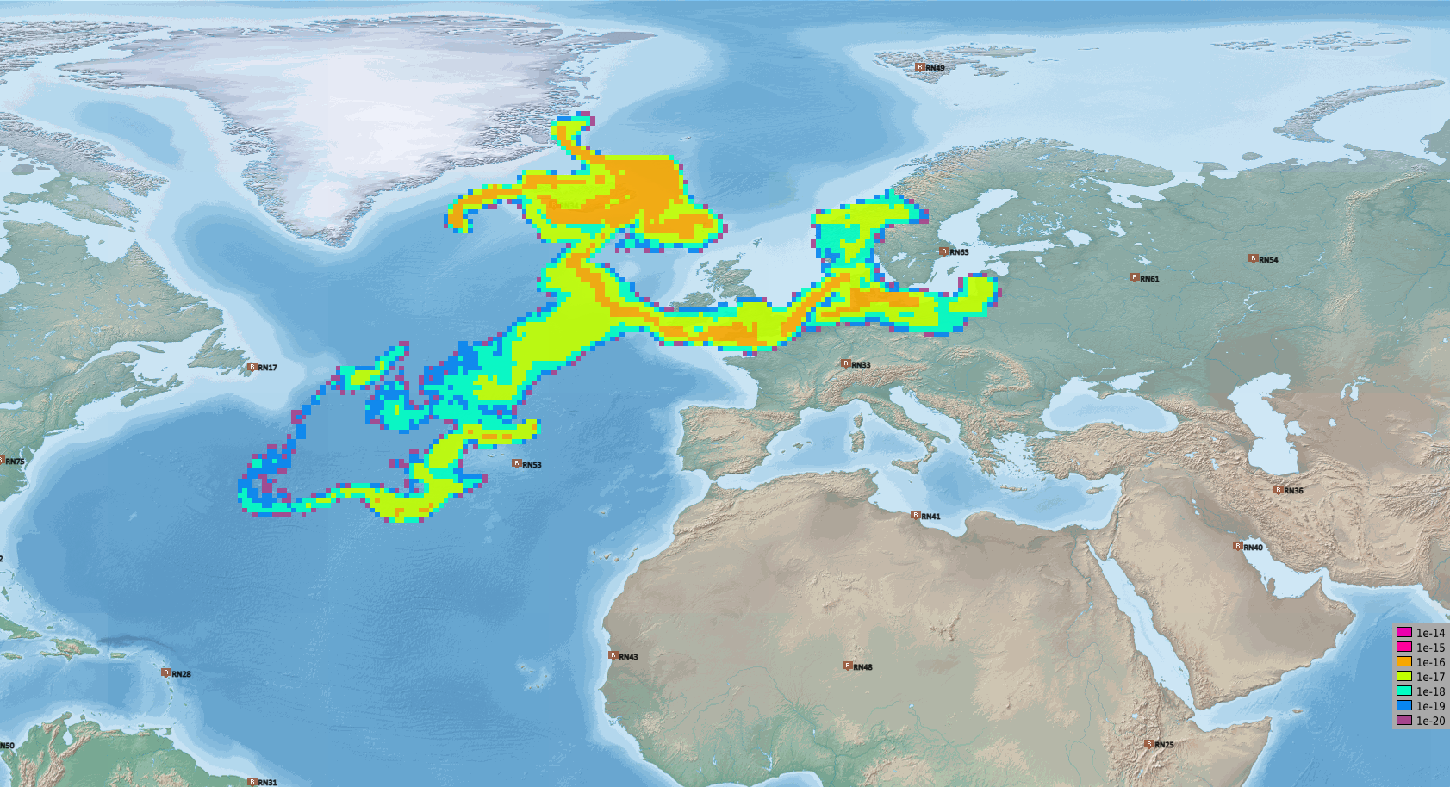
Atmospheric Transport Modeling
PTS-520
T – 10h
Atmospheric Transport Modeling (ATM) provides a connection between waveform-based events and radionuclide monitoring stations
ATM Simulates the propagation of passive tracers through the atmosphere based on wind-field data
It is computationally expensive to perform the forward-in-time simulation for each waveform event
Instead, we perform backward-in-time simulation from each detecting station.
  Produces Source Receptor Sensitivity (SRS) Field
  Traces backward in time for 14 days
  Current resolution is 1 hour, 0.5 x 0.5 deg
SRS (m⁻³)
T – 115h
webgrape.ctbto.org

Slide 7
Data Fusion Methodology
PTS-520
T – 10h
Follow ATM simulation backwards from each RN station
Overlap is accomplished by considering all grid elements which match an SHI ellipse at the event time
Latitude
SRS (m⁻³)
Longitude
T – 115h
Results in many-to-many relationship between RN samples and waveform events.
This is the maximal set of possible matches, which must be further processed
Waveform events
RN samples
webgrape.ctbto.org

Slide 8
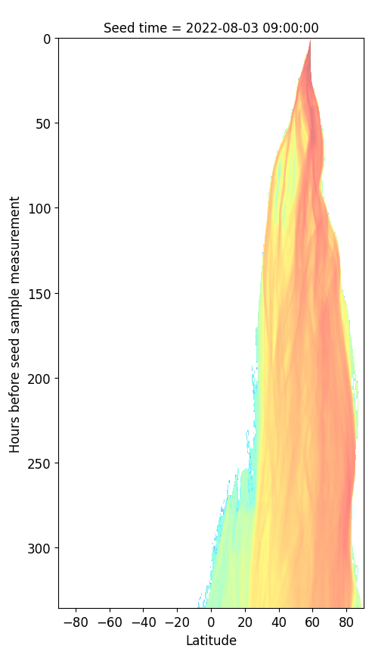
Data Fusion Methodology
PTS-520
Visualize fusion with time – latitude projection
Backward simulation start at station location
T – 10h
T – 115h
…
…
14-day duration

Slide 9
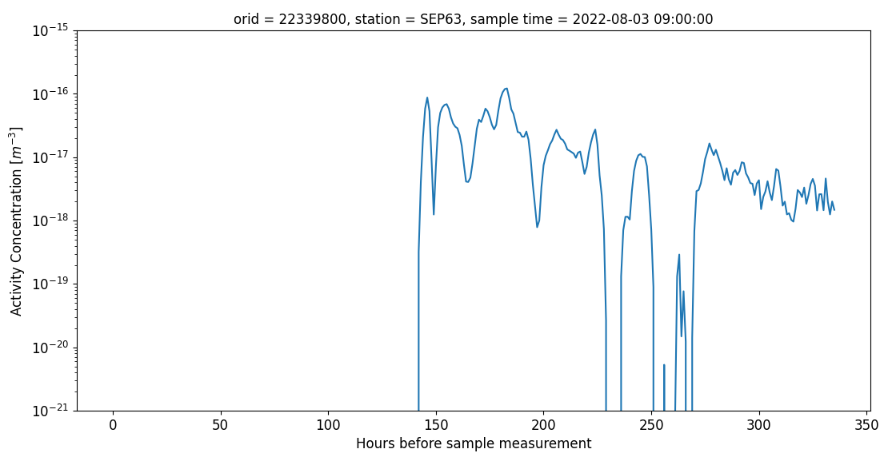
Delayed Releases
PTS-520
We consider delayed release of up to 60 days
60 day limit is motivated by suspected release delay from the announced nuclear test by DPRK in 2013 [1]
Achieved by releasing the requirement on the time component of the overlap
Results in a series of matched SRS values
SRS time series can be further used to quantify match probability
Prompt
Prediction from full SRS field
SRS (m⁻³)
[1] A. Ringborn et al., “Radioxenon detections at CTBT international monitoring system likely related to the announced nuclear test in North Korea on February 12, 2013”, Journal of Environmental Radioactivity 128 (2014) 47-63

Slide 10
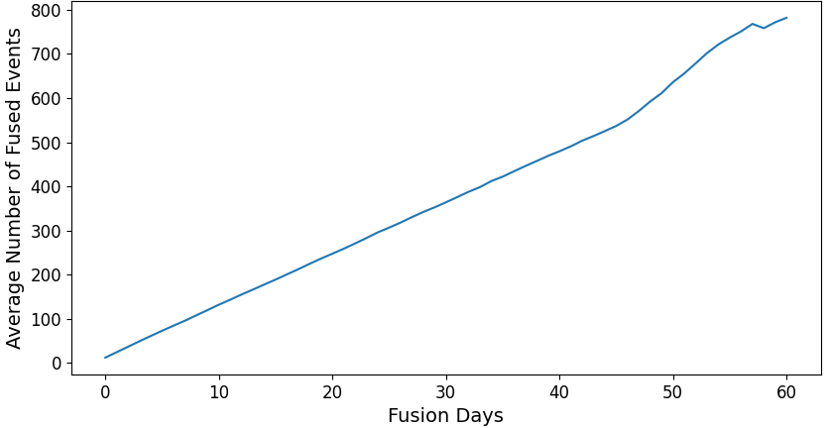
Challenges with Delayed Release
PTS-520
Allowing for delayed release significantly increases the number of fusion matches
Quickly becomes untenable to analyze such a large number of matches
Now investigating methods to rank fusion candidates based on information from multiple stations
Average number of fused events vs release delay, 2021
Prompt
Release delay [days]

Slide 11
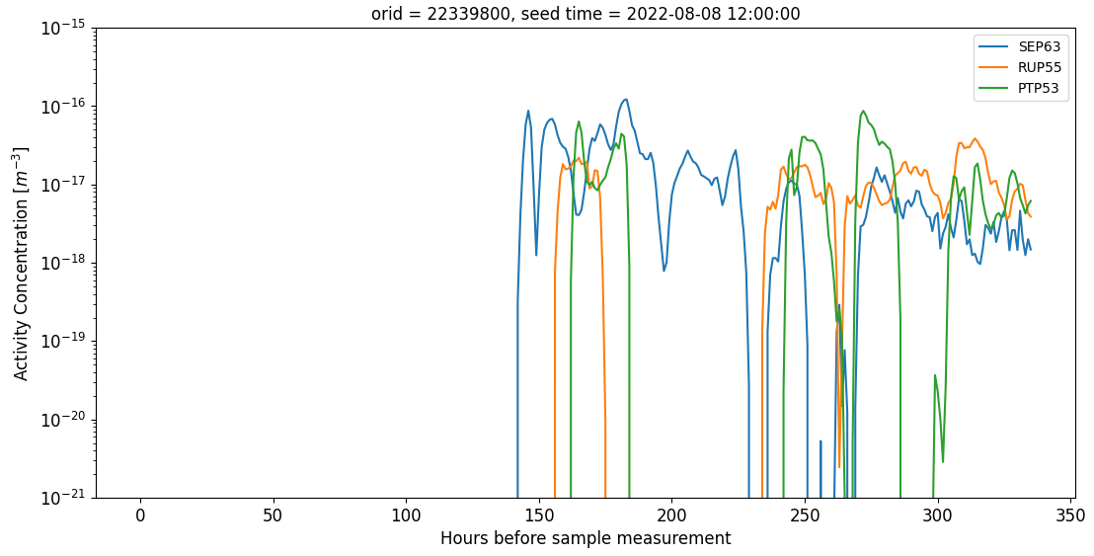
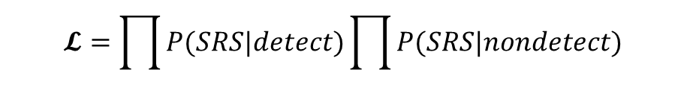
Future Work
PTS-520
The same waveform event may have matches with multiple RN stations
  Aligned SRS time series should agree on time of release
  The same nuclides should be measured at all stations
  Non-detections provide refuting evidence
Investigate a probabilistic model to incorporate information from non-detections
Investigate Bayesian inference models such as FREAR which incorporates non-detections and provides source location
  https://gitlab.com/trDMt2er/FREAR
SRS (m⁻³)
$$𝓛=\prod{P(SRS|detect)}\prod{P(SRS|nondetect)}$$

Slide 12
PTS-520
Thank you!

