Slide 1
iNSPIRE extension to particulates for unifying CTBTO radionuclide analysis software tools
Abdelhakim Gheddou, Martin B. Kalinowski, Jonathan Baré, Arend Harms, Jana Merešová, Eric Jilbert Nguelem Mekongtso, Carla Pires, Seokryung Yoon
CTBTO
PTS-564
Presentation Date: dd Month yyyy / Font: Arial Size: 18

Slide 2
Scope
PTS-564
Introduction
iNSPIRE project
Key features
Summary

Slide 3
Introduction
PTS-564
The project …
iNSPIRE is an integrated software platform for the interactive review of IMS Radionuclide data and analysis results, that the IDC developed over the recent years.
A first release, which covers beta-gamma coincidence-based noble gas systems (current and next generation) or the IMS, was deployed in in IDC operations and delivered to NDCs in Q4 2020.
Over 2021-2022, the IDC completed the phase 2 development of iNSPIRE project by extending the software functionalities to IMS particulate stations and HPGe SPALAX based noble gas systems.
… Objectives
Completing the migration to open-source license free software for the Radionuclide technology;
Moving to modern software development technologies;
Unifying the tools for particulates and noble gas;
Optimizing the software cycle management;
Enhancing modularity (shared libraries – same language);
Integrating new technologies at IMS stations;
Integrating new analysis methods;
Further automating analysis tools;
Enhancing IDC products.
3

Slide 4
iNSPIRE project phase
PTS-564
Old interactive software:
- 3 different tools
IDC
iNSPIRE
Saint2 (matlab)
NDC-in-a-Box
openSpectra (java)
Beta-gamma coincidence based noble gas
(SAUNA II/III, SPALAX NG, Xenon International, MIKS)
iNSPIRE (Python/Qt)
Particulates, HPGe based SPALAX
New interactive software
- 1 integrated platform !
IDC NDC-in-a-Box
iNSPIRE (Python/Qt)
Beta-gamma coincidence based noble gas
(SAUNA II/III, SPALAX NG, Xenon International, MIKS)
Particulates, HPGe based SPALAX
4

Slide 5
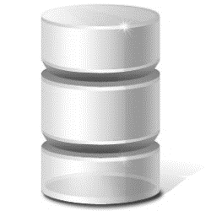
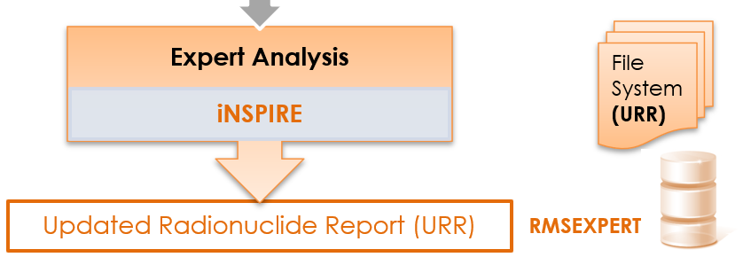
Automatic domain
Analyst
domain
Novel IDC Radionuclide pipeline
PTS-564
Automatic processing:
autoSaint for particulates and HPGe noble gas
autoSTRADA for beta-gamma noble gas
Interactive review:
iNSPIRE for both particulates and noble gas
Database schema:
RMSAUTO
RMSMAN
RMSEXPERT
IDC products:
ARR
RRR
URR
File System
(ARR)
Automatic processing
autoSTRADA
Interactive review
Reviewed Radionuclide Report (RRR)
iNSPIRE
Automatic Radionuclide Report (ARR)
Expert
domain
autoSTRADA/autoSaint
RMSAUTO
File System
(RRR)
iNSPIRE
RMSMAN

Slide 6
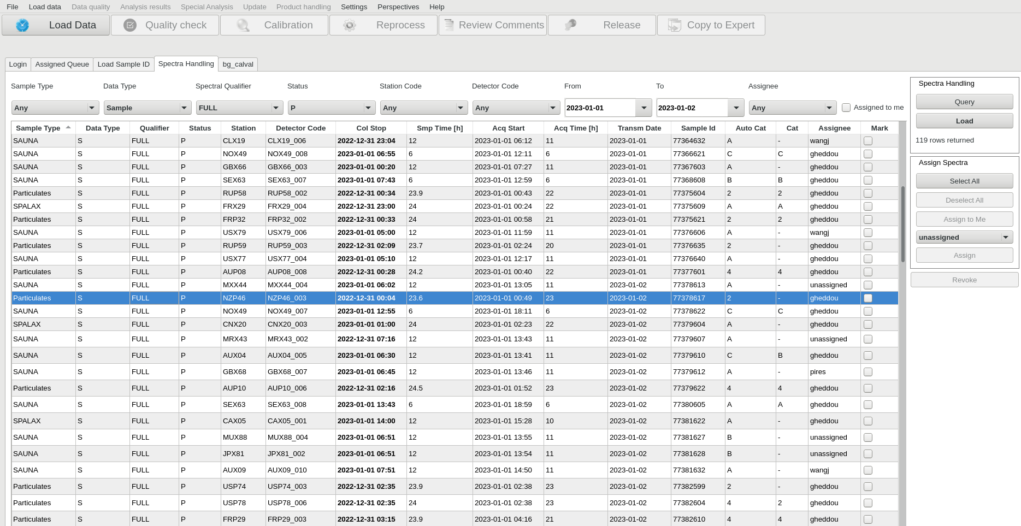
Handled data
PTS-564
The new iNSPIRE handles all Radionuclide spectral data from all IMS technologies:
Beta-gamma coincidence based noble gas (SAUNA II/III, SPALAX NG, Xenon International, MIKS)
Particulates
HPGe based SPALAX noble gas
6

Slide 7
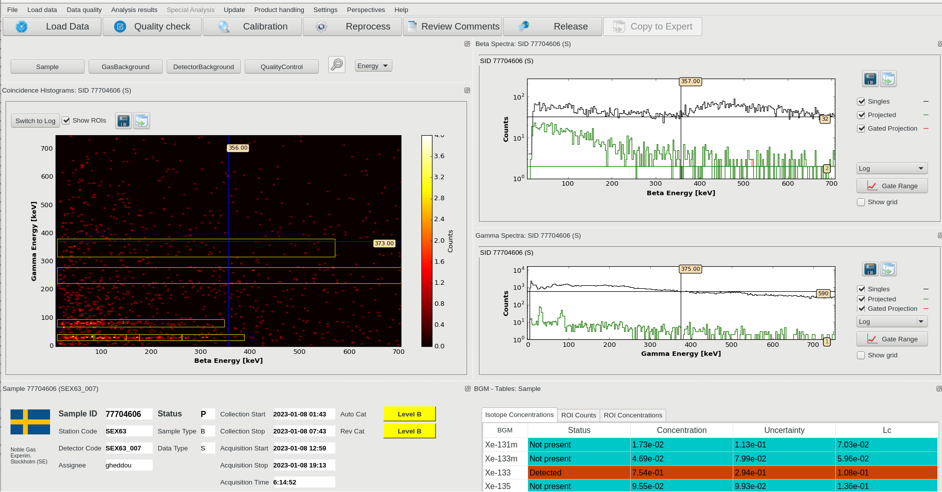
Functionality 1: Beta-gamma noble gas
PTS-564
The GUI provides dedicated features for:
- Sample information,
Spectral data
Sample metrics,
Analysis results
Calibrations
Reprocessing
Comment editor
Sample release options
Reviewed product generation
Special analysis,
…
7

Slide 8
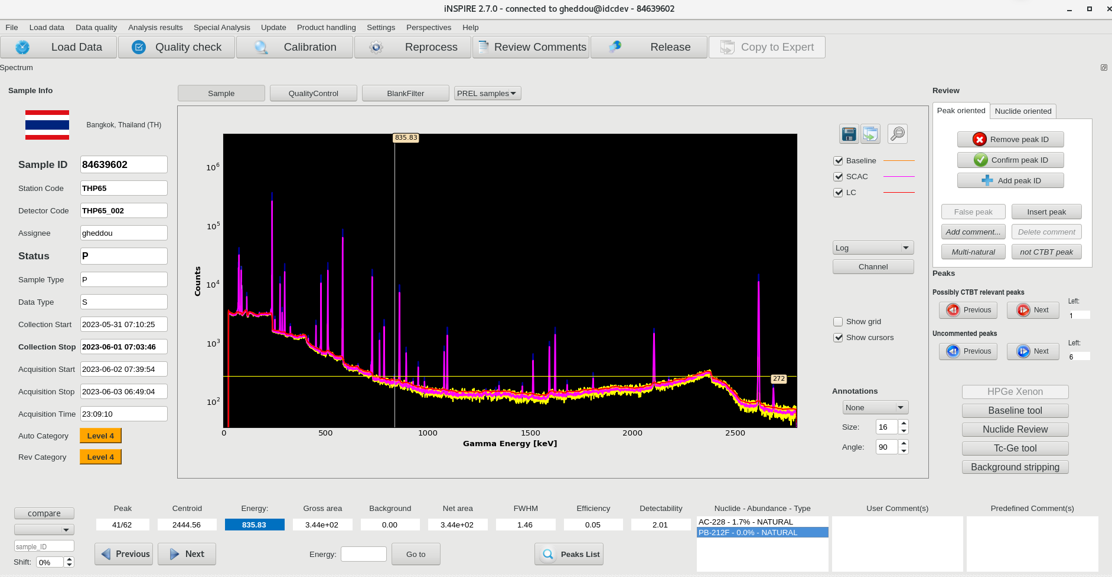
Functionality 2: Particulates
PTS-564
The GUI provides dedicated features for:
- Sample information,
Spectral data
Sample metrics,
Peak browser
Analysis results
Calibrations
Reprocessing
Comment editor
Review tools
Sample release options
Reviewed product generation
Special analysis,
…
8

Slide 9
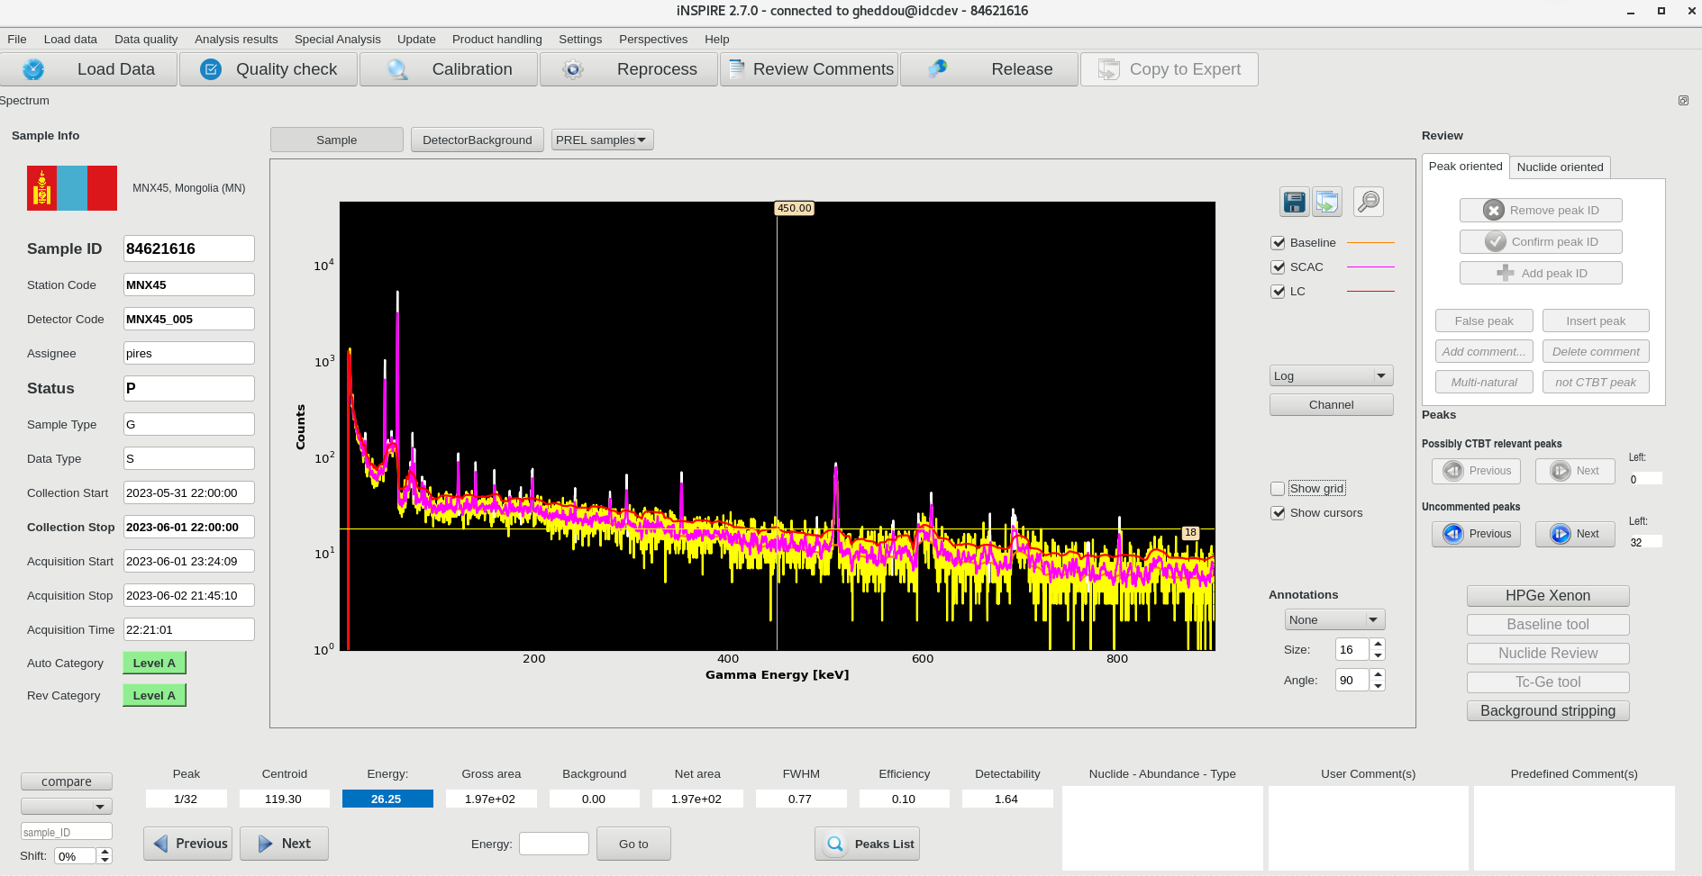
Functionality 3: HPGe based noble gas
PTS-564
The GUI provided dedicated features for:
- Sample information
Spectral data
Sample metrics
Peak browser
Analysis results
Calibrations
Reprocessing
Comment editor
Review tools
Sample release options
Reviewed product generation
Special analysis,
…
9

Slide 10
Sample metrics
PTS-564
Sample metrics for current sample.
Timeseries of station history for anomaly/ trend analysis.
Mapping color scheme
good (green)
fair (yellow)
bad (red)
Used for checking data quality against certification thresholds
HPGe noble gas Particulates Beta-Gamma noble gas
10

Slide 11
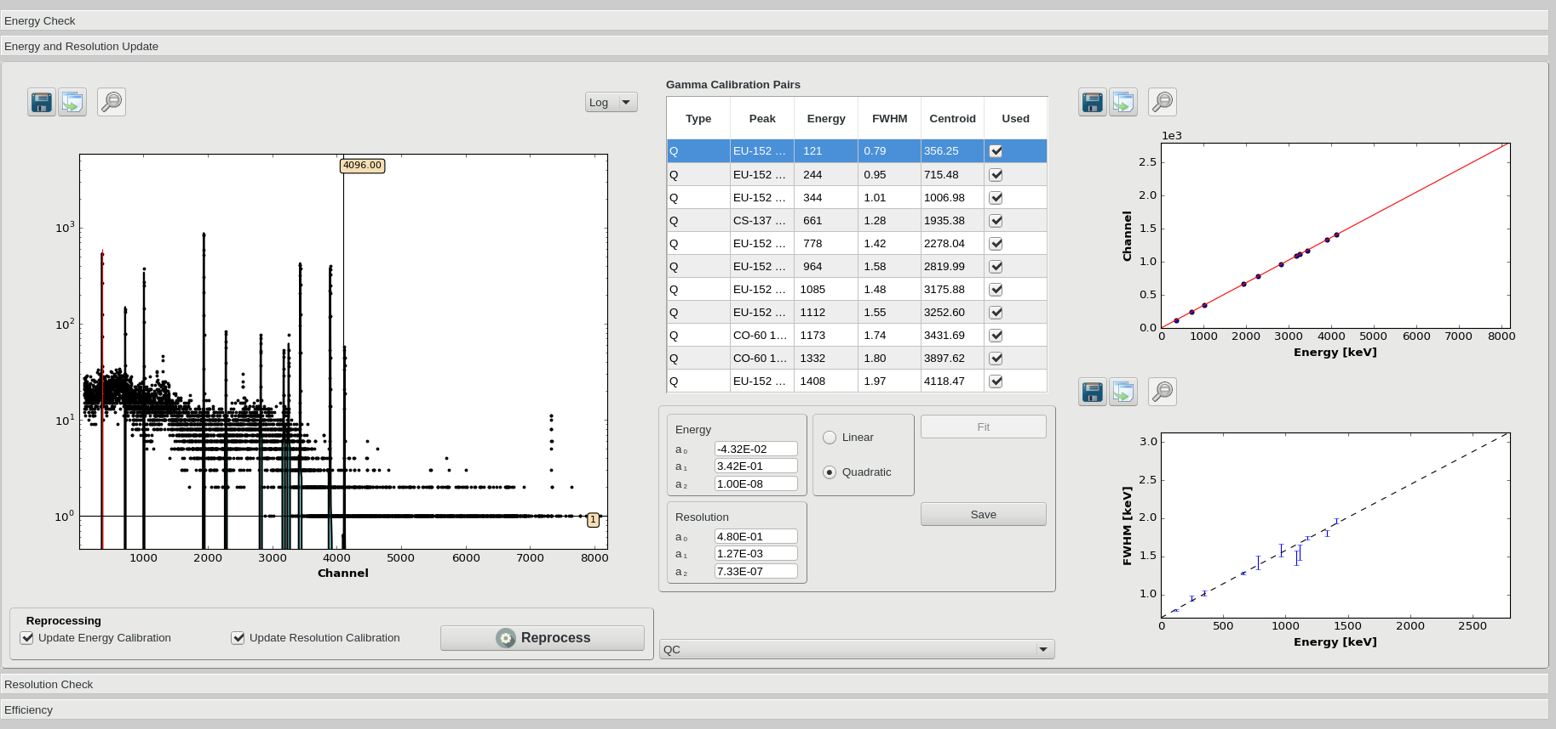
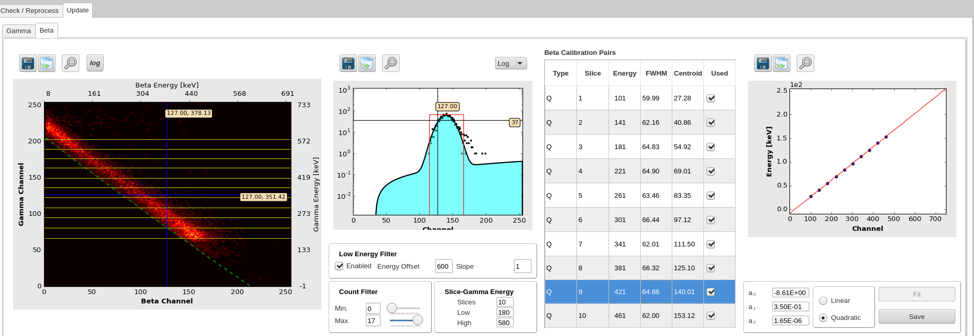
Calibration check and update
PTS-564
Dedicated features for:
Checking energy calibration
Checking resolution calibration
Updating energy and/or resolution calibrations, if necessary
Verifying efficiency calibration
11

Slide 12
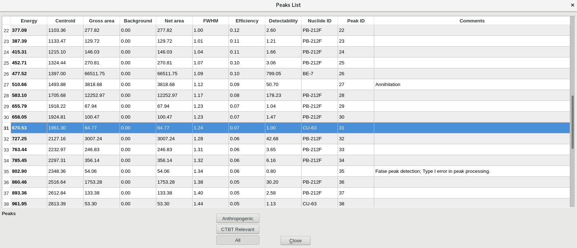
Peak browser (particulates)
PTS-564
Peak browser:
CTBT relevant, anthropogenic (but not CTBT relevant), natural radionuclides
Peak attributes and associated Analyst comment(s)
Spectrum graph synchronized with peak selection
12

Slide 13
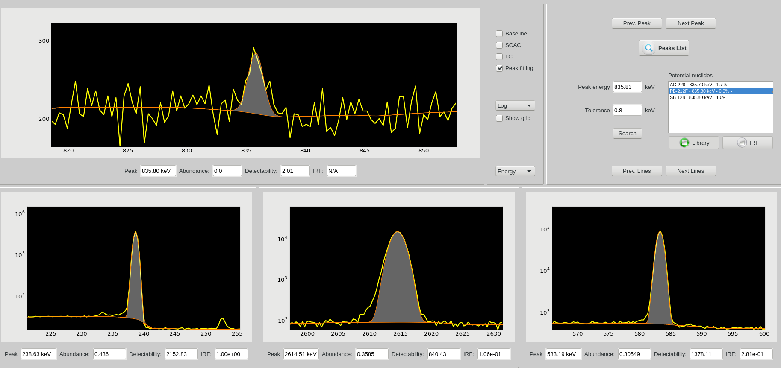
Peak/Nuclide review (particulates)
PTS-564
The Nuclide Review facility is a decision support system which assists the Analyst while checking/ exploring peak identification options.
Resources:
Radionuclide library
Isotope Response Function (Monte Carlo)
13

Slide 14
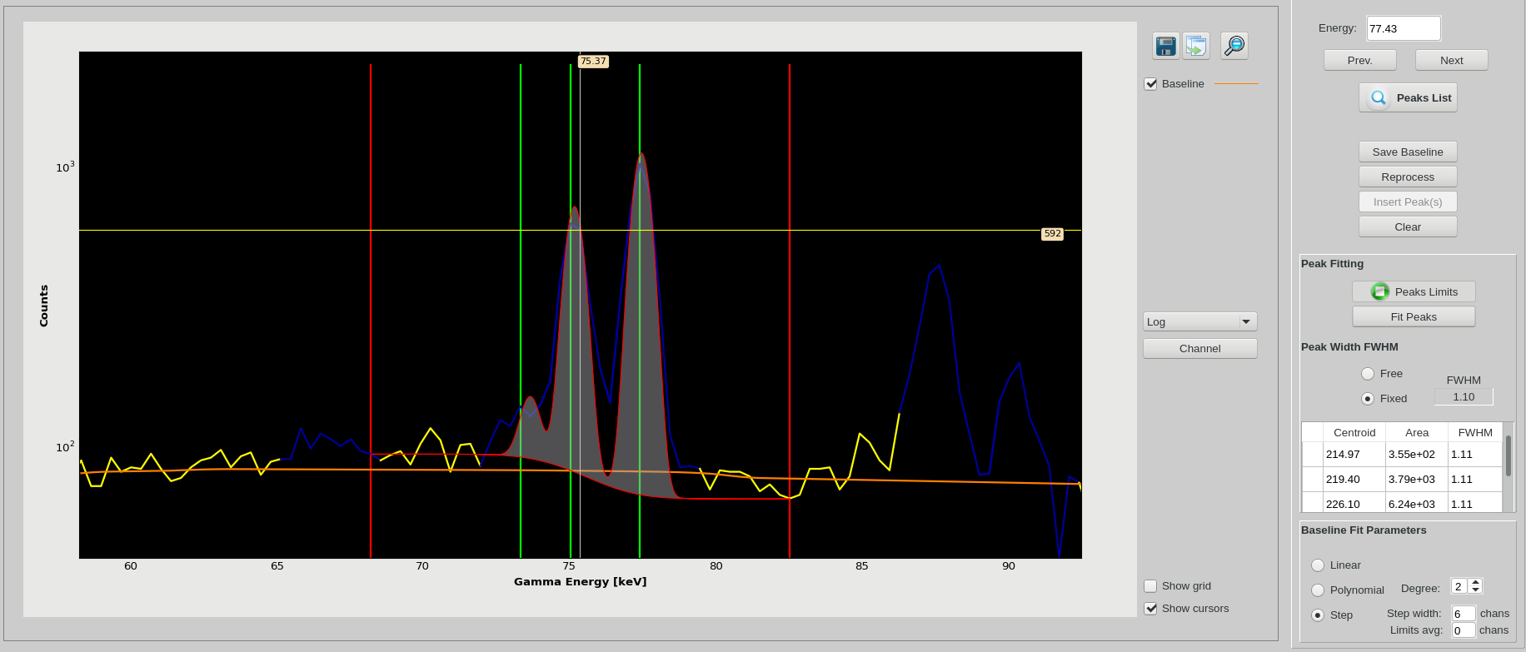
Baseline tool (particulates and HPGe noble gas)
PTS-564
The Baseline Tool facility allows Analysts to fit single peaks, deconvolve multiples, enhance the local baseline.
The functionality is available for particulates and HPGe based noble gas spectra
14

Slide 15
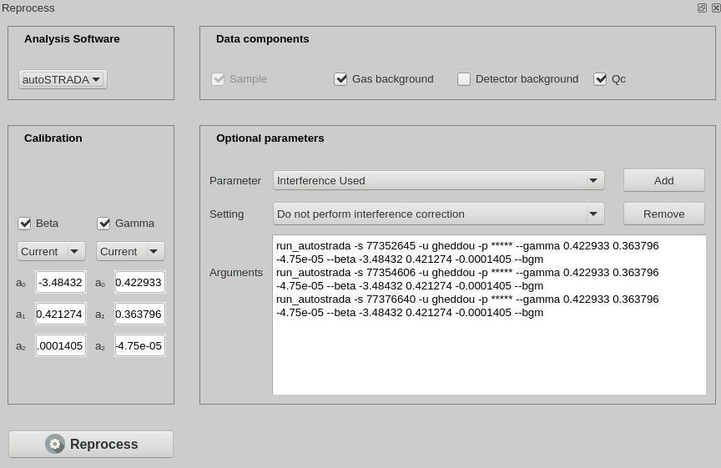
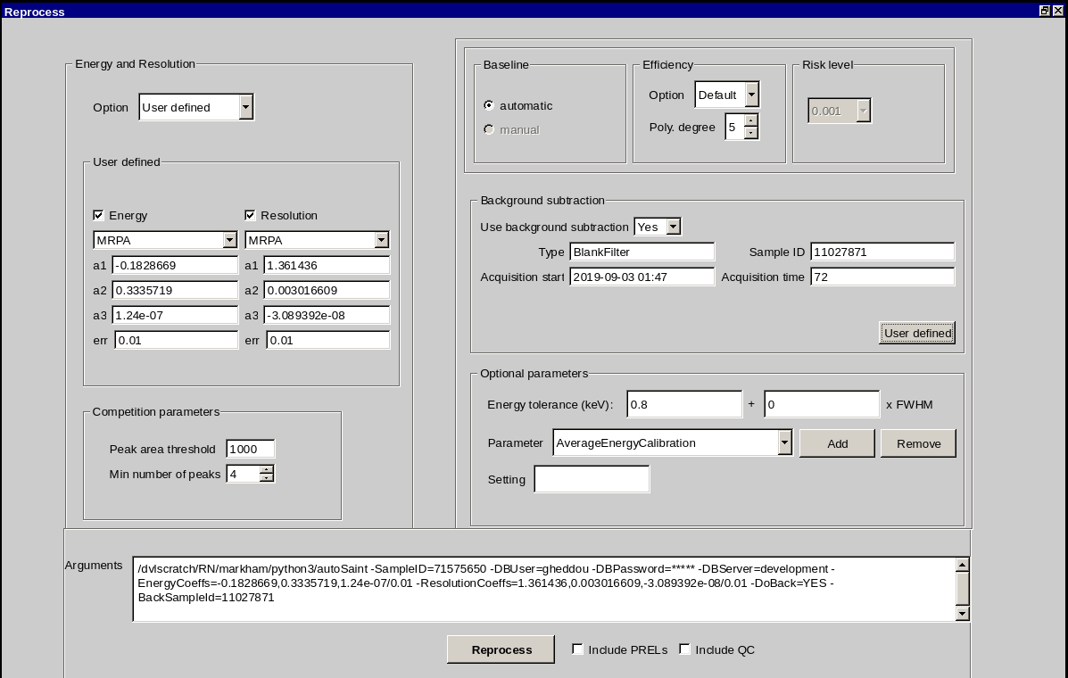
Data reprocessing
PTS-564
Beta-gamma noble gas data reprocessing with updated parameters:
Gamma and/or beta energy calibrations
Detector/gas background subtraction
any other processing parameter
Options for including detector/gas background, QC spectra
Particulates data reprocessing with updated parameters:
energy, resolution, efficiency calibrations
spectrum baseline
background subtraction
any other processing parameter
Options for including PRELs, QC spectra
15

Slide 16
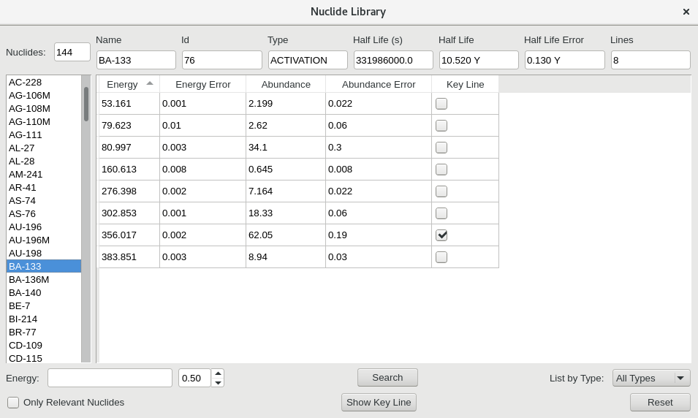
PTS-564
The Nuclide library window consists of a GUI interface for browsing nuclear data of radionuclides as in the database.
Relevant attributes:
Nuclide type
Half-life
Energies
Emission rates
Search options are provided for customizing contextual needs.

Slide 17
Spectrum release options
PTS-564
Noble gas release window
Sample spectra can be released with or without category.
Support spectra (calibration, blank, detector background) can be marked as viewed, bad, duplicate
Particulates release window
17

Slide 18
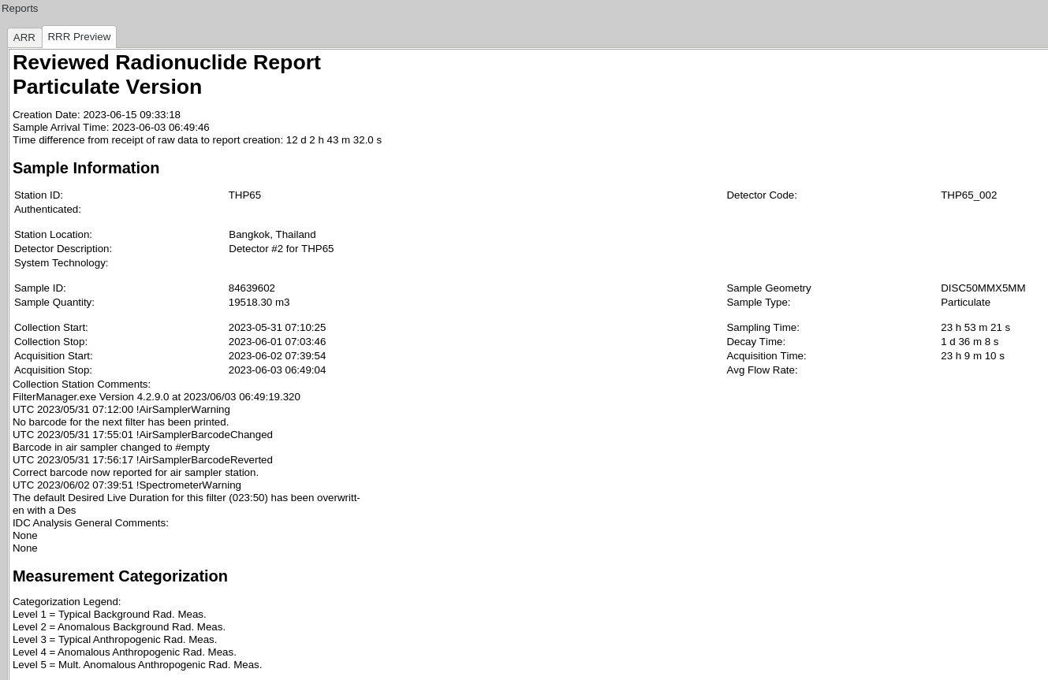
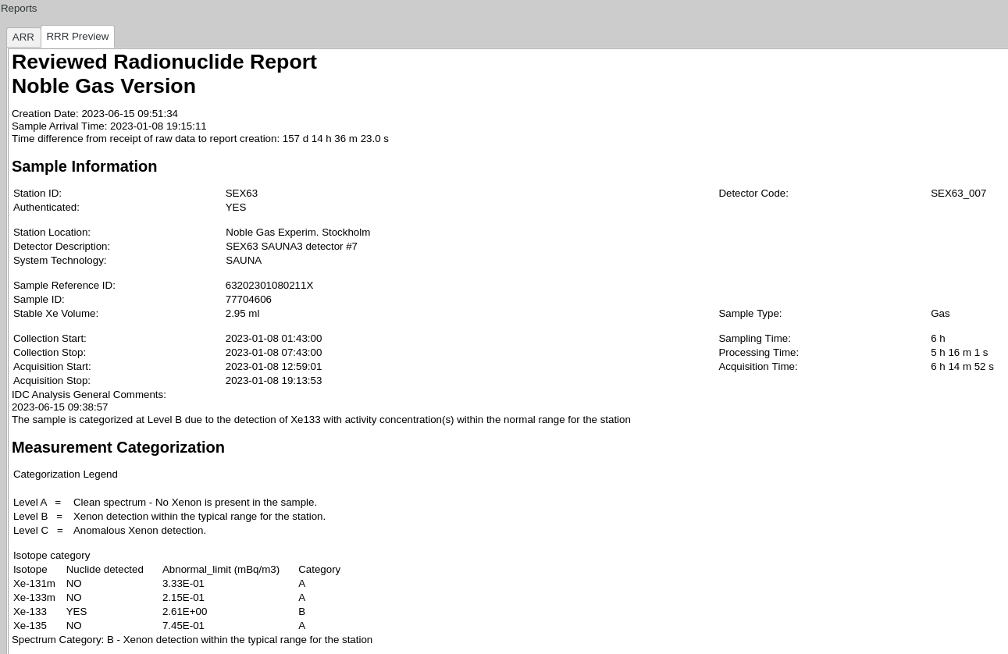
Report generation
PTS-564
After the interactive review is completed, iNSPIRE allows Reviewed Radionuclide Report (RRR) to be generated, in 3 formats: ascii, html and xml
18

Slide 19
Summary
PTS-564
The development by the IDC of iNSPIRE project is successfully completed.
The new version handles both noble gas and particulates data from IMS Radionuclide stations and Laboratories.
iNSPIRE provides relevant features and dedicated functionalities to Analysts to check the data quality, perform the standard interactive review and introduce necessary corrections to automatic processing results, as appropriate, and release sample spectra which produce Reviewed Radionuclide Reports (RRR).
It allows to perform Special Studies, on request by member states or the PTS, as well. The outcome will be an Updated Radionuclide Report (URR).
In addition to sample spectra analysis, the GUI is also used to interactively check all auxiliary spectral data (gas and detector backgrounds, Quality Control, calibration, blank) as well as spike spectra.
iNSPIRE phase 2 is currently under formal pre-release testing by IDC Analysts before deployment into IDC operations and integration into NDC-in-a-Box package.
19

