Slide 1
Scheduled Calibration of
IMS Infrasound Stations
Yacine Sid Ahmed, Benoit Doury,
Alfred Kramer, Ichrak Ketata
CTBTO Preparatory Commission, Vienna, Austria
PTS-680
Presentation Date: 20 June 2023, 12:00

Slide 2
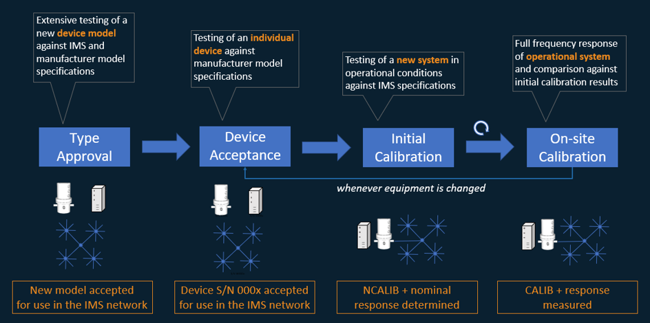
Quality Assurance Processes¹
PTS-680
¹ Quality Assurance Infrastructure for IMS Infrasound Measurements (ECS/WGB-52/PTS/8)

Slide 3
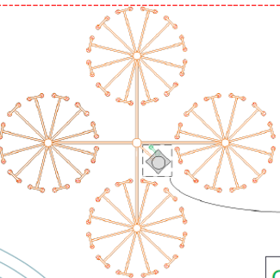
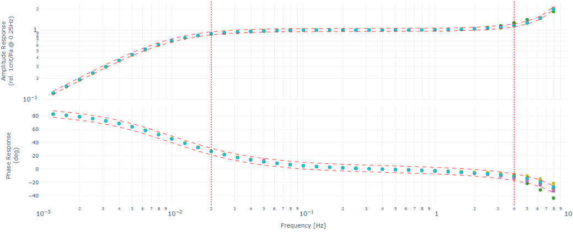
Operational Manual Requirements¹
PTS-680
“Stations are provided with the means to carry out a calibration whose result can be compared against a reference that was established at the time the station was certified or when a revalidation was completed at the station”
The calibration performed at the time of the station certification or revalidation is referred to as “initial calibration”. “The result of the initial calibration forms the baseline for certification and future calibrations”
The calibration performed on a regular basis to verify that the system response remains “within tolerances” of the baseline is referred to as “on-site calibration”.
“When the results of the calibration are not within tolerances, the station operator informs the Technical Secretariat and initiates the required maintenance.”
On-site calibrations are performed at least on a yearly basis
Both initial and on-site calibrations are “full frequency response calibrations”
System baseline
sensitivity
+ response
5% threshold
1 year
¹ [CTBT/WGB/TL-11,17/17/Rev.7]

Slide 4
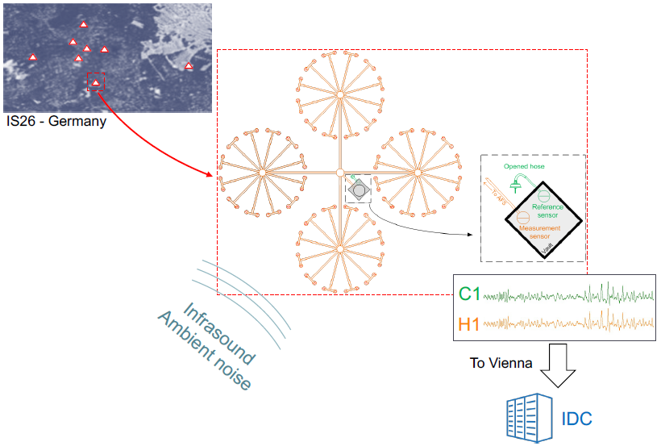
Principle: side-by-side comparison
PTS-680
A passive calibration method described by Gabrielson1 was chosen2 for on-site calibration
Station equipped with calibration capabilities:
reference system: sensor + pipe + inlet port
second data stream forwarded t
¹ In situ calibration of atmospheric-infrasound sensors including the effects of wind-noise-reduction pipe systems
² Quality Assurance Infrastructure for IMS Infrasound Measurements (ECS/WGB-52/PTS/8)

Slide 5
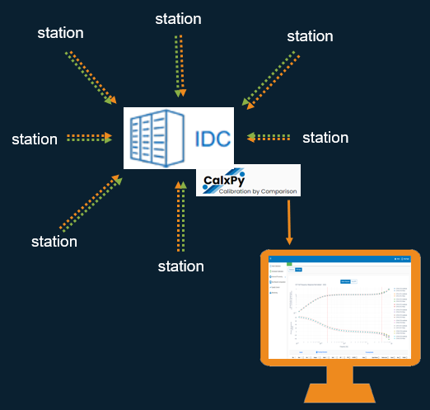
Principle: processing in Vienna
PTS-680
Scheduled Calibration process supported by software (CalxPy) for IS stations equipped with calibration capabilities (results computation, review, results archiving)
Calibration results computation is centralized in Vienna
Calibration is continuous
[see ePoster on CalxPy]

Slide 6
Scheduled Calibration Process
PTS-680
Responsibility shared between the Station Operator and the PTS.
Processes in 4 phases
PLANNING
Verification that calibration is possible (via CalxPy, IRS)
IMPLEMENTATION
Automatic results computation (via CalxPy)
Results reviewed at the PTS (via CalxPy)
Troubleshooting/maintenance initiated if applicable (via IRS)
REVIEW
Validated calibration results prepared for being shared with Authorized Users (CalxPy)
Update of computed sensitivities in the digitizers (followed via IRS, data frames)
PUBLICATION
[ECS-WGB-59-PTS-1]

Slide 7
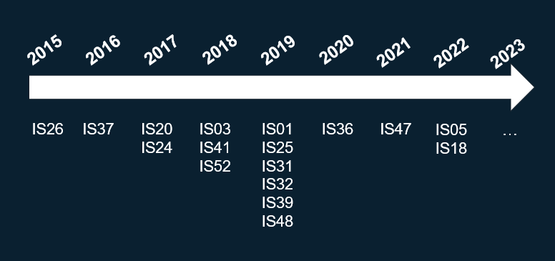
Scheduled Deployment of calibration capabilities - Status
PTS-680
Deployment of calibration capabilities is ongoing at infrasound stations of the IMS network

Slide 8
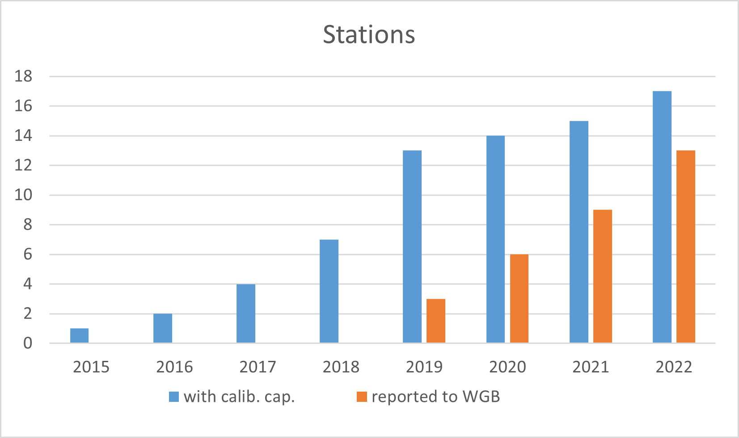
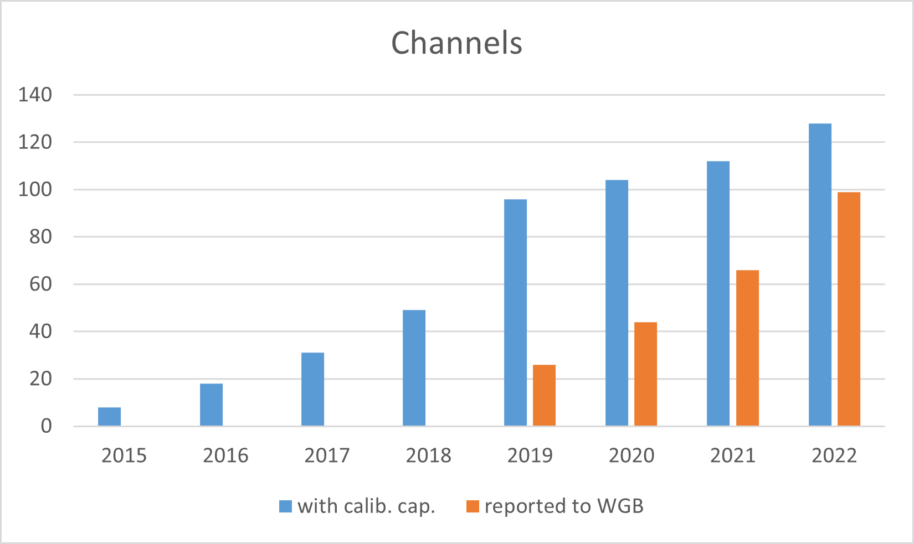
Results: overview
PTS-680
32% of the IS network is equipped with calibration capabilities (17 stations; 128 channels)
25% of the IS network have calibration results reported to Member States (13 stations; 99 channels)
[ECS-WGB-59-PTS-1]

Slide 9
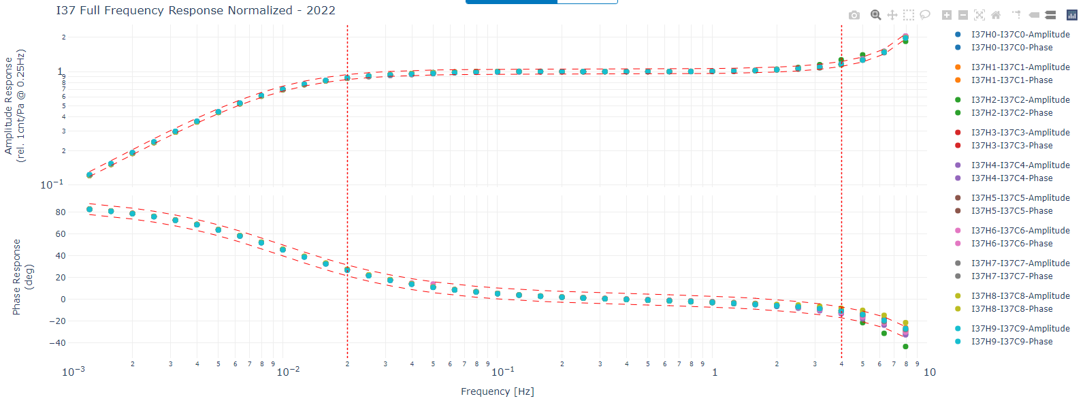
Examples of review: overview of all sites
PTS-680
Amplitude
Phase
All sites
IMS passband
[see ePoster on CalxPy]

Slide 10
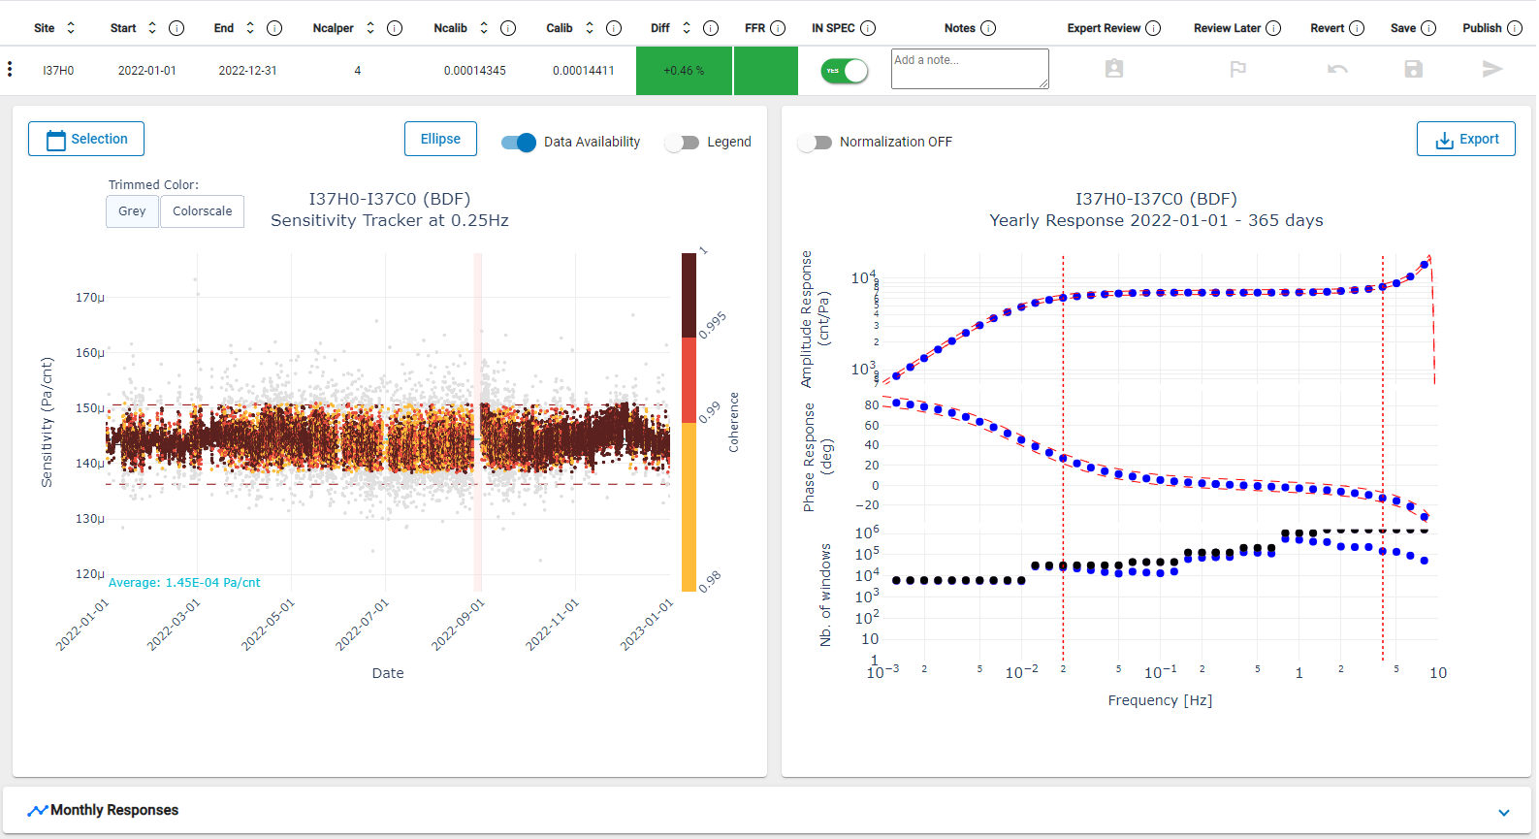
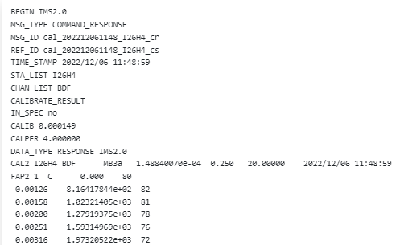
Examples of review: detailed site review
PTS-680
2
5
6
1
3
1 - Sensitivity tracker @4s
2 - Averaged sensitivity
3 - Averaged response
4 - # coherent windows
5 - Time selection
6 - IMS2.0 result
4
[see ePoster on CalxPy]

Slide 11
Findings
PTS-680
Unexpected sensitivity and unexpected responses are investigated
Identification of IDC misconfiguration
Identification of instrument change without configuration update
Identification of sensors sensitivity shift at specific pressure levels [ITW 2019]
Identify equipment integration issues at stations (optimal installation of reference systems ¹)
change inlet port location at sites
use of 2 reference inlet ports (case of no primary manifold)
¹ Gabrielson T., Quality Effects of Spacing between a Reference Sensor and an IMS Infrasound Element
on the Accuracy of Frequency-Response Estimation

Slide 12
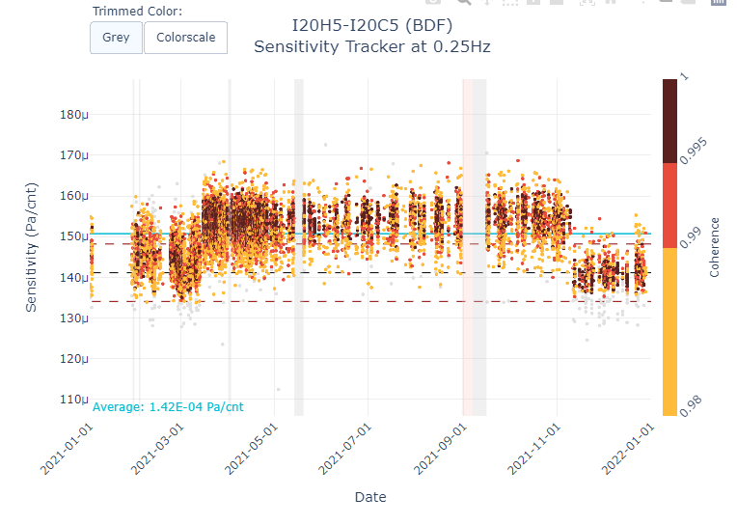
Principle: processing in Vienna
PTS-680
2 issues identified and fixed
inverted connection between operational & reference channels at the digitizer level following maintenance activity
reference sensor DQ issues
1 issue identified (flooding): site relocation to be planned
[see ePoster on CalxPy]

Slide 13
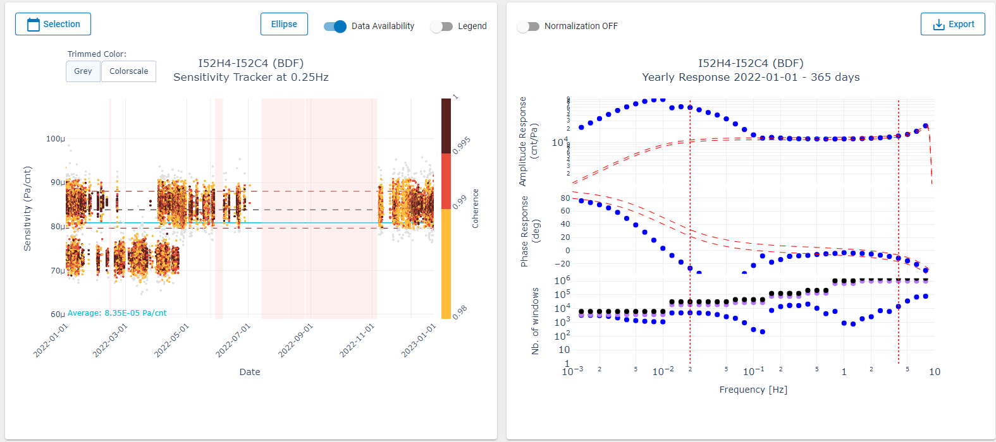
Principle: processing in Vienna
PTS-680
2 issues identified and fixed
inverted connection between operational & reference channels at the digitizer level following maintenance activity
reference sensor DQ issues
1 issue identified (flooding): site relocation to be planned
[see ePoster on CalxPy]

Slide 14
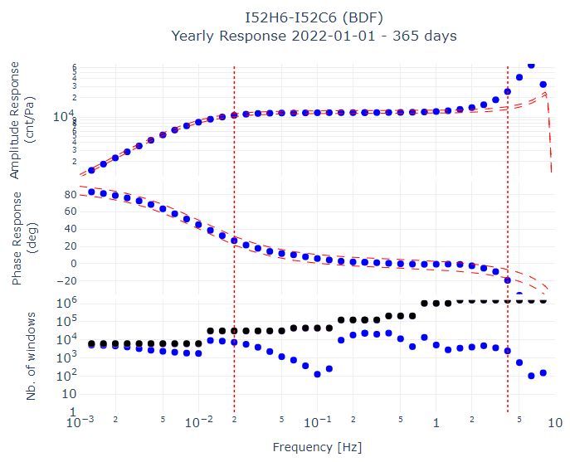
Principle: processing in Vienna
PTS-680
2 issues identified and fixed
inverted connection between operational & reference channels at the digitizer level following maintenance activity
reference sensor DQ issues
1 issue identified (flooding): site relocation to be planned
[see ePoster on CalxPy]

Slide 15
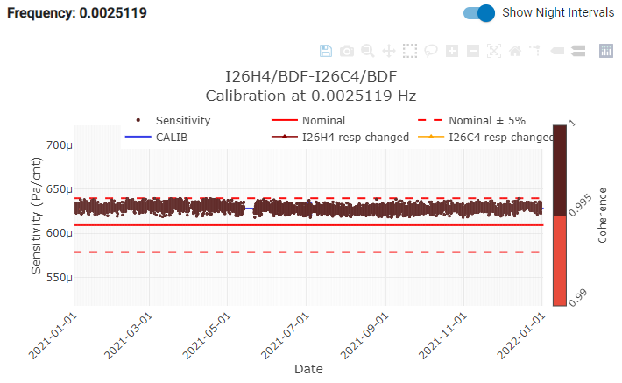
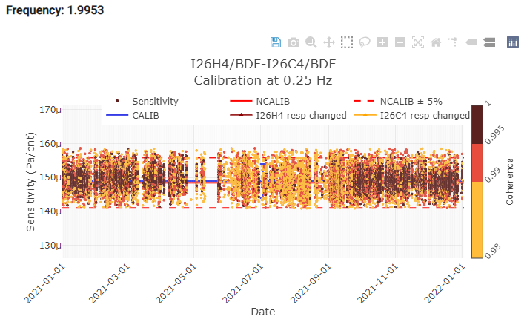
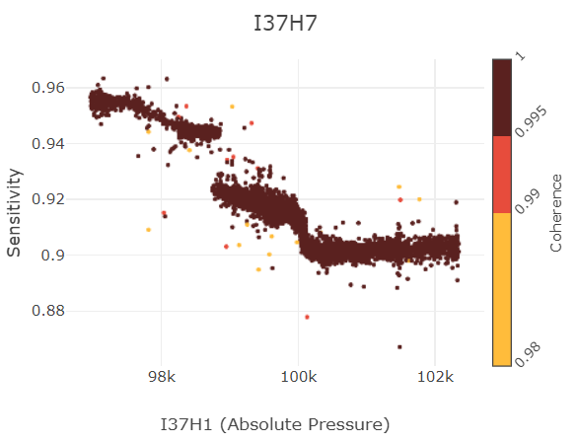
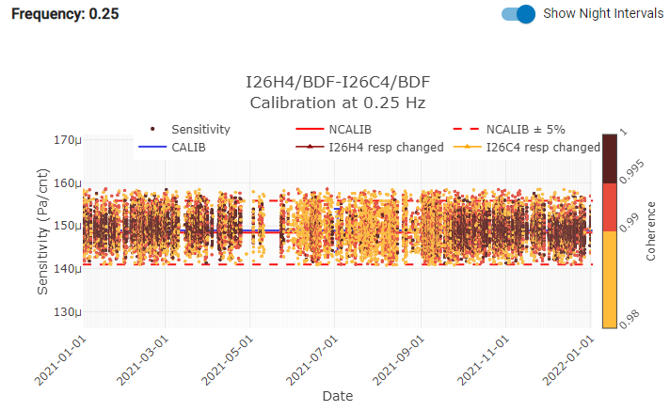
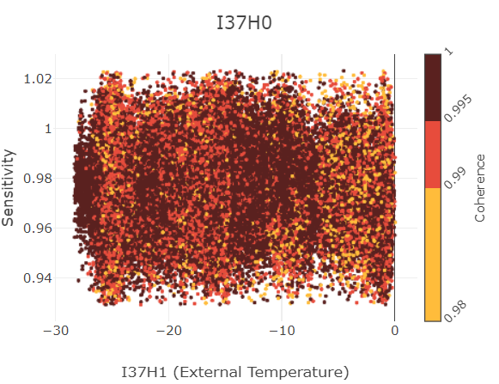
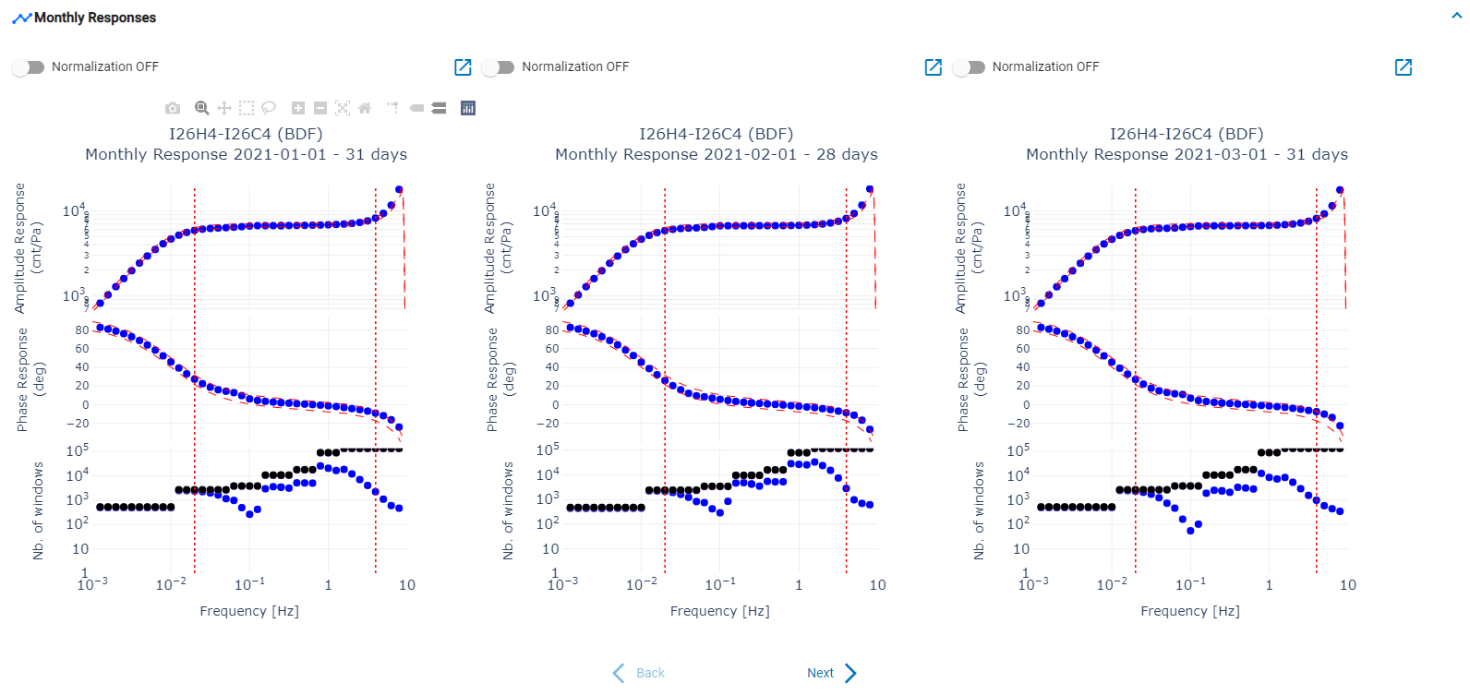
Principle: Going further with Data Quality Control
PTS-680
Sensitivity trackers for selectable time periods and frequencies
Sensitivity as a function of the absolute pressure
Sensitivity as a function of the temperature
Responses over selectable time periods
(predefined, configurable)
Refined responses using specific algorithms
(e.g. identify low spectral levels)
[see ePoster on CalxPy]

Slide 16
Benefits
PTS-680
Significant progress in a relatively short time period
Scheduled Calibration Process is operational at the PTS
Success:
compliance with requirements on calibration
maintenance actions triggered
validation that most channels have a stable response which reassures current PTS installation practices

Slide 17
Perspective
PTS-680
Roll-out calibration capabilities in the IS network
Refine/Develop additional software features (e.g. advanced data QC)
Passive and continuous calibration gives access to a goldmine of data (~2TB)
How can we get even more out of this dataset?
Improve station design to further improve stability of systems sensitivity
(e.g., vault design, sensor models for specific environments, testing of sensors in labs)
→ Any suggestion? …
CalxPy will be made available shortly in NIAB to authorized users
For further information, see ePosters on the software tool [P3.1-578]
and the calibration process of IMS stations [P4.1-714].

Slide 18
Perspective
PTS-680
Thank you for your attention

